Slide 1



VR Exploration Assistance through
Automatic Occlusion Removal
Lili Wang,
Jian Wu,
Xuefeng Yang
Beihang University
Voicu Popescu
Purdue University
Notes:
Thank you for the introduction. XXX look at chair as you say this XXX
Hello everyone.
XXX if chair did not read all authors XXX This work is together with Lili Wang, …, and Xuefeng Yang from Beihang University, and with Voicu Popescu from Purdue University.

Slide 2
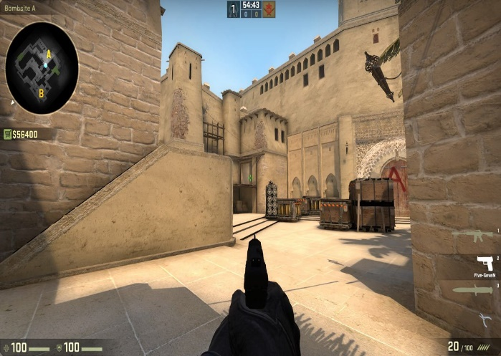
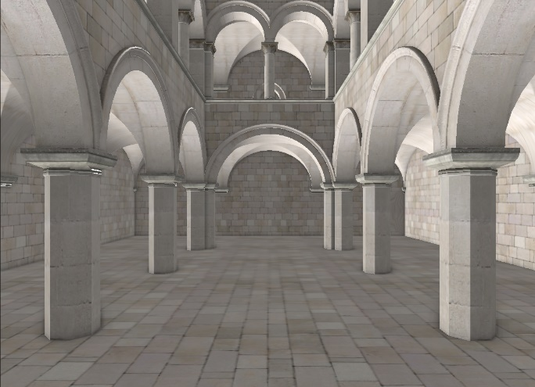
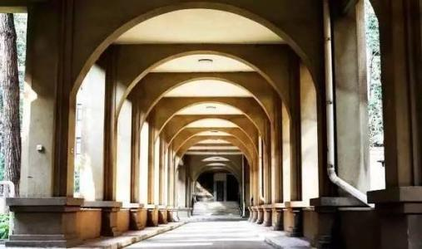
Motivation
VR Scenes with Occlusions
Notes:
Occlusions abound in our real and virtual 3D worlds. They make VR exploration complex since we have to navigate around occluders to inspect the parts of the scene that they hide. Our motivation is to devise visualization schemes that assist the user with the problem of occlusions.

Slide 3
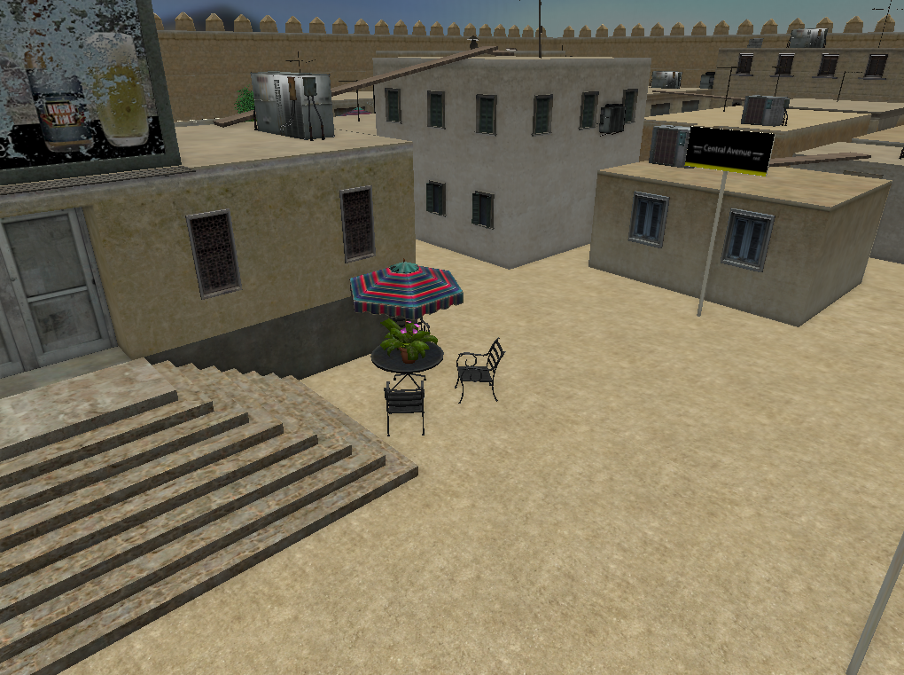

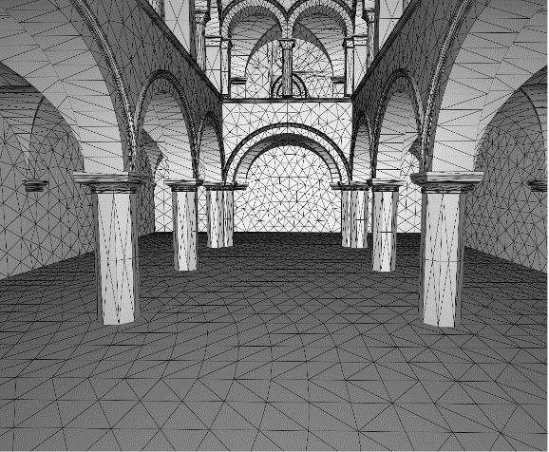
Challenges
3D Scenes
Occlusions
Detection
Modeling
Removal
Notes:
But how can we achieve this? There are some challenges that have to be overcome:
First, given a 3D scene and a user view, how can we find where occlusions occur?
Once we find where occlusions occur, how can we model the occlusion process, in a way that is conducive to ultimately removing the occlusions?
XXX I suggest adding a slide that previews your coolest results; an image or a short video XXX

Slide 4
Occlusion Management
Transparency
[Avery et al. IEEE VR 2009]
[Erat et al. TVCG 2018]
Notes:
One approach for handling occlusions is to render occluders transparently, like in X-ray or cut-away visualization.
The approach works well for a single occluding layer, but visualization clarity decreases and interface complexity increasing when the user has to see through multiple occluding layers.

Slide 5
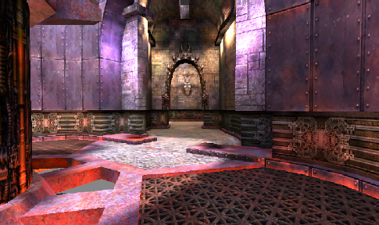
Occlusion Management
Multiperspective visualization
[Wu et al. EuroVR 2018]
Notes:
XXX add the conventional image to the left here to get people to understand the multiperspective visualization; label the two images conventional and multiperspective XXX
An alternative approach is multiperspective visualization, which integrates into the main view samples captured from additional viewpoints.
Here the multiperspective visualization shows the entire side corridor to the user from their current location.
In this previous work, the disocclusion effect was modeled by hand, as a preprocess, with a rectangle that maps to the side corridor portal, and a secondary viewpoint. XXX switch to annotation of the two images with semitransparent rectangle for the portal XXX
Our paper automates the process of finding, modeling, and removing occlusions.

Slide 6
Method Overview
Conventional Rendering
Depth Discontinuity Analysis
Occlusion Portal Construction
Graph Camera Construction
Occlusion Portal Visualization
Multi-perspective Rendering
Notes:
Here is an overview of out method.

Slide 7
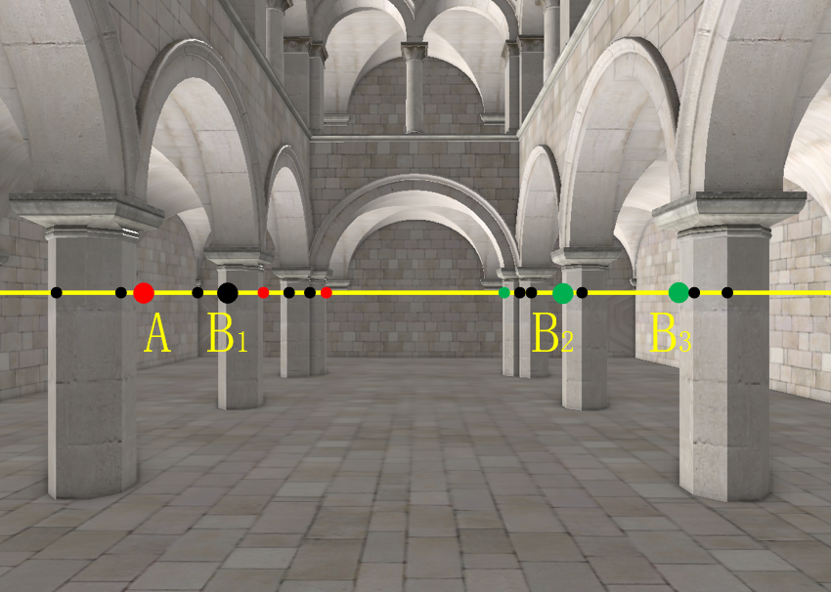
Conventional Rendering
Conventional Rendering
Depth Discontinuity Analysis
Occlusion Portal Construction
Graph Camera Construction
Occlusion Portal Visualization
Multi-perspective Rendering
Notes:
Here is an overview of out method.
First, the scene is rendered conventionally. XXX Add frame with no annotations. Align with position of image from next slide XXX

Slide 8
Depth Discontinuity Analysis
Conventional Rendering
Depth Discontinuity Analysis
Occlusion Portal Construction
Graph Camera Construction
Occlusion Portal Visualization
Multi-perspective Rendering
Notes:
Our method finds occlusions by finding depth discontinuities in the zbuffer.
We detect depth discontinuities on the center line of the depth buffer.
XXX add legend with red dot, black dot, and green dot at the left of the image; also remove the A and Bi labels by masking with the original image from the previous frame XXX
Here the red dots show the near-to-far silhouette points, green dots show far-to-near silhouette points, and black dots show inflection points. Red dots are only detected in the left side of the image, where the disocclusion effect will be enacted with a small head translation to the right. Similarly, green dots are only detected in the right side of the image. XXX be prepared to answer how exactly the depth discontinuities are detected (by thresholding the second order depth difference,?) and how you differentiate between red and black (with different epsilon values?) XXX

Slide 9
Portal construction
Conventional Rendering
Depth Discontinuity Analysis
Occlusion Portal Construction
Graph Camera Construction
Occlusion Portal Visualization
Multi-perspective Rendering
Notes:
XXX remove the white dotted lines and the angle labels from the image XXX
The depth discontinuity points are used to construct the disocclusion portals. A disocclusion portal is a vertical planar contour that starts from a silhouette points to ensure this portal is binding with a potential occluded area.
Given a silhouette point, several candidate portals are considered. Here the candidate portals for the red silhouette point A are AB1, AB2, and AB3. Each is defined by a green silhouette point or an inflection point. Our algorithm chooses the portal based on a quality metric that optimizes portal screen footprint and disocclusion potential. I will get back to portal selection a little bit later. Here the best portal is AB2.

Slide 10
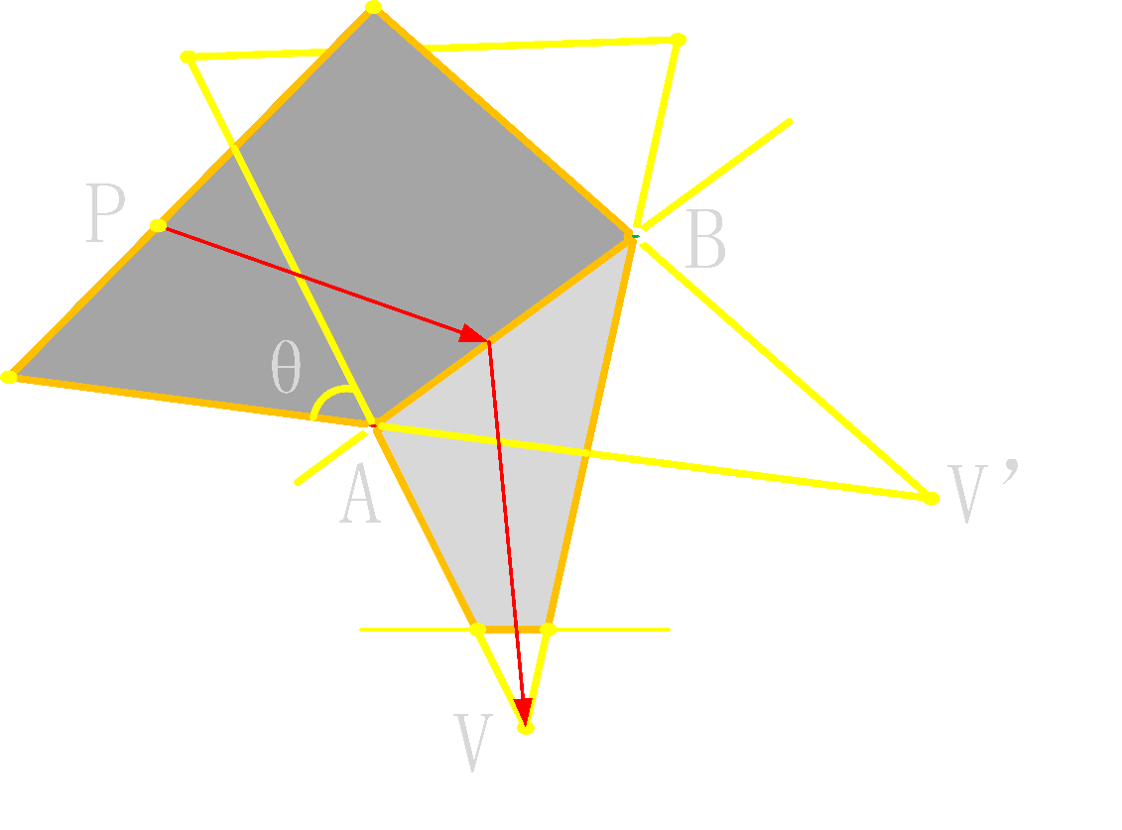
Graph Camera Construction
Conventional Rendering
Depth Discontinuity Analysis
Occlusion Portal Construction
Graph Camera Construction
Occlusion Portal Visualization
Multi-perspective Rendering
Notes:
The disocclusion portals are used to build a graph camera which will ultimately be used to render the multiperspective visualization. XXX add reference to graph camera paper under figure XXX
Here the portal AB is used to define a hinge plane where the visualization transitions from viewpoint V to viewpoint V’. The rays are piecewise linear with two segments. Point P is projected directly onto the image plane with a compound projection matrix that accounts for the two viewpoints. XXX add red dotted line from P to V’; it should start only at AB XXX
The magnitude of the disocclusion effect is controlled by placing the secondary viewpoint V’. This left up to the user, who controls the disocclusion effect with small lateral head translations. Here a 20cm translation to the right swings V’ from V to location shown in the figure.

Slide 11
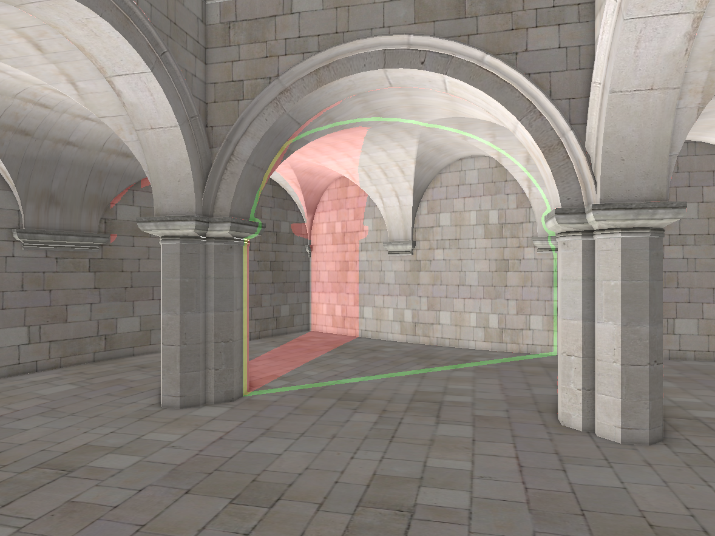
Portal Visualization
Conventional Rendering
Depth Discontinuity Analysis
Occlusion Portal Construction
Graph Camera Construction
Occlusion Portal Visualization
Multi-perspective Rendering
Notes:
XXX replace these two images with just the portal visualization, over a conventional rendering of the scene XXX
The available disocclusion portals are shown to the user who selects one or several portals, and then triggers and controls the disocclusion effect.

Slide 12
Multiperspective Rendering
Conventional Rendering
Depth Discontinuity Analysis
Occlusion Portal Construction
Graph Camera Construction
Occlusion Portal Visualization
Multi-perspective Rendering
Notes:
Here are the disocclusion effects achieved. Here, the disoccluded regions are highlighted in red for the purpose of this presentation. XXX you can switch back and forth several times between this and the previous slide XXX

Slide 13
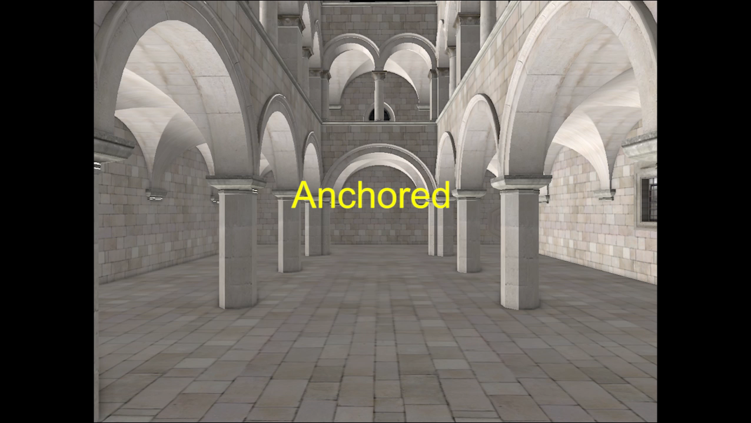
Disocclusion Effect
Notes:
This video shows the merged disocclusion effect of four portals. XXX Make sure the audio does not play back. It is very loud and bad. XXX

Slide 14
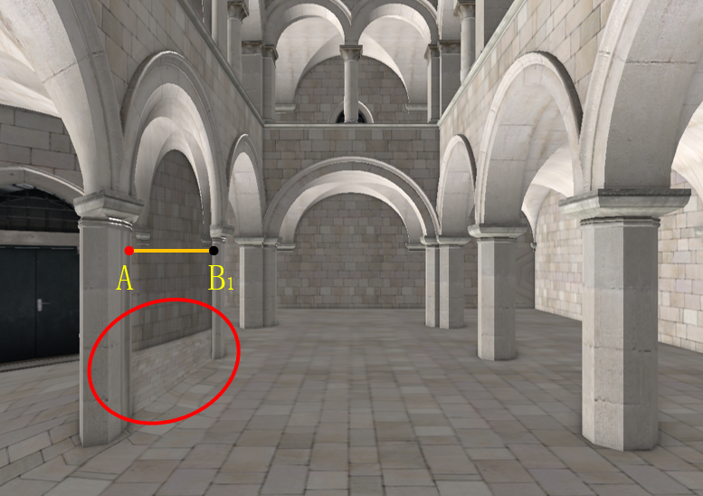
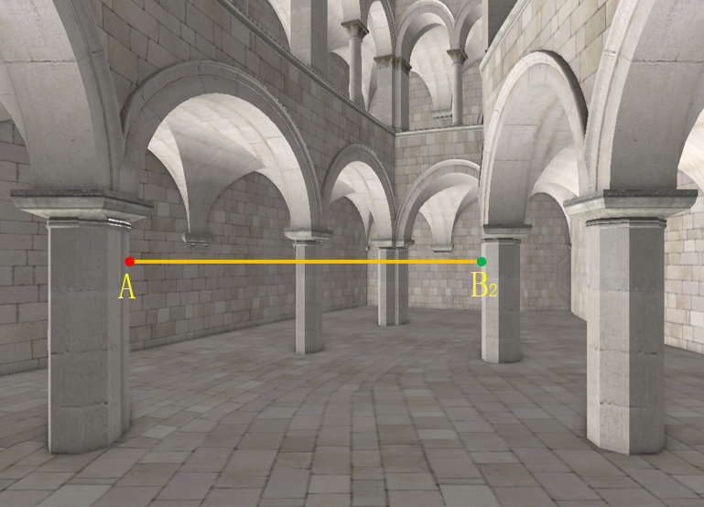
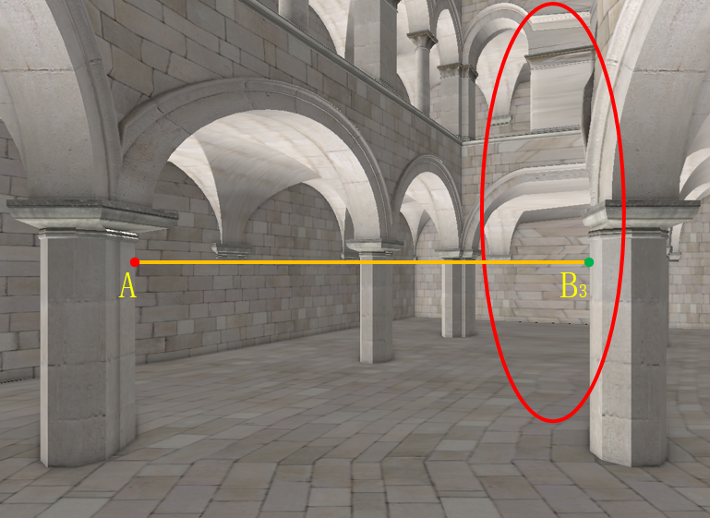
Portal Selection
Notes:
Here is another quick look at our algorithm’s portal selection.
The bottom images show the disocclusion effects achieved by the three candidate portals discussed earlier.
For AB1, the portal image footprint is too small to show the disoccluded part of the scene at adequate resolution.
For AB3, the footprint of the portal is large, but achieving a revealing disocclusion effect requires translating the secondary viewpoint substantially, which introduces substantial distortions.
AB2 offers a good compromise of the two antagonistic requirements.

Slide 15
For Dynamic Scenes
Notes:
Since the occlusions are detected, modeled, and removed in real time, our method can also handle dynamic scenes.
As shown in this figure, the disocclusion effect changes to keep up with the moving carriage.

Slide 16
User Study
Task | Metrics
VR1: find three vehicles in a desert village | Viewpoint Translation | View Direction Rotation
 | Boundary Redirection | Completion Time
VR2: catch up with a walking person in a Chinese garden | Viewpoint Translation | View Direction Rotation
 | Boundary Redirection | Completion Time
Perceptual experiments (Sponza scene) | Depth Estimation | Pointing Task
Notes:
In order to evaluate the effect of our VR exploration assistance method, we conducted controlled user studies in which participants were asked to find a stationary target in a Desert Village VR environment and to find a dynamic target in a Chinese Garden VR environment. In addition, participants completed a simulator sickness questionnaire (SSQ) before and after the two tasks, and they participated in perceptual experiments.

Slide 17
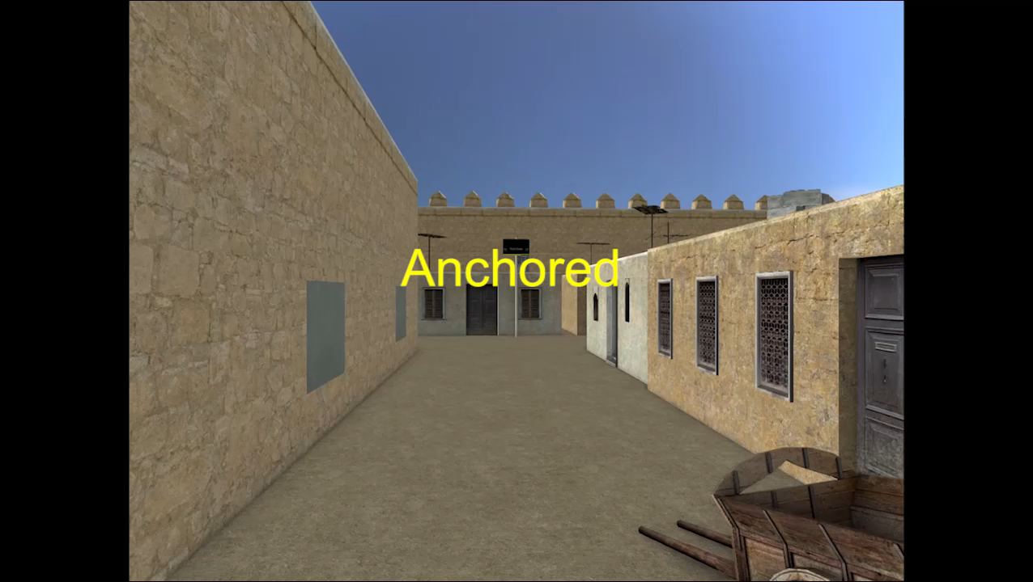
VR1 Task
Notes:
Here the user finds the occluded blue car using our occlusion removal method.

Slide 18
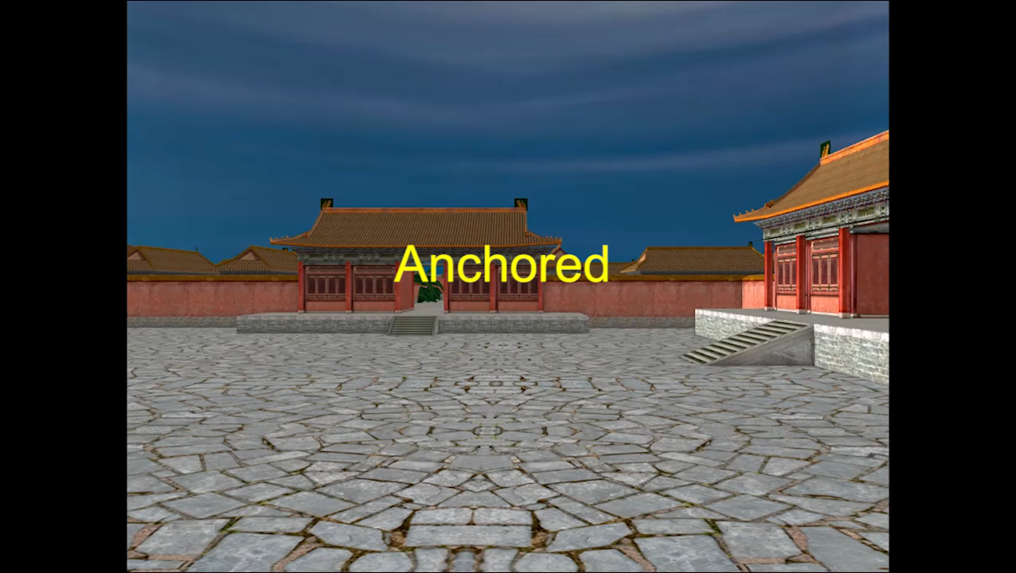
VR2 Task
Notes:
Here a disocclusion effect based on depth discontinuities on the vertical center line is used to inspect the inner yard from afar.

Slide 19
Perceptual Experiments
Depth Estimation
Pointing Task
Notes:
We also conducted perceptual experiments to evaluate the impact of our method on spatial awareness.
In the depth estimation task, participants were asked which of the red and green balls is farther. Both balls are visible to control group participants. The balls are invisible to experimental group participants, who have to use the disocclusion effect.
XXX split this slide into two slides: depth estimation one slide, pointing task the other slide XXX
XXX for depth estimation, did we have the balls overlap in the conventional visualization? That is a strong cue as to which one is closer? XXX
XXX for depth estimation, show two images for the exp. Group: before and after disocclusion; label the images XXX
In the pointing task, participants were asked to indicate the direction to a hidden green ball.
A control group participant starts at the blue ball, from where the green ball is not visible, walks to the red ball, from where the green ball is visible, and then walks back to the blue ball, from where they have to indicate the direction to the green ball.
An experimental group participant stays at the blue ball, temporarily disoccludes the green ball with the multiperspective visualization, and then indicates the direction to the green ball.
XXX add images to show the view from the blue ball, red ball, and MPV. Label images. XXX

Slide 20
Results and Discussion
Total Viewpoint Translation [m]
Task | Group | Avg±std.dev | Red. | p | Cohen’d | Effect Size
VR1 | CG | 291±58.5 | 46% | 0.0051 | 3.0 | Huge
 | EG | 156±23
VR2 | CG | 485±107 | 74% | 0.0015 | 3.9 | Huge
 | EG | 126±74.1
Total View Direction Rotation [x 360º]
Task | Group | Avg±std.dev | Red. | p | Cohen’d | Effect Size
VR1 | CG | 61±7.8 | 50% | 0.0003 | 5.2 | Huge
 | EG | 30.7±2.6
VR2 | CG | 62±7.3 | 70% | <0.0001 | 5.4 | Huge
 | EG | 19±8.8
Notes:
XXX all tables are too big, they fill the slide too much, make them a bit smaller, the slide will be more readable; same for next two slides XXX
For two VR exploration tasks, we record the total viewpoint translation, total view direction rotation, boundary redirection times and task completion time, and quantify effect size using Cohen’s d.
As expected, the ability to see behind occluders without actual viewpoint translation reduces the total viewpoint translation significantly. XXX be prepared to know the details of the statistical analysis; what test, etc. XXX
The method also reduces the total rotation significantly and more so for the VR2 Task, since by conventional visualization, a participant has to pan the view around as they retrace their steps repeatedly in search of the moving person.
…………………………..

Slide 21
Results and Discussion
Tracked Boundary Redirections [times]
Task | Group | Avg±std.dev | Red. | p | Cohen’d | Effect Size
VR1 | CG | 99±19 | 44% | 0.0110 | 3.0 | Huge
 | EG | 55±8
VR2 | CG | 62±19 | 77% | 0.0040 | 3.2 | Huge
 | EG | 14±9
Task Completion Time [s]
Task | Group | Avg±std.dev | Red. | p | Cohen’d | Effect Size
VR1 | CG | 824±81 | 45% | 0.0007 | 4.5 | Huge
 | EG | 454±84
VR2 | CG | 550±88 | 61% | 0.0039 | 3.2 | Huge
 | EG | 216±118
Notes:
The top table gives the number of walking redirections needed when a participant reached the boundary of the tracked physical space. Redirection is known to cause user disorientation. Our method significantly alleviates the need for redirection.
The bottom table shows that the tasks were completed faster when using the disocclusion effect.

Slide 22
Results and Discussion
Distance Estimation Error(Times) and Pointing Angle Error(Degrees)
Task | Group | Avg±std.dev | p
VR1 | CG | 0.00±0.00 | 0.29
 | EG | 0.25±0.43
VR2 | CG | 24.5±7.58 | 0.35
 | EG | 19.0±7.66
Total Severity Score(TS) for Pre and Post SSQ
Task | Group | Pre±std.dev | Post±std.dev
VR1 | CG | 1.87±3.24 | 7.48±0.00
 | EG | 12.16±11.64 | 26.18±16.09
VR2 | CG | 1.87±3.24 | 7.48±0.00
 | EG | 8.42±12.51 | 15.90±10.7
Notes:
XXX too many decimals, just three significant digits please XXX
XXX why does the top table say VR1 and VR2? XXX
XXX why does the bottom table have VR1 and VR2 values? Did we do SSQ after each task? Did a participant perform both VR1 and VR2? XXX
Distance estimation is perfect for the control condition, but not significantly worse for the experimental group. Pointing errors actually decrease for the experimental group. A control group participant has to walk to a point where the target ball is visible and then come back, which affects the accuracy of the mental map of the scene. With the experimental condition, the participant stays in place and sees where the ball is hidden.
The second table shows that the TS scores increase for the experimental condition, but that they remain well below the 70 simulator sickness threshold. XXX I recommend splitting this slide into two slides; if you spend too much time on one slide, you are putting everyone to sleep XXX

Slide 23
Conclusions
Automatic method for occlusion management in VR
Method increases scene exploration efficiency
Method preserves spatial awareness w/ modest simulator sickness increase
Notes:
We have presented an method for alleviating occlusions in the head-mounted display exploration of virtual environments. The disocclusion effect is constructed automatically and in real time based on depth discontinuity analysis and fast multiperspective rendering.
The method leads to less navigation and faster completion times.
The benefits of our approach do not come at the cost of a significant decrease in spatial awareness, or of a significant increase in simulator sickness.

Slide 24
Possible future Work
Quantify the amount of occlusion in a conventional visualization frame
Provide disocclusion guarantees
Address fine-grain occlusions
Notes:
Our current work provides a greedy solution to the problem of occlusions. A direction of future work is to quantify the amount of occlusion in a conventional visualization frame, and to devise multiperspective visualization with disocclusion guarantees.
Our work assumes the presence of large occluders, on which relies the construction of the underlying graph camera. Further improving the disocclusion capability of our approach will require addressing fine grain occlusions, as those arising, for example, in the crown of a leafy tree.

Slide 25
Thank you
Notes:
Thank you.
XXX show something interesting; maybe the portal visualization; maybe a video; put Lily’s contact info XXX
XXX the total number of slides is incorrect now; is that hard coded? XXX

Slide 26
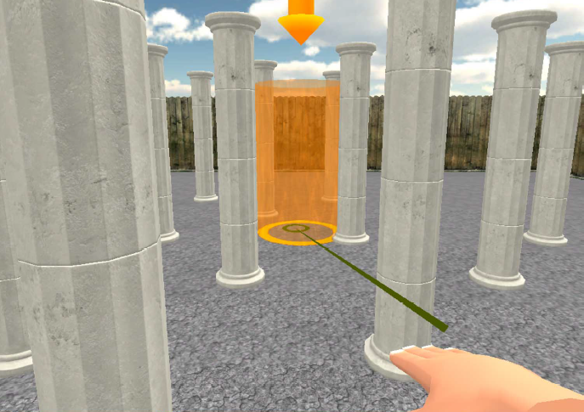
Prior Work
VR Exploration Methods
  Redirected Walking
  Teleportation
  Lazy Navigation.
[ Sun et al. TOG 2016]
[Bozgeyikli et al. CHI 2016]
[Guy et al. 3DUI 2015]
Notes:
XXX This prior work is less relevant, I suggest you skip it XXX
To allow people to navigate a large virtual scene in a limited physical space, there are many previous research.
One approach is redirected walking. It packs the user’s virtual environment path in the confined physical space by resorting to path distortion.
Teleportation is also a traditional approach, for example, in point based teleportation users can jump to locations they point to with a handheld controller.
Lazy Navigation lets the user to control the viewpoint translation through body movements that are evocative of the actual locomotion.
%%A different idea includes the amplification of the user ‘s head rotations to assume scene coverage with minimal view direction changes.

Slide 27
Limitations
Complex occluded scenes.
  Inclined occlusions
  Occlusions in the corners
Small occlusions.
  Leaves of trees
  Engines’ parts
Notes:
Our approach relies on depth discontinuities found on the horizontal and the vertical center lines. So it may not work well in some complex occluded scenes, such as inclined occlusions and occlusions in the corners of the field of vi.
Another limitation is that our method targets relatively large scale occlusions, it may not address small occlusions, for example, those created by the leaves of a tree, or a complex car engine.

