Slide 1
Efficient VR and AR Navigation through
Multiperspective Occlusion Management
Paper Session: 15
Meng-Lin Wu and Voicu Popescu
Purdue University
IEEE TVCG Invited Paper

Slide 2
Motivation
Tracked Head-Mounted Displays (HMD)
  A natural interface for exploring 3D scenes in AR and VR
Notes:
Natural in VR, necessary in AR

Slide 3
Motivation
Tracked Head-Mounted Displays (HMD)
  A natural interface for exploring 3D scenes in AR and VR
  Can be inefficient due to occlusions
?
user

Slide 4
Motivation
Tracked Head-Mounted Displays (HMD)
  A natural interface for exploring 3D scenes in AR and VR
  Can be inefficient due to occlusions
    Translation required to reduce occlusion
user
nothing

Slide 5
Motivation
Tracked Head-Mounted Displays (HMD)
  A natural interface for exploring 3D scenes in AR and VR
  Can be inefficient due to occlusions
    Sequential exploration is slow
nothing
user
Notes:
Now you got to walk back
Having accomplished little

Slide 6
Motivation
Tracked Head-Mounted Displays (HMD)
  A natural interface for exploring 3D scenes in AR and VR
  Can be inefficient due to occlusions
    Parallel visualization is difficult
user
Notes:
“Impossible if the sets of viewpoints are disjoint.”
*From MENTAL memory* especially physical locomotion involved

Slide 7
How to address occlusions?
Multiperspective visualization
user
Notes:
“integrate views from multiple perspectives into the main perspective”

Slide 8
How to address occlusions?
Multiperspective visualization
B
A
user
user
Primary viewpoint A, secondary viewpoint B
Notes:
!!!! INTEGRATE, CAN’T REPLACE
Disocclude!
Keep Enough of 1st Person View
Continuity

Slide 9
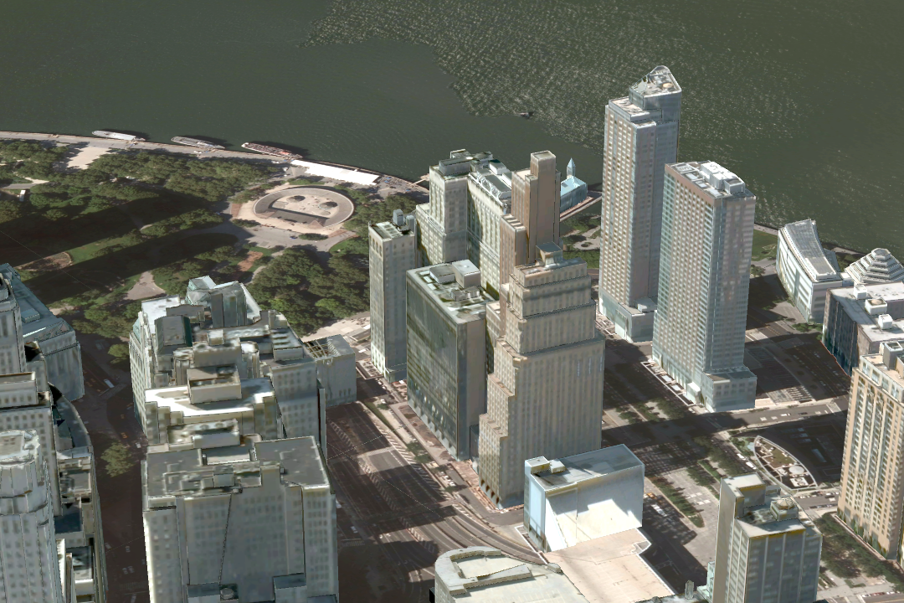
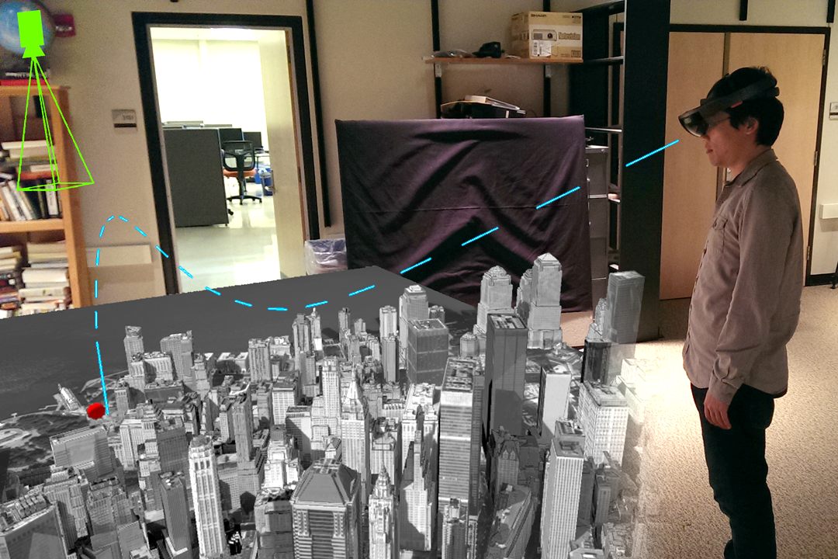
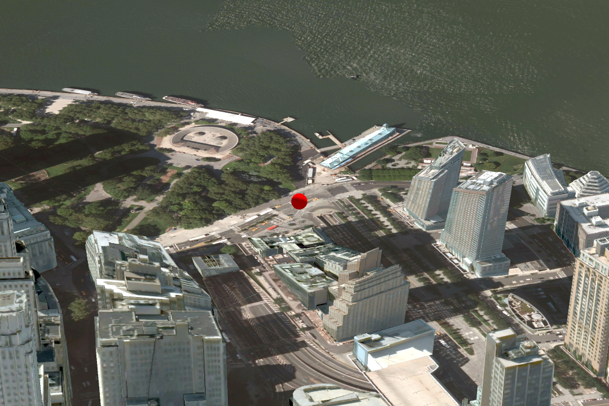
MPV for urban scenes, shown in VR
Main perspective
MPV construction
to reveal street-level target
Main + secondary perspective
Notes:
!!!! Red sphere shows up where it should be

Slide 10
MPV for urban scenes
Main perspective
Main perspective +
2 secondary perspectives
Notes:
!!!! Where they should be seen

Slide 11
MPV for indoor scenes, shown in AR
User wearing AR HMD
Main perspective from user
Secondary perspective showing side corridor
AR annotation rendered with pre-acquired real world model + dynamic virtual target
Notes:
In AR, if acquired geometry, use in annotation
It’s *NOT* a billboard – explain
“Does it look like a billboard?”
“It’s not a billboard. It is acquired real scene geometry, swings into view, distorted, rendered with correct stereoscopic depth”

Slide 12
User study
16 subjects
Two VR and two AR tasks
  VR urban
  AR corridor
Notes:
!!!! Hololens

Slide 13
User study
Metrics
  Total distance traveled
  Total head rotation
  Completion time

Slide 14

User study
VR task 1: keep moving target in view
Notes:
Conventional visualization, user repositions himself.
Our visualization, user repositions the secondary with gaze
Choice to not move

Slide 15
Sample user trajectory for VR tracking
Conventional
MPV
Notes:
The USER CHOSE
HAS THE OPTION

Slide 16
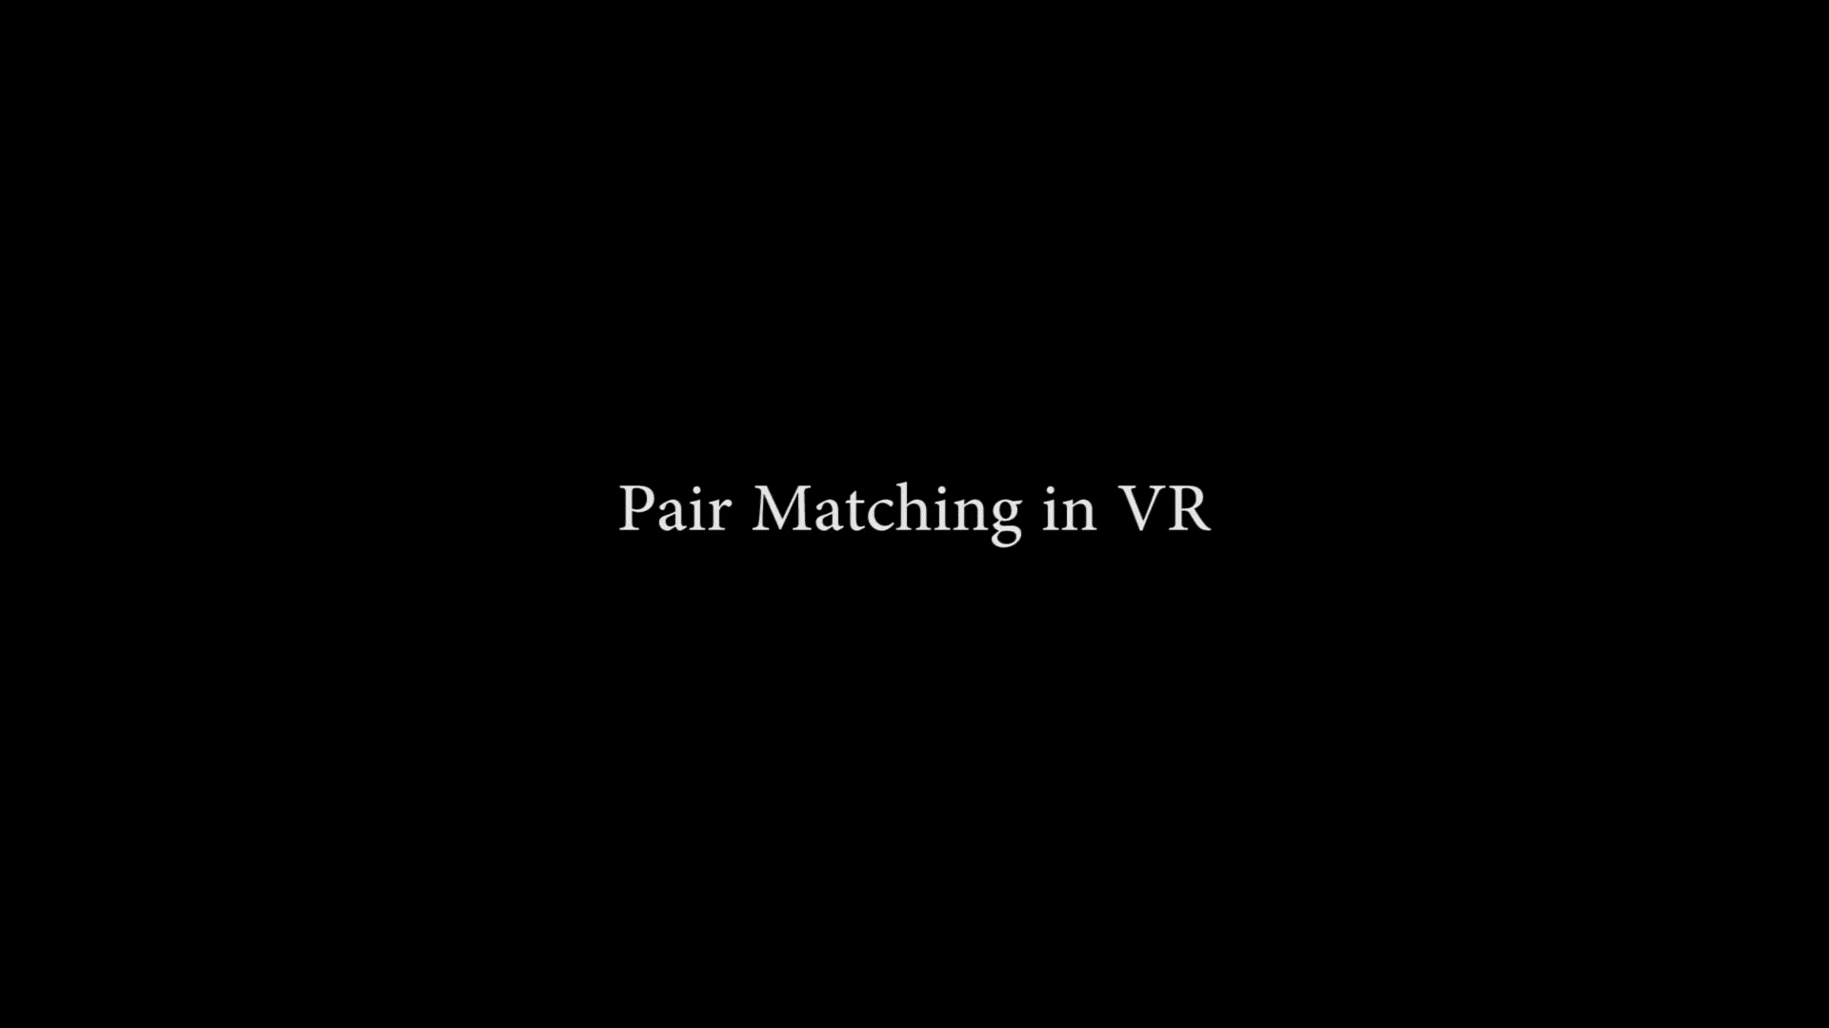
User study
VR task 2: pair matching
Notes:
*memory task to vision task*
Conventional, sequential
Our vis, parallel

Slide 17
Sample user trajectory for VR matching
Conventional
MPV

Slide 18

User study
AR task 1: search

Slide 19

User study
AR task 2: ambushing evading target

Slide 20
User study results
Metrics
  Total distance traveled
  Total head rotation
  Completion time
Significant improvement in all metrics, in all tasks*
* Except completion time in ambush task

Slide 21
MPV reduces distance traveled
Distance traveled, in meters
Task | Control | Experiment | Difference | p | d | Effect size
Tracking | 14 ± 3 | 5 ± 4 | 8 | < 0.01 | 2.3 | huge
Matching | 92 ± 47 | 8 ± 7 | 83 | < 0.01 | 2.5 | huge
Search | 99 ± 3 | 85 ± 12 | 14 | < 0.01 | 1.6 | very large
Ambush | 109 ± 17 | 93 ± 18 | 16 | 0.04 | 0.9 | large

Slide 22
MPV reduces head rotation
Head rotation, in hundreds of degrees
Task | Control | Experiment | Difference | p | d | Effect size
Tracking | 8 ± 1 | 4 ± 2 | 3 | < 0.01 | 1.8 | very large
Matching | 66 ± 23 | 10 ± 5 | 56 | < 0.01 | 3.4 | huge
Search | 42 ± 7 | 33 ± 11 | 9 | 0.04 | 1.0 | large
Ambush | 44 ± 9 | 34 ± 7 | 10 | 0.01 | 1.3 | very large

Slide 23
MPV reduces time
Completion time, in seconds
Task | Control | Experiment | Difference | p | d | Effect size
Tracking | n/a | n/a | n/a | n/a | n/a | n/a
Matching | 216 ± 86 | 58 ± 27 | 158 | < 0.01 | 2.5 | huge
Search | 92 ± 8 | 69 ± 20 | 23 | < 0.01 | 1.5 | very large
Ambush | 75 ± 25 | 74 ± 19 | 1.5 | 0.5 | 0.1 | very small
Notes:
Spawn far

Slide 24
Conclusions and future work
MPV—nice superpower
Other applications, other MPV constructors?
Notes:
Superpower user move far less
AUTOMATIC
DEEPER MPV?

Slide 25
Efficient VR and AR Navigation through
Multiperspective Occlusion Management
Paper Session: 15
Meng-Lin Wu and Voicu Popescu
Purdue University
IEEE TVCG Invited Paper
Thank you!

Slide 26
How to address occlusions?
Transparency
user
Notes:
Down x2
See through occluding

Slide 27
How to address occlusions?
Transparency
user

Slide 28
How to address occlusions?
Transparency
  Confusing for multiple occluder layers
  Pictorial depth
user
Notes:
See through walls
More walls, more walls to see through
Pictorial depth violate
Number of layer

Slide 29
How to address occlusions?
Cutaway
user
Notes:
Skip

Slide 30
How to address occlusions?
Cutaway
user
Notes:
Really need to know where it is
Extra geometry
Dynamically generate geometry

Slide 31
How to address occlusions?
Cutaway
  Existing knowledge of target
  Extra geometry
user
Notes:
Skip

Slide 32
How to address occlusions?
Explosion
user
Notes:
Down x2

Slide 33
How to address occlusions?
Explosion
user

Slide 34
How to address occlusions?
Explosion
  Scene geometry severely perturbed
  Spatial awareness
user

Slide 35
Motivation
Tracked Head-Mounted Displays (HMD)
  A natural interface for exploring 3D scenes in AR and VR
  Can be inefficient due to occlusions
    Difficult to find dynamic, possibly
    evading targets
user
Notes:
If target evades
Down x4

Slide 36
Motivation
Tracked Head-Mounted Displays (HMD)
  A natural interface for exploring 3D scenes in AR and VR
  Can be inefficient due to occlusions
    Difficult to find dynamic, possibly
    evading targets
user
Notes:
3

Slide 37
Motivation
Tracked Head-Mounted Displays (HMD)
  A natural interface for exploring 3D scenes in AR and VR
  Can be inefficient due to occlusions
    Difficult to find dynamic, possibly
    evading targets
user
Notes:
1 to go

Slide 38
Motivation
Tracked Head-Mounted Displays (HMD)
  A natural interface for exploring 3D scenes in AR and VR
  Can be inefficient due to occlusions
    Difficult to find dynamic, possibly
    evading targets
user
Notes:
Stop

