Slide 1
VR Haptics

Slide 2
Haptics
“The perception of objects by touch”
Big challenge in VR
Easier to cater to visual sensors than to touch sensors

Slide 3
Haptic displays
Low resolution, i.e. only a few taxels
Taxel = haptic display pixel = one pressure point
Keep in Touch: Portable Haptic Display With 192 High Speed Taxels. Juan Jose Zarate, Olexandr Gudozhnik, Anthony Sébastien Ruch, Herbert Shea. ACM SIGGCHI 2016

Slide 4
Tanvas
Mimic surface feel on tablet like device
Tanvas Haptic Display: Hands-on

Slide 5
Haptics for VR
Haptic displays have limited applicability in VR
Hard to cover the entire VE with haptic displays
Hard to mount on user
Haptic glove
Haptic display attached to user hand
Hand is tracked
Glove provides haptic feedback when user touches virtual objects

Slide 6
VR Gloves
https://vimeo.com/276517370
Plexus VR haptics gloves

Slide 7
VR Gloves
HaptX Glove
- 100 points of tactile displacement feedback
- up to 5 pounds of resistance per finger
- sub-millimeter precision motion tracking

Slide 8
VR haptic jacket
The Haptic Jacket uses an air compressor and a vacuum pump. These air compartments in the jacket can be inflated to exert a force on the user’s body relative to force sensitive resistors.
26 air compartments are activated using microcontrollers for either pressure or vibrotactile feedback or both.
Controllers are used to activating the solenoid valves which are connected to the vacuum.
There are certain Jacket inflation parameters like speed, force, and duration which are specified using the haptic effects editor.
The jacket makes use of the motion interface to sequentially inflate the compartments for simulating motion across the body.
Disney’s VR Haptic “Force Jacket”

Slide 9
HoloSuit
HoloSuit Video
- 36 embedded sensors for tracking
- 9 haptic feedback devices dispersed across arms, legs, and fingers.

Slide 10
Limitations of VR gloves/jackets/suits
Limited haptic resolution
Encumbrance
Latency
Inaccurate tracking

Slide 11
Passive haptics for VR
Provide most important haptic feedback, ignore other
Example 1: VR golf game
Let user use an actual golf club
Benefit: realism of important haptics
Challenge: tracking club, which is fast, shiny, thin
Limited to most important haptics, i.e. holding golf club; secondary haptics are missing, e.g. the feel of grass / dirt when swinging or walking, wind on face, picking up the ball from hole after successful put, etc.

Slide 12
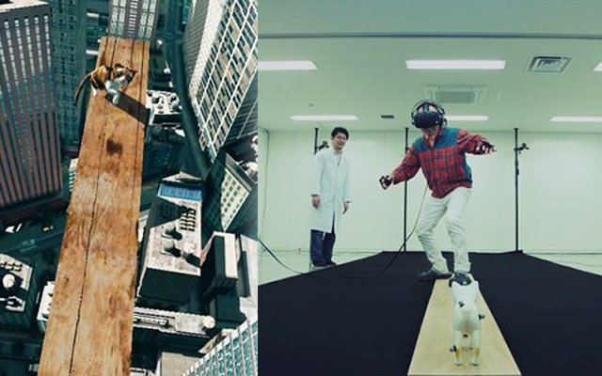
Passive haptics for VR
Provide most important haptic feedback, ignore other
Example 1: VR golf game
Example 2: triggering, treating acrophobia (fear of heights)
© Bandai Namco

Slide 13
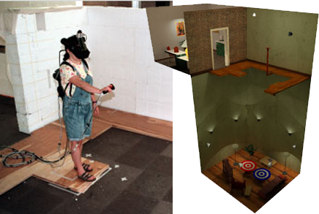
Passive haptics for VR
Provide most important haptic feedback, ignore other
Example 1: VR golf game
Example 2: acrophobia (fear of heights)
UNC Chapel Hill “The Walking Experiment and the Pit”

Slide 14
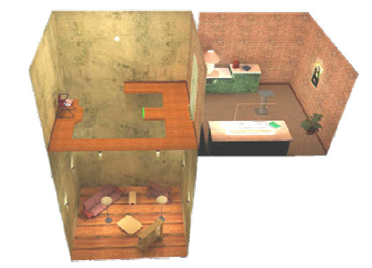
Passive haptics for VR
Provide most important haptic feedback, ignore other
Example 1: VR golf game
Example 2: acrophobia (fear of heights)
UNC Chapel Hill “The Walking Experiment and the Pit”

Slide 15
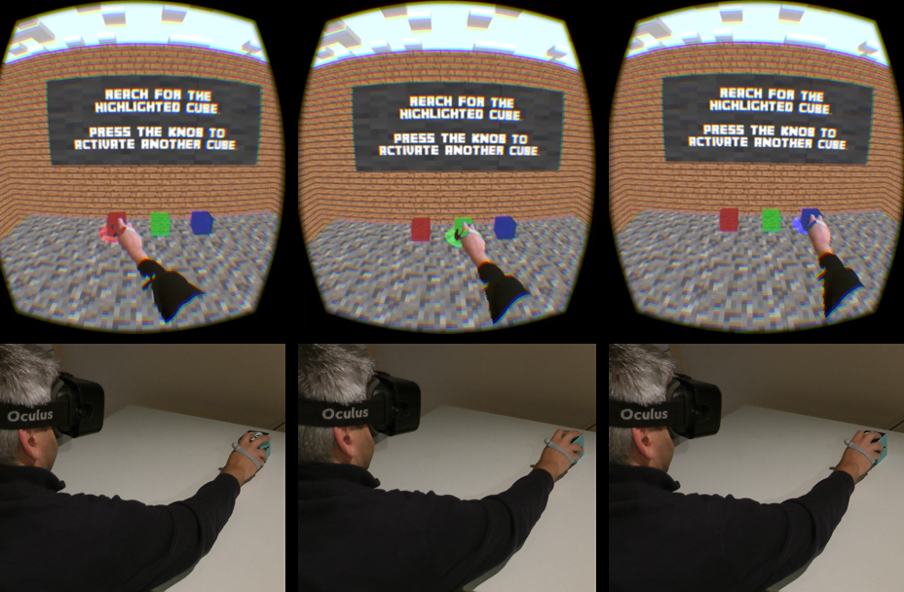
Haptic Retargeting
Idea: reuse scarce passive haptic feedback opportunities by manipulating user motion
One real cube, three virtual cubes
Illusion: the user thinks there are three real cubes
Haptic Retargeting: Dynamic Repurposing of
Passive Haptics for Enhanced Virtual Reality Experiences. Mahdi Azmandian, Mark Hancock, Hrvoje Benko, Eyal Ofek, Andrew D. Wilson. ACM SIGCHI 2016
Video of talk

Slide 16
Sparse Passive Haptics for VR
Sparse Haptic Proxy: Touch Feedback in Virtual Environments Using a General Passive Prop. Lung-Pan Chang, Eyal Ofek, Christian Holz, Hrvoje Benko & Andrew D. Wilson, ACM SIGCHI 2017
Video

Slide 17
Sparse Passive Haptics for VR
Sparse Haptic Proxy: Touch Feedback in Virtual Environments Using a General Passive Prop. Lung-Pan Chang, Eyal Ofek, Christian Holz, Hrvoje Benko & Andrew D. Wilson, ACM SIGCHI 2017
A set of geometric primitives that simulate touch feedback in elaborate virtual reality scenes.
Unlike previous passive haptics that replicate the virtual environment in physical space, a Sparse Haptic Proxy simulates a scene’s detailed geometry by redirecting the user’s hand to a matching primitive of the proxy.
To bridge the divergence of the scene from the proxy, an existing Haptic Retargeting technique is augmented with an on-the-fly target remapping
Users’ intentions are predicted during interaction in the virtual space by analyzing their gaze and hand motions, and consequently redirect their hand to a matching part of the proxy.
Formative study results
1) The maximum angle participants found acceptable for hand retargeting is 40°, rated 4.6 out of 5.
2) Tracking participants’ eye gaze reliably predicts their touch intentions (97.5%), even while simultaneously manipulating the user’s hand-eye coordination for retargeting.
3) Participants preferred minimized retargeting distances over better-matching surfaces of our Sparse Haptic Proxy when receiving haptic feedback for single-finger touch input.
System demonstrated on two virtual environments: a flight cockpit and a room quest game. While their scene geometries differ substantially, both use the same sparse haptic proxy to provide haptic feedback to the user during task completion.

Slide 18
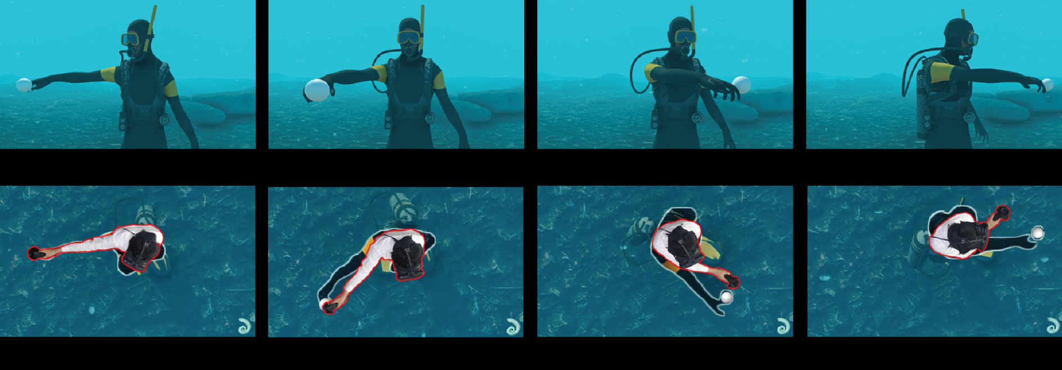
Pseudo Haptics
Make the user avatar behave as if there were haptics, and the user will believe there really are haptics
Visual Manipulation for Underwater Drag Force Perception in Immersive Virtual Environments. Kang et al. IEEE VR 2019
Avatar (top and black silhouette bottom) lags behind user (bottom) as if slowed down by drag
VIDEO

