Slide 1
Meshes, visibility

Slide 2
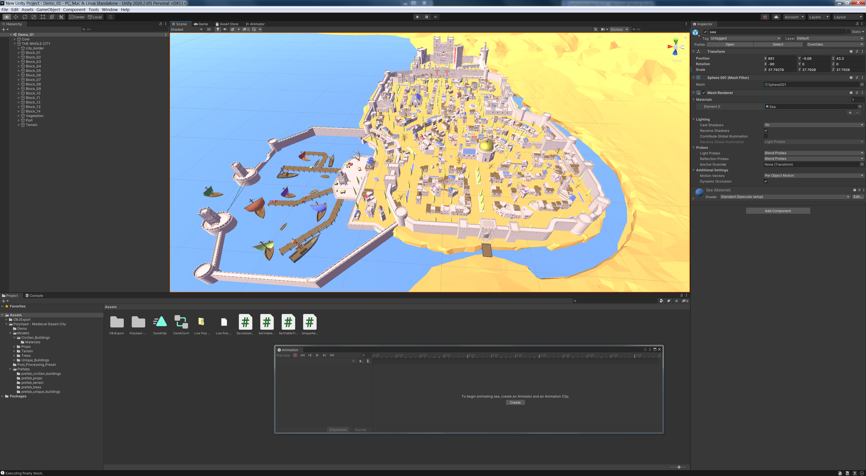
Entire scene

Slide 3
Path, entire scene

Slide 4
Entire scene

Slide 5
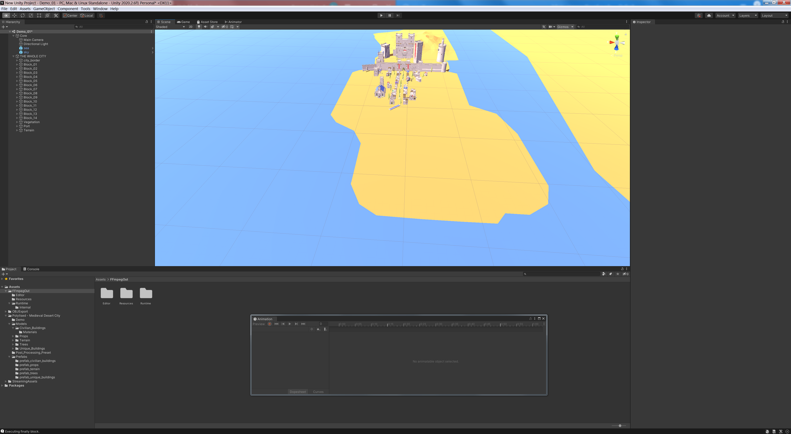
Visible set (object level)

Slide 6
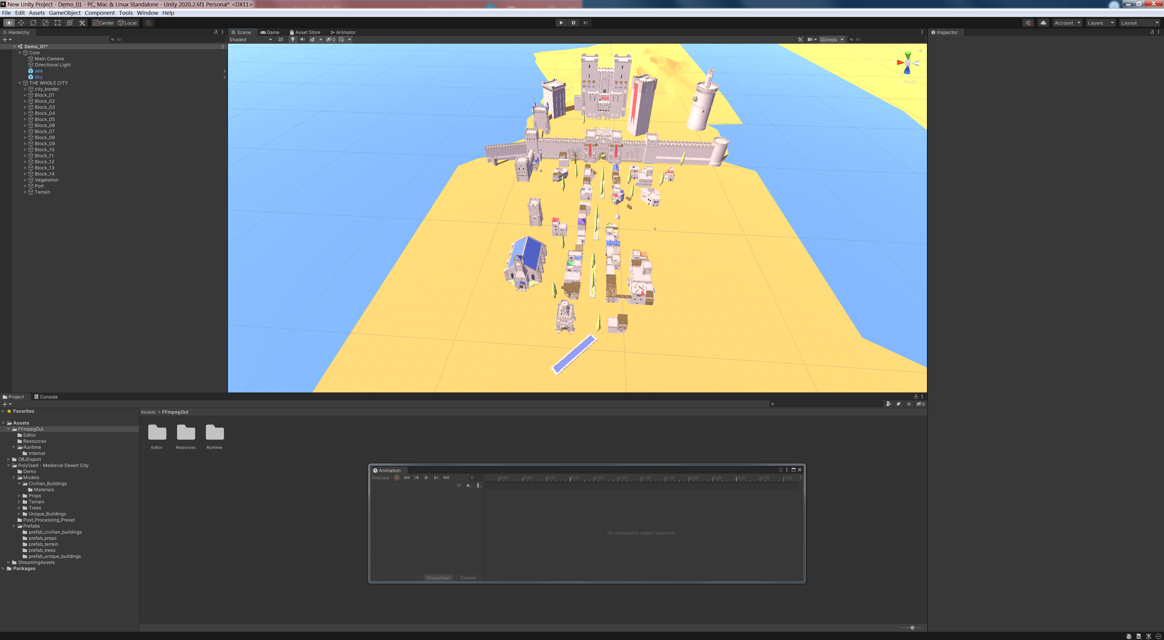
Visible set (object level)

Slide 7
Path, from object level visible set

Slide 8
Path, entire scene
Path, from object level visible set

Slide 9
Visible set (object level)

Slide 10
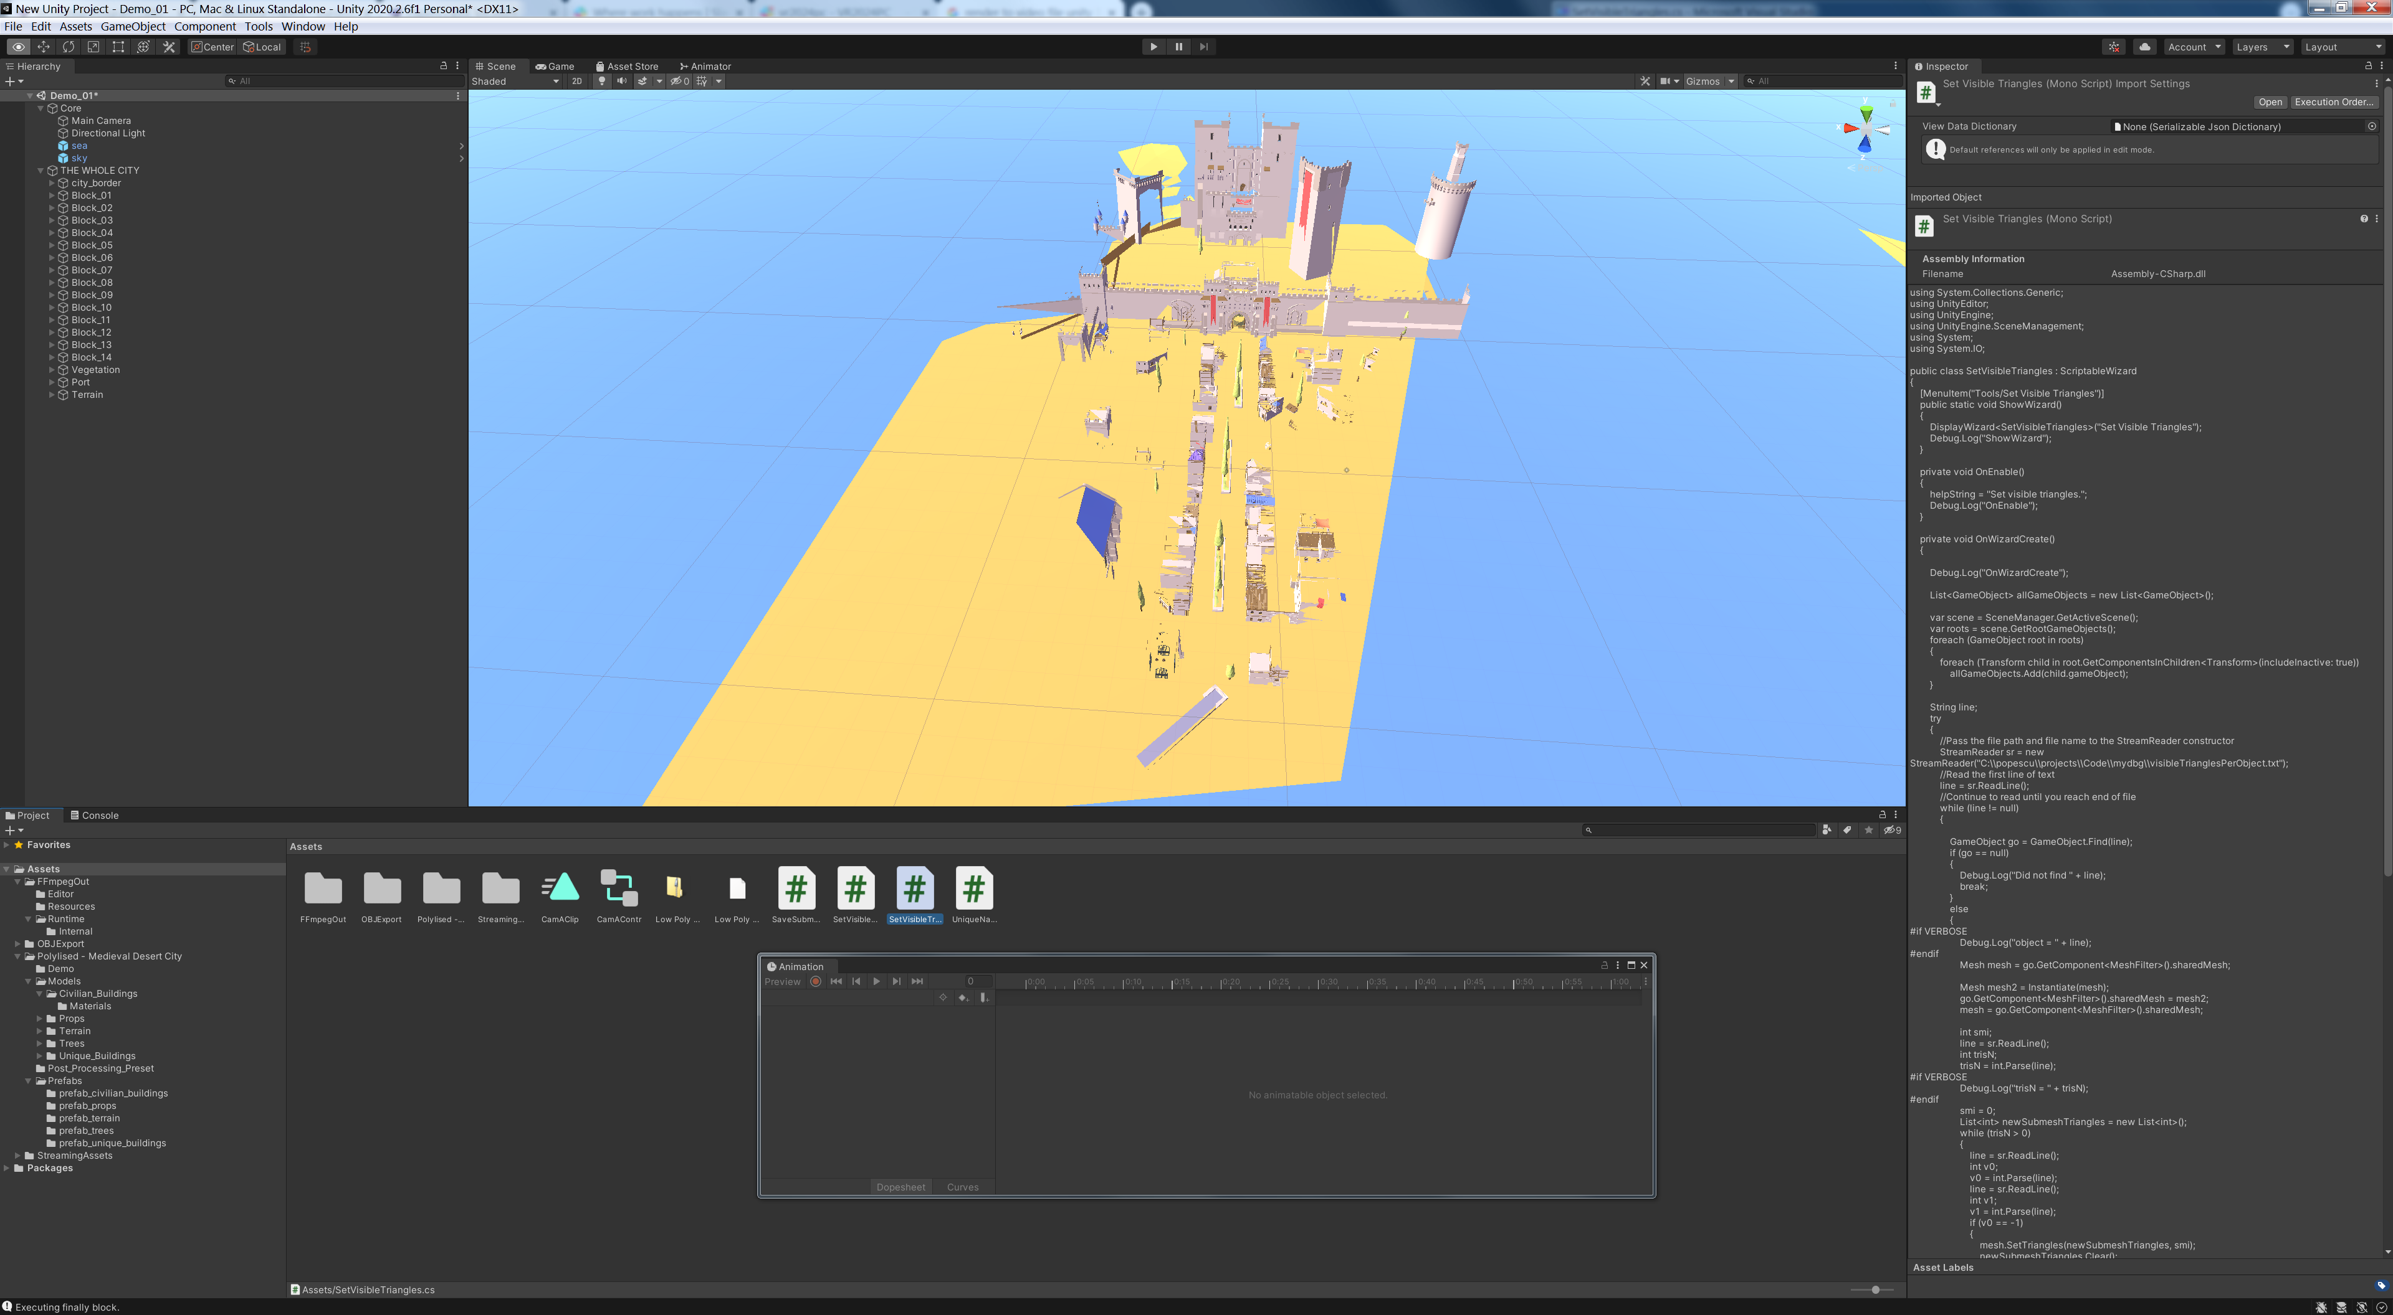
Visible set (triangle level)

Slide 11
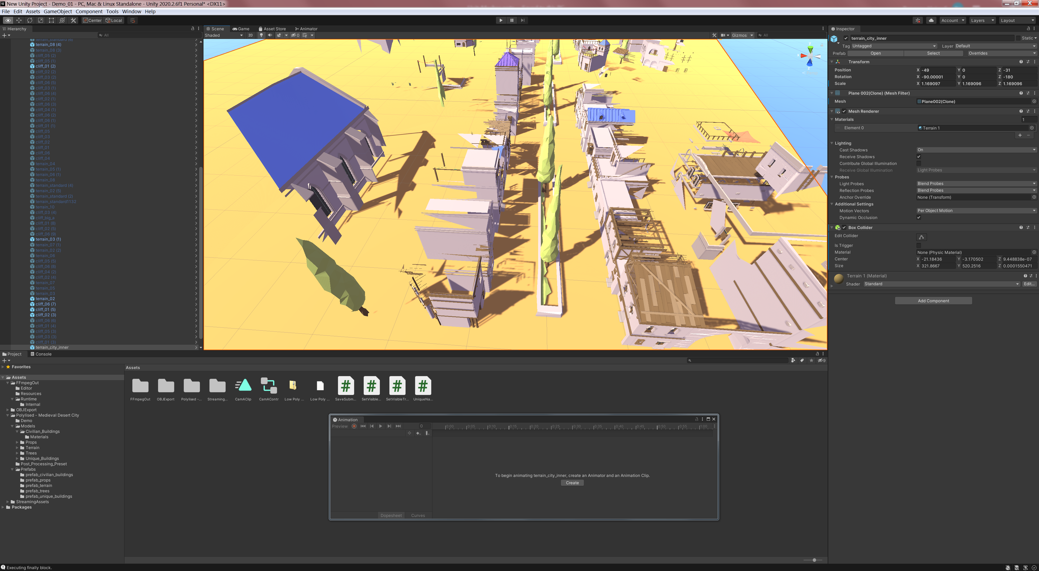
Visible set (triangle level)

Slide 12
Path, from triangle level visible set

Slide 13
Path, entire scene
Path, from triangle level visible set

