Slide 1
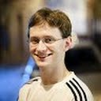
On the Economics of Offline Password Cracking
Jeremiah Blocki (Purdue University)
Benjamin Harsha (Purdue University)
Samson Zhou (Purdue University)
S&P 2018

Slide 2
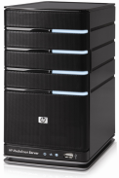
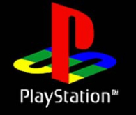
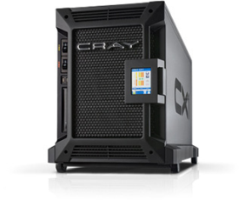
Offline Attacks
jblocki, 123456
Username
jblocki
Salt
89d978034a3f6
Hash
85e23cfe0021f584e3db87aa72630a9a2345c062
HASH(12345689d978034a3f6)=85e23cfe0021f584e3db87aa72630a9a2345c062
+
Notes:
Suppose that I register for an account at playstation.com

Slide 3
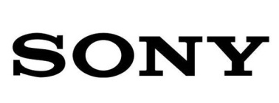
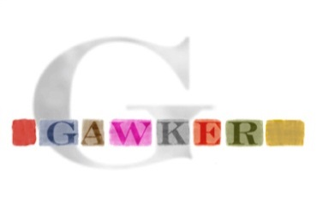
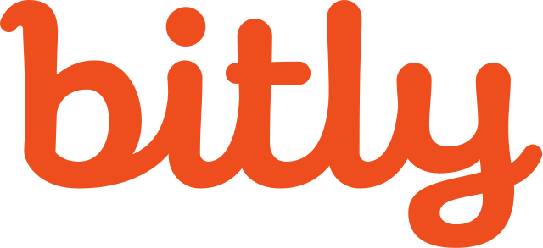
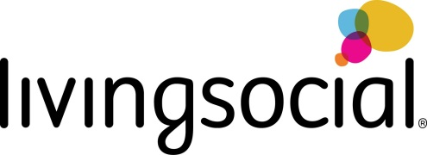
Offline Attacks: A Common Problem
Password breaches at major companies have affected millions billions of user accounts.
Notes:
Unfortunately, such breaches are increasingly commonplace and have affected billions of user accounts. Shown below is an incomplete list of major breaches and I apologize if I forgot to include your competitor.

Slide 4
Key Stretching
Hash Function | Cost: C
H
$H^{τ}$ | …
Hash Iteration
Memory Hard Functions
PBKDF2

Slide 5
Offline Attacks: A Common Problem
Password breaches at major companies have affected millions billions of user accounts.
PKKDF2-SHA256
PBKDF2-SHA256
($τ={10}^{5}$ iterations)
NIST 2017 Guidelines:$τ>{10}^{4}$
Notes:
Unfortunately, offline dictionary attacks are quite common. Password breaches at major companies have affected millions of users.

Slide 6
Strong Claims (Post Breaches)
“Cracking our algorithms [PBKDF2-SHA256] is extremely difficult, even for the strongest of computers.” – LastPass Blog
“The bcrypt hashing algorithm protecting it is very resilient to cracking and frankly, all but the worst possible password choices are going to remain secure even with the breach now out in the public…”
Key Research Question:
Can we predict how many users passwords a rational attacker will crack after a breach?

Slide 7
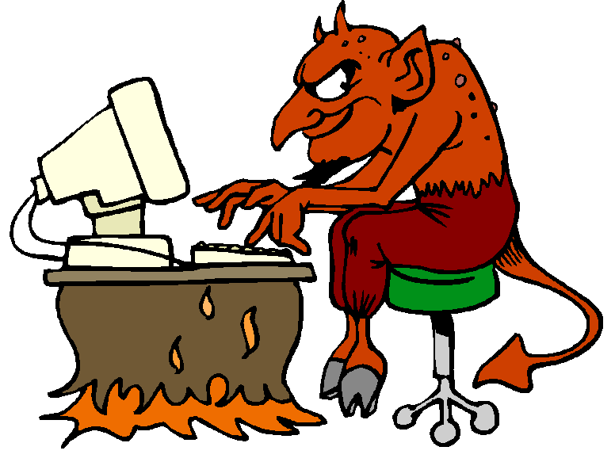
Decision Theoretic Model
Untargeted Rational Password Attacker
Attacker knows the distribution of user chosen passwords, but not which particular password the user picked
Quits guessing as soon as
$$Marginal Guessing Cost>Marginal Reward$$
Dependent on key stretching algorithm
e.g., how many hash iterations ($τ$)?
Cost PBKDF2: $τ×Cost(SHA256)$
$1,200

Slide 8
Decision Theoretic Model
Untargeted Rational Password Attacker
Attacker knows the distribution of user chosen passwords, but not which particular password the user picked
Quits guessing as soon as
$$Marginal Guessing Cost>Marginal Reward$$
LastPass:$τ={10}^{5}$ SHA256 iterations
What is Cost(SHA256)?
Estimate from Bitcoin (2014) $\$7×{10}^{−15}$ [BS14]
Cost per Guess: $\$7×{10}^{−10}$
$1,200

Slide 9
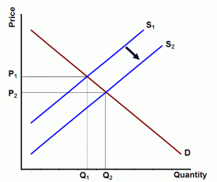
Decision Theoretic Model
Untargeted Rational Password Attacker
Attacker knows the distribution of user chosen passwords, but not which particular password the user picked
Quits guessing as soon as
$$Marginal Guessing Cost>Marginal Reward$$
Dependent on
Value of cracked pwds (V)
User password distribution ($p_{i}$)
Diminishing Marginal Returns (a)
(Extends CASH model [BD16])

Slide 10
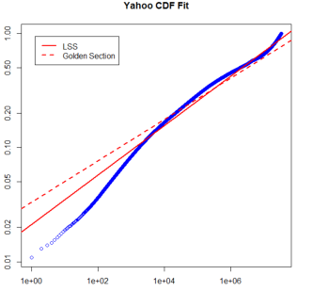
User Password Distribution
Empirical Data from Yahoo!
70 million passwords [B12]
Not a breach! (differentially private [BDB16])
Fits CDF-Zipf’s Law Nicely
$$λ_{t}=\sum_{j=1}^{t}{{\tilde{p}}_{j}}≈y×t^{r}$$
$${CDF: λ}_{t}$$
Slope: $r=0.2166$
$$y=0.0211$$
$$Rank:t$$

Slide 11
User Password Distribution
Empirical Data from Yahoo!
70 million passwords [B12]
Not a breach! (differentially private [BDB16])
Fits CDF-Zipf’s Law Nicely
$$λ_{i}=\sum_{j=1}^{i}{{\tilde{p}}_{j}}≈y×t^{r}$$
Consistent with previous findings on smaller breached datasets
Wang et al. [WCWHJ17]
Our Result: CDF-Zipf’s Law Parameters (y,r) for Yahoo!

Slide 12
Threshold Function of Doom
Theorem: If $\frac{v}{k}≥T\left(y,r,a\right)$ then a rational attacker will crack 100% of passwords from a CDF-Zipf’s Law Distribution where
$$T\left(y,r,a\right):=\max_{t≤Z}\left(\frac{1−y{\left(t−1\right)}^{r}}{y^{a}{\left(ra\right)t}^{ra−1}}\right)$$
$$with Z=\left\lceil {\left(\frac{1}{y}\right)}^{\frac{1}{r}}\right\rceil +1$$
y,r - Zipf parameters
a - diminishing returns
v - password value
k - cost to compute hash function (e.g., $k=τ×Cost(SHA256)$)

Slide 13
An “Optimistic” Picture
$a=0.8$ – significant diminishing returns
v – wide range of estimates for “value” based on blackmarket prices
Consider the lowest possible estimate!
DOOM ZONE
NIST Recommendations
LastPass

Slide 14
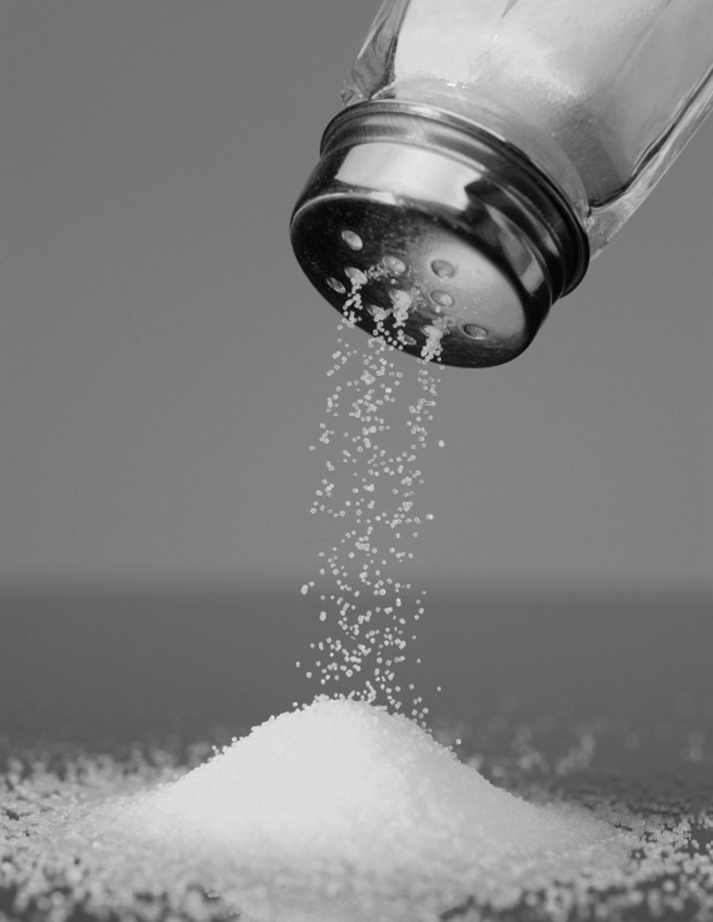
A grain of salt
See paper for “Model Independent” Analysis
Even if we make no assumptions about the shape of the password distribution, we can still argue that the attacker cracks most passwords with high probability.
(Chernoff Bounds)
While CDF-Zipf’s law fits empirical datasets nicely, we cannot be certain that it models the tail of the distribution.
At minimum attacker cracks all passwords that do follow Zipf’s Law (it is possible that some passwords from the tail of the distribution won’t be cracked)
How big is the tail of the distribution?
LinkedIn: Only 14% of passwords unique.
Source: https://www.troyhunt.com/86-of-passwords-are-terrible-and-other-statistics/

Slide 15
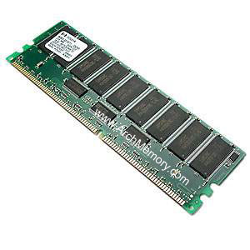
Memory Hard Functions (MHF)
Intuition: fill $τ$ memory blocks with random content that must be kept in memory for entire duration of computation ($τ$ steps).
→Expensive even on customized hardware
vs.
Ideal MHF: Area-Time Costs scale Quadratically with $τ$
$$k=τ{×C}_{H}+τ^{2}×C_{mem}$$
Contrast: BCRYPT/PBKDF2 costs scale linearly with $τ$
Candidate MHFs: SCRYPT, Argon2id, DRSample
Notes:
In this work we study a special type of memory hard function called data-independent memory hard functions. As the name suggests the memory access pattern will not depend on the input making the functions resistant to side-channel attacks.

Slide 16
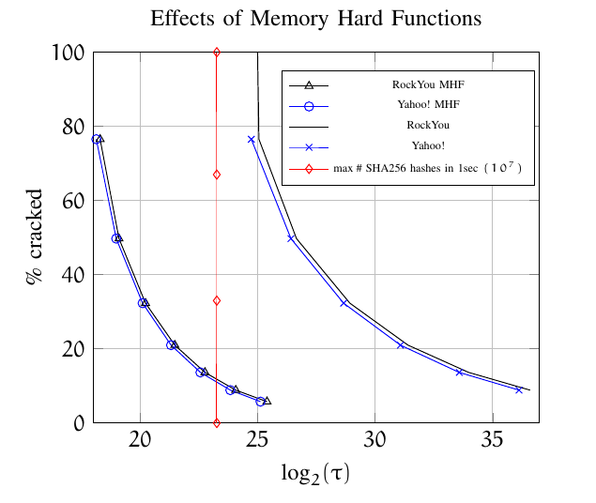
MHFs Are Helpful
“Pessimistic” Analysis
a=1
No Diminishing Marginal Returns (a=1)
v=$4
Value of cracked password is order of magnitude higher than in previous analysis
Quadratic Scaling: Less time required to give the same protection!
MHF: ~250ms
Non-MHF:~2 minutes

Slide 17
Executive Summary of Our Findings
BCRYPT/PBKDF2 provide insufficient protection for most user passwords!
Memory Hard Functions provide much stronger protection
SCRYPT, Argon2id, DRSample

Slide 18
Recommendations for Organizations
Distribute Storage of Password Hashes to Minimize Chances of Breach
E.g., Pythia PRF[ECSJR15], Phoenix [LESC17]
Use Memory Hard Functions to Minimize Damage of a Breach
Our Position: PBKDF2 no longer an acceptable password hashing algorithm.
We contend that NIST should disallow PBKDF2 for password hashing
Shameless Plug: Use “Just In Time” hashing to perform extra key-stretching as the user types their password [BH18].
Outside the Box Idea: Adapt a Bitcoin miner like the Antminer S9 for key-stretching?

Slide 19
Recommendations for Users
Enable Two-Factor Authentication
Focus energy on selecting different passwords for different accounts (as opposed to selecting more complex passwords)
Write down (part of) your passwords?
Example: (Purdue, jblocki, ______3jtph$)

Slide 20
Thanks for Listening

Slide 21
Competing Adversaries?
In some cases we might have multiple rational password attackers competing to crack the same?
Suppose that only first attacker to crack the password benefits.
Question: Does competition significantly reduce % of cracked passwords?
Our Answer: Probably not
Case 1: Unlikely another attacker has cracked password
→ expected reward is high
Case 2: Likely that another attacker has cracked password
→ password probably cracked

Slide 22
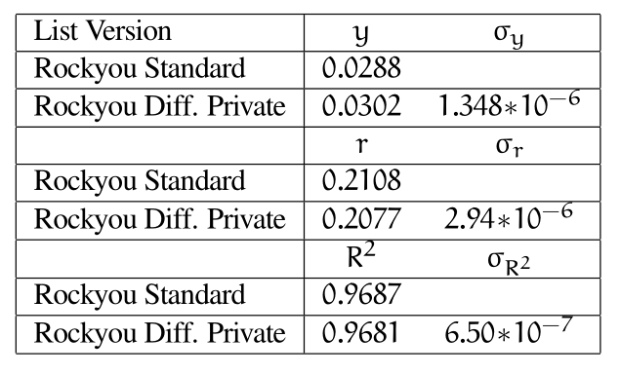
Differential Privacy and Rockyou
We take a known distribution (rockyou) and apply the differential privacy with the same parameters used for Yahoo
Calculate the CDF Zipf Parameters for each list created

