Slide 1
Sustained Space Complexity
Joël Alwen (IST Austria/Wickr)
Jeremiah Blocki (Purdue)
Krzysztof Pietrzak (IST Austria)
Crypto Reading Group 2019

Slide 2
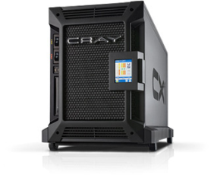
Motivation: Password Storage
jblocki, 123456
Username
jblocki
Salt
89d978034a3f6
Hash
85e23cfe0021f584e3db87aa72630a9a2345c062
SHA1(12345689d978034a3f6)=85e23cfe0021f584e3db87aa72630a9a2345c062
+
Notes:
As a motivating example consider an adversary who breaks into an authentication server and steals a users crptographic hash value. The adversary can execute an offline attack against the password by comparing the hash value with the hashes of likely password guesses. The adversary is limited only by the resources that he is willing to invest cracking the passwords.

Slide 3
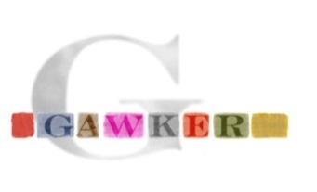
Offline Attacks: A Common Problem
Password breaches at major companies have affected millions billions of user accounts.
Notes:
Unfortunately, offline dictionary attacks are quite common. Password breaches at major companies have affected millions of users.

Slide 4
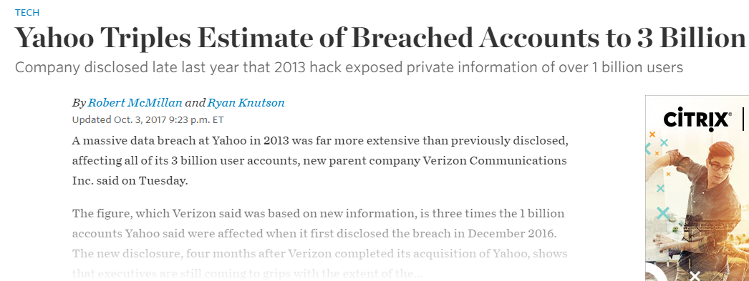
Offline Attacks: A Common Problem
Password breaches at major companies have affected millions billions of user accounts.
Notes:
Unfortunately, offline dictionary attacks are quite common. Password breaches at major companies have affected millions of users.

Slide 5
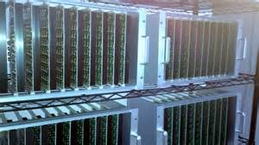
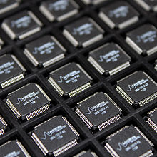
Goal: Moderately Expensive Hash Function
Fast on PC and
Expensive on ASIC?
Notes:
This motivates the need for moderately hard functions. The basic idea is to build a password hash function that is moderately expensive to compute to limit the number of guesses that an adversary would be willing to try. An honest server only needs to compute the function once during a typical authentication session. However, the adversary potentially has an advantage in this game. While the honest server must typically evaluate the function on standard hardware, the adversary could use potentially reduce the cost per password guess by developing customized hardware (GPUs, FPGAs, ASICs) to evaluate the password hash function. Thus, we want to ensure that the cost to evaluate this function is equitable across platforms.

Slide 6
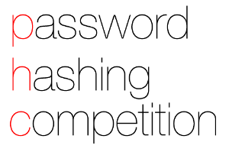
(2013-2015)
https://password-hashing.net/

Slide 7
We recommend that you use Argon2…
(2013-2015)
https://password-hashing.net/

Slide 8
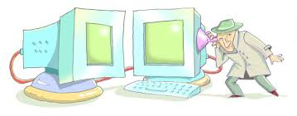
We recommend that you use Argon2…
There are two main versions of Argon2, Argon2i and Argon2d. Argon2i is the safest against side-channel attacks
(2013-2015)
https://password-hashing.net/

Slide 9
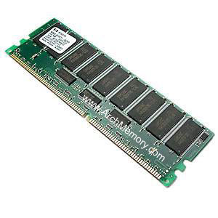
Memory Hard Function (MHF)
Intuition: computation costs dominated by memory costs
vs.
Goal: force attacker to lock up large amounts of memory for duration of computation
→Expensive even on customized hardware
Notes:
In this work we study a special type of memory hard function called data-independent memory hard functions. As the name suggests the memory access pattern will not depend on the input making the functions resistant to side-channel attacks.

Slide 10
Memory Hard Function (MHF)
Intuition: computation costs dominated by memory costs
vs.
Notes:
In this work we study a special type of memory hard function called data-independent memory hard functions. As the name suggests the memory access pattern will not depend on the input making the functions resistant to side-channel attacks.

Slide 11
Memory Hard Function (MHF)
Intuition: computation costs dominated by memory costs
vs.
Notes:
In this work we study a special type of memory hard function called data-independent memory hard functions. As the name suggests the memory access pattern will not depend on the input making the functions resistant to side-channel attacks.

Slide 12
Memory Hard Function (MHF)
Intuition: computation costs dominated by memory costs
vs.
Data Independent Memory Hard Function (iMHF)
Memory access pattern should not depend on input
Notes:
In this work we study a special type of memory hard function called data-independent memory hard functions. As the name suggests the memory access pattern will not depend on the input making the functions resistant to side-channel attacks.

Slide 13
Memory Hard Function (MHF)
Intuition: computation costs dominated by memory costs
vs.
Data Independent Memory Hard Function (iMHF)
Memory access pattern should not depend on input
Notes:
In this work we study a special type of memory hard function called data-independent memory hard functions. As the name suggests the memory access pattern will not depend on the input making the functions resistant to side-channel attacks.

Slide 14
Data-Independent Memory Hard Function (iMHF)
iMHF f_{G,H} defined by
H:$\left\{0,1\right\}2k→\left\{0,1\right\}k$ (Random Oracle)
DAG G (encodes data-dependencies)
Maximum indegree: $δ=O\left(1\right)$
Input: pwd, salt
2
4
1
Output: f_{G,H} (pwd,salt)= L₄
1
3
$$L1=H(pwd,salt)$$
$$L3=H(L2,L1)$$

Slide 15
Evaluating an iMHF (pebbling)
2
4
Output: L₄
Input:
1
1
pwd, salt
3
$$L1=H(pwd,salt)$$
$$L3=H(L2,L1)$$
Pebbling Rules : $\vec{P}$=P₁,…,P_{t}$⊂V$ s.t.
P_{i+1}$⊂\text{P}\text{i}∪\left\{x∈V | parents\left(x\right)⊂\text{P}\text{i}\text{+1}\right\}$(need dependent values)
n$∈$P_{t} (must finish and output L_{n})
Notes:
We will describe our algorithms for evaluating an iMHF using the language of graph pebbling. Placing a pebble on a node corresponds to computing the corresponding label, and keeping a pebble on the graph corresponds to storing that label in memory. Of course we can only compute a label if we have all of the dependent labels. Thus, in a legal pebbling we cannot place a pebble on a node until we have pebbles on the parents of that node. If the adversary is parallel then we are allowed to place multiple pebbles on the graph in each round. We can remove pebbles from the graph at any point in time.

Slide 16
Evaluating an iMHF (pebbling)
4
5
3
4
5
1
3
1
2

Slide 17
Evaluating an iMHF (pebbling)
1
2
3
4
5
P₁ = {1} (data value L₁ stored in memory)

Slide 18
Pebbling Example
1
2
3
4
5
P₁ = {1}
P₂ = {1,2} (data values L₁ and L₂ stored in memory)

Slide 19
Pebbling Example
1
2
3
4
5
P₁ = {1}
P₂ = {1,2}
P₃ = {3}

Slide 20
Pebbling Example
1
2
3
4
5
P₁ = {1}
P₂ = {1,2}
P₃ = {3}
P₄ = {3,4}

Slide 21
Pebbling Example
1
2
3
4
5
P₁ = {1}
P₂ = {1,2}
P₃ = {3}
P₄ = {3,4}
P₅ = {5}

Slide 22
Measuring Cost: Attempt 1
Space $×$Time (ST)-Complexity
$$ST\left(G\right)=\min_{\vec{P}}\left(t_{\vec{P}}×\max_{i≤t_{\vec{P}}}\left|P_{i}\right|\right)$$
Rich Theory
Space-time tradeoffs
But not appropriate for password hashing
ST Cost
m
space
time
t

Slide 23
Amortization and Parallelism
Problem: for parallel computation ST-complexity can scale badly in the number of evaluations of a function.
[AS15] $∃$function f_{n} (consisting of n RO calls) such that: $ST\left(f^{×\sqrt{n}}\right)=O(ST\left(f\right))$
S₃
ST₁ = S₁ × T₁ ≈ S₃ × T₃ = ST₃
S₁
space
cost of computing
f once
cost of computing
f three times
time
T₁
T₃

Slide 24
Measuring Pebbling Costs [AS15]
$$CC\left(G\right)=\min_{\vec{P}}{\sum_{i=1}^{t_{\vec{P}}}{\left|P_{i}\right|}}$$
Approximates Amortized Area x Time Complexity of iMHF
Memory Used at Step i
Cumulative Memory Cost
space
iterations

Slide 25
Measuring Pebbling Costs [AS15]
$$CC\left(G\right)=\min_{\vec{P}}{\sum_{i=1}^{t_{\vec{P}}}{\left|P_{i}\right|}}$$
[AS15] $\text{Costs}$scale linearly with #password guesses
$$CC\left(G,…,G\right)=m×CC(G)$$
Memory Used at Step i
$m$ times

Slide 26
Pebbling Example: Cumulative Cost
1
2
3
4
5
$$CC\left(G\right)≤\sum_{i=1}^{5}{\left|P_{i}\right|}$$
$$= 1+2+1+2+1$$
$= 7$
P₁ = {1}
P₂ = {1,2}
P₃ = {3}
P₄ = {3,4}
P₅ = {5}

Slide 27
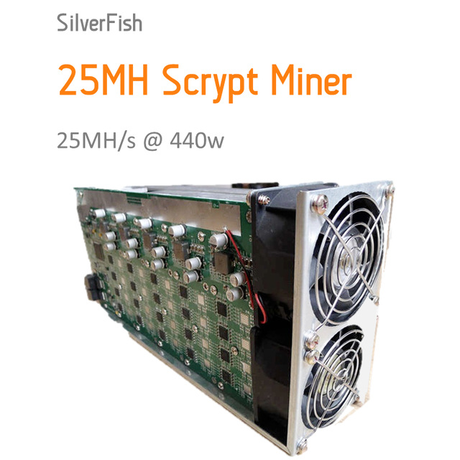
Lessons from SCRYPT
SCRYPT [Per09]
CON: Data-Dependent→ Side-Channel Concerns
PRO: Proven to have high CC [ACPRT17]
CC(SCRYPT) = $Ω\left(n^{2}\right)$
Contrast: any iMHF has CC at most $O\left(\frac{n^{2}\log{\log{n}}}{\log{n}}\right)$
Maximally Memory Hard → Egalitarian?

Slide 28
What Happened?
CC(SCRYPT) = $Ω\left(n^{2}\right)$ the function can be computed with low memory
Each strategy below is easily feasible
Evaluate with $O\left(n\right)$ memory in $O\left(n\right)$ time
Evaluate with $O\left(\sqrt{n}\right)$memory in $O\left(n\sqrt{n}\right)$ time
Evaluate with $O\left(1\right)$memory in $O\left(n^{2}\right)$ time
SCRYPT ASIC miners opt for low memory + high computation options
Goal: Ensure that low memory options are infeasible

Slide 29
Sustained Space
Using memory is more costly than doing computation (at least for ASICs).
Idea: Only charge for computational steps where a lot of memory is being used.
Definition: s-Sustained Space
“Time spent above memory threshold s”
FACT:
$$CC>st$$
s-Sustained Space
Intuition: trade-offs are free.
space
s
time

Slide 30
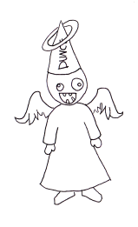
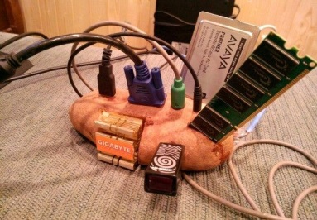
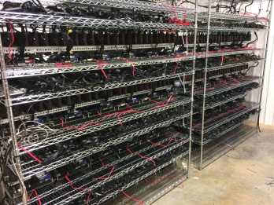
Wanted: A Moderately Hard Function
Desiderata:
Cost for honest & adversary roughly same:
Honest Computational Model
Sequential Computation
Single Evaluation
Cost measured in ST Complexity
Adversarial Model
Parallel Computation
Amortization across many evaluations
Cost measured in s-SS
(for some large s)

Slide 31
Main Theorem
For any n∊ℕ we give a function f_{n} and prove that in the parallel Random Oracle Model (PROM):
Bonus: f_{n} is an iMHF.
E runs in constant time and has data-independent memory access pattern
Honest
Sequential Algorithm E
Time(E(f_{n})) = n
ST(E(f_{n})) = n²
Adversarial
∀ parallel algs. A
s-SS(A(f_{n})) = Ω(n) per eval.
for s = Ω(n/log(n))

Slide 32
The Parallel Black Pebbling Game
Parallel Black Pebbling Game: Same as Black Pebbling, except can touch many pebbles per iteration.
s-SS analogue: Count number of steps when at least s pebbles on graph.
Goal: Place a pebble on the sink.
Rule 1: A node can be pebbled only if all parents contain a pebble.
Rule 2: A pebble can always be removed.
Want G with…
Size(G) = n
In-degree(G) = 2
$\frac{n}{log⁡(n)}$ -SS(G) = Ω(n)
G
s-SS Complexity
1-SS = 3
2-SS = 1

Slide 33
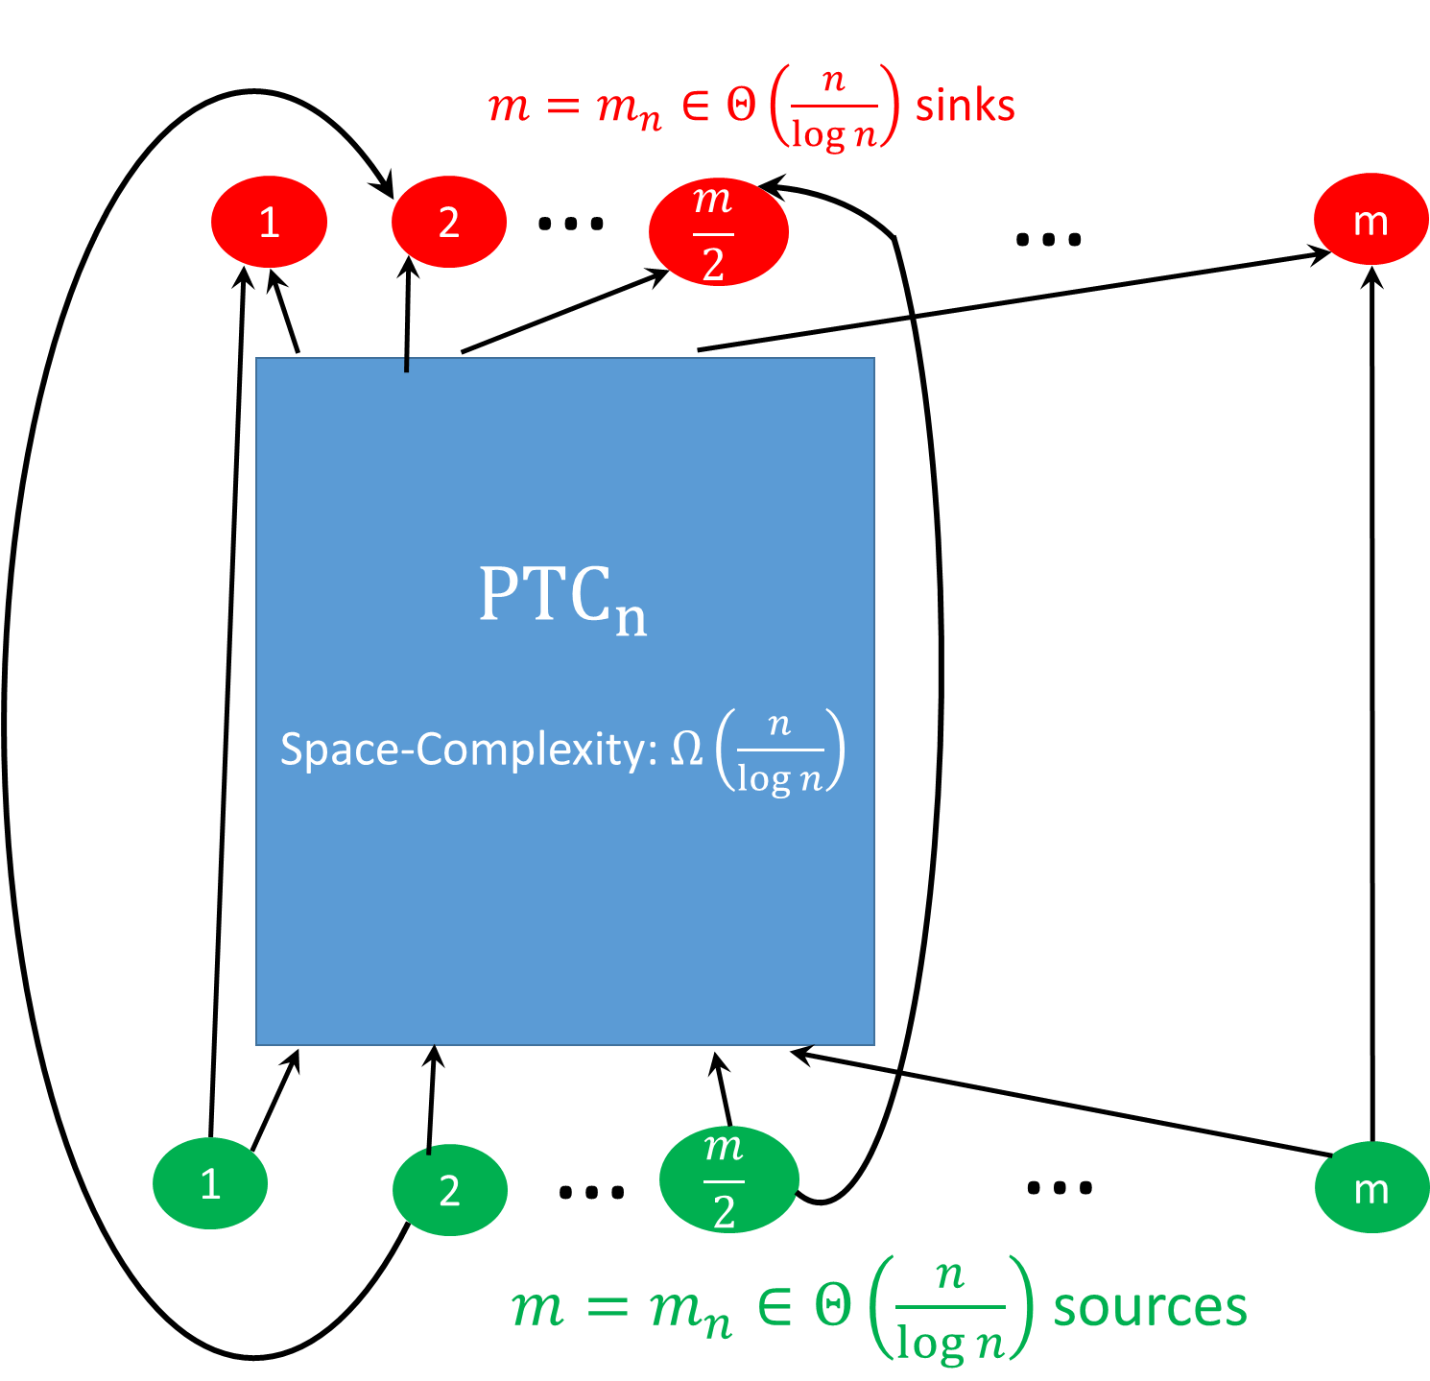
Technical Ingredient #1 [PTC77]
[PTC77] Built a constant indegree DAG G with n nodes and proves that any sequential pebbling has at least one step in which there are at least $Ω\left(n/\log{n}\right)$ pebbles on the graph.
[Hopcroft77] Any constant indegree graph DAG G can be pebbled with space at most $O\left(n/\log{n}\right)$

Slide 34
Technical Ingredient #1 [PTC77]
[PTC77] Built a constant indegree DAG G space complexity $Ω\left(n/\log{n}\right)$
Recursive Construction
PTC_{2n} contains 2 internal copies of PTC_{n}
Stronger Lemma used for Induction!
For any sequential pebbling $P_{1},…,P_{t}$
We can find an interval $\left[i,j\right]⊆[t]$ such that both
$\left|P_{k}\right|≥c_{1}m$ for each $k∈\left[i,j\right]$
At least $c_{2}m$ source nodes are (re)pebbled during the interval

Slide 35
Technical Ingredient #1 [PTC77]
[PTC77] Built a constant indegree DAG G space complexity $Ω\left(n/\log{n}\right)$
Recursive Construction
PTC_{2n} contains 2 internal copies of PTC_{n}
Stronger Lemma used for Induction!
For any parallel (sequential) pebbling $P_{t},…,P_{t}$
Can find an interval $\left[i,j\right]⊆[t]$ such that
$\left|P_{k}\right|≥c_{1}n/\log{n}$ for each $k∈\left[i,j\right]$ (lots of pebbles on the graph)
At least $c_{2}n/\log{n}$ source nodes are (re)pebbled during the interval
Implication ($s=c_{1}n/\log{n}$): s-SS(P) $≥j+1−i$
Sequential Pebbling: $j+1−i≥c_{2}n/\log{n}$ (by (2) above)
Parallel Pebbling: Could (re)pebble all $c_{2}n/\log{n}$ in one step!

Slide 36
Depth Robustness [ABP17]
Definition: A DAG G=(V,E) is (e,d)-depth-robust for all $S⊆V$
s.t. $\left|S\right|≤e$ we have $depth\left(G−S\right)>d.$
Otherwise, we say that G is (e,d)-reducible.
Example: (e=2,d=2)-reducible
1
2
3
4
5
6

Slide 37
Block Depth Robustness [ABP17]
Definition: A DAG G=(V,E) is (e,d)-depth-robust for all $S⊆V$
s.t. $\left|S\right|≤e$ we have $depth\left(G−S\right)>d.$
Otherwise, we say that G is (e,d)-reducible.
Example: (e=2,d=2)-reducible
1
2
3
4
5
6

Slide 38
Technical Ingredient #2
Definition: A DAG $G_{n}^{ε}$ is $ε$-extremely depth robust if it is (e,d)-depth-robust for all $e+d≤\left(1−ε\right)n$.
[EGS75] n node G with log(n) in-degree and (Ω(n), Ω(n))-depth-robust
Problem: Constants too small e.g., $e={10}^{−4}n$ and $d={10}^{−2}n$
Problem: in-degree too high.
[MMV13] $ε$-extremely depth robust DAG $G_{n}^{ε}$ with log²(n) in-degree and (e,d)-DR for any e+d < n(1-ε).
Problem: in-degree too high.

Slide 39
Technical Ingredient #2
Definition: A DAG $G_{n}^{ε}$ is $ε$-extremely depth robust if it is (e,d)-depth-robust for all $e+d≤\left(1−ε\right)n$.
[MMV13] $ε$-extremely depth robust DAG $G_{n}^{ε}$ with indegree $O\left(log2{n} \operatorname{polylog}\left(\log{n}\right)\right)$.
Problem: in-degree too high.
[NEW] $ε$-extremely depth robust DAG $D_{n}^{ε}$ with indegree O(log (n))
Construction: similar to [EGS75]
Many technical details to work out (see paper)

Slide 40
Technical Ingredient #2
Definition: A DAG $G_{n}^{ε}$ is $ε$-extremely depth robust if it is (e,d)-depth-robust for all $e+d≤\left(1−ε\right)n$.
[NEW] $ε$-extremely depth robust DAG $D_{n}^{ε}$with indegree O(log (n))
Construction: similar to [EGS75]
Many technical details to work out (see paper)
Useful Observation: Any subgraph of $D_{n}^{ε}[S]$ of size $\left|S\right|>εn$ must contain a path of length $\left|S\right|−εn$
Proof: Otherwise DAG${ D}_{n}^{ε}$ is not $\left(e,d\right)$-depth robust for $d=\left|S\right|−εn$ and $e=\left|V∖S\right|=n−\left|S\right|.$Contradiction, $D_{n}^{ε}$ is $ε$-extremely depth robust and
$$e+d=n−εn≤\left(1−ε\right)n.$$

Slide 41
Technical Ingredient #2
Definition: A DAG $G_{n}^{ε}$ is $ε$-extremely depth robust if it is (e,d)-depth-robust for all $e+d≤\left(1−ε\right)n$.
Lemma: If legal (parallel) pebbling P₁,…,P_{t} of $D_{n}^{ε}$ has at least one pebbling round j with space $s=\left|Pj\right|>2εn$ then there are at least $t=\frac{\left|Pj\right|}{2}−εn$ distinct time rounds k with space $\left|Pk\right|≥\frac{\left|Pj\right|}{2}$
Proof: Let i<j be last round before round j such that $\left|Pi\right|<\frac{\left|Pj\right|}{2}$and let $S=Pj∖Pi$. Any node in S is (re)pebbled during the interval [i,j].
→ (observation) the subgraph $J_{n}^{ε}[S]$ contains a path of length $t≥\frac{\left|Pj\right|}{2}−εn$
→ at least $t$ pebbling rounds to reach configuration $Pj$ from $Pi$

Slide 42
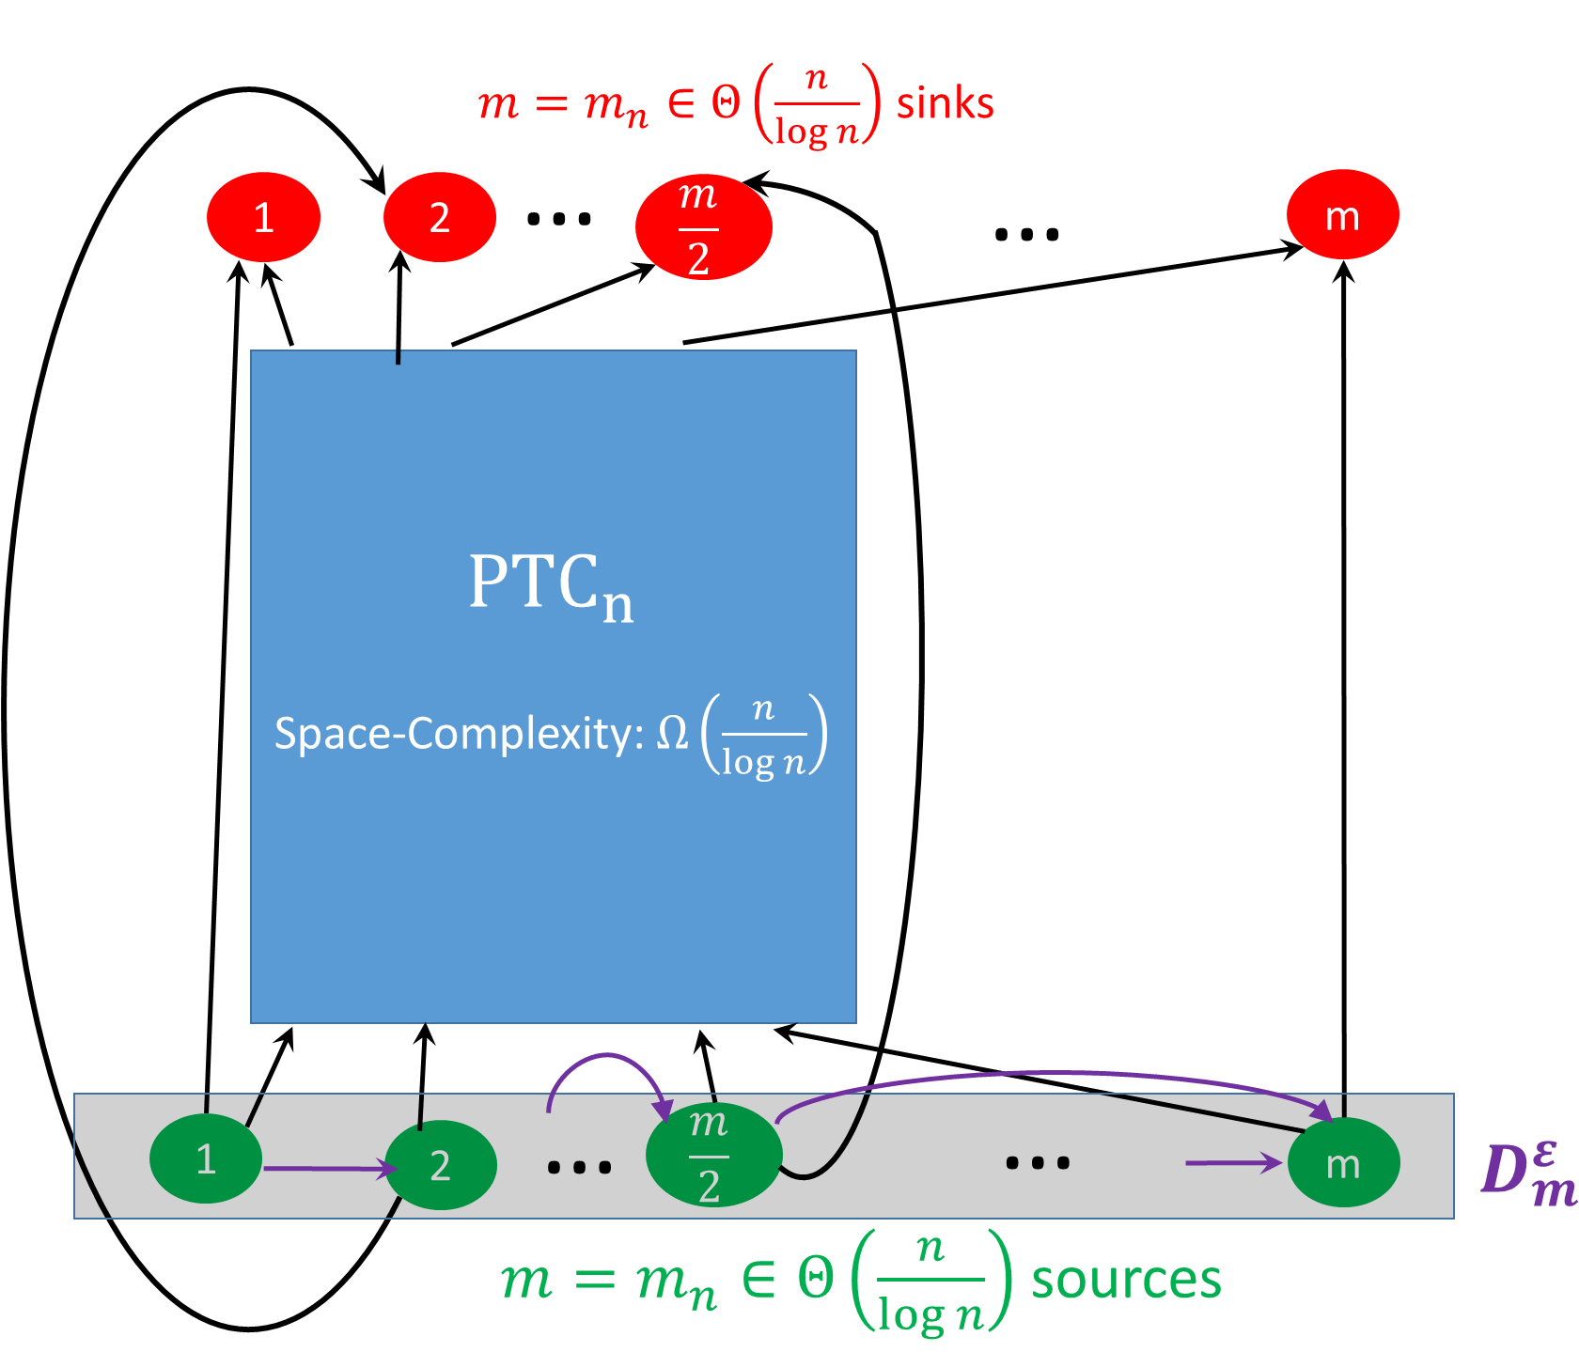
PTC Overlay (Attempt 1)
Lemma [PTC77] In any pebbling of PTC_{n} we can find an interval $\left[i,j\right]⊆[t]$ such that
$\left|P_{k}\right|≥c_{1}n/\log{n}$for each $k∈\left[i,j\right]$ (lots of pebbles on the graph)
At least $c_{2}n/\log{n}$ source nodes are (re)pebbled during the interval
[NEW] Now requires $Ω\left(m\right)$ rounds since $D_{n}^{ε}$ is $ε$-extremely depth robust

Slide 43
PTC Overlay (Attempt 1)
Lemma [PTC77] In any pebbling of PTC_{n} we can find an interval $\left[i,j\right]⊆[t]$ such that
$\left|P_{k}\right|≥c_{1}n/\log{n}$for each $k∈\left[i,j\right]$ (lots of pebbles on the graph)
At least $c_{2}n/\log{n}$ source nodes are (re)pebbled during the interval
[NEW] Overlay requires $Ω\left(m\right)$ rounds since $D_{m}^{ε}$ is $ε$-extremely depth robust
Problems:
Requires $s=Ω\left(n/\log{n}\right)$ pebbles for $t=Ω\left(n/\log{n}\right)$ rounds
I promised $s=Ω\left(n/\log{n}\right)$ pebbles for $t=Ω\left(n\right)$ rounds)
Indegree still too high i.e., $indeg\left(D_{m}^{ε}\right)=O(\log{n})$
I promised constant indegree O(1)

Slide 44
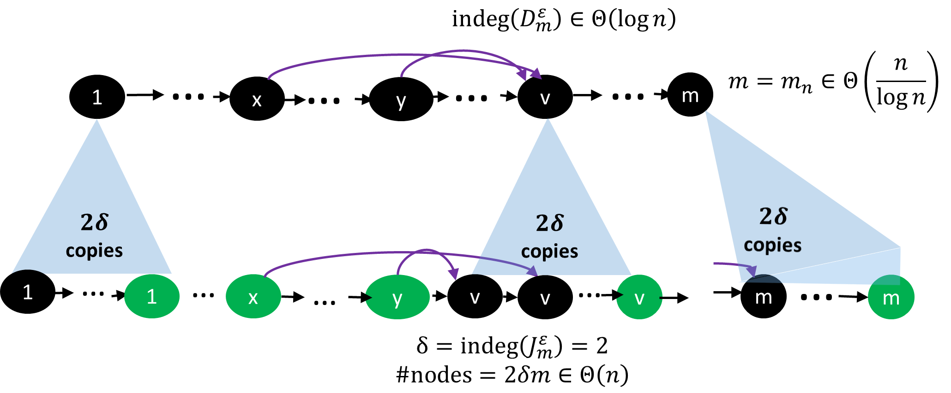
Technical Ingredient #3
Indegree Reduction [ABP17] deals with both problems simultaneously!

Slide 45
Technical Ingredient #3
Indegree Reduction [ABP17] deals with both problems simultaneously!
Lemma [ABP17]: If $D_{m}^{ε}$ is $(e,d)$-depth robust then $J_{m}^{ε}$is $(e,dδ)$-depth robust. Furthermore, $indeg\left(J_{m}^{ε}\right)=2$ and $J_{m}^{ε}$ has $2dm=O(n)$ nodes.

Slide 46
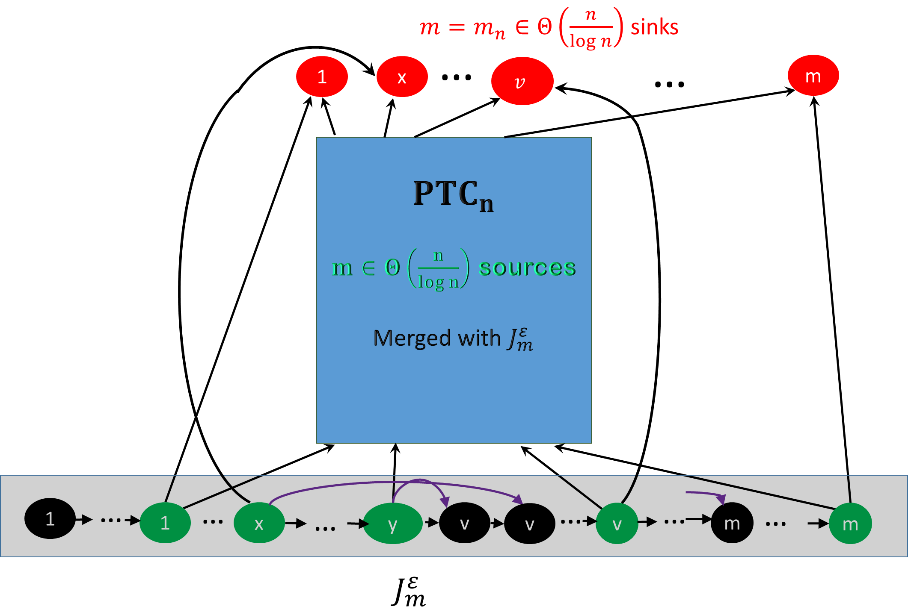
The Final Construction
Theorem: Any (parallel) pebbling requires
$s=Ω\left(n/\log{n}\right)$ pebbles for $t=Ω\left(n\right)$ rounds
Technical Details in paper

Slide 47
Consequences of new Depth-Robust Graphs
Logic: “Parallel Black-White Pebbling”
Application: CNF formulas with very memory costly refutation resolution proofs.
MHFS: Applications: Optimal CC for any graph of size n even though only O(log(n)) in-degree
$CC\left(D_{m}^{ε}\right)≥\frac{\left(1−η\right)n2}{2}$
Exact Constants!
Complete DAG: $CC\left(K_{n}^{}\right)≤\frac{n2}{2}$ (prior result is almost optimal!)
Coding Theory: better locally detectable error detection codes [BGGZ19]
Improved Proof-of-Sequential work (temporarily. See “Simple Proofs of Sequential Work” for construction without depth-robust graphs).

Slide 48
A Few Open Questions
Practical Construction of iMHF with high sustained space complexity?
Analyze/improve constant factors in bounds
Computer Aided Analysis?
Stronger Results for dMHFs? Hybrid Modes like Argon2id?
Find constant indegree DAG with parallel space-time complexity ${ST}^{||}\left(G\right)=Ω\left(n2\right)$ or show that no such DAG exists
Note: [AB16] pebbling shows that $CC\left(G\right)=O\left(\frac{n^{2}\log{\log{n}}}{\log{n}}\right)$, but the pebbling attack P still has ${ST}^{||}(P)=Ω\left(n2\right)$

Slide 49
A Few Open Questions
Practical Construction of iMHF with high sustained space complexity?
See upcoming crypto 2019 paper
Data-Independent Memory Hard Functions: New Attacks and Stronger Constructions (with Ben Harsha and Siteng Kang and Seunghoon Lee and Lu Xing and Samson Zhou).
Theorem: Any pebbling of (practical) DAG G either has
Cumulative Cost $ω\left(n^{2}\right)$, or
At least $s=Ω\left(n/\log{n}\right)$ pebbles for $t=Ω\left(n\right)$ rounds

Slide 50
Junk E-mail?
From: CRYPTO 2019 Chair
Subject: Your submission was accepted to CRYPTO 2019

Slide 51
Thanks for Listening

