Slide 1
Midterm Exam Stats
View Your Graded Exam on Gradescope (link by e-mail)
Maximum: 97
Minimum: 61
Mean: 75.85
Median: 77.2
Standard Deviation: 9.1
Reminder: Homework 3 Released

Slide 2
Recap
Polynomial time algorithms (in bit lengths $\left\|a\right\|$, $\left\|b\right\|$ and $\left\|N\right\|$) to do important stuff
GCD(a,b)
Find multiplicative inverse a⁻¹ of a such that 1=[aa⁻¹ mod N] (if it exists)
Note: a⁻¹ exists if and only if GCD(a,N) = 1 i.e. ${a∈ℤ}_{N}^{∗}$.
Extended Euclidean Algorithm: Finds integers x,y s.t. ax+Ny =GCD(a,N).
Define: a⁻¹ =[x mod N] and observe [aa⁻¹ mod N]=[ax-Ny mod N] = GCD(a,N)=1.
PowerMod: [a^{b} mod N]
Draw uniform sample from $ℤ_{N}^{∗}= \left\{x∈ℤN | \gcd\left(N,x\right)=1\right\}$
Randomized PPT algorithm

Slide 3
More Useful Facts
$${x,y∈ℤ}_{N}^{∗}→[xy mod N] {∈ℤ}_{N}^{∗}$$
Fact 1: Let $φ\left(N\right)=\left|ℤ_{N}^{∗}\right|$ then for any ${x∈ℤ}_{N}^{∗}$ we have
$$\left[x^{φ\left(N\right)}mod N\right]=1$$
Example: $ℤ_{8}^{∗}=\left\{1,3,5,7\right\}$, $φ\left(8\right)=4$
$$\left[3^{4}mod 8\right]=\left[9×9 mod 8\right]=1$$
$$\left[5^{4}mod 8\right]=\left[25×25 mod 8\right]=1$$
$$\left[7^{4}mod 8\right]=\left[49×49 mod 8\right]=1$$

Slide 4
More Useful Facts
$${x,y∈ℤ}_{N}^{∗}→[xy mod N] {∈ℤ}_{N}^{∗}$$
Fact 1: Let $φ\left(N\right)=\left|ℤ_{N}^{∗}\right|$ then for any ${x∈ℤ}_{N}^{∗}$ we have $\left[x^{φ\left(N\right)}mod N\right]=1$
Fact 2: Let $φ\left(N\right)=\left|ℤ_{N}^{∗}\right|$ and let $N=\prod_{i=1}^{m}{p_{i}^{e_{i}}}$, where each $p_{i}$ is a distinct prime number and e_{i} > 0 then
$$φ\left(N\right)=\prod_{i=1}^{m}{(p_{i}−1)p_{i}^{e_{i}−1}}=N\prod_{i=1}^{m}{\left(1−\frac{1}{p_{i}}\right)}$$

Slide 5
More Useful Facts
Fact 2: Let $φ\left(N\right)=\left|ℤ_{N}^{∗}\right|$ and let $N=\prod_{i=1}^{m}{p_{i}^{e_{i}}}$, where each $p_{i}$ is a distinct prime number and e_{i} > 0 then
$$φ\left(N\right)=\prod_{i=1}^{m}{(p_{i}−1)p_{i}^{e_{i}−1}}=N\prod_{i=1}^{m}{\left(1−\frac{1}{p_{i}}\right)}$$
Example 0: Let p be a prime so that $ℤ_{p}^{∗}=\left\{1,…,p−1\right\}$
$$φ\left(p\right)=p\left(1−\frac{1}{p}\right)=p−1$$

Slide 6
More Useful Facts
Fact 2: Let $φ\left(N\right)=\left|ℤ_{N}^{∗}\right|$ and let $N=\prod_{i=1}^{m}{p_{i}^{e_{i}}}$, where each $p_{i}$ is a distinct prime number and e_{i} > 0 then
$$φ\left(N\right)=\prod_{i=1}^{m}{(p_{i}−1)p_{i}^{e_{i}−1}}=N\prod_{i=1}^{m}{\left(1−\frac{1}{p_{i}}\right)}$$
Example 1: N = 9 = 3² (m=1, e₁=2)
$$φ\left(9\right)=\prod_{i=1}^{1}{(p_{i}−1)p_{i}^{2−1}}=2×3$$

Slide 7
More Useful Facts
Example 1: N = 9 = 3² (m=1, e₁=2)
$$φ\left(9\right)=\prod_{i=1}^{1}{(p_{i}−1)p_{i}^{2−1}}=2×3$$
Double Check: $ℤ_{9}^{∗}=\left\{1,2,4,5,7,8\right\}$

Slide 8
More Useful Facts
Fact 2: Let $φ\left(N\right)=\left|ℤ_{N}^{∗}\right|$ and let $N=\prod_{i=1}^{m}{p_{i}^{e_{i}}}$, where each $p_{i}$ is a distinct prime number and e_{i} > 0 then
$$φ\left(N\right)=\prod_{i=1}^{m}{(p_{i}−1)p_{i}^{e_{i}−1}}=n\prod_{i=1}^{m}{\left(1−\frac{1}{p_{i}}\right)}$$
Example 2: N = 15 = $5×3$ (m=2, e₁=e₂=1)
$$φ\left(15\right)=\prod_{i=1}^{2}{(p_{i}−1)p_{i}^{1−1}}=\left(5−1\right)\left(3−1\right)=8$$

Slide 9
More Useful Facts
Example 2: N = 15 = $5×3$ (m=2, e₁=e₂=1)
$$φ\left(15\right)=\prod_{i=1}^{2}{(p_{i}−1)p_{i}^{1−1}}=\left(5−1\right)\left(3−1\right)=8$$
Double Check: $ℤ_{15}^{∗}=\left\{1,2,4,7,8,11,13,14\right\}$
I count 8 elements in $ℤ_{15}^{∗}$

Slide 10
More Useful Facts
Fact 2: Let $φ\left(N\right)=\left|ℤ_{N}^{∗}\right|$ and let $N=\prod_{i=1}^{m}{p_{i}^{e_{i}}}$, where each $p_{i}$ is a distinct prime number and e_{i} > 0 then
$$φ\left(N\right)=\prod_{i=1}^{m}{(p_{i}−1)p_{i}^{e_{i}−1}}=n\prod_{i=1}^{m}{\left(1−\frac{1}{p_{i}}\right)}$$
Special Case: N = p$q$ (p and q are distinct primes)
$$φ\left(N\right)=\left(p−1\right)\left(q−1\right)$$

Slide 11
More Useful Facts
Special Case: N = p$q$ (p and q are distinct primes)
$$φ\left(N\right)=\left(p−1\right)\left(q−1\right)$$
Proof Sketch: If ${x∈ℤ}_{N}^{}$ is not divisible by p or q then ${x∈ℤ}_{N}^{∗}$. How many elements are not in $ℤ_{N}^{∗}$ $?$
Multiples of p: p, 2p, 3p,…,pq (q multiples of p)
Multiples of q: q, 2q,…,pq (p multiples of q)
Double Counting? N=pq is in both lists. Any other duplicates?
No! cq = dp → q divides d (since, gcd(p,q)=1) and consequently $d≥q$
Hence, $dp≥pq=N$

Slide 12
More Useful Facts
Special Case: N = p$q$ (p and q are distinct primes)
$$φ\left(N\right)=\left(p−1\right)\left(q−1\right)$$
Proof Sketch: If ${x∈ℤ}_{N}^{}$ is not divisible by p or q then ${x∈ℤ}_{N}^{∗}$. How many elements are not in $ℤ_{N}^{∗}$ $?$
Multiples of p: p, 2p, 3p,…,pq (q multiples of p)
Multiples of q: q, 2q,…,pq (p multiples of q)
Answer: p+q-1 elements are not in $ℤ_{N}^{∗}$
$$φ\left(N\right)=N−\left(p+q−1\right)$$
$$=pq−p−q+1=(p−1)(q−1)$$

Slide 13
Groups
Definition: A (finite) group is a (finite) set $𝔾$with a binary operation $∘$ (over G) for which we have
(Closure:) For all $g,h∈𝔾$ we have $g∘h∈𝔾$
(Identity:) There is an element $e∈𝔾$ such that for all $g∈𝔾$ we have
$$g∘e=g=e∘g$$
(Inverses:) For each element $g∈𝔾$ we can find $h∈𝔾$ such that $g∘h=e$. We say that h is the inverse of g.
(Associativity: ) For all $g1,g2,g3∈𝔾$ we have
$$\left(g1∘g2\right)∘g3=g1∘\left(g2∘g3\right)$$
We say that the group is abelian if
(Commutativity:) For all $g,h∈𝔾$ we have $g∘h=$ $h∘g$

Slide 14
Abelian Groups (Examples)
Example 1: $ℤ_{N}^{}$ when $∘$ denotes addition modulo N
Identity: 0, since 0 $∘$x =[0+x mod N] = [x mod N].
Inverse of x? Set x⁻¹=N-x so that [x⁻¹+x mod N] = [N-x+x mod N] = 0.
Example 2: $ℤ_{N}^{∗}$ when $∘$ denotes multiplication modulo N
Identity: 1, since 1$∘$x =[1(x) mod N] = [x mod N].
Inverse of x? Run extended GCD to obtain integers a and b such that
$$ax+bN=\gcd\left(x,N\right)=1$$
Observe that: x⁻¹ = a. Why?

Slide 15
Abelian Groups (Examples)
Example 1: $ℤ_{N}^{}$ when $∘$ denotes addition modulo N
Identity: 0, since 0 $∘$x =[0+x mod N] = [x mod N].
Inverse of x? Set x⁻¹=N-x so that [x⁻¹+x mod N] = [N-x+x mod N] = 0.
Example 2: $ℤ_{N}^{∗}$ when $∘$ denotes multiplication modulo N
Identity: 1, since 1$∘$x =[1(x) mod N] = [x mod N].
Inverse of x? Run extended GCD to obtain integers a and b such that
$$ax+bN=\gcd\left(x,N\right)=1$$
Observe that: x⁻¹ = a, since [ax mod N] = [1-bN mod N] = 1

Slide 16
Abelian Groups (Examples)
Example 1: $ℤ_{N}^{}$ when $∘$ denotes addition modulo N
Identity: 0, since 0 $∘$x =[0+x mod N] = [x mod N].
Inverse of x? Set x⁻¹=N-x so that [x⁻¹+x mod N] = [N-x+x mod N] = 0.
Example 2: $ℤ_{N}^{∗}$ when $∘$ denotes multiplication modulo N
Identity: 1, since 1$∘$x =[1(x) mod N] = [x mod N].
Closure?
Recall that ${x,y∈ℤ}_{N}^{∗}→[xy mod N] {∈ℤ}_{N}^{∗}$ (see proof from last week)

Slide 17
Groups
Lemma 8.13: Let $𝔾$be a group with a binary operation $∘$ (over G) and let $a,b,c∈𝔾$. If $a∘c=b∘c$ then $a=b$.
Proof Sketch: Apply the unique inverse to $c^{−1}$ both sides.
$a∘c=b∘c$ → $\left(a∘c\right){∘c}^{−1}=\left(b∘c\right){∘c}^{−1}$
→ $a∘ \left(c{∘c}^{−1}\right)=b∘\left(c{∘c}^{−1}\right)$
→ $a∘ \left(e\right)=b∘\left(e\right)$
→ $a=b$
(Remark: it is not to difficult to show that a group has a unique identity and that inverses are unique).

Slide 18
Group Exponentiation
Definition: Let $𝔾$be a group with a binary operation $∘$ (over G) let m be a positive integer and let $g∈𝔾$ be a group element then we define
$$gm≔g∘…∘g$$
Theorem: Let $𝔾$be finite group with size $m=\left|𝔾\right|$ and let $g∈𝔾$ be a group element then $gm$=1 (where 1 denotes the unique identity of $𝔾$).
m times

Slide 19
Group Exponentiation
Theorem 8.14: Let $𝔾$be finite group with size $m=\left|𝔾\right|$ and let $g∈𝔾$ be a group element then $gm$=1 (where 1 denotes the unique identity of $𝔾$).
Proof: (for abelian group) Let $𝔾=\left\{g_{1},…,g_{m}\right\}$ then we claim
$$g_{1}∘…∘g_{m}=\left(g∘g_{1}\right)∘…∘\left(g∘g_{m}\right)$$
Why? If $\left(g_{i}∘g\right)=\left(g_{j}∘g\right)$ then ${g_{j}=g}_{i}$ (by Lemma 8.13)

Slide 20
Group Exponentiation
Theorem 8.14: Let $𝔾$be finite group with size $m=\left|𝔾\right|$ and let $g∈𝔾$ be a group element then $gm$=1 (where 1 denotes the unique identity of $𝔾$).
Proof: (for abelian group) Let $𝔾=\left\{g_{1},…,g_{m}\right\}$ then we claim
$$g_{1}∘…∘g_{m}=\left(g∘g_{1}\right)∘…∘\left(g∘g_{m}\right)$$
Because $𝔾$ is abelian we can re-arrange terms
$$1∘\left(g_{1}∘…∘g_{m}\right)=\left(gm\right)∘\left(g_{1}∘…∘g_{m}\right)$$
By Lemma 8.13 we have $1=gm$. QED

Slide 21
Group Exponentiation
Theorem 8.14: Let $𝔾$be finite group with size $m=\left|𝔾\right|$ and let $g∈𝔾$ be a group element then $gm$=1 (where 1 denotes the unique identity of $𝔾$).
Corollary 8.15: Let $𝔾$be finite group with size $m=\left|𝔾\right|>1$ and let $g∈𝔾$ be a group element then for any integer x we have $gx=g^{[x mod m]}$.
Proof: $gx=g^{qm+[x mod m]}=1×g^{[x mod m]},$ where q is unique integer such that x=qm+ $[x mod m]$

Slide 22
Group Exponentiation
Special Case: $ℤ_{N}^{∗}$ is a group of size $φ\left(N\right)$ so we have now proved
Corollary 8.22: For any ${g∈ℤ}_{N}^{∗}$ and integer x we have
$$\left[g^{x}mod N\right]=\left[g^{[x mod φ\left(N\right)]}mod N\right]$$

Slide 23
Chinese Remainder Theorem
Theorem: Let N = pq (where gcd(p,q)=1) be given and let ${f:ℤ}_{N}^{}→ℤp×ℤq$ be defined as follows
$$f\left(x\right)=\left([x mod p],[x mod q]\right)$$
then
f is a bijective mapping (invertible)
f and its inverse $f^{−1}:ℤp×ℤq→ℤ_{N}^{}$ can be computed efficiently
$f\left(x+y\right)=f\left(x\right)+f\left(y\right)=\left([x+y mod p],[x+y mod q]\right)$
The restriction of f to $ℤ_{N}^{∗}$ yields a bijective mapping to $ℤ_{p}^{∗}×ℤ_{q}^{∗}$
For inputs ${x,y∈ℤ}_{N}^{∗}$ we have $f\left(x\right)f\left(y\right)=f\left(xy\right)$

Slide 24
Chinese Remainder Theorem
Application of CRT: Faster computation modulo N=pq.
Example: Compute [11⁵³ mod 15]
f(11)=([-1 mod 3],[1 mod 5])
f(11⁵³) =([(-1)⁵³ mod 3],[1⁵³ mod 5])= (-1,1)
$f^{−1}$(-1,1)=11
Thus, 11=[11⁵³ mod 15]

Slide 25
Cryptography CS 555
Week 10:
RSA
Attacks on Plain RSA
Discrete Log/DDH
Readings: Katz and Lindell Chapter 8.2-8.3,11.5.1
Fall 2018

Slide 26
CS 555: Week 10: Topic 1 Finding Prime Numbers, RSA

Slide 27
Recap
Number Theory Basics
Polynomial Time Operations on Integers
Addition/Subtraction/Multiplication/Division
Exponentiation Modulo N
GCD
Find Modular Inverse of${ x∈ℤ}_{N}^{∗}$
$φ\left(N\right)=\left|ℤ_{N}^{∗}\right|$
Special Case: $φ\left(pq\right)=\left(p−1\right)\left(q−1\right)$ for distinct primes p and q
Key Property: For each ${g∈ℤ}_{N}^{∗}$ and integer $x∈ℕ$ we have
$$\left[g^{x}mod N\right]=\left[g^{[x mod φ\left(N\right)]}mod N\right]$$

Slide 28
RSA Key-Generation
KeyGeneration(1^{n})
Step 1: Pick two random n-bit primes p and q
Step 2: Let N=pq, $φ\left(N\right)=(p−1)(q−1)$
Step 3: …
Question: How do we accomplish step one?

Slide 29
Bertrand’s Postulate
Theorem 8.32. For any n > 1 the fraction of n-bit integers that are prime is at least $1/{3n}$.
GenerateRandomPrime(1^{n})
For i=1 to 3n²:
p’← {0,1}^{n-1}
p← $1\left\|p′\right.$
if isPrime(p) then
return p
return fail
Can we do this in polynomial time?

Slide 30
Bertrand’s Postulate
Theorem 8.32. For any n > 1 the fraction of n-bit integers that are prime is at least $1/{3n}$.
GenerateRandomPrime(1^{n})
For i=1 to 3n²:
p’← {0,1}^{n-1}
p← $1\left\|p′\right.$
if isPrime(p) then
return p
return fail
Assume for now that we can run isPrime(p). What are the odds that the algorithm fails?
On each iteration the probability that p is not a prime is $\left(1−\frac{1}{3n}\right)$
We fail if we pick a non-prime in all 3n² iterations. The probability of failure is at most
$${\left(1−\frac{1}{3n}\right)}^{3n^{2}}={\left({\left(1−\frac{1}{3n}\right)}^{3n}\right)}^{n}≤e^{−n}$$

Slide 31
isPrime(p): Miller-Rabin Test
We can check for primality of p in polynomial time in $\left\|p\right\|$.
Theory: Deterministic algorithm to test for primality.
See breakthrough paper “Primes is in P”
Practice: Miller-Rabin Test (randomized algorithm)
Guarantee 1: If p is prime then the test outputs YES
Guarantee 2: If p is not prime then the test outputs NO except with negligible probability.
https://www.cse.iitk.ac.in/users/manindra/algebra/primality_v6.pdf

Slide 32
The “Almost” Miller-Rabin Test
Input: Integer N and parameter 1^{t}
Output: “prime” or “composite”
for i=1 to t:
a ← {1,…,N-1}
if $a^{N−1} ≠1 mod N$ then return “composite”
Return “prime”
Claim: If N is prime then algorithm always outputs “prime”
Proof: For any $a∈\text{\{1,…,}\text{N}\text{−1\}}$ we have $a^{N−1}=a^{φ\left(N\right)}=1 mod N$

Slide 33
The “Almost” Miller-Rabin Test
Need a bit of extra work to handle Carmichael numbers (see textbook).
Input: Integer N and parameter 1^{t}
Output: “prime” or “composite”
for i=1 to t:
a ← {1,…,N-1}
if $a^{N−1} ≠1 mod N$ then return “composite”
Return “prime”
Fact: If N is composite and not a Carmichael number then the algorithm outputs “composite” with probability
$$1−2^{−t}$$

Slide 34
Miller-Rabin Primality Test
Input: Integer N and parameter 1^{t}
Output: “prime” or “composite”
If Even(N) or PerfectPower(N) return “composite”
Else find $u$ (odd) and $r≥1$ s.t. $N−1=2^{r}u$
for j=1 to t:
if $a^{u}≠±1 mod N$ and $a^{2^{i}u}≠−1 mod N$ for all $1≤ i≤ r−1$
return “composite”
Return “prime”

Slide 35
Miller-Rabin Primality Test
Lemma: If p is prime and
$x^{2}=1 mod p$ then
$$x=±1 mod p$$
Input: Integer N and parameter 1^{t}
Output: “prime” or “composite”
If Even(N) or PerfectPower(N) return “composite”
Else find $u$ (odd) and $r≥1$ s.t. $N−1=2^{r}u$
for j=1 to t:
if $a^{u}≠±1 mod N$ and $a^{2^{i}u}≠−1 mod N$ for all $1≤ i≤ r−1$
return “composite”
Return “prime”

Slide 36
Miller-Rabin Primality Test
Observe:
$${\left(a^{2^{r−1}u}\right)}^{2}=a^{N−1} mod N$$
$=1 mod N$
Input: Integer N and parameter 1^{t}
Output: “prime” or “composite”
If Even(N) or PerfectPower(N) return “composite”
Else find $u$ (odd) and $r≥1$ s.t. $N−1=2^{r}u$
for j=1 to t:
if $a^{u}≠±1 mod N$ and $a^{2^{i}u}≠−1 mod N$ for all $1≤ i≤ r−1$
return “composite”
Return “prime”
$${\left(a^{2^{i}u}\right)}^{2}−1=\left(a^{2^{i−1}u}−1\right)\left(a^{2^{i−1}u}+1\right)+1$$

Slide 37
Miller-Rabin Primality Test
Observe:
$${\left(a^{2^{r−1}u}\right)}^{2}=a^{N−1} mod N$$
$=1 mod N$
Input: Integer N and parameter 1^{t}
Output: “prime” or “composite”
If Even(N) or PerfectPower(N) return “composite”
Else find $u$ (odd) and $r≥1$ s.t. $N−1=2^{r}u$
for j=1 to t:
if $a^{u}≠±1 mod N$ and $a^{2^{i}u}≠−1 mod N$ for all $1≤ i≤ r−1$
return “composite”
Return “prime”
If N is prime we won’t return composite
$$\left(a^{2^{r}u}\right)−1=\left(a^{2^{r−1}u}−1\right)\left(a^{2^{r−1}u}+1\right)$$
$$=…=\left(a^{2^{r−2}u}−1\right)\left(a^{2^{r−2}u}+1\right)\left(a^{2^{r−1}u}+1\right)$$

Slide 38
Miller-Rabin Primality Test
Observe:
$${\left(a^{2^{r−1}u}\right)}^{2}=a^{N−1} mod N$$
$=1 mod N$
Input: Integer N and parameter 1^{t}
Output: “prime” or “composite”
If Even(N) or PerfectPower(N) return “composite”
Else find $u$ (odd) and $r≥1$ s.t. $N−1=2^{r}u$
for j=1 to t:
if $a^{u}≠±1 mod N$ and $a^{2^{i}u}≠−1 mod N$ for all $1≤ i≤ r−1$
return “composite”
Return “prime”
One of the factors must be 0 (mod N)
If N is prime we won’t return composite
$$0=\left(a^{2^{r}u}\right)−1=…=\left(a^{u}−1\right)\prod_{i=0}^{r−1}{\left(a^{2^{i}u}+1\right)}$$

Slide 39
Back to RSA Key-Generation
KeyGeneration(1^{n})
Step 1: Pick two random n-bit primes p and q
Step 2: Let N=pq, $φ\left(N\right)=(p−1)(q−1)$
Step 3: Pick e > 1 such that gcd(e, $φ\left(N\right)$)=1
Step 4: Set d=[e⁻¹ mod $φ\left(N\right)$] (secret key)
Return: N, e, d
How do we find d?
Answer: Use extended gcd algorithm to find e⁻¹mod $φ\left(N\right)$.

Slide 40
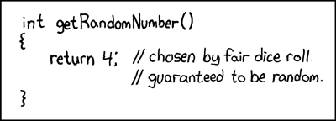
Be Careful Where You Get Your “Random Bits!”
RSA Keys Generated with weak PRG
Implementation Flaw
Unfortunately Commonplace
Resulting Keys are Vulnerable
Sophisticated Attack
Coppersmith’s Method
The Return of Coppersmith's Attack: Practical Factorization of Widely Used RSA Moduli (CCS 2017)

Slide 41
(Plain) RSA Encryption
Public Key: PK=(N,e)
Message $m∈ℤ_{N}^{}$
$$\text{Enc}\text{PK}\text{(}\text{m}\text{)}= \left[m^{e}\operatorname{mod}{N}\right]$$
Remark: Encryption is efficient if we use the power mod algorithm.

Slide 42
(Plain) RSA Decryption
Secret Key: SK=(N,d)
Ciphertext $c∈ℤ_{N}^{}$
$$\text{D}\text{e}\text{c}\text{S}\text{K}\text{(}\text{c}\text{)}= \left[c^{d}\operatorname{mod}{N}\right]$$
Remark 1: Decryption is efficient if we use the power mod algorithm.
Remark 2: Suppose that $m∈ ℤ_{N}^{∗}$ and let c=$\text{Enc}\text{PK}\text{(}\text{m}\text{)}= \left[m^{e}\operatorname{mod}{N}\right]$
$$\text{De}\text{c}\text{SK}\text{(}\text{c}\text{)}= \left[{\left(m^{e}\right)}^{d}\operatorname{mod}{N}\right]= \left[m^{ed}\operatorname{mod}{N}\right]$$
$$= \left[m^{[ed mod φ\left(N\right)]}\operatorname{mod}{N}\right]$$
$$= \left[m1\operatorname{mod}{N}\right]=m$$

Slide 43
RSA Decryption
Secret Key: SK=(N,d)
Ciphertext $c∈ℤ_{N}^{}$
$$\text{D}\text{e}\text{c}\text{S}\text{K}\text{(}\text{c}\text{)}= \left[c^{d}\operatorname{mod}{N}\right]$$
Remark 1: Decryption is efficient if we use the power mod algorithm.
Remark 2: Suppose that $m∈ ℤ_{N}^{∗}$ and let c=$\text{Enc}\text{PK}\text{(}\text{m}\text{)}= \left[m^{e}\operatorname{mod}{N}\right]$ then
$$\text{De}\text{c}\text{SK}\text{(}\text{c}\text{)}= m$$
Remark 3: Even if $m∈ℤ_{N}^{}− ℤ_{N}^{∗}$ and let $c=\text{Enc}\text{PK}\text{(}\text{m}\text{)}= \left[m^{e}\operatorname{mod}{N}\right]$ then
$$\text{De}\text{c}\text{SK}\text{(}\text{c}\text{)}= m$$
Use Chinese Remainder Theorem to show this
$$ed=1+k\left(p−1\right)\left(q−1\right)$$
$$→f\left(c^{d}\right)=\left(\left[m^{ed}\operatorname{mod}{p}\right],\left[m^{ed}\operatorname{mod}{q}\right]\right)=\left(\left[m^{1}\operatorname{mod}{p}\right],\left[m^{1}\operatorname{mod}{q}\right]\right)$$
$$→f^{−1}\left(f\left(c^{d}\right)\right)=f^{−1}\left(\left[m^{1}\operatorname{mod}{p}\right],\left[m^{1}\operatorname{mod}{q}\right]\right)=m$$

Slide 44
Plain RSA (Summary)
Public Key (pk): N = pq, e such that $GCD\left(e,φ\left(N\right)\right)=1$
$φ\left(N\right)=\left(p−1\right)\left(q−1\right)$ for distinct primes p and q
Secret Key (sk): N, d such that ed=1 mod $φ\left(N\right)$
Encrypt(pk=(N,e),m) = $m^{e} mod N$
Decrypt(sk=(N,d),c) = $c^{d} mod N$
$Decryption Works because$
$$\left[c^{d}mod N\right]=\left[m^{ed}mod N\right]=\left[m^{[ed mod φ\left(N\right)]}mod N\right]=\left[m mod N\right]$$

Slide 45
Factoring Assumption
Let GenModulus(1^{n}) be a randomized algorithm that outputs (N=pq,p,q) where p and q are n-bit primes (except with negligible probability negl(n)).
Experiment FACTOR_{A,n}
(N=pq,p,q) ← GenModulus(1^{n})
Attacker A is given N as input
Attacker A outputs p’ > 1 and q’ > 1
Attacker A wins if N=p’q’.

Slide 46
Factoring Assumption
Necessary for security of RSA.
Not known to be sufficient.
Experiment FACTOR_{A,n}
(N=pq,p,q) ← GenModulus(1^{n})
Attacker A is given N as input
Attacker A outputs p’ > 1 and q’ > 1
Attacker A wins ($\text{FACTOR}\text{A}\text{,}\text{n}=1$) if and only if N=p’q’.
$$∀PPT A ∃μ (negligible) s.t Pr\left[\text{FACTOR}\text{A}\text{,}\text{n}=1\right]≤μ(n)$$

Slide 47
RSA-Assumption
RSA-Experiment: RSA-INV_{A,n}
Run KeyGeneration(1^{n}) to obtain (N,e,d)
Pick uniform $y∈ ℤ_{N}^{∗}$
Attacker A is given N, e, y and outputs $x∈ ℤ_{N}^{∗}$
Attacker wins (RSA-INV_{A,n}=1) if $x^{e}=y mod N$
$$∀PPT A ∃μ (negligible) s.t Pr\left[\text{RSA}\text{−}\text{INVA}\text{,}\text{n} =1\right]≤μ(n)$$

Slide 48
RSA-Assumption
RSA-Experiment: RSA-INV_{A,n}
Run KeyGeneration(1^{n}) to obtain (N,e,d)
Pick uniform $y∈ ℤ_{N}^{∗}$
Attacker A is given N, e, y and outputs $x∈ ℤ_{N}^{∗}$
Attacker wins (RSA-INV_{A,n}=1) if $x^{e}=y mod N$
$$∀PPT A ∃μ (negligible) s.t Pr\left[\text{RSA}\text{−}\text{INVA}\text{,}\text{n}=1\right]≤μ(n)$$
Plain RSA Encryption behaves like a one-way function
Attacker cannot invert encryption of random message

Slide 49
Discussion of RSA-Assumption
Plain RSA Encryption behaves like a one-way-function
Decryption key is a “trapdoor” which allows us to invert the OWF
RSA-Assumption ➔ OWFs exist

Slide 50
Recap
Plain RSA
Public Key (pk): N = pq, e such that $GCD\left(e,φ\left(N\right)\right)=1$
$φ\left(N\right)=\left(p−1\right)\left(q−1\right)$ for distinct primes p and q
Secret Key (sk): N, d such that ed=1 mod $φ\left(N\right)$
Encrypt(pk=(N,e),m) = $m^{e} mod N$
Decrypt(sk=(N,d),c) = $c^{d} mod N$
$Decryption Works because$
$$\left[c^{d}mod N\right]=\left[m^{ed}mod N\right]=\left[m^{[ed mod φ\left(N\right)]}mod N\right]=\left[m mod N\right]$$

Slide 51
Mathematica Demo
https://www.cs.purdue.edu/homes/jblocki/courses/555_Spring17/slides/Lecture24Demo.nb
http://develop.wolframcloud.com/app/
Note: Online version of mathematica available at https://sandbox.open.wolframcloud.com (reduced functionality, but can be used to solve homework bonus problems)

Slide 52
(Toy) RSA Implementation in Mathematica
(* Random Seed 123456 is not secure, but it allows us to repeat the experiment *)
SeedRandom[123456]
(* Step 1: Generate primes for an RSA key *)
p = RandomPrime[{10^1000, 10^1050}];
q = RandomPrime[{10^1000, 10^1050}];
NN = p q; (*Symbol N is protected in mathematica *)
phi = (p - 1) (q - 1);
https://www.cs.purdue.edu/homes/jblocki/courses/555_Spring17/slides/Lecture24Demo.nb

Slide 53
(Toy) RSA Implementation in Mathematica
(* Step 1.A: Find e *)
GCD[phi,7]
Output: 7
(* GCD[phi,7] is not 1, so he have to try a different value of e *)
GCD[phi,3]
Output: 1
(* We can set e=3 *)
e=3;
https://www.cs.purdue.edu/homes/jblocki/courses/555_Spring17/slides/Lecture24Demo.nb

Slide 54
(Toy) RSA Implementation in Mathematica
(* Step 1.B find d s.t. ed = 1 mod N by using the extended GCD algorithm *)
(* Mathematica is clever enough to do this automatically *)
Solve[e x == 1, Modulus->phi]
Output:
{{x->36469680590663028301700626132883867272718728905205088...
…………………………………………………………………………………………………………
394069421778610209425624440980084481398131}}
(* We can now set d = x *)
d=364696805…. 8131;

Slide 55
(Toy) RSA Implementation in Mathematica
(* Double Check 1 = [ed mod $φ\left(N\right)]$ *)
Mod [e d, (p-1)(q-1)]
Output: 1
(* Encrypt the message 200, c= m^e mod N *)
m = 200;
PowerMod[m,e,NN]
Output: 8 000 000

Slide 56
(Toy) RSA Implementation in Mathematica
(* Encrypt the message 200, c= m^e mod N *)
m = 200;
PowerMod[m,e,NN]
Output: 8 000 000
(* Hm...That doesn't seem too secure *)
CubeRoot[PowerMod[m,e,NN]]
Output: 200
(* Moral: if $m^{e}<N$then Plain RSA does not hide the message m. *)

Slide 57
RSA Implementation in Mathematica
(* Encrypt a larger message, c= m^e mod N *)
SeedRandom[1234567];
m2= RandomInteger[{10^1500,10^1501}];
c=PowerMod[m2,e,NN]
Output: 405215834903772786……… 388068292685976133
(* Does it Decrypt Properly? *)
PowerMod[c,d, NN]-m2
Output: 0
(* Yes! *)

Slide 58
CS 555: Week 10: Topic 2 Attacks on Plain RSA

Slide 59
(Plain) RSA Discussion
We have not introduced security models like CPA-Security or CCA-security for Public Key Cryptosystems
However, notice that (Plain) RSA Encryption is stateless and deterministic.
→Plain RSA is not secure against chosen-plaintext attacks
As we will see Plain RSA is also highly vulnerable to chosen-ciphertext attacks

Slide 60
(Plain) RSA Discussion
However, notice that (Plain) RSA Encryption is stateless and deterministic.
→Plain RSA is not secure against chosen-plaintext attacks
Remark: In a public key setting the attacker who knows the public key always has access to an encryption oracle
Encrypted messages with low entropy are particularly vulnerable to brute-force attacks
Example: If $m<B$ then attacker can recover $m$ from $c={Enc}_{pk}\left(m\right)$after at most $B$ queries to encryption oracle (using public key)

Slide 61
Chosen Ciphertext Attack on Plain RSA
Attacker intercepts ciphertext $c=\left[m^{e}\operatorname{mod}{N}\right]$
Attacker generates ciphertext c’ for secret message 2m as follows
$\text{c}\text{’}=\left[\left(c2^{e}\right)\operatorname{mod}{N}\right]$
$=\left[\left(m^{e}2^{e}\right)\operatorname{mod}{N}\right]$
$=\left[{\left(2m\right)}^{e}\operatorname{mod}{N}\right]$
Attacker asks for decryption of $\left[c2^{e}\operatorname{mod}{N}\right]$ and receives 2m.
Divide by two to recover message
Above Example: Shows plain RSA is highly vulnerable to ciphertext-tampering attacks

Slide 62
More Weaknesses: Plain RSA with small e
(Small Messages) If m^{e} < N then we can decrypt c = m^{e} mod N directly e.g., m=c^{(1/e)}
(Partially Known Messages) If an attacker knows first 1-(1/e) bits of secret message $m=m_{1}\left\|??\right.$ then he can recover m given
$$Encrypt\left(pk,m\right)=m^{e} mod N$$
Theorem[Coppersmith]: If p(x) is a polynomial of degree e then in polynomial time (in log(N), 2e) we can find all m such that p(m) = 0 mod N and |m|<N^{(1/e)}

Slide 63
More Weaknesses: Plain RSA with small e
Theorem[Coppersmith]: If p(x) is a polynomial of degree e then in polynomial time (in log(N), e) we can find all m such that p(m) = 0 mod N and |m|<N^{(1/e)}
Example: e = 3, $m=m1\left\|m2\right.$ and attacker knows $m1\left(2k bits\right)$ and $c={\left(m1\left\|m2\right.\right)}^{e}mod N$, but not $m2\left(k bits\right)$
$$p\left(x\right)={\left(2^{k}m1+x\right)}^{3}−c$$
Polynomial has a small root mod N at x= $m2$ and coppersmith’s method will find it!
D. Coppersmith (1996). "Finding a Small Root of a Univariate Modular Equation".

Slide 64
More Weaknesses: Plain RSA with small e
Theorem[Coppersmith]: Can also find small roots of bivariate polynomial $p\left(x_{1},x_{2}\right)$
Similar Approach used to factor weak RSA secret keys N=q₁q₂
Weak PRG → Can guess many of the bits of prime factors
Obtain $\tilde{q_{1}}≈q_{1}$ and $\tilde{q_{2}}≈q_{2}$
Coppersmith Attack: Define polynomial p(.,.) as follows
$$p\left(x_{1},x_{2}\right)=\left(x_{1}+\tilde{q_{1}}\right)\left(x_{2}+\tilde{q_{2}}\right)−N$$
Small Roots of $p\left(x_{1},x_{2}\right)$: $x_{1}=q_{1}−\tilde{q_{1}}$ and $x_{2}=q_{2}−\tilde{q_{2}}$
D. Coppersmith (1996). "Finding a Small Root of a Bivariate Integer Equation; Factoring with high bits known"

Slide 65
The Return of Coppersmith's Attack: Practical Factorization of Widely Used RSA Moduli (CCS 2017)

Slide 66
RSA-Assumption
RSA-Experiment: RSA-INV_{A,n}
Run KeyGeneration(1^{n}) to obtain (N,e,d)
Pick uniform $y∈ ℤ_{N}^{∗}$
Attacker A is given N, e, y and outputs $x∈ ℤ_{N}^{∗}$
Attacker wins (RSA-INV_{A,n}=1) if $x^{e}=y mod N$
$$∀PPT A ∃μ (negligible) s.t Pr\left[\text{RSA}\text{−}\text{INVA}\text{,}\text{n} =1\right]≤μ(n)$$

Slide 67
(Plain) RSA Discussion
However, notice that (Plain) RSA Encryption is stateless and deterministic.
→Plain RSA is not secure against chosen-plaintext attacks
In a public key setting the attacker does have access to an encryption oracle
Encrypted messages with low entropy are vulnerable to a brute-force attack.

Slide 68
Fixes for Plain RSA
Approach 1: RSA-OAEP
Incorporates random nonce r
CCA-Secure (in random oracle model)
Approach 2: Use RSA to exchange symmetric key for Authenticated Encryption scheme (e.g., AES)
Key Encapsulation Mechanism (KEM)
More details in future lectures…stay tuned!
For now we will focus on attacks on Plain RSA

Slide 69
Chinese Remainder Theorem
Theorem: Let N = pq (where gcd(p,q)=1) be given and let ${f:ℤ}_{N}^{}→ℤp×ℤq$ be defined as follows
$$f\left(x\right)=\left([x mod p],[x mod q]\right)$$
then
f is a bijective mapping (invertible)
f and its inverse$f^{−1}:ℤp×ℤq→ℤ_{N}^{}$ can be computed efficiently
$f\left(x+y\right)=f\left(x\right)+f(y)$
The restriction of f to $ℤ_{N}^{∗}$ yields a bijective mapping to $ℤ_{p}^{∗}×ℤ_{q}^{∗}$
For inputs ${x,y∈ℤ}_{N}^{∗}$ we have $f\left(x\right)f\left(y\right)=f\left(xy\right)$

Slide 70
Chinese Remainder Theorem
Application of CRT: Faster computation
Example: Compute [11⁵³ mod 15]
f(11)=([-1 mod 3],[1 mod 5])
f(11⁵³) =([(-1)⁵³ mod 3],[1⁵³ mod 5])= (-1,1)
$f^{−1}$(-1,1)=11
Thus, 11=[11⁵³ mod 15]

Slide 71
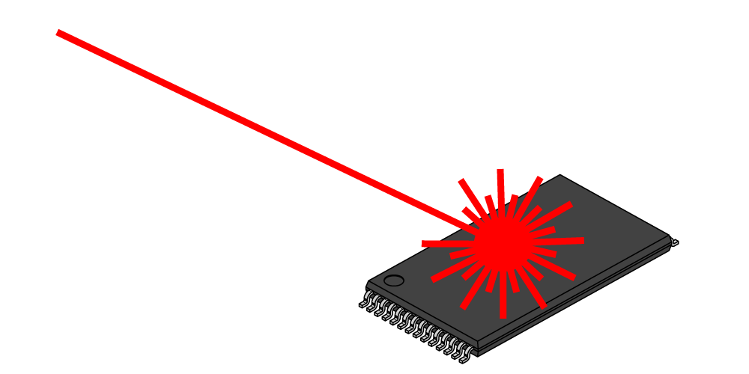
A Side Channel Attack on RSA with CRT
Suppose that decryption is done via Chinese Remainder Theorem for speed.
$${Dec}_{sk}^{}\left(c\right)=c^{d} mod N↔\left(c^{d} mod p,c^{d} mod q\right)$$
Attacker has physical access to smartcard
Can mess up computation of $c^{d} mod p$
Response is $R↔\left(r,c^{d} mod q\right)$
$R−m↔\left(r−m mod p,0 mod q\right)$
GCD(R-m,N)=q

Slide 72
Recovering Encrypted Message faster than Brute-Force
Claim: Let m < 2^{n} be a secret message. For some constant $α=\frac{1}{2}+ε.$ We can recover m in in time ${T=2}^{αn}$ with high probability.
For r=1,…,T
let $xr=\left[cr^{−e}mod N\right]$, where $r^{−e}={\left(r^{−1}\right)}^{e}mod N$
Sort $L={\left\{\left(r,x_{r}\right)\right\}}_{r=1}^{T}$ (by the x_{r} values)
For s=1,…,T
if $\left[s^{e}mod N\right]=x_{r}$ for some r then
return $\left[rs mod N\right]$

Slide 73
Recovering Encrypted Message faster than Brute-Force
For r=1,…,T
let $xr=\left[cr^{−e}mod N\right]$, where $r^{−e}={\left(r^{−1}\right)}^{e}mod N$
Sort $L={\left\{\left(r,x_{r}\right)\right\}}_{r=1}^{T}$ (by the x_{r} values)
For s=1,…,T
if $\left[s^{e}mod N\right]=x_{r}$ for some r then
return $\left[rs mod N\right]$
Analysis: $\left[rs mod N\right]=\left[r\left(s^{e}\right)d mod N\right]=\left[r\left(xr\right)d mod N\right]$
$$=\left[r\left(cr^{−e}\right)d mod N\right]=\left[rr^{−ed}\left(c\right)d mod N\right]$$
$$=\left[rr^{−1}m mod N\right]=m$$

Slide 74
Recovering Encrypted Message faster than Brute-Force
For r=1,…,T
let $xr=\left[cr^{−e}mod N\right]$, where $r^{−e}={\left(r^{−1}\right)}^{e}mod N$
Sort $L={\left\{\left(r,x_{r}\right)\right\}}_{r=1}^{T}$ (by the x_{r} values)
For s=1,…,T
if $\left[s^{e}mod N\right]=x_{r}$ for some r then
return $\left[rs mod N\right]$
Fact: some constant $α=\frac{1}{2}+ε$ setting ${T=2}^{αn}$ with high probability we will find a pair s and x_{r} with $\left[s^{e}mod N\right]=xr$.

Slide 75
Recovering Encrypted Message faster than Brute-Force
Claim: Let m < 2^{n} be a secret message. For some constant $α=\frac{1}{2}+ε.$ We can recover m in in time ${T=2}^{αn}$ with high probability.
Roughly $\sqrt{B}$ steps to find a secret message m < B

Slide 76
CS 555: Week 10: Topic 3 Discrete Log + DDH Assumption

Slide 77
(Recap) Finite Groups
Definition: A (finite) group is a (finite) set $𝔾$with a binary operation $∘$ (over G) for which we have
(Closure:) For all $g,h∈𝔾$ we have $g∘h∈𝔾$
(Identity:) There is an element $e∈𝔾$ such that for all $g∈𝔾$ we have
$$g∘e=g=e∘g$$
(Inverses:) For each element $g∈𝔾$ we can find $h∈𝔾$ such that $g∘h=e$. We say that h is the inverse of g.
(Associativity: ) For all $g1,g2,g3∈𝔾$ we have
$$\left(g1∘g2\right)∘g3=g1∘\left(g2∘g3\right)$$
We say that the group is abelian if
(Commutativity:) For all $g,h∈𝔾$ we have $g∘h=$ $h∘g$

Slide 78
Finite Abelian Groups (Examples)
Example 1: $ℤ_{N}^{}$ when $∘$ denotes addition modulo N
Identity: 0, since 0 $∘$x =[0+x mod N] = [x mod N].
Inverse of x? Set x⁻¹=N-x so that [x⁻¹+x mod N] = [N-x+x mod N] = 0.
Example 2: $ℤ_{N}^{∗}$ when $∘$ denotes multiplication modulo N
Identity: 1, since 1$∘$x =[1(x) mod N] = [x mod N].
Inverse of x? Run extended GCD to obtain integers a and b such that
$$ax+bN=\gcd\left(x,N\right)=1$$
Observe that: x⁻¹ = a. Why?

Slide 79
Cyclic Group
Let $𝔾 be a group with order m=\left|𝔾\right|$with a binary operation $∘$ (over G) and let $g∈𝔾$ be given consider the set
$$\left\langle g\right\rangle =\left\{g0,g1,g2,…\right\}$$
Fact: $\left\langle g\right\rangle$ defines a subgroup of $𝔾.$
Identity: $g0$
Closure: $gi∘gj=g^{i+j}∈\left\langle g\right\rangle$
g is called a “generator” of the subgroup.
Fact: Let $r=\left|\left\langle g\right\rangle \right|$ then $g^{i }=gj$ if and only if $i=j mod r$. Also m is divisible by r.

Slide 80
Finite Abelian Groups (Examples)
Fact: Let p be a prime then $ℤ_{p}^{∗}$ is a cyclic group of order p-1.
Note: Number of generators g s.t. of $\left\langle g\right\rangle =ℤ_{p}^{∗}$ is $φ\left(p−1\right)$
Example (non-generator): p=7, g=2
<2>={1,2,4}
Example (generator): p=7, g=5
<2>={1,5,4,6,2,3}

Slide 81
Discrete Log Experiment DLog_{A,G}(n)
Run G(1^{n}) to obtain a cyclic group $𝔾$ of order q (with $\left\|q\right\|=n$) and a generator g such that $<g>=𝔾$.
Select$h∈𝔾$ uniformly at random.
Attacker A is given $𝔾$, q, g, h and outputs integer x.
Attacker wins (DLog_{A,G}(n)=1) if and only if g^{x}=h.
We say that the discrete log problem is hard relative to generator G if
$$∀PPT A ∃μ (negligible) s.t Pr\left[\text{DLog}\text{A}\text{,}\text{n} =1\right]≤μ(n)$$

Slide 82
Diffie-Hellman Problems
Computational Diffie-Hellman Problem (CDH)
Attacker is given $h1=g^{x_{1}}∈𝔾$ and $h2=g^{x_{2}}∈𝔾.$
Attackers goal is to find${ g}^{x_{1}x_{2}}={\left(h1\right)}^{x_{2}}={\left(h2\right)}^{x_{1}}$
CDH Assumption: For all PPT A there is a negligible function negl upper bounding the probability that A succeeds with probability at most negl(n).
Decisional Diffie-Hellman Problem (DDH)
L$et z0={ g}^{x_{1}x_{2}}$ and let $z1={ g}^{r}$, where x₁,x₂ and r are random
Attacker is given $g^{x_{1}}$, $g^{x_{2}}$ and $zb$ (for a random bit b)
Attackers goal is to guess b
DDH Assumption: For all PPT A there is a negligible function negl such that A succeeds with probability at most ½ + negl(n).

Slide 83
Secure key-agreement with DDH
Alice publishes ${ g}^{xA}$ and Bob publishes ${ g}^{xB}$
Alice and Bob can both compute ${K_{A,B}=g}^{xB xA}$ but to Eve this key is indistinguishable from a random group element (by DDH)
Remark: Protocol is vulnerable to Man-In-The-Middle Attacks if Bob cannot validate ${ g}^{xA}$.

Slide 84
Can we find a cyclic group where DDH holds?
Example 1: $ℤ_{p}^{∗}$ where p is a random n-bit prime.
CDH is believed to be hard
DDH is *not* hard (Exercise 13.15)
Theorem: $Let$p=rq+1 be a random n-bit prime where q is a large $λ$-bit prime then the set of r^{th} residues modulo p is a cyclic subgroup of order q. Then $𝔾_{r}=\left\{[h^{r}mod p] | {h∈ℤ}_{p}^{∗}\right\}$is a cyclic subgroup of $ℤ_{p}^{∗}$ of order q.
Remark 1: DDH is believed to hold for such a group
Remark 2: It is easy to generate uniformly random elements of $𝔾_{r}$
Remark 3: Any element (besides 1) is a generator of $𝔾_{r}$

Slide 85
Can we find a cyclic group where DDH holds?
Theorem: $Let$p=rq+1 be a random n-bit prime where q is a large $λ$-bit prime then the set of rth residues modulo p is a cyclic subgroup of order q. Then $𝔾_{r}=\left\{[h^{r}mod p] | {h∈ℤ}_{p}^{∗}\right\}$is a cyclic subgroup of $ℤ_{p}^{∗}$ of order q.
Closure: $hrgr={\left(hg\right)}^{r}$
Inverse of $hr$ is ${\left(h^{−1}\right)}^{r}∈𝔾_{r}$
Size ${\left(hr\right)}^{x}=h^{[rx mod rq]}={{\left(hr\right)}^{x}=h}^{r[x mod q]}={\left(hr\right)}^{[x mod q]}mod p$
Remark: Two known attacks on Discrete Log Problem for $𝔾_{r}$(Section 9.2).
First runs in time $O\left(\sqrt{q}\right)=O\left(2^{λ/2}\right)$
Second runs in time $2^{O\left(\sqrt[3]{n}{\left(\log{n}\right)}^{2/3}\right)}$

Slide 86
Can we find a cyclic group where DDH holds?
Remark: Two known attacks (Section 9.2).
First runs in time $O\left(\sqrt{q}\right)=O\left(2^{λ/2}\right)$
Second runs in time $2^{O\left(\sqrt[3]{n}{\left(\log{n}\right)}^{2/3}\right)},$where n is bit length of p
Goal: Set $λ$ and n to balance attacks
$$λ=O\left(\sqrt[3]{n}{\left(\log{n}\right)}^{2/3}\right)$$
How to sample p=rq+1?
First sample a random $λ$-bit prime q and
Repeatedly check if rq+1 is prime for a random n- $λ$ bit value r

Slide 87
Can we find a cyclic group where DDH holds?
Elliptic Curves Example: Let p be a prime (p > 3) and let A, B be constants. Consider the equation
$$y2=x3+Ax+B mod p$$
And let
$$E\left(ℤ_{p}^{}\right)=\left\{\left(x,y\right)∈ℤ_{p}^{2} | y2=x3+Ax+B mod p \right\}∪\left\{𝒪\right\}$$
Note: $𝒪$ is defined to be an additive identity $\left(x,y\right)+𝒪=\left(x,y\right)$
W$hat is \left(x1,y1\right)+\left(x2,y2\right)?$

Slide 88
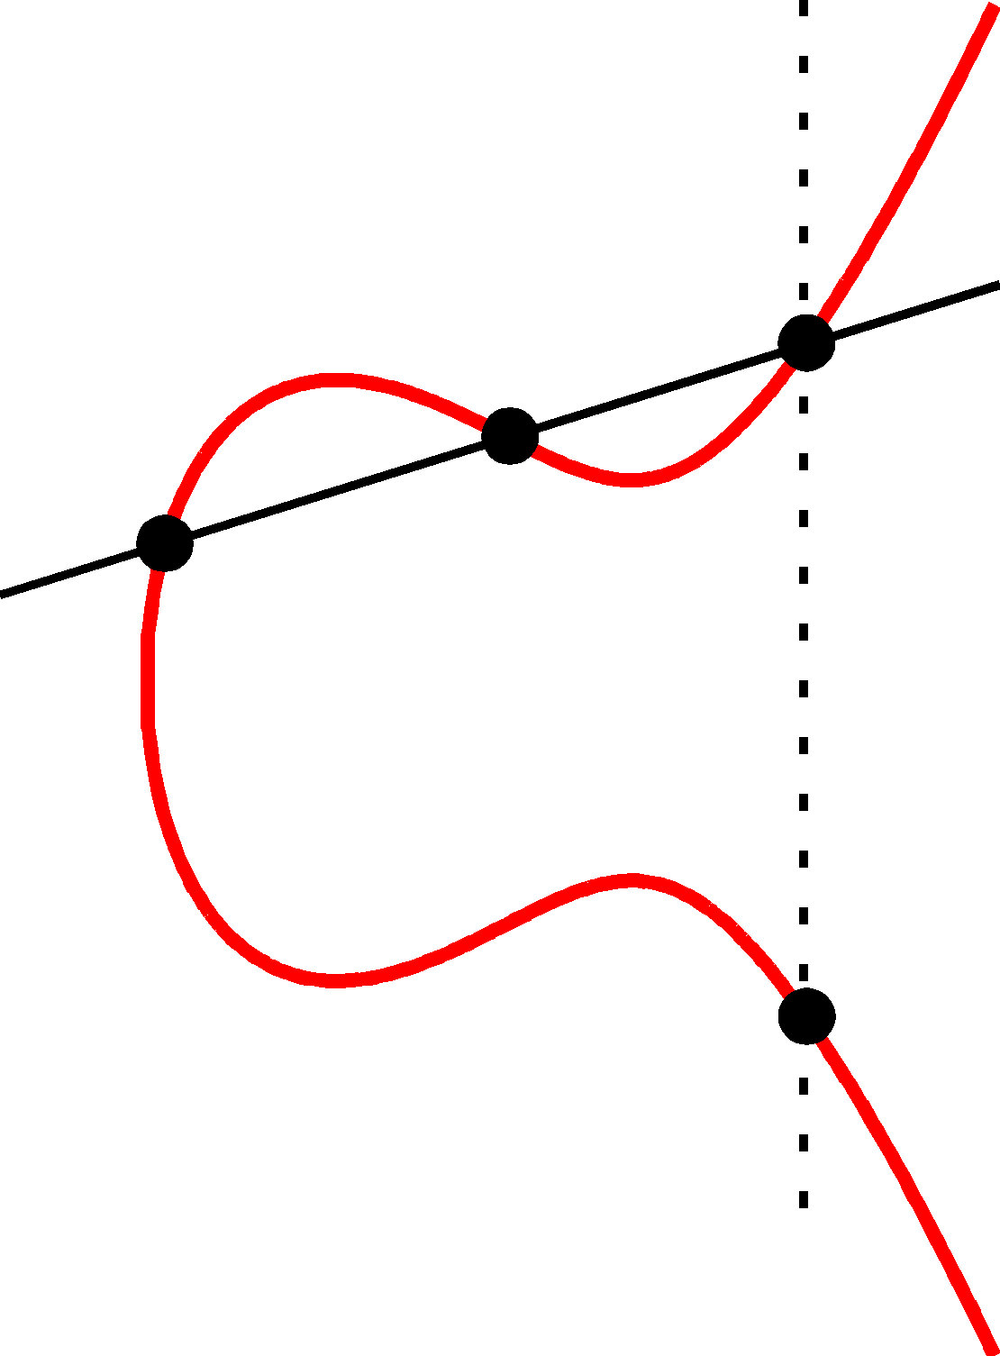
Elliptic Curve Example
$$\left(x2,y2\right)$$
(x₃,y₃)
The line passing through $\left(x1,y1\right)$ and $\left(x2,y2\right)$ has the equation
$$y=m\left(x−x1\right)+y1 mod P$$
Where the slope
$$m=\left[\frac{y1−y2}{x1−x2} mod p\right]$$
$$\left(x1,y1\right)$$
(x₃,-y₃)=$\left(x1,y1\right)+\left(x2,y2\right)$

Slide 89
Elliptic Curve Example
$$\left(x2,y2\right)$$
(x₃,y₃)
$$\left(x1,y1\right)$$
Formally, let
$$m=\left[\frac{y1−y2}{x1−x2} mod p\right]$$
Be the slope. Then the line passing through $\left(x1,y1\right)$ and $\left(x2,y2\right)$ has the equation
$$y=m\left(x−x1\right)+y1 mod P$$
$$\left(m\left(x−x1\right)+y1\right)2=x3+Ax+B mod p$$
(x₃,-y₃)=$\left(x1,y1\right)+\left(x2,y2\right)$
$$x3=[m2−x1−x2 mod p]$$
$$y3=[m\left(x3−x1\right)+y1 mod p]$$

Slide 90
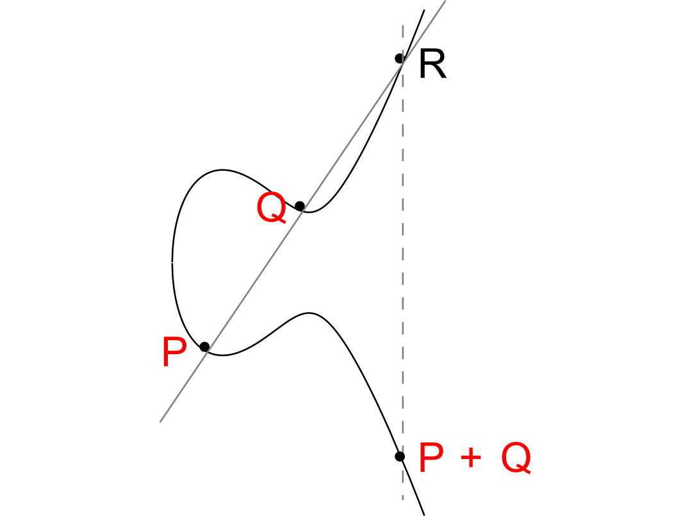

Slide 91
Elliptic Curve Example
No third point R on the elliptic curve.
P+Q = 0
(Inverse)

Slide 92
Can we find a cyclic group where DDH holds?
Elliptic Curves Example: Let p be a prime (p > 3) and let A, B be constants. Consider the equation
$$y2=x3+Ax+B mod p$$
And let
$$E\left(ℤ_{p}^{}\right)=\left\{\left(x,y\right)∈ℤ_{p}^{2} | y2=x3+Ax+B mod p \right\}∪\left\{𝒪\right\}$$
Fact: $E\left(ℤ_{p}^{}\right)$ defines an abelian group
For appropriate curves the DDH assumption is believed to hold
If you make up your own curve there is a good chance it is broken…
NIST has a list of recommendations

