Slide 1
Overview of Markov chains
David Gleich
Purdue University
Network & Matrix Computations
Computer Science
15 Sept 2011

Slide 2
Lots of words
transient
recurrent
primitive
regular
ergodic
periodic
irreducible
Perron root
Perron vector
stationary distribution
first transition analysis
Cesáro limit
reversible Markov chain
simple stationary distribution
Perron-Frobenius theorem

Slide 3
Some theory
Theorem Let A ≥ 0 be irreducible then A has a unique positive eigenvector with eigenvalue equal to the spectral radius of A.

Slide 4
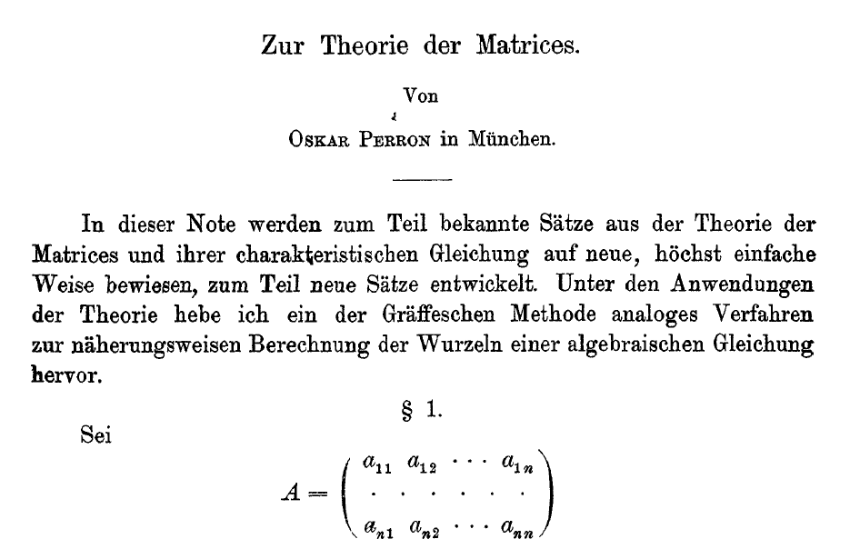
In German
Oskar Perron, Mathematische Annalen, 64:248-263, 1907 doi: 10.1007/BF01449896

Slide 5
Just kidding

Slide 6
Important application
PageRank
centrality measures
spectral graph theory
random sampling

Slide 7
Probable outline
Stochastic processes, Markov chains, and random walks, and stochastic matrices
The Perron-Frobenius theorem and stationary distribution
Hitting times, commute times, and other transition related problems

