Slide 1

Northrop Grumman TechFest
Privacy Preserving Cross-Domain Data Dissemination
(with adaptable service selection)
June 2015
PI: Prof. Bharat Bhargava
Purdue University
Technical Champions: Dr. Sunil Lingayat, Mr. Jason C. Kobes

Slide 2

End-to-End Security in Trusted and Untrusted SOA and Cloud
Service request
Browser
Insecure browser
analyze request source based on W3C standards
Secure browser
CAC
authentication
PIN
Send active
bundle to cloud
for execution
Trust = X + Y
Trust = X
execute active
bundle in cloud
Low trust
High trust
Active Bundle
Service Domain
Service X
Data access
request
Encrypted
search
Data
Service X
is authorized
to access
Data
request
Filtered/lower
quality data
Filtered search
results
Active Bundle
UNTRUSTED
TRUSTED

Slide 3
End-to-End Information Flow
Client sends request to the service using browser and shares data by means of Active Bundle (AB)
Service checks the request source (secure or insecure browser)
  Based on W3C Crypto standards
Service executes AB in Cloud if created by an insecure browser
Service interacts with AB and requests data
AB behaves differently under different contexts
  Full data dissemination based on service authorization/trust level
  Context-based partial data dissemination based on insufficient authorization level
  No data dissemination for unauthorized access/attacks
Cross-domain information exchange with trustworthy/untrustworthy subscribers
  Data dissemination is done on a “need to know” basis by limiting the disclosure of decryption keys
  Incremental disclosure of keys based on increase in the “need”

Slide 4
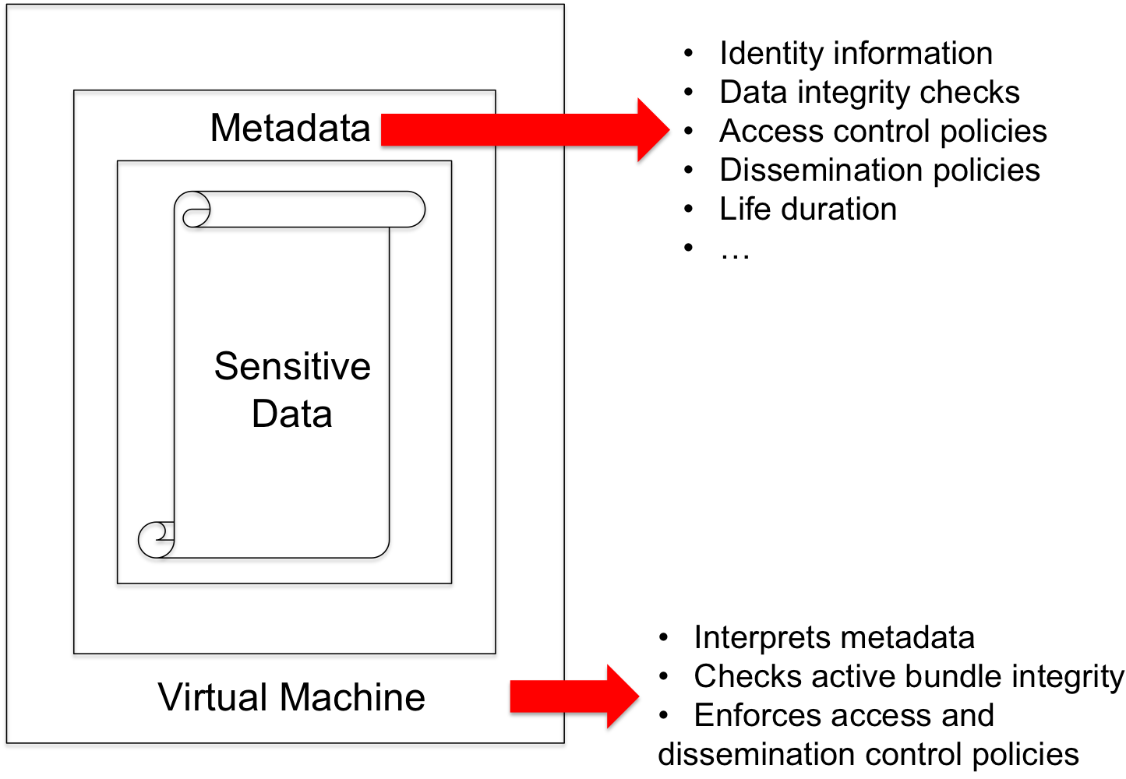
Active Bundle
Active Bundle (AB) approach for secure data dissemination
  Self-protecting data encapsulation
  mechanism
  Provides secure cross-domain
  information exchange
Sensitive data
  Encrypted data items
Metadata
  Access control and operational
  policies
Virtual Machine
  Protection mechanism (self-integrity check)
  Policy evaluation, enforcement and data dissemination

Slide 5



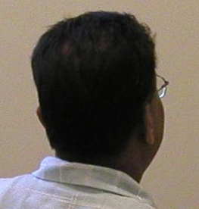

Example of Controlled Data Distortion
Distorted data reveal less, protects privacy
Examples:
  accurate data more and more distorted data
  250 N. Salisbury Street
  West Lafayette, IN
  250 N. Salisbury Street
  West Lafayette, IN
  [home address]
  765-123-4567
  [home phone]
  Salisbury Street
  West Lafayette, IN
  250 N. University Street
  West Lafayette, IN
  [office address]
  765-987-6543
  [office phone]
  somewhere in
  West Lafayette, IN
  P.O. Box 1234
  West Lafayette, IN
  [P.O. box]
  765-987-4321
  [office fax]

Slide 6
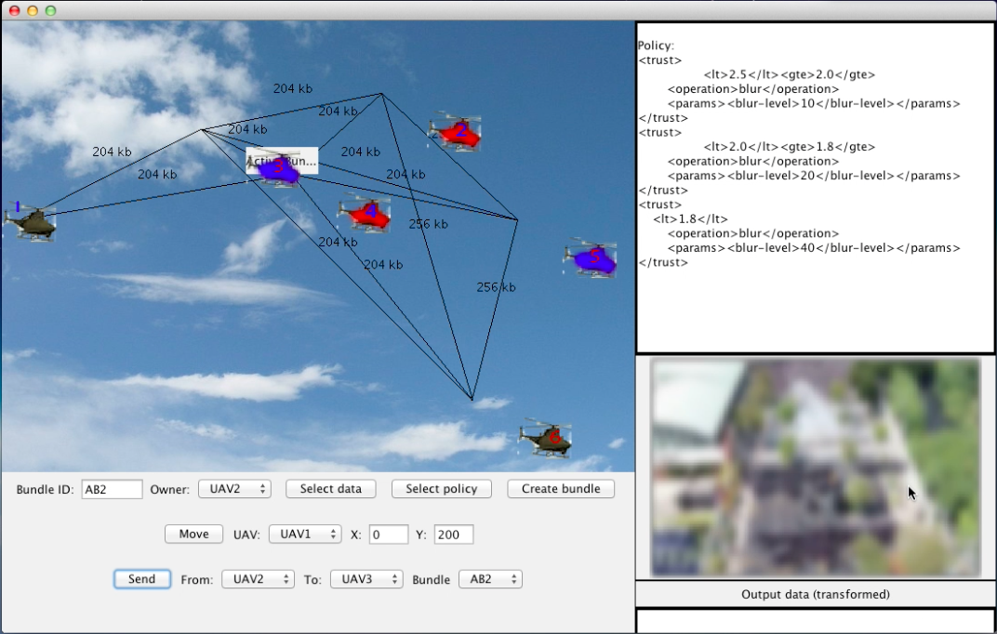
P2P Secure Data Sharing in UAV Network
Each UAV creates active bundle with captured image data and trust-based dissemination policies
When active bundle is sent to a UAV, image data is filtered (blurred) based on trust level
Trust levels of UAVs change based on context, distance, communication bandwidth

Slide 7




P2P Secure Data Sharing in UAV Network
Original image
Dissemination Policy:
If 2.5 > trust ≥ 2.2 => blur level = 20
If 2.2 > trust ≥ 2.0 => blur level = 40
If 2.0 > trust => blur level = 80
trust = 2.4
trust = 2.1
trust = 1.5

Slide 8
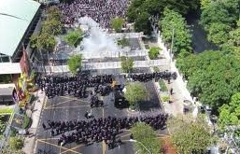

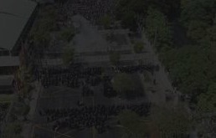

P2P Secure Data Sharing in UAV Network
Original image
Dissemination Policy:
If context = emergency => contrast = 0.4
If 2.5 > trust ≥ 2.2 => contrast = 0.2
If 1.8 > trust => contrast = 0.1
trust = 2.0
context = emergency
trust = 2.4
trust = 1.7

Slide 9



Example of Controlled Data Filtering of Electronic Healthcare Record (EHR)
EHRs stored in a database and filtered for different data consumers using SQL queries run in the AB’s VM
a. Data consumer verified as doctor at the hospital can get all patient data
b. Hospital Receptionist gets filtered data
c. Insurance company gets only the minimal required data

Slide 10
Cross-Domain Data Dissemination
(disclosure based on classification level)
UAV 1
Infrared imagery
Location coordinates
UAV 2
Multispectral imagery
Location coordinates
UAV 3
Time period
Deployed personnel
Target locations
Intelligence reports
Mission expenses
Deployed weapons
Casualties
Press Release
Command
& Control
Time period
Deployed personnel
Target locations
Intelligence reports
Mission expenses
Deployed weapons
Casualties
Press Release
Top Secret
Secret
Confidential
Unclassified
Target locations
Intelligence reports
Mission expenses
Deployed weapons
Press Release
Mission expenses
Press Release
Press Release

Slide 11
Context-based Data Dissemination
(disclosure during emergency context)
Medical data
Medical history
E(Patient ID)
E(Insurance ID)
E(Medical test prescription)
E(Prescription)
E(Treatment code)
Emergency context
Data access: GRANTED
Patient ID
Medical data
Medical history
Medical test prescription
Prescription
E(Insurance ID)
E(Treatment code)
Paramedic’s
App
Doctor’s
App
Active
Bundle
Active
Bundle
Active
Bundle
Medical
Information
System
Laboratory’s
App
Patient ID
Insurance ID
Treatment code
E(Medical data)
E(Medical history)
E(Medical test prescription)
E(Prescription)
Patient ID
Medical test prescription
E(Medical data)
E(Insurance ID)
E(Medical history)
E(Prescription)
E(Treatment code)
Active
Bundle
Active
Bundle
Patient ID
Insurance ID
Medical data
Medical history
Medical test
prescription
Prescription
Treatment code
Pharmacy’s
App
Insurance’s
App
Patient ID
Prescription
E(Medical data)
E(Insurance ID)
E(Medical history)
E(Medical test prescription)
E(Treatment code)

Slide 12

Trust-based Data Dissemination
(access based on trust level)
Name
Email
Credit card type
Credit card
Shipping preference
Mailing address
SERVICE MONITOR
Trust
Request
order
request
+
Trust
Request
Trust
level: 5
Trust
level: 1
1
Active
Bundle
Low trust level of Seller Data access: DENIED
Name
Email
Payment type
E(Credit card)
E(Shipping preference)
E(Mailing address)
verify
request
Active
Bundle
+
Shopping
Service
Seller
Service
2
Payment
Service
Shipping
Service

Slide 13
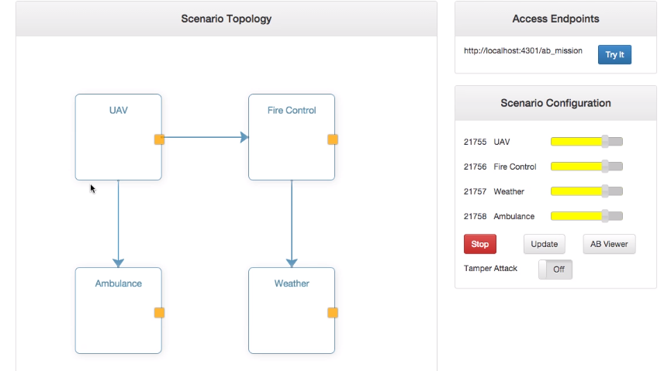
Trusted vs. Untrusted Service Invocation
UAV on search and rescue mission for a fire hazard
When invoked from secure browser, active bundle is sent to each involved service domain
(Fire Control, Ambulance, Weather), so they access data they are authorized for.

Slide 14
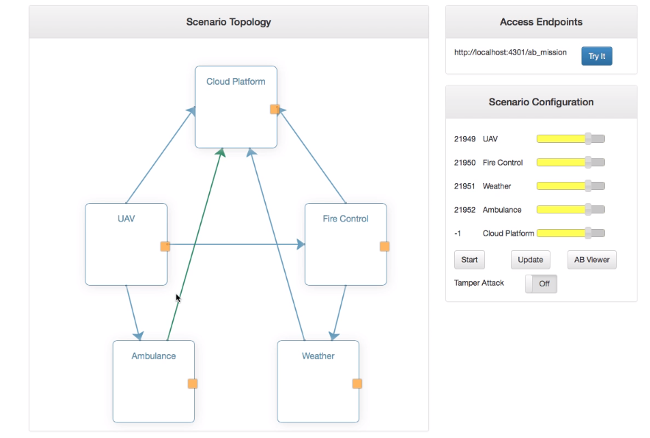
Trusted vs. Untrusted Service Invocation (cont.)
When invoked from insecure browser, active bundle is sent to the cloud and each service
(Fire Control, Ambulance, Weather), interacts with active bundle in the cloud for data access.

Slide 15
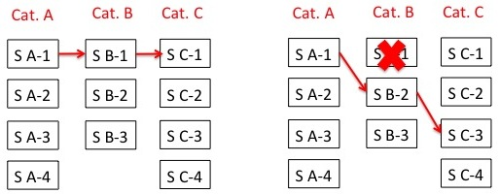
Dynamic Service Composition Reconfiguration
An SOA service orchestration is composed of a series of services that interact with each other based on a service interaction graph
Select services in each category for specific functionality, for e.g., category: Weather, services: Accuweather, Yahoo weather
Dynamic service composition reconfiguration is based on changes in context and type, duration, extent of attacks and failures
Goal: Given a set of service categories (each with a set of services), a set of security constraints, a set of target performance parameters; Create a service composition that complies with the given security constraints and has best performance
Approach:
Sort services in each category based on given performance parameters
Select highest performing service from each category to form a composition
Check composition against given security constraints and switch to alternate services if the constraints are not satisfied (acceptance test fails)

Slide 16
Technical Approach Overview
Service Monitor
Active Bundle
Service 1
request
Instrumentation
Passive
Passive Listener
Passive Monitoring Algorithms
Active
Interaction Authorization Algorithms
Active Listener
request
(if authorized)
Active Bundle State Listener
response
request
Service 2
Heartbeat & Inflow Listener
Policies
Dynamic Service Composition
reconfiguration
Anomaly Detection
Trust Management
Service monitor intercepts all client-service/service-service interactions.
The approach aims to provide a unified security architecture for SOA and cloud by integrating components for:
  Service trust management
  Interaction authorization between different services
  Anomaly detection based on service behavior
  Dynamic service composition
  Secure data dissemination using active bundles

