Slide 1
Reasoning and Detecting Collaborative Attacks in Autonomous UAV Networks
Bharat Bhargava

Slide 2
Growing Autonomous UAV Network Market
Autonomous UAV networks are gaining increasing prevalence.
  The UAV market will reach 100 billion USD by 2030. [1]
Their growing prevalence demands robust security, especially against collaborative attacks.
Notes:
The rapid growth of the UAV market is projected to reach $100 billion by 2030.
As UAVs become more prevalent in commercial, civil, and military applications, ensuring their security becomes a top priority.
This increasing scale also raises the stakes for potential cyber and physical threats, particularly collaborative ones.

Slide 3
Autonomous UAV Network Security
Inherit fundamental security vulnerabilities from traditional autonomous networks, while facing unique challenges
  Wireless nature
  Highly dynamic topology
  Rapid node mobility
  Communication disruptions and packet losses
Thus, it is important to develop robust security mechanisms for autonomous UAV networks.
These characteristics make them more vulnerable to collaborative attacks.
Notes:
UAV networks inherit challenges from traditional wireless networks and face new ones: mobility, dynamic topologies, and wireless link instability.
These characteristics make them especially vulnerable to collaborative attacks, which exploit their distributed and resource-constrained nature.
There is the need for new, robust security mechanisms that account for these unique features.

Slide 4
Collaborative Attack Definition
Multiple adversaries coordinate and synchronize their actions to achieve disruption, deception, or usurpation of the target network.
It is a threat that will be exacerbated by the increasing availability of commercial off-the-shelf (COTS) UAV platforms.
Implications
  Attackers can simultaneously compromise multiple UAVs within a network to wage attacks that exceed the capabilities of individual adversaries, such as co- ordinated jamming combined with false data injection.
  Multiple attackers may employ different attack vectors concurrently, forcing the network to defend against diverse threats simultaneously.
Notes:
Define collaborative attacks: where multiple adversaries coordinate their actions to disrupt, deceive, or take over a network.
Such attacks are becoming more feasible due to cheap, widely available UAV platforms.
Examples are coordinated jamming or combining different attack vectors (e.g., false data injection with routing disruption).

Slide 5
Collaborative Attacks
What are Collaborative Attacks?
  DDoS Attacks [2]
  Coordinated Eavesdropping [3]
Why are they Important?
  They are more harmful to the network
    Amplifying Effect
    Shortcut Effect
  They are harder to detect and defend
    Hiding Effect
  The above effects are dubbed synergy effects (SEs)
Notes:
These attacks are particularly dangerous:
Amplifying Effect: Collective damage is more than the sum of parts.
Shortcut Effect: Faster achievement of adversary goals.
Hiding Effect: Attacks are more stealthy and harder to detect.
These are referred to as “synergy effects” which we will explore in more depth.

Slide 6
Proposed Tasks
Task 1: Defining Collaborative Attacks against Autonomous UAV Networks
  Develops formal system and threat models for collaborative attacks against autonomous UAV networks, while establishing experimental validation approaches.
  Three subtasks include:
    characterizing system models that capture the features and resource constraints of autonomous UAV networks,
    formulating threat models that define the capabilities and coordination patterns of collaborative attackers, and
    developing comprehensive approaches for experimental validation of both attacks and defenses.
Notes:
Task 1: Define formal system and threat models to systematically study collaborative attacks.
These models help understand how attackers coordinate and what resources UAVs have to defend themselves.

Slide 7
Proposed Tasks
Task 2: Designing Mechanisms to Secure Autonomous UAV Networks against Collaborative Attacks
  Resource-constrained UAVs require a lightweight, onboard filtering mechanism to handle high-volume traffic loads, for which we employ lightweight machine learning (ML) models as the initial detection layer.
  The filtered alerts are then processed with two complementary tracks: an instant analysis track and a long-term analysis track.
    Instant track: alerts trigger security verification against defined attack models using model checking technology to identify immediate threats.
    Long-term track: employs sequential and attention-based ML techniques to uncover complex temporal dependencies between alerts that may indicate coordinated adversarial behavior.
Notes:
Task 2: Design lightweight, multi-layered defense mechanisms.
Onboard ML filters handle traffic first.
2. Two analysis tracks:
Instant analysis (e.g., rule-based or formal checking).
Long-term analysis (e.g., temporal patterns via deep learning).

Slide 8
Proposed Tasks
Task 2: Designing Mechanisms to Secure Autonomous UAV Networks against Collaborative Attacks (continued)
  The discovered long-term attack patterns are then fed back into the model checker for pattern analysis.
    This creates a closed-loop system where model checking discovers attack patterns that guide the refinement of ML models
Notes:
These allow real-time detection as well as learning from evolving patterns.

Slide 9
Proposed Tasks
Task 3: Designing Defense Framework to Counter Collaborative Attacks
  We exemplify the approach through a framework designed for a centralized autonomous UAV network topology.
  It serves as a baseline example — through this project, the research will explore framework variations including decentralized architectures, hybrid networks with ground vehicles, and other topological configurations.
  The modular design ensures the research not only validates the core detection mechanisms but also establishes foundations for adapting the framework to diverse autonomous UAV network deployments.
Notes:
Task 3: Design a flexible defense framework applicable across different UAV network topologies.
We begin with a centralized model but aim for adaptability to decentralized or hybrid networks.
Our framework has modularity so components can be reused and extended.

Slide 10
Task 1: Developing System Model of Autonomous UAV Networks
Autonomous UAV networks also include ground vehicles and other autonomous aircraft (see figure in next slide).
The network can operate in various configurations:
  networks with and without ground vehicle nodes,
  fully autonomous versus human-supervised operations, and
  centralized versus decentralized control structures.
Each configuration presents distinct security implications and requires tailored defensive approaches.
Furthermore, we should consider dynamic network membership, where nodes can join or leave during task.
Notes:
We consider different configurations—centralized, decentralized, with or without ground vehicles.
Each configuration influences threat exposure and response strategies.
Our study also includes the concept of dynamic node participation, which is a common feature in real-world UAV tasks.

Slide 11
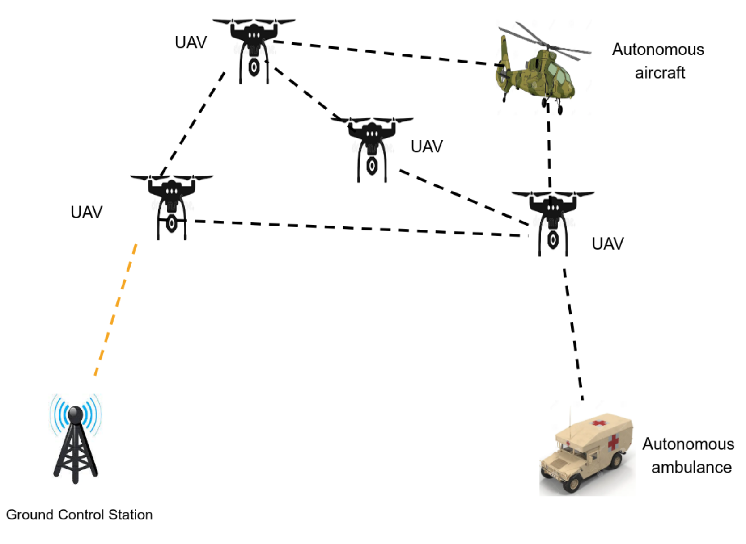
An Autonomous UAV Networks with Ground Vehicles and Other Autonomous Aircrafts
Notes:
The network is heterogeneous and includes air and ground components.
Defense strategies must account for these varied entities and their communication behaviors.

Slide 12
Limitations of Prior Works
Traditional defense mechanisms are inadequate because they focus on detecting and mitigating individual attack patterns rather than identifying the subtle interplay between multiple coordinated adversaries.
  For example, attackers deliberately distribute their malicious activities across multiple nodes to stay below detection thresholds or employ complementary attack methods that mask each other’s signatures.
Prior research on collaborative attacks
  focused primarily on developing detection and defense strategies for traditional networks,
  failing to address the resource limitations inherent to UAV platforms, their limited energy capacity and limited onboard computational capabilities.
These constraints affect the feasibility and effectiveness of security solutions, as resource-intensive defense mechanisms can potentially compromise the network’s operational lifetime and mission capabilities.
Notes:
Previous works most focus on single-node or single-attack scenarios, missing the subtle collaboration between multiple adversaries.
However, attackers may spread out activity to stay under detection thresholds or use complementary strategies to confuse defenses.
UAV-specific constraints: low energy, limited compute power—meaning heavyweight defenses are not viable.

Slide 13
Understanding Threat Models against Autonomous UAV Networks
Real world implications
  In search and rescue operations, coordinated attacks can disrupt communications while injecting false data to mislead rescue efforts.
  In precision agriculture, attackers can manipulate UAV routing while depleting ground sensor resources in critical areas.
  In military applications, physical sabotage may be synchronized with cyber attacks to maximize fleet vulnerability.
A collaborative attack is composed of individual, atomic attacks
  Sybil attacks, where attackers create multiple fake identities to manipulate system-wide collaborative decisions;
  Wormhole attacks, where adversaries record and retransmit packets between different network locations to disrupt routing;
  Black hole attacks, where malicious nodes advertise false shortest paths to intercept network traffic.
Notes:
Real-world implications of collaborative attacks:
Search and Rescue: Misleading data disrupts coordination.
Precision Agriculture: Diverted UAVs or drained sensors.
Military: Physical sabotage timed with cyberattacks.
We study three atomic attack types
Sybil: Fake identities.
Wormhole: Malicious routing loops.
Blackhole: Traffic drops via false routes.
These atomic attacks can combine into powerful, stealthy collaborative attacks.

Slide 14
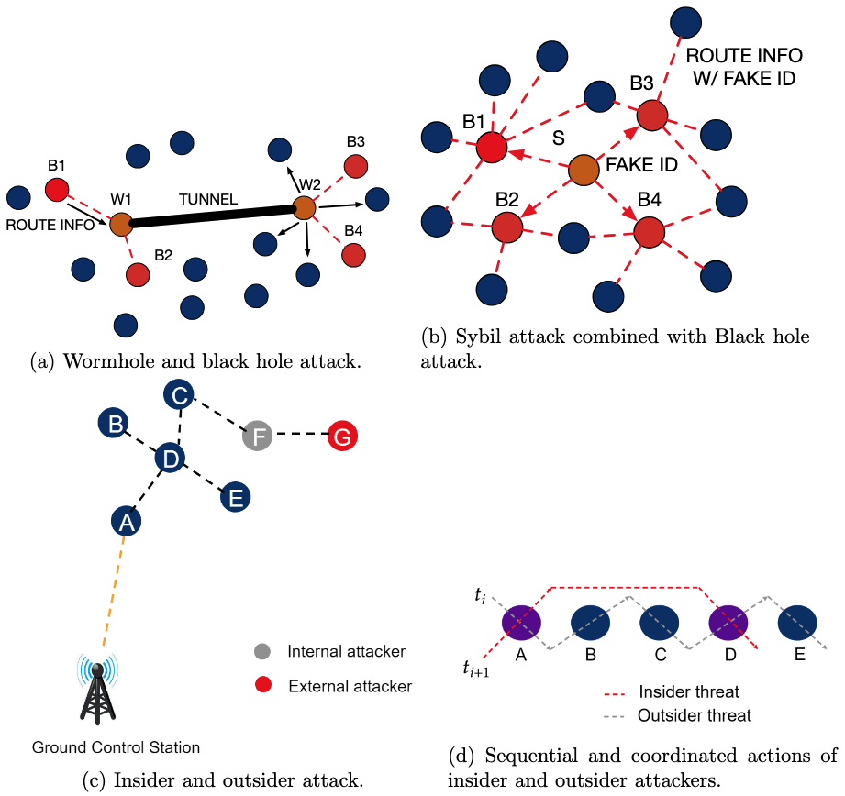
Examples of Collaborative Attacks
(a): Wormhole nodes (W1, W2) collaborating with blackhole nodes (B1-B4) for amplified routing disruption;
(b): Sybil node (S) providing fake IDs to blackhole nodes for detection evasion;
(c) and (d): Sequential insider (F) and outsider (G) attack coordination across time steps.
Notes:
Different collaborative attack scenarios:
(a) Wormhole and Blackhole working together.
(b) Sybil node giving fake IDs to other attackers.
(c) and (d) Time-based coordination: insiders + outsiders across time.
These scenarios illustrate the complexity and variability in how adversaries collaborate.

Slide 15
The Hiding Effect: A Blackhole-Sybil example
Blackhole-Sybil Collaborative Attack
  The Sybil adversary secretly transfers valid IDs to blackhole adversaries instead of abusing them.
    SE1: It does not trigger abnormal events and, thus, is hidden from detection.
  Blackhole adversaries broadcast false routing information with distinct IDs received from the Sybil adversary.
    SE2: Making blacklisting-based blackhole attack defense mechanisms[4~6] invalid.
Notes:
The Hiding Effect in Blackhole-Sybil collaboration example:
A Sybil attacker quietly hands out IDs to blackhole nodes.
The blackholes then act using valid-looking IDs, evading detection.
This coordination defeats blacklisting defenses.

Slide 16
Task 2: Designing Mechanisms to Secure Autonomous UAV Networks against Collab- orative Attacks
Defense against Multi-Stage Attacks (MSAs) vs. Defense against Collaborative Attacks:
  Defenses against MSAs are concerned with finding patterns in sequential actions that are typically conducted by a single attacker.
  By contrast, collaborative attacks are more general because they involve multiple attackers, who can execute their actions in an interleaved fashion which is more sophisticated than sequential events.
Nevertheless, the research will use sequential data analysis as some building-blocks in the defenses.
Moreover, the MSAs launched by a single attacker cannot achieve synergy effects as discussed above.
Notes:
Comparing Multi-Stage Attacks (MSAs) and Collaborative Attacks:
MSAs = single attacker over time.
Collaborative = multiple actors in parallel or staggered steps.
While MSAs provide a foundation (e.g., sequence learning), collaborative attacks require new methods for interleaved, multi-agent detection.

Slide 17
Task 2: Designing Mechanisms to Secure Autonomous UAV Networks against Collab- orative Attacks
Current multi-stage attack defenses fail to address three challenges in UAV environments:
  (1) coordinated actions by multiple attackers,
  (2) rapidly changing attack surfaces due to UAV mobility, and
  (3) resource constraints that limit computational defense mechanisms.
Notes:
3 challenges of detecting collaborative attacks in UAV networks:
Multiple attackers acting together.
Changing attack surfaces due to UAV motion.
Resource constraints making heavy processing infeasible.
These issues demand innovative, layered, and lightweight solutions.

Slide 18
Using Formal Methods to Detect Collaborative Attacks
Traditional ML models struggle to detect multi-step, coordinated attack behavior. Collaborative attacks often span multiple nodes and evolve over time — difficult to capture via flow-based features alone.
Our Approach:
Treat network events as state transitions in a system model.
Use formal verification techniques (e.g., model checking) to:
  Detect illegal state transitions or unexpected sequences.
  Identify if multiple agents are collaborating across time to breach security.
Key Ideas:
Model UAV network behavior using finite state machines or temporal logic.
Encode known benign and malicious interaction patterns.
Use runtime verification or offline checking to flag potential coordinated attacks.
Notes:
Traditional ML often fails with multi-step, spread-out attacks.
Formal methods provide a powerful alternative:
Model the UAV network as a system with states and transitions.
Use model checking to verify that transitions follow expected patterns.
Unexpected behavior → potential collaborative attack.
We use finite state machines and temporal logic to formalize attacker behavior.

Slide 19
Learning-Based Models for Sequential Detection
Hidden Markov Models (HMM):
Probabilistic models capturing transitions between hidden system states.
Suitable for lightweight onboard detection.
Assumes limited memory (Markov property) and works best with relatively simple or periodic attack patterns.
Long Short-Term Memory Networks (LSTM):
A type of recurrent neural network designed to capture long-term dependencies.
Effective in learning subtle, delayed, or multi-stage attack patterns.
Requires extensive training data and higher computational resources.
Notes:
Compare two ML approaches:
HMM (Hidden Markov Models): Good for simple, periodic attacks, works onboard due to low overhead.
LSTM (Long Short-Term Memory): Better for complex or delayed patterns, but needs more resources.
These models are complementary: HMMs can be run on UAVs, LSTMs at base stations for deep analysis.

Slide 20
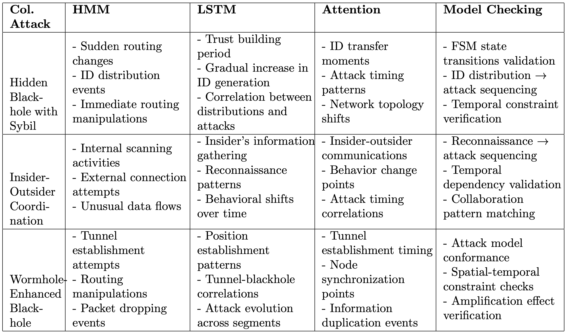
Examples of events and actions associated with the four proposed mechanisms in the context of three examples of collaborative attacks.
Notes:
The table highlights how different events and actions map to the detection mechanisms described earlier.
It shows how the system tracks events in relation to various collaborative attack examples.
The table bridges theory with implementation—how the detection framework processes real UAV behavior and alerts.

Slide 21
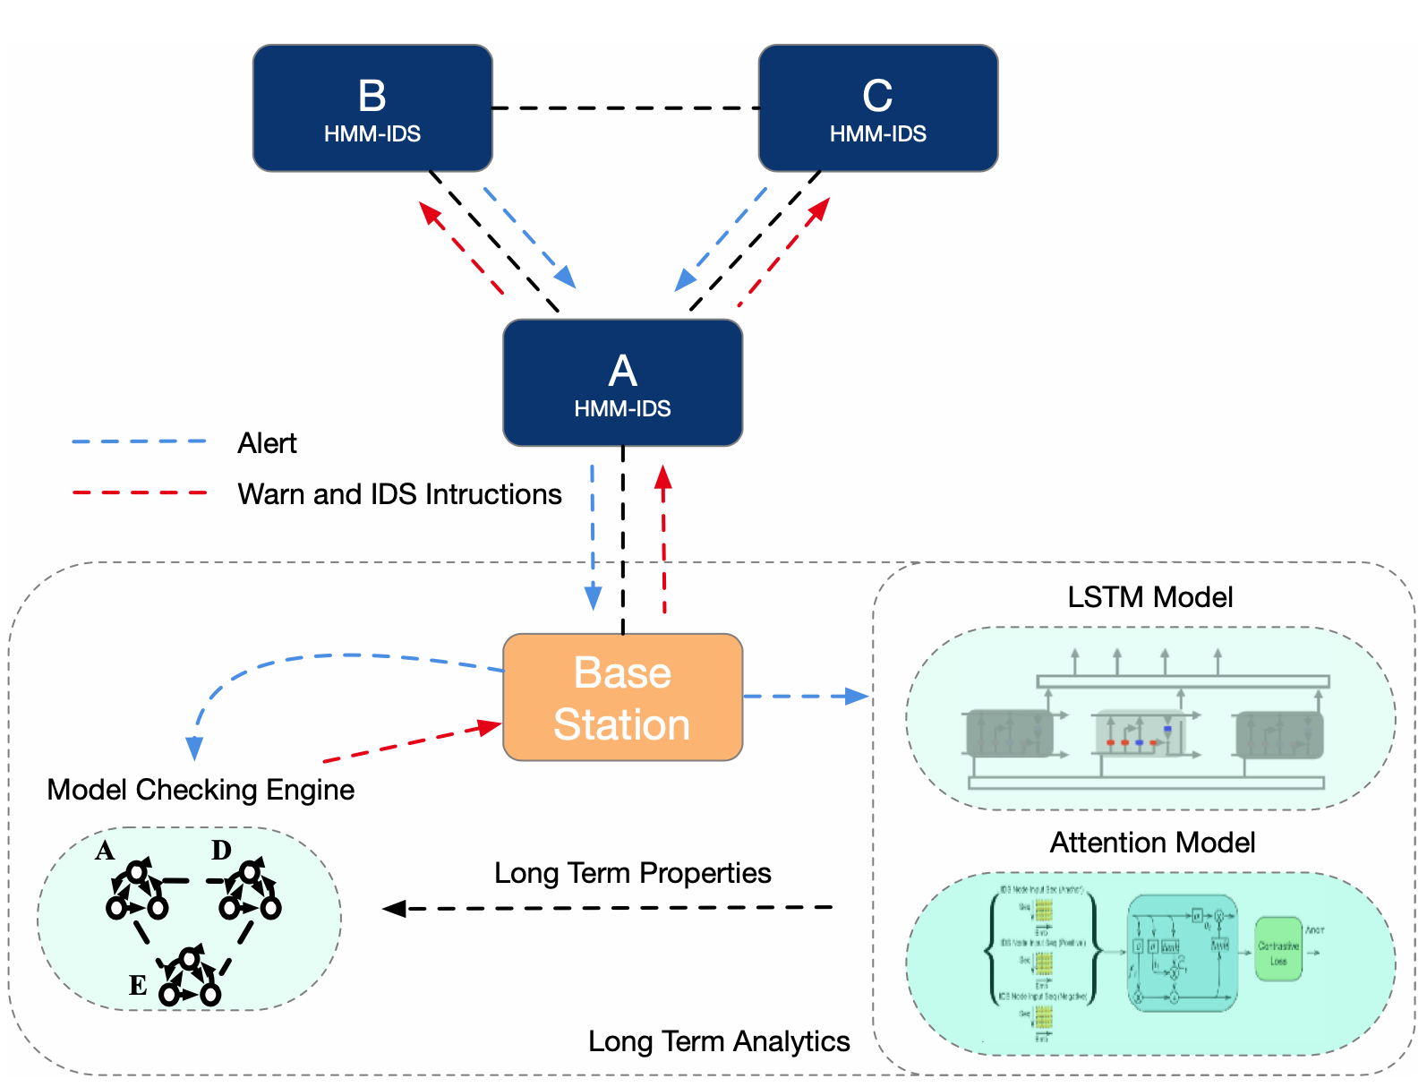
Task 3: Designing Defense Framework to Counter Collaborative Attacks
Notes:
Our frame is distributed, striking a balance between:
Lightweight detection at UAVs.
Deep analysis at the Base Station (BS).
Three key BS roles are:
Use model checking to find collaboration patterns.
Generate attack signatures.
Analyze sequences with attention-based models.
This architecture makes detection scalable and adaptive.

Slide 22
A Proposed Framework
The figure highlights the preliminary framework
  The framework implements a distributed detection architecture that balances detection capability with UAV resource constraints.
  It leverages the Base Station (BS) for computationally intensive analysis while deploying efficient short-term detection on individual UAVs.
Base Station Components
  The Model Checking Engine forms the framework’s foundation, providing three functions.
    Discovers and verifies possible attack collaboration patterns.
    Generates attack signatures to guide HMM deployment on UAVs.
    Identifies temporal dependencies and critical events for LSTM and attention analysis.
Notes:
UAVs run lightweight HMM-based models for quick, local threat detection.
More complex, long-term analysis is offloaded to the Base Station using LSTM and attention mechanisms.

Slide 23
A Proposed Framework
The architecture offers several key advantages.
  Immediate threat detection occurs at network edges through lightweight HMMs while complex attack evolution analysis is centralized at the BS.
  UAVs maintain minimal state information and computational overhead, yet the framework continuously adapts to new attack patterns.
  Most importantly, all detection decisions can be verified through model checking.
The preliminary experiments show this distributed approach provides a good tradeoff between effectiveness in detecting collaborative attacks and resource utilization.
Notes:
Low computational burden on UAVs.
Real-time adaptability.
Model checking ensures verifiability of all decisions.

Slide 24
A Variant of the Proposed Framework
RDCollab: Reasoning and Detecting Collaborative Attacks
  A framework to reason about and detect collaborative attacks in autonomous UAV networks that leverages model checking to explore attack patterns.
  It models individual attacks as finite state machines (FSMs) that can be combined to represent collaboration.
  The framework uses properties describing network safety to explore collaborative attacks and guide intrusion detection systems.
  RDCollab improves IDSs' detection rates on non-hidden adversaries by up to 63% and can detect hidden adversaries within 6.1 seconds.
Notes:
We introduce RDCollab — “Reasoning and Detecting Collaborative Attacks”.
It uses model checking to uncover complex attack patterns.
Represents each attack as a finite state machine (FSM) and explores their interactions.
Up to 63% improvement in detection rates.
Detects hidden adversaries within 6.1 seconds.

Slide 25
A Variant of the Proposed Framework
RDCollab: Reasoning and Detecting Collaborative Attacks
  Three major synergy effects are identified: Hiding Effect, Amplifying Effect, and Shortcut Effect.
    The Hiding Effect makes adversaries more difficult to detect or makes specific adversaries undetectable.
    The Amplifying Effect occurs when coordinated attacks cause more damage than the sum of individual attacks.
    The Shortcut Effect allows adversaries to launch attacks with fewer steps or achieve goals faster.
  Seven novel collaborative attacks were discovered through model checking, including Hidden Blackhole Attack, Hidden Wormhole Attack, Duplicated Routing Disturbance Attack, Distributed Data Exfiltration Attack, and others.
  The framework extracts segment patterns from collaborative attack counterexamples as signatures to guide IDSs.
  Three baseline ML-based IDSs were used for evaluation: HMM-based, SVM-based, and RFC-based.
Notes:
RDCollab identifies three synergy effects introduced in previous slides:
Hiding Effect: Harder to detect.
Amplifying Effect: More damage together.
Shortcut Effect: Faster path to disruption.
7 novel attacks discovered using RDCollab (e.g., Hidden Blackhole Attack).
These results show how formal methods can discover unknown but dangerous attack variants.

Slide 26
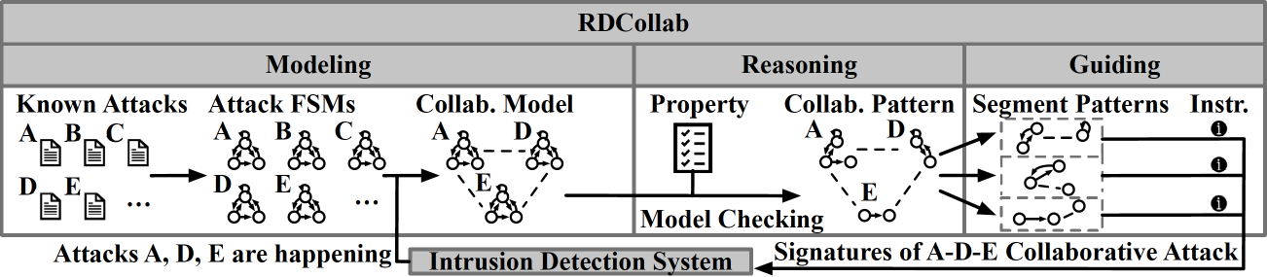
Our Solution: RDCollab (Reasoning and Detecting Collaborative Attacks)
The collaborating attacks are formally modeled as finite states machines (FSMs) connected by channels for message exchange.
Notes:
Collaborative attacks are formally modeled as FSMs with message-passing channels.
Each attacker’s behavior is encoded as a state machine.
Communication between FSMs allows simulation of collaboration.
This approach enables systematic discovery of synergy effects and vulnerabilities.

Slide 27
An Example of Collaborative Attack Model
privilege
impact, det
impact
non_det
Notes:
This structure lets us trace blackhole and Sybil attackers’ behavior and interaction.
This modeling phase lays the groundwork for precise detection.

Slide 28
More Details of the Modeling Phase
We define impact labels that describe how an adversary's actions violate the confidentiality, integrity, or availability of the system. For example, we label "send_fake_rtn_info” (send fake routing information) with "int_viol" for integrity violation, and "drop_packet" with "avai_viol" for availability violation.
Then we have detectability labels that indicate how observable an adversary's actions are. We use "det" for detectable actions, "part_det" for partially detectable actions, and "non_det" for actions that can't be observed externally. For instance, "send_fake_rtn_info" is labeled as "det" since it's observable, while "generate_id" in the Sybil FSM is labeled as "non_det" as it's done locally by the adversary.
These labels help us bridge the gap between abstract security requirements and concrete system behaviors.
Notes:
Labels are added to attacker actions:
Impact Labels: What kind of security violation? (e.g., integrity, availability).
Detectability Labels: Can it be observed? Fully, partially, or not at all?
These annotations help map real-world behaviors to abstract attack models.
They also enables IDS to better understand which actions are stealthy or harmful.

Slide 29
Our Solution: RDCollab (Reasoning and Detecting Collaborative Attacks)
Synergy effects are encoded as security properties in linear temporal logic (LTL) formulas.
Model checking is used to check collaborating model consisting of attack FSMs against the LTL-form security properties indicating attack collaborations.
Notes:
Linear Temporal Logic (LTL) is a way to encode security properties.
The system checks if the attack models violate expected safety properties over time.
If violations occur, a counterexample is generated, showing how attacks collaborate.
This process makes hidden threats discoverable and explainable.

Slide 30
Our Solution: RDCollab (Reasoning and Detecting Collaborative Attacks)
If the check fails, the model checker outputs a counterexample which can be referred to by IDS as oracles on how individual attacks collaborates.
Notes:
The role of counterexamples:
They act as "oracles" or patterns of malicious collaboration.
These are then fed back into IDSs to update their detection logic.
This forms a learning loop—every detected attack makes the IDS smarter.

Slide 31
Our Solution: RDCollab (Reasoning and Detecting Collaborative Attacks)
The IDS thus updates its detection and defense strategy accordingly.
Notes:
Reasoning Phase: Model checking reveals collaborative patterns.
Guiding Phase: These patterns are translated into actionable IDS rules.
This approach directly improves IDS accuracy by learning from collaboration evidence.

Slide 32
More Details of the Reasoning and Guiding Phases
RDCollab defines properties the model should satisfy in a synergy effects-free scenario (i.e., the scenario without the collaborative attacks that cause synergy effects).
It then uses the model checking to verify the collaboration model against the properties. If the model violates a property, the model checker outputs a counterexample demonstrating a model execution that can be interpreted as a collaboration pattern with synergy effects.
The segments of such a pattern are used in the guiding phase, as they can be used as signatures to detect collaborative attacks.
RDCollab translates the segments into instructions to guide IDS in improving its detection effectiveness.

Slide 33
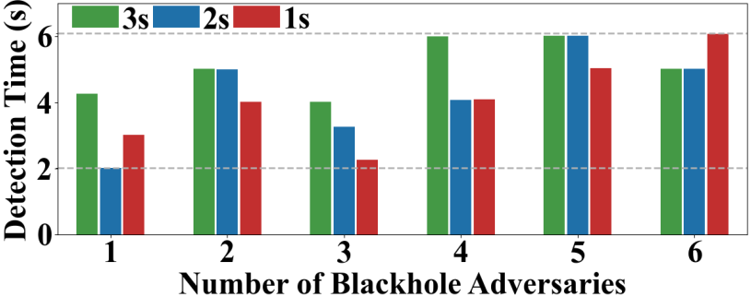
RDCollab Evaluation Results
Detecting the Hidden Sybil Adversary (SE1)
With various numbers (1~6, x-axis) of blackhole adversaries, RDCollab can detect the Sybil adversary that transfer fake IDs to them every 3, 2 and 1 second(s) within 6 seconds (y-axis).
Notes:
The evaluation results for Hiding Effect (SE1).
X-axis: Number of blackhole nodes.
Y-axis: Time to detect the hidden Sybil attacker.
Key point: RDCollab detects hidden adversaries within 6 seconds, even under complex multi-node collaboration.
Shows real-time applicability in fast-moving UAV networks.

Slide 34
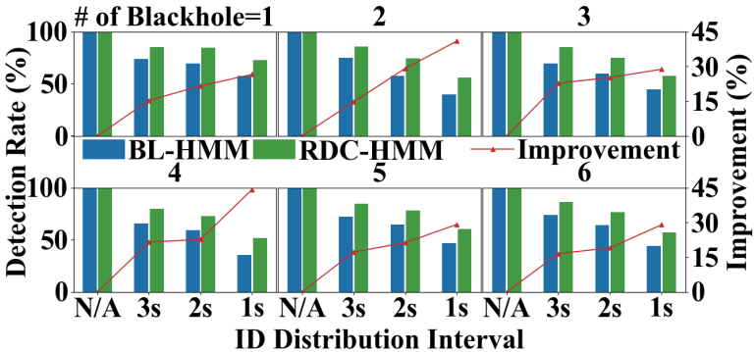
RDCollab Evaluation Results
Improving the Detection of Blackhole Adversaries (SE2)
With various numbers (1~6, subfigure titles) of blackhole adversaries, RDCollab-guided HMM-based IDS improves the detection rate of blackhole adversaries compared with baseline HMM-based IDS.
The improvements are shown by the red lines.
Notes:
The evaluation of RDCollab on Amplifying Effect (SE2) and the improved detection of blackhole adversaries.
Compare baseline HMM-based IDS (blue bars) vs. RDCollab-guided version (green bars).
The red lines show significantly higher detection rates across different blackhole configurations.
Using RDCollab as a guiding layer boosts existing IDS performance.

Slide 35
Takeaways and Contributions
Collaborative attacks pose a growing threat to UAV networks.
RDCollab provides a comprehensive approach to tackling these challenges.
  A solution to detect collaborative attacks against autonomous UAV networks.
  Implementation of RDCollab instantiating the proposed solution.
  Evaluation of RDCollab’s effectiveness of collaborative attack detection.
The next steps are to enhance collaborative attack detection and response systems.
Notes:
The key takeaways from the presentation:
Collaborative attacks are a real and growing threat to UAV systems.
Existing defenses fall short due to lack of synergy awareness and UAV-specific adaptation.
RDCollab offers a principled framework that detects, reasons about, and guides defense against these attacks.
Three core contributions:
The attack detection solution.
Implementation of RDCollab.
Evaluation demonstrating its effectiveness.

Slide 36
Another Issue: Lack of Robustness in intrusion detection systems for UAV networks
Current IDS systems lack evaluation on diverse, dynamic UAV datasets and give high False positives caused by varying network conditions and congestion, while often demanding high computational resources.
Existing IDS datasets lack UAV-specific attacks, aerial mobility, and real wireless traffic patterns.
Due to High costs of collecting large network datasets, we use data augmentation using MLP function approximation method. This makes current IDS system robust against false positives caused by mobility in UAV networks.
Notes:
Shortcomings in current IDS systems:
High false positive rates.
Poor adaptability to UAV-specific dynamics.
Lack of realistic datasets with mobility and collaborative behaviors.
There is the need for data augmentation to overcome data scarcity and variability.

Slide 37
Three-Phase Plan for Advancing Collaborative Attack Detection
Phase 1: Dataset Creation
Develop a comprehensive dataset simulating collaborative attacks in UAV networks.
Include realistic mobility models, packet-level logging, and diverse adversarial behaviors.
Emphasize attack diversity (e.g., blackhole, wormhole, Sybil) and coordination mechanisms.
Use Data Augmentation to increase diversity of dataset.
Phase 2: Transformer-Based Detection
Leverage attention-based models (e.g., Transformers) to capture temporal dependencies and multi-agent coordination patterns.
Fine-tune on domain-specific UAV datasets.
Benchmark against baseline ML models and analyze detection accuracy under dynamic conditions.
Phase 3: Enhancing Detection Efficiency
Optimize detection models for onboard deployment using techniques like knowledge distillation, pruning, and quantization.
Explore hierarchical detection: light-weight edge models + cloud-based heavy analysis.
Integrate detection with real-time response mechanisms.
Notes:
The three-phase plan:
Dataset Creation: Simulate UAV traffic and diverse collaborative attacks.
Transformer-Based Detection: Leverage deep learning for coordination analysis.
Efficiency Enhancements: Optimize models for resource-constrained UAVs.
Explain that this roadmap ensures a robust, scalable, and real-time defense solution.

Slide 38
Why Existing Datasets Fall Short for UAV Networks
Lack UAV-specific attacks
Most datasets focus on generic IT or IoT threats, not aerial or coordinated UAV threats.
Static or limited mobility
Many datasets assume fixed topologies, unsuitable for dynamic, mobile UAV environments.
No real UAV traffic
Missing realistic communication patterns like video/image transmission or inter-UAV coordination.
Not designed for swarm behavior
Fail to capture group dynamics, cooperation, or synchronized attacks.
Misaligned threat models
Include irrelevant attack types (e.g., fuzzing, worms) not applicable to UAV use cases.
Partial relevance (e.g., IoT/WSN)
Offer some overlap in resource constraints, but lack full UAV context.
Notes:
Key gaps in existing datasets:
No UAV-specific threats or mobility patterns.
No real aerial communication behaviors or swarm dynamics.
These gaps make it hard for IDSs to generalize and perform reliably in UAV environments.
There is the need for new datasets tailored to UAV scenarios.

Slide 39
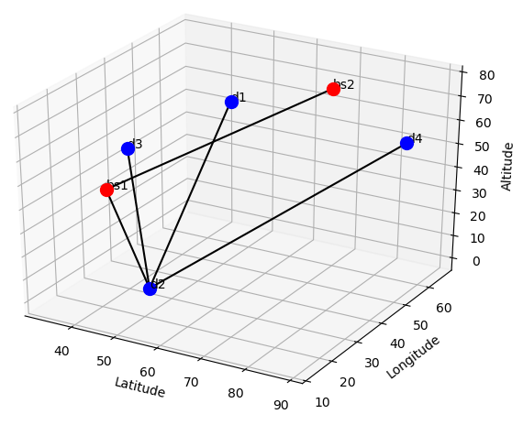
Phase 1: Our UAV IDS Dataset: Key Features
Dynamic UAV Network & Mobility
UAVs (10-50) & Basestations (1-5) move using Gaussian-Markov model.
Links dynamically change based on Euclidean distance, simulating WiFi characteristics (capacity, delay, loss).
Packet loss modeled via BER, SNR, & FSPL, with retransmission-based correction.
Attacks Simulated
DoS & DDoS – SYN floods (100 to 100K packets/sec), Black Hole, Wormhole, Replay Attack.
Realistic UAV Data Capture
UAVs send images/videos, simulating reconnaissance transmission.
Traffic captured at node & switch levels for IDS evaluation.
Systematic variation: 100 runs per setup (60s each) with diverse UAV counts, attacks, & packet rates.
Notes:
The simulated UAV network:
UAVs and base stations move using a Gaussian-Markov model.
Network topology changes based on distance and wireless properties.
Simulated attacks include DoS, blackhole, wormhole, and replay attacks.
This setup captures realistic communication and mobility behavior.

Slide 40
Phase 1: Our data augmentation: Using MLP as a function approximation
MLPs (Multi-Layer Perceptrons): are powerful function approximators that can learn nonlinear mappings between input and output feature distributions.
They capture complex relationships between flow statistics like inter-arrival times, packet sizes, and burstiness patterns across different bandwidths.
Unlike linear regression, MLPs can model diverse traffic behaviors more accurately, especially when the transformation is not linearly scalable.
Notes:
Multi-Layer Perceptrons (MLPs) are used to augment traffic data.
MLPs learn how traffic looks under different bandwidth constraints (e.g., converting 100 Mbps flows into realistic 10 Mbps flows).
This boosts dataset diversity, helping train models that perform well under realistic and constrained UAV conditions.

Slide 41
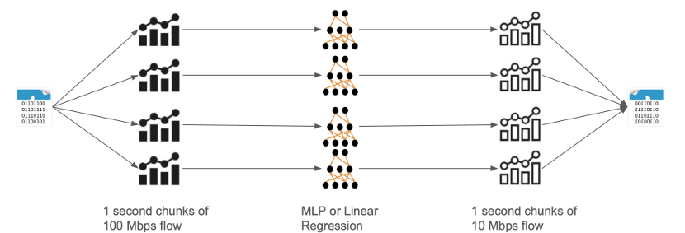
Phase 1: Our data augmentation: Using MLP as a function approximation
Input: Original network traffic is segmented into 1-second flow chunks from a 100 Mbps environment.
Feature Extraction: We extract statistical features for each chunk (e.g., flow size, number of packets, arrival times).
MLP Transformation: These features are passed through a trained MLP (or linear regression as baseline) to generate a mapped version mimicking how the same traffic would appear on a 10 Mbps link.
Output: The resulting 10 Mbps-style flow chunks are recombined into an augmented dataset with realistic traffic for low-bandwidth settings.
Notes:
The data augmentation pipeline:
Segment traffic into 1-second chunks.
Extract statistical features.
Use MLP to transform flow into low-bandwidth form.
Recombine into augmented datasets.
This helps simulate how the same network activity would appear under different communication conditions.

Slide 42
F1- score of different ML techniques using Flow features.
Machine learning model | CICIDS 2017[x] | CICIOT2023[x] | UNSW-NB15[x]
1D – CNN | 97.98 | 67.68 | 60.62
Long short-term memory | 87.15 | 64.29 | 46.17
Random Forest | 99.63 | 79.12 | 87.66
Stochastic gradient descent | 95.98 | 50.41 | 39.03
Logistic Regression | 93.16 | 48.24 | 37.82
Multilayer perceptron | 95.87 | 61.55 | 48.45
We use these vanilla models on three public datasets.
We measure 65 different flow features based on packet size, packet time of arrival, and TCP flags.
We measure F1-scores as these datasets are imbalanced.
As dataset diversity and complexity increase, traditional models struggle to generalize—highlighting the need for more expressive, context-aware approaches.
Notes:
The table shows evaluation results using three public datasets.
F1-score is used due to class imbalance (rare attacks).
Simple models struggle with diverse, complex flow patterns—especially under collaborative attack scenarios.
This reinforces the need for context-aware and expressive models like RDCollab + transformers.

Slide 43
Phase 2 – Transformer-Based Detection Ideas
Older detection methods often rely on shallow models or handcrafted features, which struggle to capture the complex temporal and multi-agent coordination patterns in collaborative attacks—necessitating more expressive architectures like Transformers.
Multi-Agent Attention Modeling
Capture inter-node interactions by modeling UAV network as a sequence of events with node-level embeddings.
Graph-Transformer Hybrid
Combine GNNs with Transformers to account for both network structure and temporal behavior.
Contrastive Learning
Learn discriminative features by contrasting collaborative vs. non-collaborative attack traces.
Few-Shot Fine-Tuning
Enable rapid adaptation to unseen coordinated attacks with minimal labeled data.
Notes:
Transformers are essential:
Older models can't capture the intricate timing and interaction patterns of multi-agent attacks.
Key design ideas:
Multi-Agent Attention: Tracks how UAVs interact over time.
Graph-Transformer Hybrid: Captures both structure and behavior.
Contrastive Learning: Distinguishes collaborative from non-collaborative patterns.
Few-Shot Fine-Tuning: Enables quick learning from small data.

Slide 44
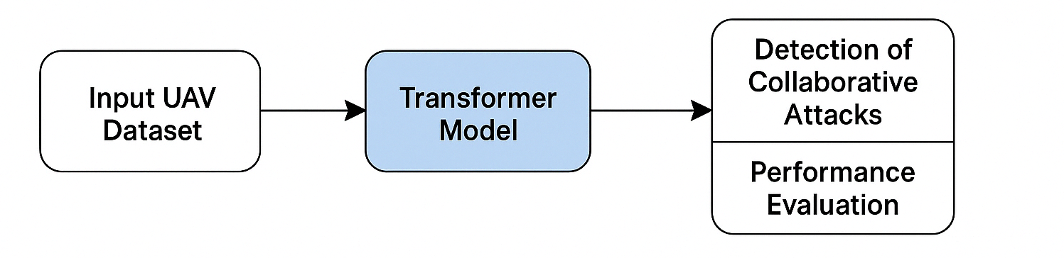
Phase 3 – Making Detection Efficient
Multi-Agent Attention Modeling
Capture inter-node interactions by modeling UAV network as a sequence of events with node-level embeddings.
Graph-Transformer Hybrid
Combine GNNs with Transformers to account for both network structure and temporal behavior.
Contrastive Learning
Learn discriminative features by contrasting collaborative vs. non-collaborative attack traces.
Few-Shot Fine-Tuning
Enable rapid adaptation to unseen coordinated attacks with minimal labeled data.
Notes:
Continue with Phase 3: optimizing detection for real-world deployment
How Transformers can be simplified:
Use MobileBERT, TinyBERT, Linformer for lightweight onboard inference.
The hierarchical detection:
Lightweight models on UAVs for fast filtering.
Deep models at base stations for complex analysis.

Slide 45
Phase 3 – Making Detection Efficient
Lightweight Transformer Variants
Explore MobileBERT, TinyBERT, and Linformer for onboard inference with low overhead.
Hierarchical Deployment
On UAVs: Quick screening via distilled models or rule-based alerts.
On Base Station: Deep analysis using full models and historical context.
Dynamic Resource Adaptation
Adjust model complexity based on available compute, energy, and threat severity.
On-the-Fly Model Updates
Incorporate detected counterexamples from RDCollab to update the detection pipeline in real time.
Notes:
Highlight dynamic and adaptive deployment:
Dynamic Resource Adaptation: Adjust model complexity based on available compute/energy.
On-the-Fly Updates: Integrate counterexamples from RDCollab to improve models in real time.
This adaptability is key in UAV missions with varying conditions and urgency.

Slide 46
Future Directions
Apply RDCollab techniques to related domains like VANETs
Apply federated learning across UAVs without raw data sharing

Slide 47
References
[1] UAV Market to Worth USD 91.23 Billion by 2030 - UAV Industry Report by Fortune Business Insight : https://www.fortunebusinessinsights.com/industry-reports/unmanned-aerial-vehicle-uav-market-101603
[2] Airlangga, Gregorius, and Alan Liu. "A Study of the Data Security Attack and Defense Pattern in a Centralized UAV–Cloud Architecture." Drones 7.5 (2023): 289.
[3] Sarkar, Nurul I., and Sonia Gul. "Artificial intelligence-based autonomous UAV networks: A survey." Drones 7.5 (2023): 322.
[4] T. Noguchi and T. Yamamoto, “Black hole attack prevention method using dynamic threshold in mobile ad hoc networks,” in 2017 Federated Conference on Computer Science and Information Systems (FedCSIS). IEEE, 2017, pp. 797–802.
[5] J. Tobin, C. Thorpe, and L. Murphy, “An approach to mitigate black hole attacks on vehicular wireless networks,” in 2017 IEEE 85th vehicular technology conference (VTC Spring). IEEE, 2017, pp. 1–7.
[6] T. N. D. Pham and C. K. Yeo, “Detecting colluding blackhole and greyhole attacks in delay tolerant networks,” IEEE Transactions on Mobile Computing, vol. 15, no. 5, pp. 1116–1129, 2015.

