Slide 1
COLLABORATIVE ATTACKS AND DEFENSE
Bharat Bhargava
CERIAS and CS department
Purdue University
www.cs.purdue.edu/homes/bb

Slide 2
Trusted Router and Protection Against Collaborative Attacks
Characterizing collaborative/coordinated attacks
Types of collaborative attacks
Identifying Malicious activity
Identifying Collaborative Attack

Slide 3
Collaborative Attacks
Informal definition:
“Collaborative attacks (CA) occur when more than one attacker or running process synchronize their actions to disturb a target network”

Slide 4
Collaborative Attacks (cont’d)
Forms of collaborative attacks
  Multiple attacks occur when a system is disturbed by more than one attacker
  Attacks in quick sequences is another way to perpetrate CA by launching sequential disruptions in short intervals
  Attacks may concentrate on a group of nodes or spread to different group of nodes just for confusing the detection/prevention system in place
  Attacks may be long-lived or short-lived
  Collaborative attacks can be launched intentionally or accidentally
  Attacks on routing

Slide 5
Collaborative Attacks (cont’d)
Open issues
  Comprehensive understanding of the coordination among attacks and/or the collaboration among various attackers
  Characterization and Modeling of CAs
  Intrusion Detection Systems (IDS) capable of correlating CAs
  Coordinated prevention/defense mechanisms

Slide 6
Collaborative Attacks (cont’d)
From a low-level technical point of view, attacks can be categorized into:
  Attacks that may overshadow (cover) each other
  Attacks that may diminish the effects of others
  Attacks that interfere with each other
  Attacks that may expose other attacks
  Attacks that may be launched in sequence
  Attacks that may target different areas of the network
  Attacks that are just below the threshold of detection but persist in large numbers

Slide 7
Examples of Attacks that can Collaborate
Denial-of-Messages (DoM) attacks
Blackhole attacks
Wormhole attacks
Replication attacks
Sybil attacks
Rushing attacks
Malicious flooding
We are investigating the interactions among these forms of attacks
Example of probably
incompatible attacks:
Wormhole attacks need fast connections, but DoM attacks reduce bandwidth!

Slide 8
Current Proposed Solutions
Blackhole attack detection
  Reverse Labeling Restriction (RLR)
Wormhole Attacks: defense mechanism
  E2E detector and Cell-based Open Tunnel Avoidance (COTA)
Sybil Attack detection
  Light-weight method based on hierarchical architecture
Modeling Collaborative Attacks using Causal Model
Detecting Collaboration using Machine Learning

Slide 9
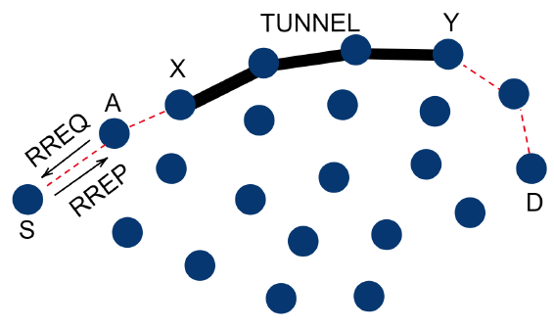
An example: blackhole attack and wormhole attack collaboration
The attacker aims to attract as many packets as possible
  to extract information about the system by packet inspection
  or, to selectively drop the packets
The goal is achieved by blackhole attack - wormhole attack collaboration

Slide 10
An example: blackhole attack and wormhole attack collaboration (cont’d)
A is a blackhole attacker that attracts packets by sending fake RREP.
X and Y are two ends of a wormhole that attract packets by advertising the one-hop route between them, namely, the wormhole.
If A forward packets it attracted to X instead of dropping them like a normal blackhole, X will have more packets collected compared with not launching an attack or launching a wormhole attack only. The attack goal is achieved.

Slide 11
Modeling collaborative attacks with causal graph model
A collaborative attack can be modeled as a causal graph model <S,E,M,L>, where
S is the set of attack states
E is the set of events triggering state transition, which can be further defined by
  Message exchange between attackers where messages are from set E, and
  Local attack operations from operation set L
The goal is to identify the malicious event sequences of collaborative attacks and stop it from reaching the key state (f3 in the above example)

Slide 12
Modeling collaborative attacks with causal graph model
To prevent the attack model from reaching f3, the defender should collaborate to
stop Attacks 1, 2 and 3 from reaching e2, f2 and g2, respectively, or
stop the communication between attackers.

Slide 13
A defense strategy consists of multiple defensive events
A defense strategy consists of a set of defensive events, in the above example
Defense 1 = {m₁, m₂, m₃, m₄}
Defense 2 = {p₁, p₂, p₃, p₄}
Defense 3 = {q₁, q₂}

Slide 14

Defensive events collaborating to interfere with Attack events
The defensive events collaborate to interfere with attack events or inter-attack communications to stop collaborative attack state transitions.

Slide 15
Graphs for blackhole attacks and wormhole attacks
For blackhole attacker A:
For each of two ends of the wormhole, X and Y:

Slide 16

Defend against single attacks by detecting abnormal events
For blackhole attacker A:
Detector D_{A} = {d_{A1,} d_{A2}}
  d_{A1}: monitors fake RREP
  d_{A2}: monitors packet drop

Slide 17
Defend against single attacks by detecting abnormal events (cont’d)
For two ends of the wormhole X and Y:
Detector D_{B} = {d_{B1,} d_{B2}}
  d_{B1}: monitors abnormal RREP
  d_{B2}: monitors abnormal packet transmission

Slide 18
Modeling and detecting collaborative attacks
The ‘bad’ state (X receives pkt) becomes ‘worse’.
Detection d_{A2} becomes ineffective since A no longer drops packets.
The bad state can be reached through more paths due to collaboration.
Thus, the detectors DA and DB have to collaborate to defend. D_{collab} = {d_{A1}, d_{B1}, d_{B2}}
Worse

Slide 19
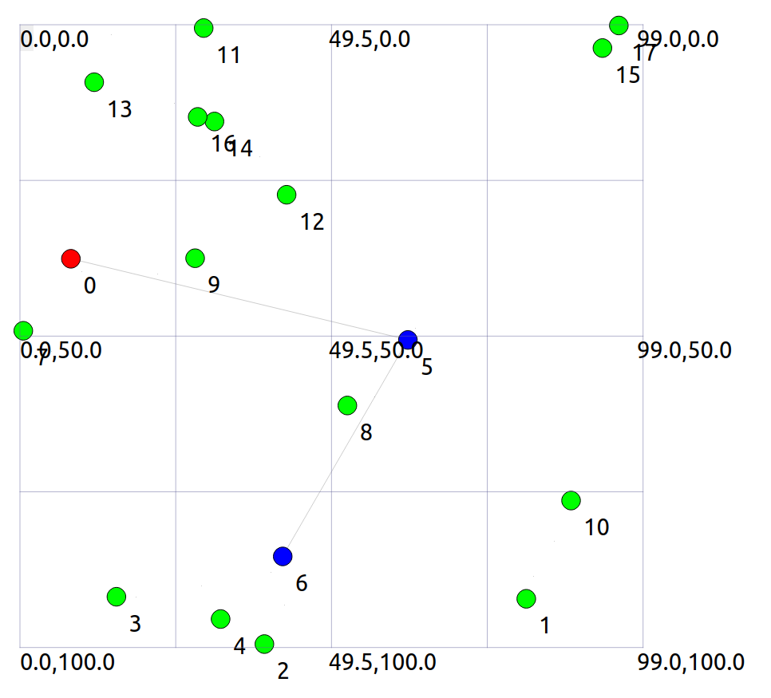
Evaluate the detection and defend mechanisms with ns3
We have implemented the above example with ns3
Red node is the blackhole attacker A
Blue nodes are wormhole attackers X and Y
Gray lines are tunnel and wormhole
We will evaluate our solution mechanism with ns3

Slide 20
Follow-up research questions
Given more single attack patterns (e.g., replication attacks, rushing attacks), we need to define causal rules to automatically judge whether and how those attacks can collaborate.
As the number of attackers increases, the collaborative attack graph becomes more complex, we need more advanced techniques to exhaust the paths from initial states to bad states.
In a system, how do we know that abnormal events are happening which may lead the system to a bad state?
  We plan to use machine learning approaches (next slides)

Slide 21
Why to use Machine Learning
The ML algorithm can continuously learn and adapt to new attack patterns.
It can analyze large amounts of data to detect advanced threats and reduce false positives/negatives.
It is initially resource-intensive but more economical in the long term.
It reduces manual updates.

Slide 22
Hidden Markov Model
A sudden spike in port scans on critical servers, coupled with a surge in message traffic and repeated login failures, potentially indicates a collaborative attack.
HMM leverages temporal relationships and probabilistic state transitions to dynamically monitor and identify potential network attacks.

Slide 23
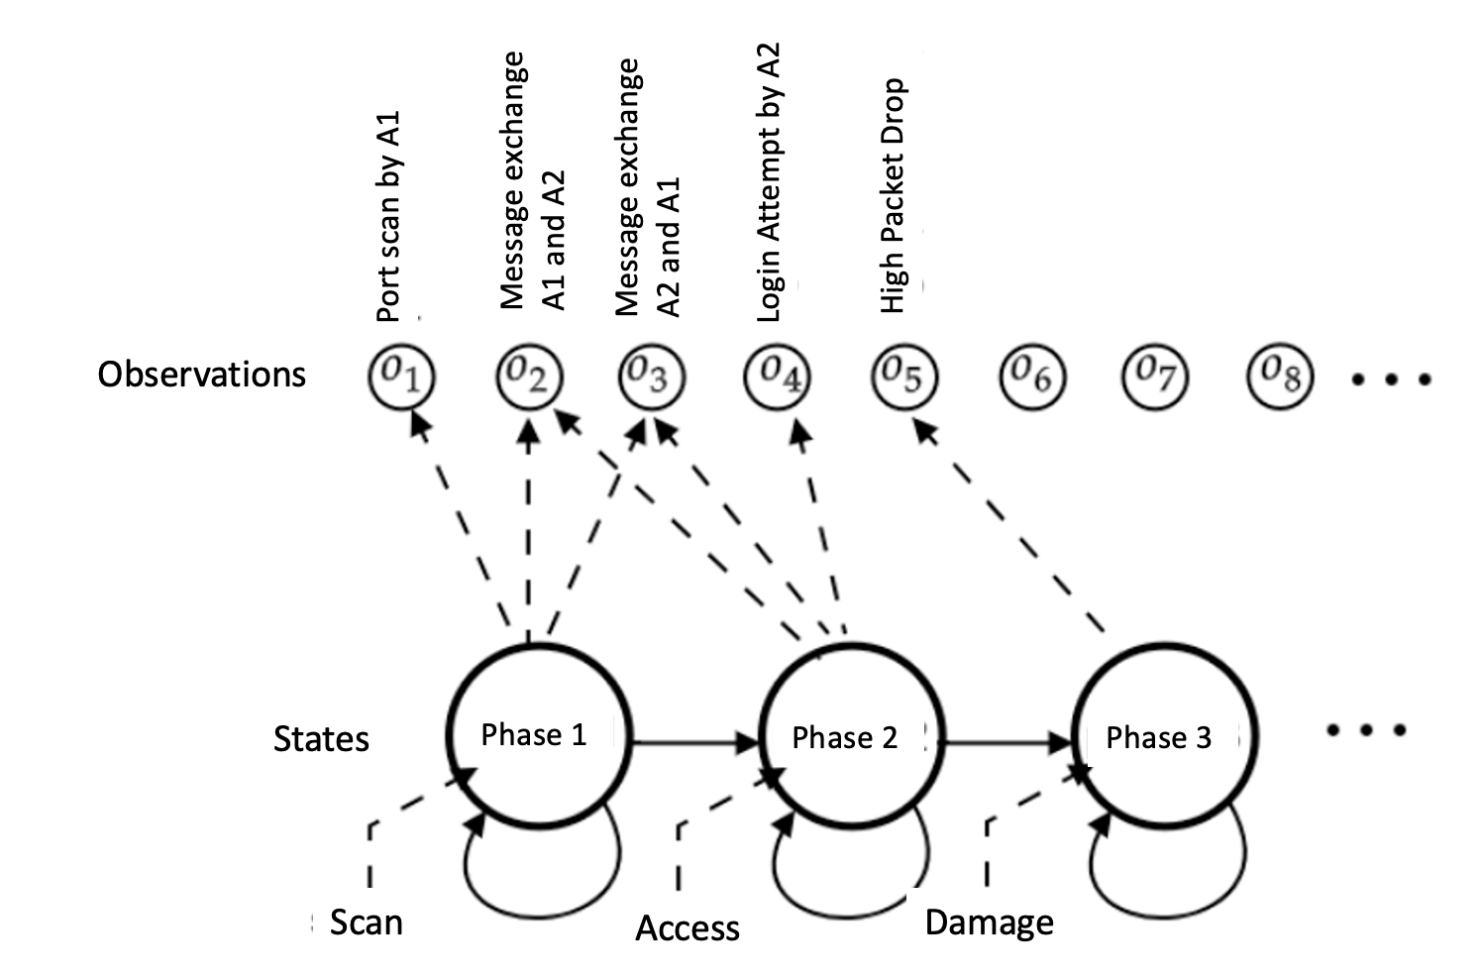
Hidden Markov Model

Slide 24
How Hidden Markov Model works?
System States can be Normal, Port Scan, Access, Damage
The system observes events called observations.
The algorithm can be trained on data including port activities, message logs, etc.
Baum-Welch (BW) and Viterbi algorithms can be used for training.
HMM can be applied to real-time data for state sequence analysis.
If there are suspicious activities, the IP address of the attacker can be blocked, and notifications can be provided

Slide 25
Utilizing LSTM (Long Short-Term Memory) Network
LSTM's strength lies in its ability to process sequential data and capture long-term patterns, making it highly effective for real-time network security monitoring.
For instance, LSTMs can detect irregular patterns, such as identifying a mild port scan followed by spikes in messages and unusual login attempts (both could happen days later “mild port scan”). This capability allows LSTM to flag such sequences as potential collaborative attacks.

Slide 26
How can LSTM work
Dataset:
  Timestep 1: event 1 [Normal Traffic]
  Timestep 2: event 2 [Port Scan]
  Timestep 3: event 3 [Increased Messaging]
  Timestep 4: event 4 [Failed Logins]
LSTM Processing: LSTM can process all previous states to predict collaboration
  input: event 1 => output: No Attack
  input: event 1, event 2 => output: Port Scan
  input: event 1, event 2, event 3 => output: Access
  input: event 1, event 2, event, event 4 => output: Potential collaborative attack

Slide 27
Contrastive Learning
Contrastive Learning's strength lies in its ability to learn nuanced differences between normal and malicious behaviors.
A model trained with Contrastive Learning could recognize irregular message exchanges and login attempts, distinguishing them from normal behavior and flagging them as potential attacks.
Not every login attempt failure is malicious; contrastive learning can help distinguish between normal login attempt failure and malicious login attempt failure.

Slide 28
How does Contrastive Learning work?
The algorithm is provided an event that is an Anchor (without anomaly) during training.
All other events are positive (P) or negative (N). The positive (P) event is an anomaly. The negative (N) is a legitimate data point.
The algorithm maximizes the distance between A and P while minimizing the distance between A and N.
In real-time, the algorithms compute the distance between the event and anchor to predict whether the event is an anomaly or legitimate.

Slide 29
Problem Statement
Packet drop attacks put severe threats to Ad Hoc network performance and safety
Directly impact the parameters such as packet delivery ratio
Will impact security mechanisms such as distributed node behavior monitoring
Different approaches have been proposed
  Vulnerable to collaborative attacks
  Have strong assumptions of the nodes

Slide 30
Problem Statement
Many research efforts focus on individual attackers
The effectiveness of detection methods will be weakened under collaborative attacks
  E.g., in “watchdog”, multiple malicious nodes can provide fake evidences to support each other’s innocence
  In wormhole and Sybil attacks, malicious nodes may share keys to hide their real identities

Slide 31
Problem Statement
We focus on collaborative packet drop attacks. Why?
Secure and robust data delivery is a top priority for many applications
The proposed approach can be achieved as a reactive method: reduce overhead during normal operations
Can be applied in parallel to secure routing

Slide 32
Related Work
Detecting packet drop attacks
Audit based approaches
  Whether or not the next hop forward the packets
  Use both first hand and second hand evidences
  Problems:
    Energy consumption of eavesdropping
    Can be cheated by directional antenna
    Authenticity of the evidence
Incentive based approaches
  Nuggets and credits
Multi-hop acknowledgement

Slide 33
Related Work
Collaborative attacks and detection
Classification of the collaborative attacks
Collusion attack model on secure routing protocols
Collaborative attacks on key management in MANET
Detection mechanisms:
    Collaborative IDS systems
    Ideas from immune systems
    Byzantine behavior based detection

Slide 34
REAct system and Vulnerability
REAct system:
Proposed by researchers in Arizona, ACM WiSec 2009
Random audit based detector of packet drop
A reactive approach: will be activated only when something bad happens
Assumptions:
  At least two node disjoint paths b/w any pair of nodes
  Know the identity of the intermediate nodes
  Pair-wise keys b/w the source and the intermediate nodes

Slide 35
REAct system and Vulnerability
Working procedure of REAct
Destination detects the drop in packet arriving rate and notifies the source
Source randomly selects an intermediate node and asks it to generate a behavioral proof of the received packets
Intermediate node constructs a bloom filter using these packets
Source compares the bloom filter to its own value
  If match: the attacker is after the intermediate node
  Otherwise, it is before the intermediate node
Repeat the procedure until the bad link is located

Slide 36
REAct system and vulnerability
Example of REAct: the source selects n4 to be the first audited node. n4 generates the correct bloom filter, so the attacker is between n4 and D.

Slide 37
Collaborative attacks on REAct
n1 and n4 are collusive attackers. n1 discards the packets but delivers the bloom filter to n4. Now the source will think that the attacker is between n4 and D.
Why REAct is vulnerable to this attack: the source can verify the bloom filter, but not the generator of the filter.

Slide 38
Proposed approach
Assumptions:
Source shares a different secret key and a different random number with every intermediate node
All nodes in the network agree on a hash function h()
There are multiple attackers in the network
  They share their secret keys and random numbers
  Attackers have their own communication channel
  An attacker can impersonate other attackers

Slide 39
Proposed approach
Hash based approach:
Every node will add a fingerprint into the packet
S1 sends out the packet to n1:
S → n1: (S, D, data packet, random number t0)
Node n1 will combine the received packet and its random number r1 to calculate the new fingerprint:
t1 = h( r1 || S || D || data packet || t0 || r1 )
n1 → n2: (S, D, data packet, t1 )
The audited node will generate the bloom filter based on the data packets and the fingerprints
The source will generate its own bloom filter and compare it to the value of the audited node

Slide 40
Proposed approach
Why our approach is safe
The node behavioral proofs in our proposed approach contain information from both the data packets and the intermediate nodes.
Theorem 1. If node ni correctly generates the value ti, then all innocent nodes in the path before ni (including ni) must have correctly received the data packet selected by S.

Slide 41
Proposed approach
Why this approach is safe
The ordered hash calculations guarantee that any update, insertion, and deletion operations to the sequence of forwarding nodes will be detected.
Therefore, we have:
  if the behavioral proof passes the test of S, the suspicious set will be reduced to {ni, ni+1, ---, D}
  if the behavioral proof fails the test of S, the suspicious set will be reduced to {S, n1, ---, ni}

Slide 42
Discussion
Indistinguishable audit packets
  The malicious node should not tell the difference between the data packets and audited packets
  The source will attach a random number to every data packet
Reducing computation overhead
  A hash function needs 20 machine cycles to process one byte
  We can choose a part of the bytes in the packet to generate the fingerprint. In this way, we can balance the overhead and the detection capability.

Slide 43
Discussion
Security of the proposed approach
  The hash function is easy to compute: very hard to conduct DoS attacks on our approach
  It is hard for attackers to generate fake fingerprint: they have to have a non-negligible advantage in breaking the hash function
The attackers will adjust their behavior to avoid detection
  The source may choose multiple nodes to be audited at the same time
  The source should adopt a random pattern to determine the audited nodes

Slide 44
Dealing with Collaborative Attacks
Earlier approach is vulnerable to collaborative attacks
Propose a new mechanism for nodes to generate behavioral proofs
  Hash based packet commitment
  Contain both contents of the packets and information of the forwarding paths
  Introduce limited computation and communication overhead
Extensions:
  Investigate other collaborative attacks
  Integrate our detection method with secure routing protocols

Slide 45
Reasoning and Detecting Collaborative Attacks in Autonomous UAV Networks

Slide 46
Growing Autonomous UAV Network Market
Autonomous UAV networks are gaining increasing prevalence.
  The UAV market will reach 100 billion USD by 2030. [1]
Their growing prevalence demands robust security, especially against collaborative attacks.
Notes:
The rapid growth of the UAV market is projected to reach $100 billion by 2030.
As UAVs become more prevalent in commercial, civil, and military applications, ensuring their security becomes a top priority.
This increasing scale also raises the stakes for potential cyber and physical threats, particularly collaborative ones.

Slide 47
Autonomous UAV Network Security
Inherit fundamental security vulnerabilities from traditional autonomous networks, while facing unique challenges
  Wireless nature
  Highly dynamic topology
  Rapid node mobility
  Communication disruptions and packet losses
Thus, it is important to develop robust security mechanisms for autonomous UAV networks.
These characteristics make them more vulnerable to collaborative attacks.
Notes:
UAV networks inherit challenges from traditional wireless networks and face new ones: mobility, dynamic topologies, and wireless link instability.
These characteristics make them especially vulnerable to collaborative attacks, which exploit their distributed and resource-constrained nature.
There is the need for new, robust security mechanisms that account for these unique features.

Slide 48
Collaborative Attack Definition
Multiple adversaries coordinate and synchronize their actions to achieve disruption, deception, or usurpation of the target network.
It is a threat that will be exacerbated by the increasing availability of commercial off-the-shelf (COTS) UAV platforms.
Implications
  Attackers can simultaneously compromise multiple UAVs within a network to wage attacks that exceed the capabilities of individual adversaries, such as co- ordinated jamming combined with false data injection.
  Multiple attackers may employ different attack vectors concurrently, forcing the network to defend against diverse threats simultaneously.
Notes:
Define collaborative attacks: where multiple adversaries coordinate their actions to disrupt, deceive, or take over a network.
Such attacks are becoming more feasible due to cheap, widely available UAV platforms.
Examples are coordinated jamming or combining different attack vectors (e.g., false data injection with routing disruption).

Slide 49
Collaborative Attacks
What are Collaborative Attacks?
  DDoS Attacks [2]
  Coordinated Eavesdropping [3]
Why are they Important?
  They are more harmful to the network
    Amplifying Effect
    Shortcut Effect
  They are harder to detect and defend
    Hiding Effect
  The above effects are dubbed synergy effects (SEs)
Notes:
These attacks are particularly dangerous:
Amplifying Effect: Collective damage is more than the sum of parts.
Shortcut Effect: Faster achievement of adversary goals.
Hiding Effect: Attacks are more stealthy and harder to detect.
These are referred to as “synergy effects” which we will explore in more depth.

Slide 50
Proposed Tasks
Task 1: Defining Collaborative Attacks against Autonomous UAV Networks
  Develops formal system and threat models for collaborative attacks against autonomous UAV networks, while establishing experimental validation approaches.
  Three subtasks include:
    characterizing system models that capture the features and resource constraints of autonomous UAV networks,
    formulating threat models that define the capabilities and coordination patterns of collaborative attackers, and
    developing comprehensive approaches for experimental validation of both attacks and defenses.
Notes:
Task 1: Define formal system and threat models to systematically study collaborative attacks.
These models help understand how attackers coordinate and what resources UAVs have to defend themselves.

Slide 51
Proposed Tasks
Task 2: Designing Mechanisms to Secure Autonomous UAV Networks against Collaborative Attacks
  Resource-constrained UAVs require a lightweight, onboard filtering mechanism to handle high-volume traffic loads, for which we employ lightweight machine learning (ML) models as the initial detection layer.
  The filtered alerts are then processed with two complementary tracks: an instant analysis track and a long-term analysis track.
    Instant track: alerts trigger security verification against defined attack models using model checking technology to identify immediate threats.
    Long-term track: employs sequential and attention-based ML techniques to uncover complex temporal dependencies between alerts that may indicate coordinated adversarial behavior.
Notes:
Task 2: Design lightweight, multi-layered defense mechanisms.
Onboard ML filters handle traffic first.
2. Two analysis tracks:
Instant analysis (e.g., rule-based or formal checking).
Long-term analysis (e.g., temporal patterns via deep learning).

Slide 52
Proposed Tasks
Task 2: Designing Mechanisms to Secure Autonomous UAV Networks against Collaborative Attacks (continued)
  The discovered long-term attack patterns are then fed back into the model checker for pattern analysis.
    This creates a closed-loop system where model checking discovers attack patterns that guide the refinement of ML models
Notes:
These allow real-time detection as well as learning from evolving patterns.

Slide 53
Proposed Tasks
Task 3: Designing Defense Framework to Counter Collaborative Attacks
  We exemplify the approach through a framework designed for a centralized autonomous UAV network topology.
  It serves as a baseline example — through this project, the research will explore framework variations including decentralized architectures, hybrid networks with ground vehicles, and other topological configurations.
  The modular design ensures the research not only validates the core detection mechanisms but also establishes foundations for adapting the framework to diverse autonomous UAV network deployments.
Notes:
Task 3: Design a flexible defense framework applicable across different UAV network topologies.
We begin with a centralized model but aim for adaptability to decentralized or hybrid networks.
Our framework has modularity so components can be reused and extended.

Slide 54
Task 1: Developing System Model of Autonomous UAV Networks
Autonomous UAV networks also include ground vehicles and other autonomous aircraft (see figure in next slide).
The network can operate in various configurations:
  networks with and without ground vehicle nodes,
  fully autonomous versus human-supervised operations, and
  centralized versus decentralized control structures.
Each configuration presents distinct security implications and requires tailored defensive approaches.
Furthermore, we should consider dynamic network membership, where nodes can join or leave during task.
Notes:
We consider different configurations—centralized, decentralized, with or without ground vehicles.
Each configuration influences threat exposure and response strategies.
Our study also includes the concept of dynamic node participation, which is a common feature in real-world UAV tasks.

Slide 55
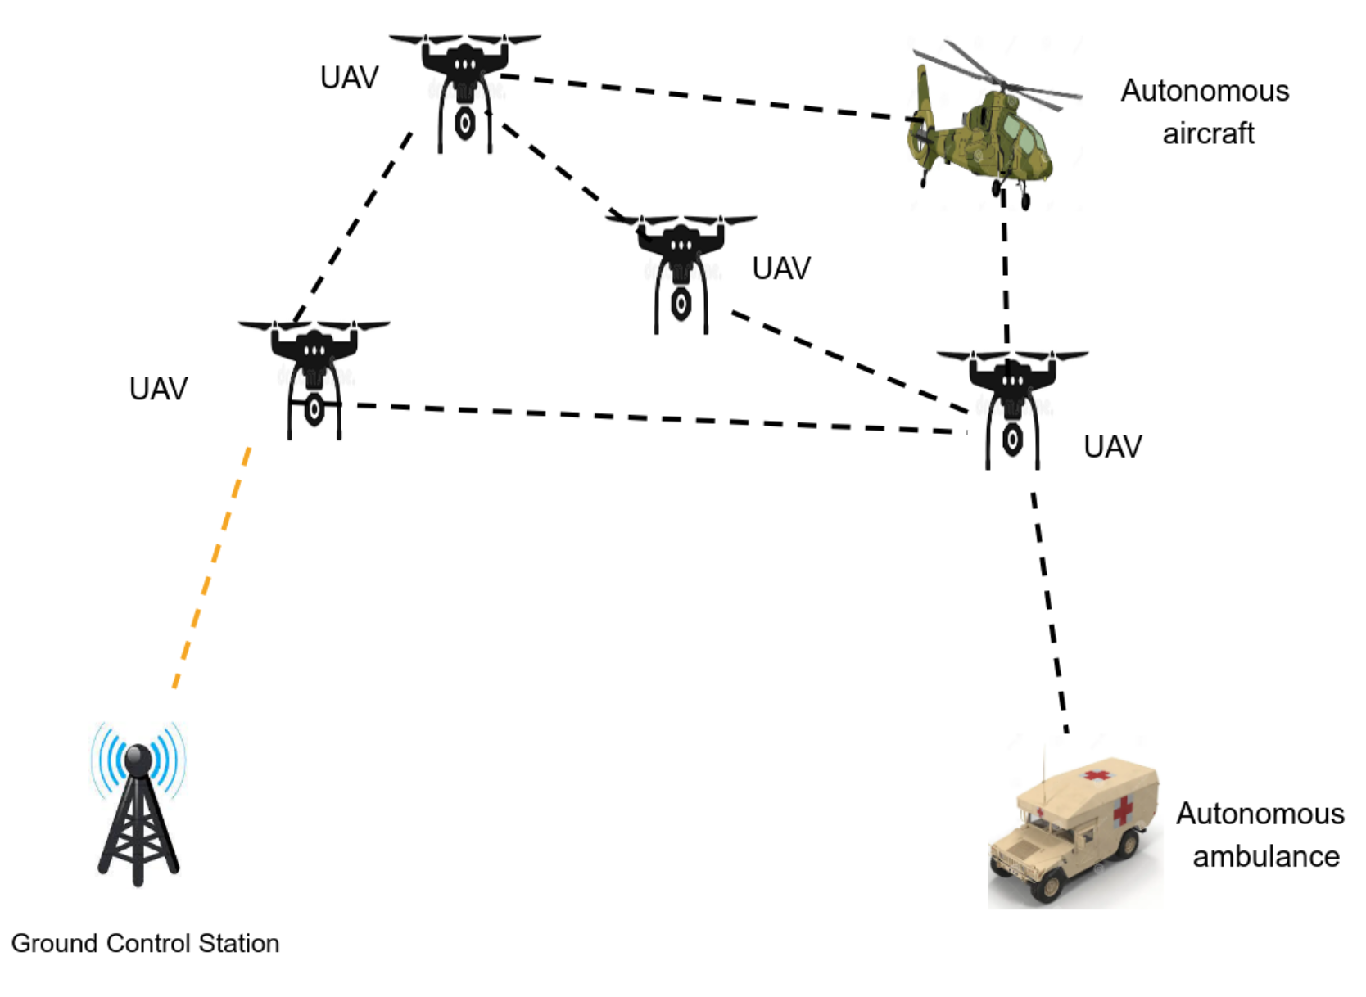
An Autonomous UAV Networks with Ground Vehicles and Other Autonomous Aircrafts
Notes:
The network is heterogeneous and includes air and ground components.
Defense strategies must account for these varied entities and their communication behaviors.

Slide 56
Limitations of Prior Works
Traditional defense mechanisms are inadequate because they focus on detecting and mitigating individual attack patterns rather than identifying the subtle interplay between multiple coordinated adversaries.
  For example, attackers deliberately distribute their malicious activities across multiple nodes to stay below detection thresholds or employ complementary attack methods that mask each other’s signatures.
Prior research on collaborative attacks
  focused primarily on developing detection and defense strategies for traditional networks,
  failing to address the resource limitations inherent to UAV platforms, their limited energy capacity and limited onboard computational capabilities.
These constraints affect the feasibility and effectiveness of security solutions, as resource-intensive defense mechanisms can potentially compromise the network’s operational lifetime and mission capabilities.
Notes:
Previous works most focus on single-node or single-attack scenarios, missing the subtle collaboration between multiple adversaries.
However, attackers may spread out activity to stay under detection thresholds or use complementary strategies to confuse defenses.
UAV-specific constraints: low energy, limited compute power—meaning heavyweight defenses are not viable.

Slide 57
Understanding Threat Models against Autonomous UAV Networks
Real world implications
  In search and rescue operations, coordinated attacks can disrupt communications while injecting false data to mislead rescue efforts.
  In precision agriculture, attackers can manipulate UAV routing while depleting ground sensor resources in critical areas.
  In military applications, physical sabotage may be synchronized with cyber attacks to maximize fleet vulnerability.
A collaborative attack is composed of individual, atomic attacks
  Sybil attacks, where attackers create multiple fake identities to manipulate system-wide collaborative decisions;
  Wormhole attacks, where adversaries record and retransmit packets between different network locations to disrupt routing;
  Black hole attacks, where malicious nodes advertise false shortest paths to intercept network traffic.
Notes:
Real-world implications of collaborative attacks:
Search and Rescue: Misleading data disrupts coordination.
Precision Agriculture: Diverted UAVs or drained sensors.
Military: Physical sabotage timed with cyberattacks.
We study three atomic attack types
Sybil: Fake identities.
Wormhole: Malicious routing loops.
Blackhole: Traffic drops via false routes.
These atomic attacks can combine into powerful, stealthy collaborative attacks.

Slide 58
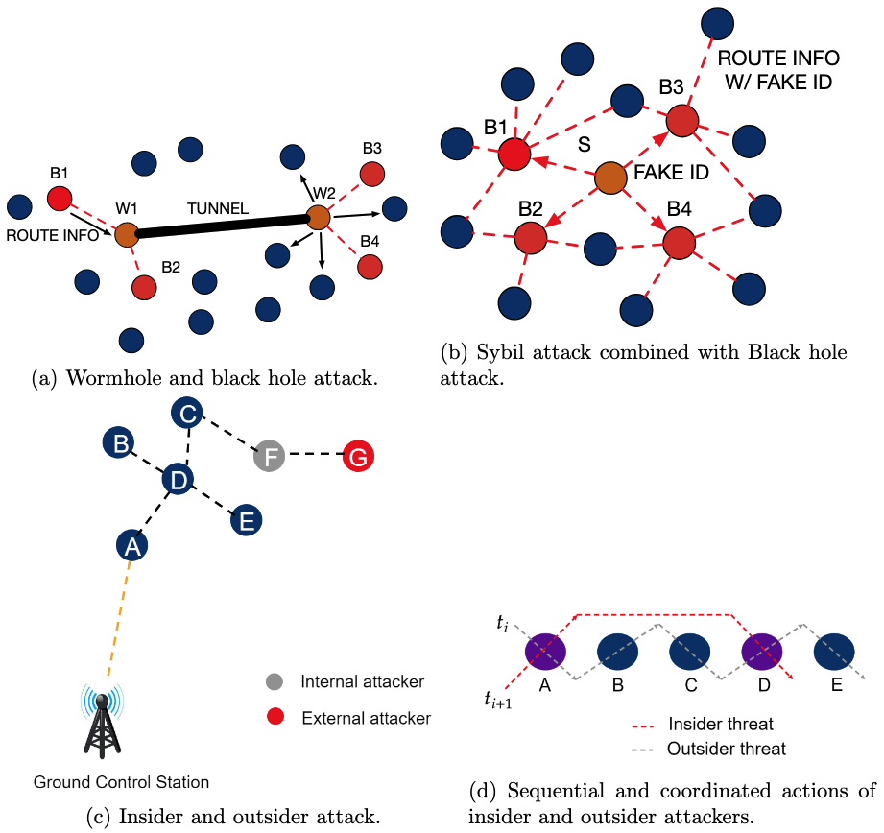
Examples of Collaborative Attacks
(a): Wormhole nodes (W1, W2) collaborating with blackhole nodes (B1-B4) for amplified routing disruption;
(b): Sybil node (S) providing fake IDs to blackhole nodes for detection evasion;
(c) and (d): Sequential insider (F) and outsider (G) attack coordination across time steps.
Notes:
Different collaborative attack scenarios:
(a) Wormhole and Blackhole working together.
(b) Sybil node giving fake IDs to other attackers.
(c) and (d) Time-based coordination: insiders + outsiders across time.
These scenarios illustrate the complexity and variability in how adversaries collaborate.

Slide 59
The Hiding Effect: A Blackhole-Sybil example
Blackhole-Sybil Collaborative Attack
  The Sybil adversary secretly transfers valid IDs to blackhole adversaries instead of abusing them.
    SE1: It does not trigger abnormal events and, thus, is hidden from detection.
  Blackhole adversaries broadcast false routing information with distinct IDs received from the Sybil adversary.
    SE2: Making blacklisting-based blackhole attack defense mechanisms[4~6] invalid.
Notes:
The Hiding Effect in Blackhole-Sybil collaboration example:
A Sybil attacker quietly hands out IDs to blackhole nodes.
The blackholes then act using valid-looking IDs, evading detection.
This coordination defeats blacklisting defenses.

Slide 60
Task 2: Designing Mechanisms to Secure Autonomous UAV Networks against Collab- orative Attacks
Defense against Multi-Stage Attacks (MSAs) vs. Defense against Collaborative Attacks:
  Defenses against MSAs are concerned with finding patterns in sequential actions that are typically conducted by a single attacker.
  By contrast, collaborative attacks are more general because they involve multiple attackers, who can execute their actions in an interleaved fashion which is more sophisticated than sequential events.
Nevertheless, the research will use sequential data analysis as some building-blocks in the defenses.
Moreover, the MSAs launched by a single attacker cannot achieve synergy effects as discussed above.
Notes:
Comparing Multi-Stage Attacks (MSAs) and Collaborative Attacks:
MSAs = single attacker over time.
Collaborative = multiple actors in parallel or staggered steps.
While MSAs provide a foundation (e.g., sequence learning), collaborative attacks require new methods for interleaved, multi-agent detection.

Slide 61
Task 2: Designing Mechanisms to Secure Autonomous UAV Networks against Collab- orative Attacks
Current multi-stage attack defenses fail to address three challenges in UAV environments:
  (1) coordinated actions by multiple attackers,
  (2) rapidly changing attack surfaces due to UAV mobility, and
  (3) resource constraints that limit computational defense mechanisms.
Notes:
3 challenges of detecting collaborative attacks in UAV networks:
Multiple attackers acting together.
Changing attack surfaces due to UAV motion.
Resource constraints making heavy processing infeasible.
These issues demand innovative, layered, and lightweight solutions.

Slide 62
Using Formal Methods to Detect Collaborative Attacks
Traditional ML models struggle to detect multi-step, coordinated attack behavior. Collaborative attacks often span multiple nodes and evolve over time — difficult to capture via flow-based features alone.
Our Approach:
Treat network events as state transitions in a system model.
Use formal verification techniques (e.g., model checking) to:
  Detect illegal state transitions or unexpected sequences.
  Identify if multiple agents are collaborating across time to breach security.
Key Ideas:
Model UAV network behavior using finite state machines or temporal logic.
Encode known benign and malicious interaction patterns.
Use runtime verification or offline checking to flag potential coordinated attacks.
Notes:
Traditional ML often fails with multi-step, spread-out attacks.
Formal methods provide a powerful alternative:
Model the UAV network as a system with states and transitions.
Use model checking to verify that transitions follow expected patterns.
Unexpected behavior → potential collaborative attack.
We use finite state machines and temporal logic to formalize attacker behavior.

Slide 63
Learning-Based Models for Sequential Detection
Hidden Markov Models (HMM):
Probabilistic models capturing transitions between hidden system states.
Suitable for lightweight onboard detection.
Assumes limited memory (Markov property) and works best with relatively simple or periodic attack patterns.
Long Short-Term Memory Networks (LSTM):
A type of recurrent neural network designed to capture long-term dependencies.
Effective in learning subtle, delayed, or multi-stage attack patterns.
Requires extensive training data and higher computational resources.
Notes:
Compare two ML approaches:
HMM (Hidden Markov Models): Good for simple, periodic attacks, works onboard due to low overhead.
LSTM (Long Short-Term Memory): Better for complex or delayed patterns, but needs more resources.
These models are complementary: HMMs can be run on UAVs, LSTMs at base stations for deep analysis.

Slide 64
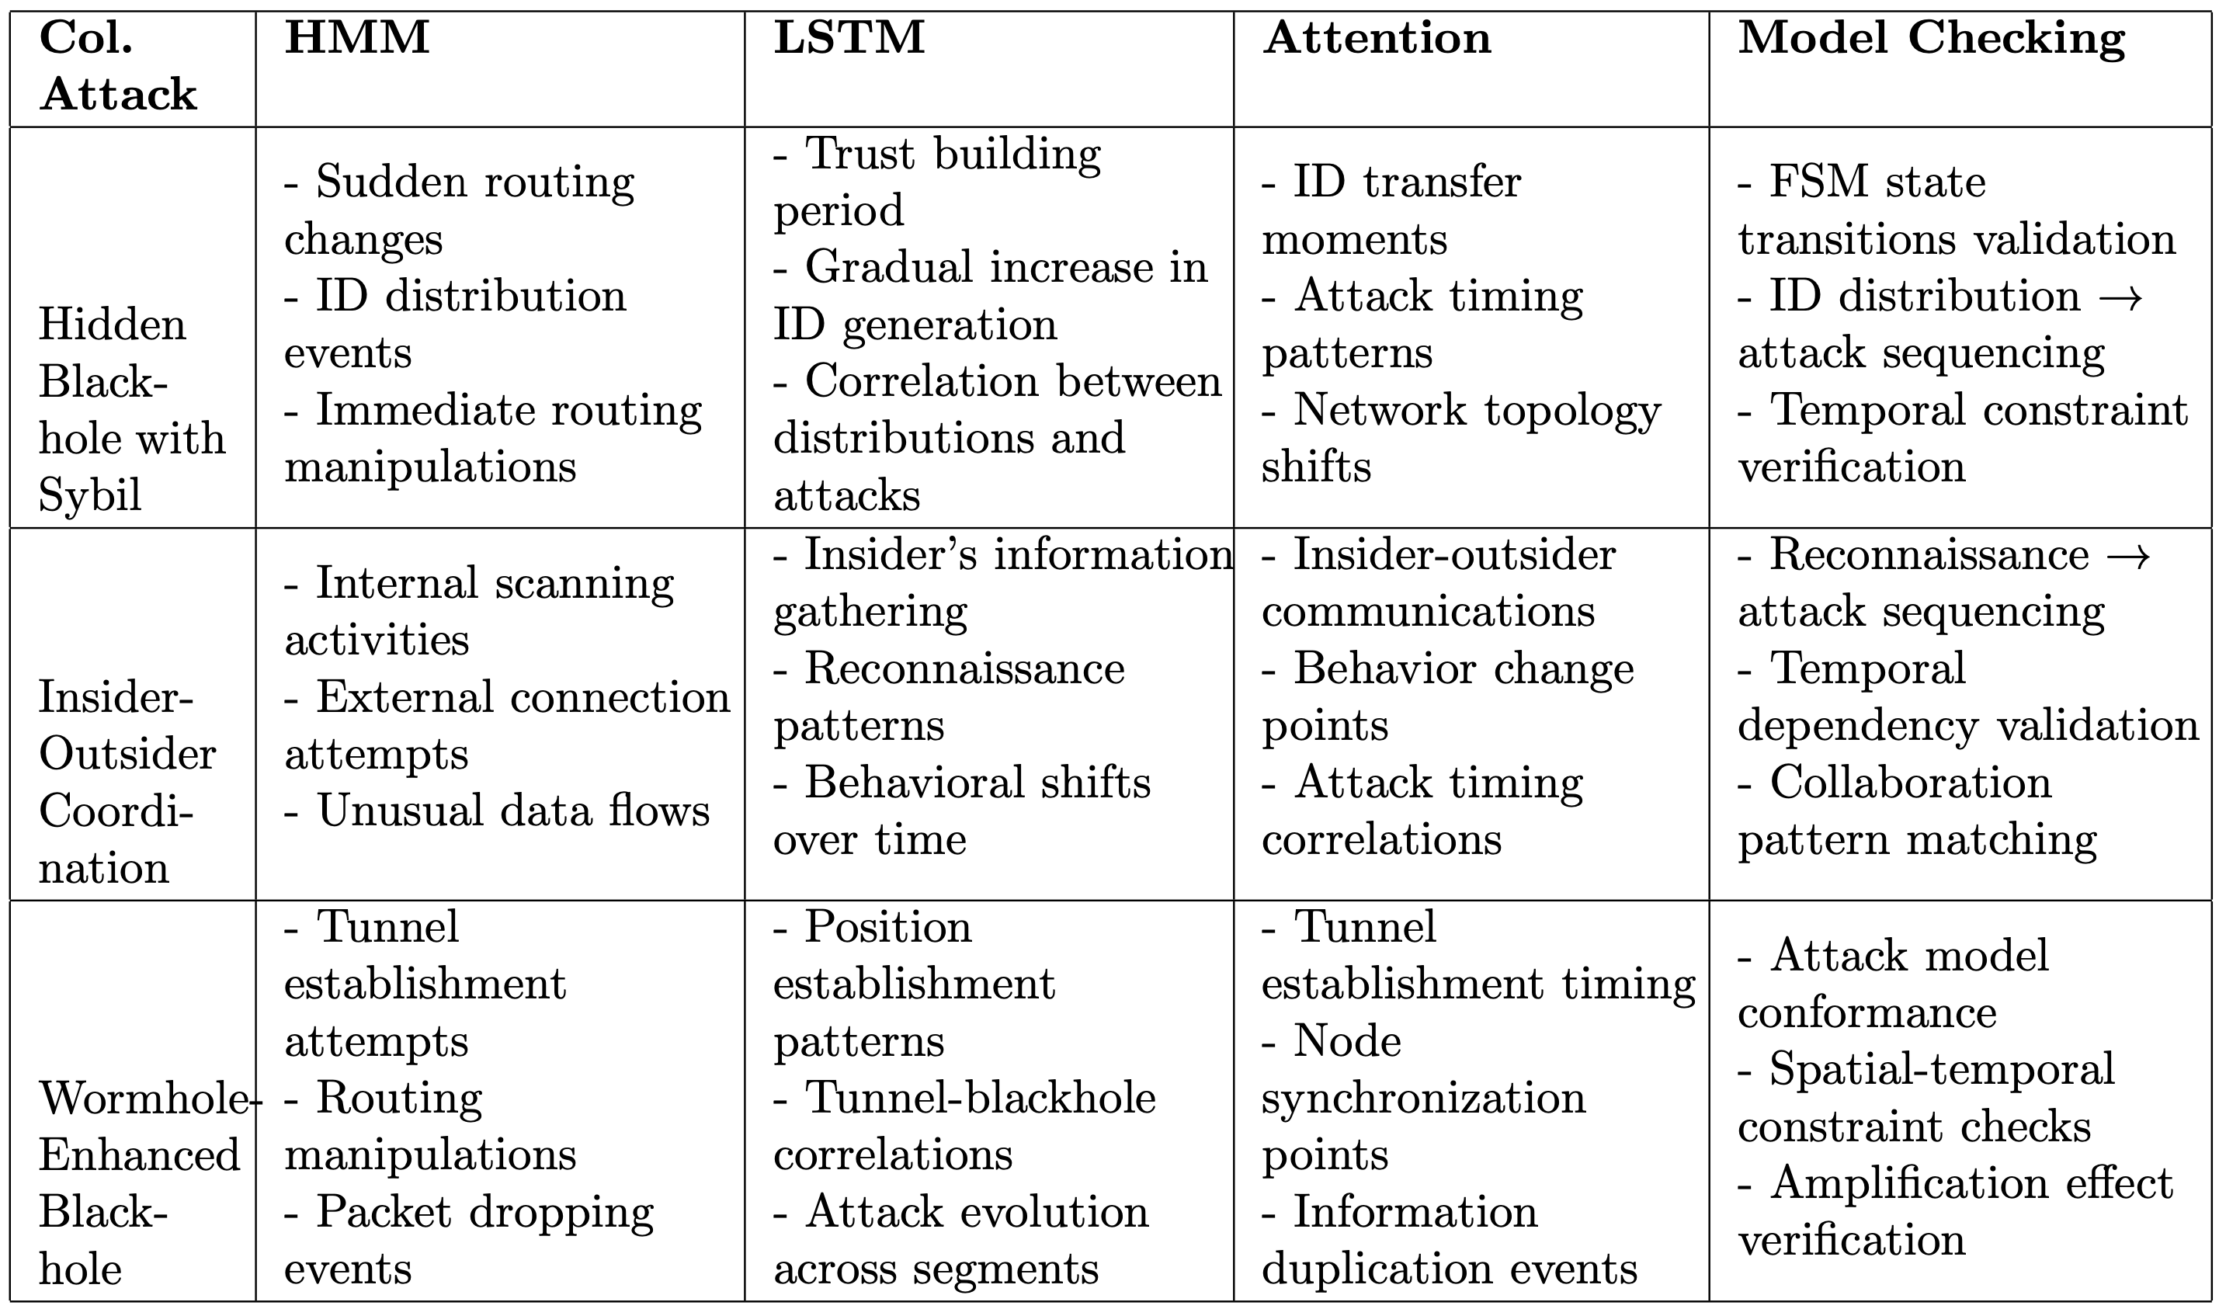
Examples of events and actions associated with the four proposed mechanisms in the context of three examples of collaborative attacks.
Notes:
The table highlights how different events and actions map to the detection mechanisms described earlier.
It shows how the system tracks events in relation to various collaborative attack examples.
The table bridges theory with implementation—how the detection framework processes real UAV behavior and alerts.

Slide 65
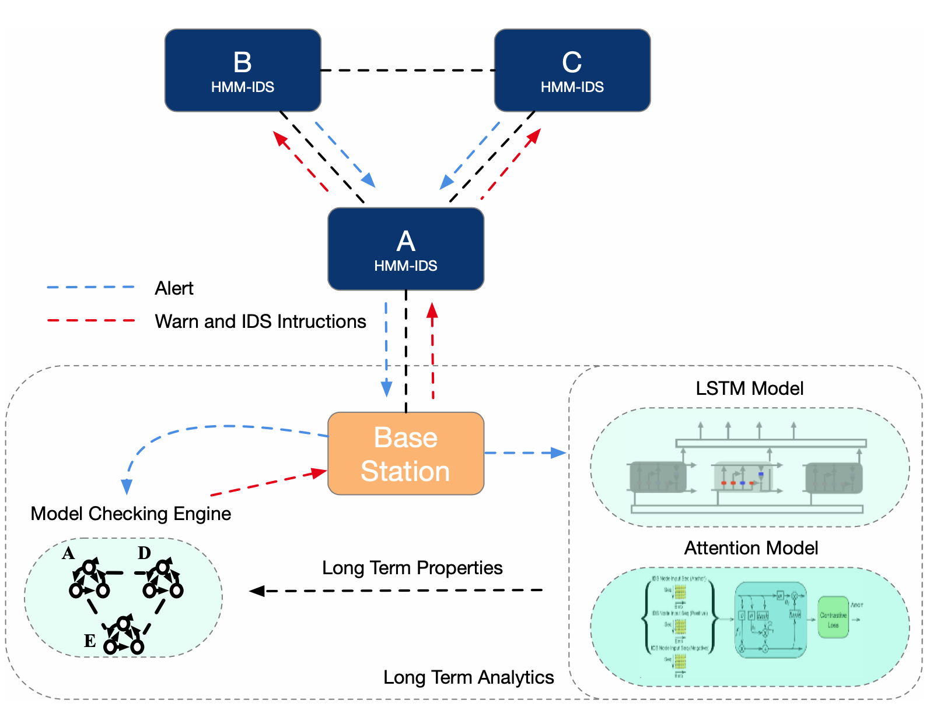
Task 3: Designing Defense Framework to Counter Collaborative Attacks
Notes:
Our frame is distributed, striking a balance between:
Lightweight detection at UAVs.
Deep analysis at the Base Station (BS).
Three key BS roles are:
Use model checking to find collaboration patterns.
Generate attack signatures.
Analyze sequences with attention-based models.
This architecture makes detection scalable and adaptive.

Slide 66
A Proposed Framework
The figure highlights the preliminary framework
  The framework implements a distributed detection architecture that balances detection capability with UAV resource constraints.
  It leverages the Base Station (BS) for computationally intensive analysis while deploying efficient short-term detection on individual UAVs.
Base Station Components
  The Model Checking Engine forms the framework’s foundation, providing three functions.
    Discovers and verifies possible attack collaboration patterns.
    Generates attack signatures to guide HMM deployment on UAVs.
    Identifies temporal dependencies and critical events for LSTM and attention analysis.
Notes:
UAVs run lightweight HMM-based models for quick, local threat detection.
More complex, long-term analysis is offloaded to the Base Station using LSTM and attention mechanisms.

Slide 67
A Proposed Framework
The architecture offers several key advantages.
  Immediate threat detection occurs at network edges through lightweight HMMs while complex attack evolution analysis is centralized at the BS.
  UAVs maintain minimal state information and computational overhead, yet the framework continuously adapts to new attack patterns.
  Most importantly, all detection decisions can be verified through model checking.
The preliminary experiments show this distributed approach provides a good tradeoff between effectiveness in detecting collaborative attacks and resource utilization.
Notes:
Low computational burden on UAVs.
Real-time adaptability.
Model checking ensures verifiability of all decisions.

Slide 68
A Variant of the Proposed Framework
RDCollab: Reasoning and Detecting Collaborative Attacks
  A framework to reason about and detect collaborative attacks in autonomous UAV networks that leverages model checking to explore attack patterns.
  It models individual attacks as finite state machines (FSMs) that can be combined to represent collaboration.
  The framework uses properties describing network safety to explore collaborative attacks and guide intrusion detection systems.
  RDCollab improves IDSs' detection rates on non-hidden adversaries by up to 63% and can detect hidden adversaries within 6.1 seconds.
Notes:
We introduce RDCollab — “Reasoning and Detecting Collaborative Attacks”.
It uses model checking to uncover complex attack patterns.
Represents each attack as a finite state machine (FSM) and explores their interactions.
Up to 63% improvement in detection rates.
Detects hidden adversaries within 6.1 seconds.

Slide 69
A Variant of the Proposed Framework
RDCollab: Reasoning and Detecting Collaborative Attacks
  Three major synergy effects are identified: Hiding Effect, Amplifying Effect, and Shortcut Effect.
    The Hiding Effect makes adversaries more difficult to detect or makes specific adversaries undetectable.
    The Amplifying Effect occurs when coordinated attacks cause more damage than the sum of individual attacks.
    The Shortcut Effect allows adversaries to launch attacks with fewer steps or achieve goals faster.
  Seven novel collaborative attacks were discovered through model checking, including Hidden Blackhole Attack, Hidden Wormhole Attack, Duplicated Routing Disturbance Attack, Distributed Data Exfiltration Attack, and others.
  The framework extracts segment patterns from collaborative attack counterexamples as signatures to guide IDSs.
  Three baseline ML-based IDSs were used for evaluation: HMM-based, SVM-based, and RFC-based.
Notes:
RDCollab identifies three synergy effects introduced in previous slides:
Hiding Effect: Harder to detect.
Amplifying Effect: More damage together.
Shortcut Effect: Faster path to disruption.
7 novel attacks discovered using RDCollab (e.g., Hidden Blackhole Attack).
These results show how formal methods can discover unknown but dangerous attack variants.

Slide 70
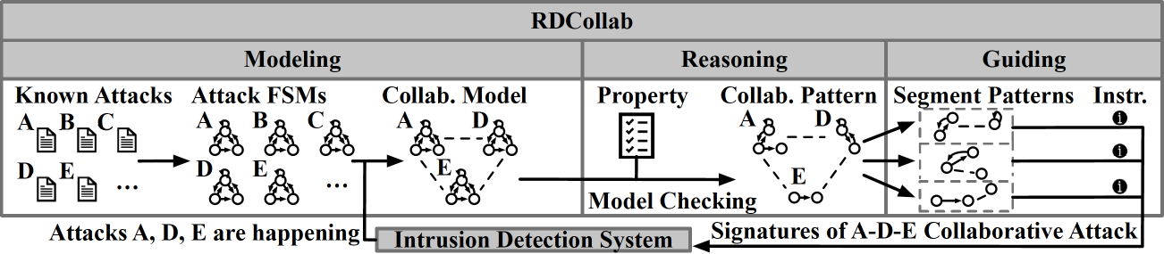
Our Solution: RDCollab (Reasoning and Detecting Collaborative Attacks)
The collaborating attacks are formally modeled as finite states machines (FSMs) connected by channels for message exchange.
Notes:
Collaborative attacks are formally modeled as FSMs with message-passing channels.
Each attacker’s behavior is encoded as a state machine.
Communication between FSMs allows simulation of collaboration.
This approach enables systematic discovery of synergy effects and vulnerabilities.

Slide 71
An Example of Collaborative Attack Model
privilege
impact, det
impact
non_det
Notes:
This structure lets us trace blackhole and Sybil attackers’ behavior and interaction.
This modeling phase lays the groundwork for precise detection.

Slide 72
More Details of the Modeling Phase
We define impact labels that describe how an adversary's actions violate the confidentiality, integrity, or availability of the system. For example, we label "send_fake_rtn_info” (send fake routing information) with "int_viol" for integrity violation, and "drop_packet" with "avai_viol" for availability violation.
Then we have detectability labels that indicate how observable an adversary's actions are. We use "det" for detectable actions, "part_det" for partially detectable actions, and "non_det" for actions that can't be observed externally. For instance, "send_fake_rtn_info" is labeled as "det" since it's observable, while "generate_id" in the Sybil FSM is labeled as "non_det" as it's done locally by the adversary.
These labels help us bridge the gap between abstract security requirements and concrete system behaviors.
Notes:
Labels are added to attacker actions:
Impact Labels: What kind of security violation? (e.g., integrity, availability).
Detectability Labels: Can it be observed? Fully, partially, or not at all?
These annotations help map real-world behaviors to abstract attack models.
They also enables IDS to better understand which actions are stealthy or harmful.

Slide 73
Our Solution: RDCollab (Reasoning and Detecting Collaborative Attacks)
Synergy effects are encoded as security properties in linear temporal logic (LTL) formulas.
Model checking is used to check collaborating model consisting of attack FSMs against the LTL-form security properties indicating attack collaborations.
Notes:
Linear Temporal Logic (LTL) is a way to encode security properties.
The system checks if the attack models violate expected safety properties over time.
If violations occur, a counterexample is generated, showing how attacks collaborate.
This process makes hidden threats discoverable and explainable.

Slide 74
Our Solution: RDCollab (Reasoning and Detecting Collaborative Attacks)
If the check fails, the model checker outputs a counterexample which can be referred to by IDS as oracles on how individual attacks collaborates.
Notes:
The role of counterexamples:
They act as "oracles" or patterns of malicious collaboration.
These are then fed back into IDSs to update their detection logic.
This forms a learning loop—every detected attack makes the IDS smarter.

Slide 75
Our Solution: RDCollab (Reasoning and Detecting Collaborative Attacks)
The IDS thus updates its detection and defense strategy accordingly.
Notes:
Reasoning Phase: Model checking reveals collaborative patterns.
Guiding Phase: These patterns are translated into actionable IDS rules.
This approach directly improves IDS accuracy by learning from collaboration evidence.

Slide 76
More Details of the Reasoning and Guiding Phases
RDCollab defines properties the model should satisfy in a synergy effects-free scenario (i.e., the scenario without the collaborative attacks that cause synergy effects).
It then uses the model checking to verify the collaboration model against the properties. If the model violates a property, the model checker outputs a counterexample demonstrating a model execution that can be interpreted as a collaboration pattern with synergy effects.
The segments of such a pattern are used in the guiding phase, as they can be used as signatures to detect collaborative attacks.
RDCollab translates the segments into instructions to guide IDS in improving its detection effectiveness.

Slide 77
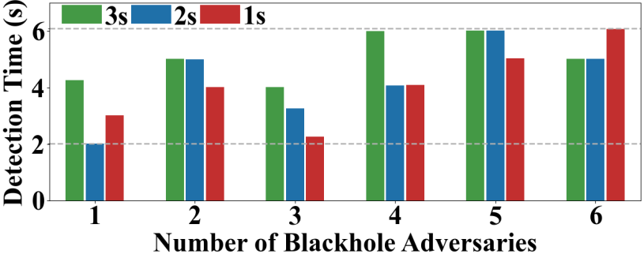
RDCollab Evaluation Results
Detecting the Hidden Sybil Adversary (SE1)
With various numbers (1~6, x-axis) of blackhole adversaries, RDCollab can detect the Sybil adversary that transfer fake IDs to them every 3, 2 and 1 second(s) within 6 seconds (y-axis).
Notes:
The evaluation results for Hiding Effect (SE1).
X-axis: Number of blackhole nodes.
Y-axis: Time to detect the hidden Sybil attacker.
Key point: RDCollab detects hidden adversaries within 6 seconds, even under complex multi-node collaboration.
Shows real-time applicability in fast-moving UAV networks.

Slide 78
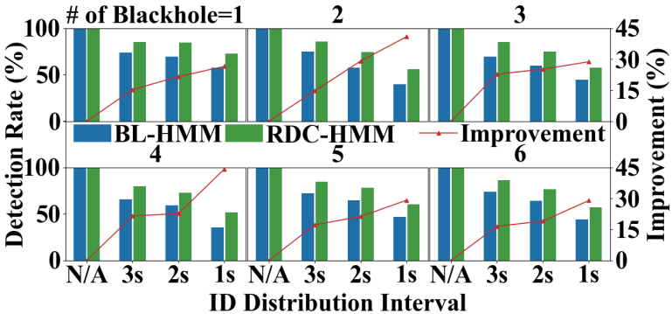
RDCollab Evaluation Results
Improving the Detection of Blackhole Adversaries (SE2)
With various numbers (1~6, subfigure titles) of blackhole adversaries, RDCollab-guided HMM-based IDS improves the detection rate of blackhole adversaries compared with baseline HMM-based IDS.
The improvements are shown by the red lines.
Notes:
The evaluation of RDCollab on Amplifying Effect (SE2) and the improved detection of blackhole adversaries.
Compare baseline HMM-based IDS (blue bars) vs. RDCollab-guided version (green bars).
The red lines show significantly higher detection rates across different blackhole configurations.
Using RDCollab as a guiding layer boosts existing IDS performance.

Slide 79
Takeaways and Contributions
Collaborative attacks pose a growing threat to UAV networks.
RDCollab provides a comprehensive approach to tackling these challenges.
  A solution to detect collaborative attacks against autonomous UAV networks.
  Implementation of RDCollab instantiating the proposed solution.
  Evaluation of RDCollab’s effectiveness of collaborative attack detection.
The next steps are to enhance collaborative attack detection and response systems.
Notes:
The key takeaways from the presentation:
Collaborative attacks are a real and growing threat to UAV systems.
Existing defenses fall short due to lack of synergy awareness and UAV-specific adaptation.
RDCollab offers a principled framework that detects, reasons about, and guides defense against these attacks.
Three core contributions:
The attack detection solution.
Implementation of RDCollab.
Evaluation demonstrating its effectiveness.

Slide 80
Another research effort for Advancing Collaborative Attack Detection
Existing IDS datasets lack UAV-specific attacks, aerial mobility, and real wireless traffic patterns.
Due to High costs of collecting large network datasets, we use data augmentation using MLP function approximation method. This makes current IDS system robust against false positives caused by mobility in UAV networks.
Notes:
Shortcomings in current IDS systems:
High false positive rates.
Poor adaptability to UAV-specific dynamics.
Lack of realistic datasets with mobility and collaborative behaviors.
There is the need for data augmentation to overcome data scarcity and variability.

Slide 81
Three-Phase Plan for Advancing Collaborative Attack Detection
Phase 1: Dataset Creation
Develop a comprehensive dataset simulating collaborative attacks in UAV networks.
Include realistic mobility models, packet-level logging, and diverse adversarial behaviors.
Emphasize attack diversity (e.g., blackhole, wormhole, Sybil) and coordination mechanisms.
Use Data Augmentation to increase diversity of dataset.
Phase 2: Transformer-Based Detection
Leverage attention-based models (e.g., Transformers) to capture temporal dependencies and multi-agent coordination patterns.
Fine-tune on domain-specific UAV datasets.
Benchmark against baseline ML models and analyze detection accuracy under dynamic conditions.
Phase 3: Enhancing Detection Efficiency
Optimize detection models for onboard deployment using techniques like knowledge distillation, pruning, and quantization.
Explore hierarchical detection: light-weight edge models + cloud-based heavy analysis.
Integrate detection with real-time response mechanisms.
Notes:
The three-phase plan:
Dataset Creation: Simulate UAV traffic and diverse collaborative attacks.
Transformer-Based Detection: Leverage deep learning for coordination analysis.
Efficiency Enhancements: Optimize models for resource-constrained UAVs.
Explain that this roadmap ensures a robust, scalable, and real-time defense solution.

Slide 82
Phase 1: Why Existing Datasets Fall Short for UAV Networks
Lack UAV-specific attacks
Most datasets focus on generic IT or IoT threats, not aerial or coordinated UAV threats.
Static or limited mobility
Many datasets assume fixed topologies, unsuitable for dynamic, mobile UAV environments.
No real UAV traffic
Missing realistic communication patterns like video/image transmission or inter-UAV coordination.
Not designed for swarm behavior
Fail to capture group dynamics, cooperation, or synchronized attacks.
Misaligned threat models
Include irrelevant attack types (e.g., fuzzing, worms) not applicable to UAV use cases.
Partial relevance (e.g., IoT/WSN)
Offer some overlap in resource constraints, but lack full UAV context.
Notes:
Key gaps in existing datasets:
No UAV-specific threats or mobility patterns.
No real aerial communication behaviors or swarm dynamics.
These gaps make it hard for IDSs to generalize and perform reliably in UAV environments.
There is the need for new datasets tailored to UAV scenarios.

Slide 83
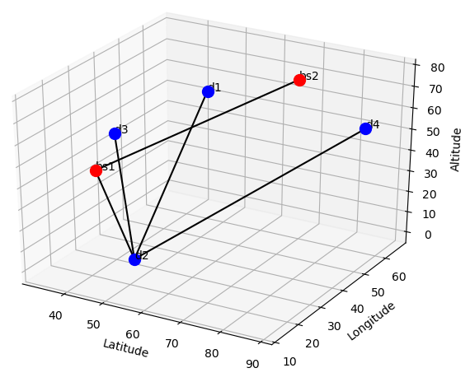
Phase 1: Our UAV IDS Dataset: Key Features
Dynamic UAV Network & Mobility
UAVs (10-50) & Basestations (1-5) move using Gaussian-Markov model.
Links dynamically change based on Euclidean distance, simulating WiFi characteristics (capacity, delay, loss).
Packet loss modeled via BER, SNR, & FSPL, with retransmission-based correction.
Attacks Simulated
DoS & DDoS – SYN floods (100 to 100K packets/sec), Black Hole, Wormhole, Replay Attack.
Realistic UAV Data Capture
UAVs send images/videos, simulating reconnaissance transmission.
Traffic captured at node & switch levels for IDS evaluation.
Systematic variation: 100 runs per setup (60s each) with diverse UAV counts, attacks, & packet rates.
Notes:
The simulated UAV network:
UAVs and base stations move using a Gaussian-Markov model.
Network topology changes based on distance and wireless properties.
Simulated attacks include DoS, blackhole, wormhole, and replay attacks.
This setup captures realistic communication and mobility behavior.

Slide 84
Phase 1: Our data augmentation: Using MLP as a function approximation
MLPs (Multi-Layer Perceptrons): are powerful function approximators that can learn nonlinear mappings between input and output feature distributions.
They capture complex relationships between flow statistics like inter-arrival times, packet sizes, and burstiness patterns across different bandwidths.
Unlike linear regression, MLPs can model diverse traffic behaviors more accurately, especially when the transformation is not linearly scalable.
Notes:
Multi-Layer Perceptrons (MLPs) are used to augment traffic data.
MLPs learn how traffic looks under different bandwidth constraints (e.g., converting 100 Mbps flows into realistic 10 Mbps flows).
This boosts dataset diversity, helping train models that perform well under realistic and constrained UAV conditions.

Slide 85
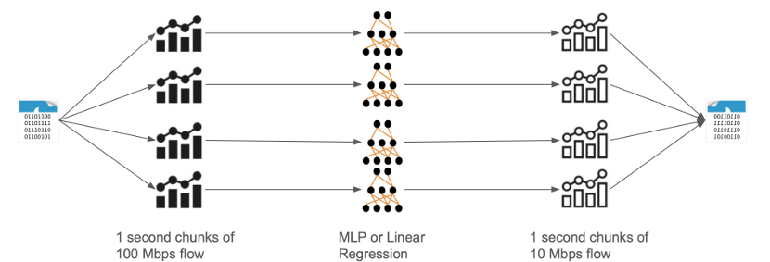
Phase 1: Our data augmentation: Using MLP as a function approximation
Input: Original network traffic is segmented into 1-second flow chunks from a 100 Mbps environment.
Feature Extraction: We extract statistical features for each chunk (e.g., flow size, number of packets, arrival times).
MLP Transformation: These features are passed through a trained MLP (or linear regression as baseline) to generate a mapped version mimicking how the same traffic would appear on a 10 Mbps link.
Output: The resulting 10 Mbps-style flow chunks are recombined into an augmented dataset with realistic traffic for low-bandwidth settings.
Notes:
The data augmentation pipeline:
Segment traffic into 1-second chunks.
Extract statistical features.
Use MLP to transform flow into low-bandwidth form.
Recombine into augmented datasets.
This helps simulate how the same network activity would appear under different communication conditions.

Slide 86
F1- score of different ML techniques using Flow features.
Machine learning model | CICIDS 2017[x] | CICIOT2023[x] | UNSW-NB15[x]
1D – CNN | 97.98 | 67.68 | 60.62
Long short-term memory | 87.15 | 64.29 | 46.17
Random Forest | 99.63 | 79.12 | 87.66
Stochastic gradient descent | 95.98 | 50.41 | 39.03
Logistic Regression | 93.16 | 48.24 | 37.82
Multilayer perceptron | 95.87 | 61.55 | 48.45
We use these vanilla models on three public datasets.
We measure 65 different flow features based on packet size, packet time of arrival, and TCP flags.
We measure F1-scores as these datasets are imbalanced.
As dataset diversity and complexity increase, traditional models struggle to generalize—highlighting the need for more expressive, context-aware approaches.
Notes:
The table shows evaluation results using three public datasets.
F1-score is used due to class imbalance (rare attacks).
Simple models struggle with diverse, complex flow patterns—especially under collaborative attack scenarios.
This reinforces the need for context-aware and expressive models like RDCollab + transformers.

Slide 87
Phase 2 – Transformer-Based Detection Ideas
Older detection methods often rely on shallow models or handcrafted features, which struggle to capture the complex temporal and multi-agent coordination patterns in collaborative attacks—necessitating more expressive architectures like Transformers.
Multi-Agent Attention Modeling
Capture inter-node interactions by modeling UAV network as a sequence of events with node-level embeddings.
Graph-Transformer Hybrid
Combine GNNs with Transformers to account for both network structure and temporal behavior.
Contrastive Learning
Learn discriminative features by contrasting collaborative vs. non-collaborative attack traces.
Few-Shot Fine-Tuning
Enable rapid adaptation to unseen coordinated attacks with minimal labeled data.
Notes:
Transformers are essential:
Older models can't capture the intricate timing and interaction patterns of multi-agent attacks.
Key design ideas:
Multi-Agent Attention: Tracks how UAVs interact over time.
Graph-Transformer Hybrid: Captures both structure and behavior.
Contrastive Learning: Distinguishes collaborative from non-collaborative patterns.
Few-Shot Fine-Tuning: Enables quick learning from small data.

Slide 88
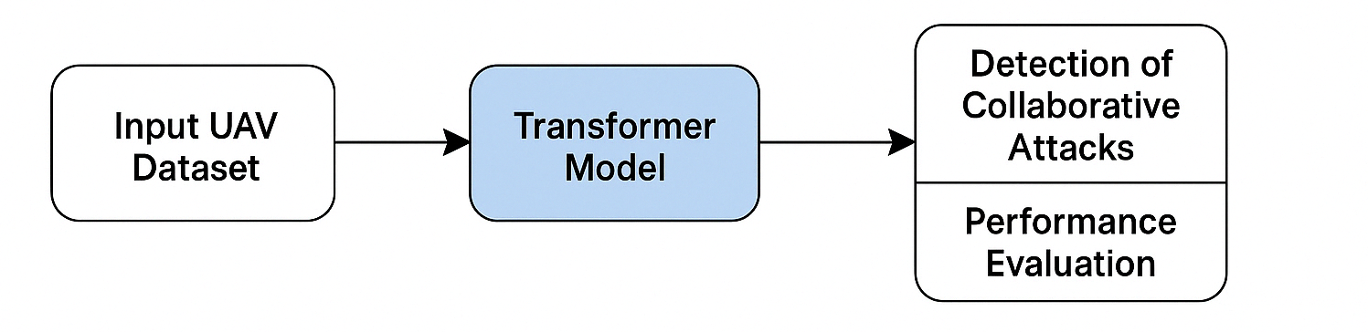
Phase 3 – Making Detection Efficient
Multi-Agent Attention Modeling
Capture inter-node interactions by modeling UAV network as a sequence of events with node-level embeddings.
Graph-Transformer Hybrid
Combine GNNs with Transformers to account for both network structure and temporal behavior.
Contrastive Learning
Learn discriminative features by contrasting collaborative vs. non-collaborative attack traces.
Few-Shot Fine-Tuning
Enable rapid adaptation to unseen coordinated attacks with minimal labeled data.
Notes:
Continue with Phase 3: optimizing detection for real-world deployment
How Transformers can be simplified:
Use MobileBERT, TinyBERT, Linformer for lightweight onboard inference.
The hierarchical detection:
Lightweight models on UAVs for fast filtering.
Deep models at base stations for complex analysis.

Slide 89
Phase 3 – Making Detection Efficient
Lightweight Transformer Variants
Explore MobileBERT, TinyBERT, and Linformer for onboard inference with low overhead.
Hierarchical Deployment
On UAVs: Quick screening via distilled models or rule-based alerts.
On Base Station: Deep analysis using full models and historical context.
Dynamic Resource Adaptation
Adjust model complexity based on available compute, energy, and threat severity.
On-the-Fly Model Updates
Incorporate detected counterexamples from RDCollab to update the detection pipeline in real time.
Notes:
Highlight dynamic and adaptive deployment:
Dynamic Resource Adaptation: Adjust model complexity based on available compute/energy.
On-the-Fly Updates: Integrate counterexamples from RDCollab to improve models in real time.
This adaptability is key in UAV missions with varying conditions and urgency.

Slide 90
Future Directions
Apply RDCollab techniques to related domains like VANETs
Apply federated learning across UAVs without raw data sharing

Slide 91
References
[1] UAV Market to Worth USD 91.23 Billion by 2030 - UAV Industry Report by Fortune Business Insight : https://www.fortunebusinessinsights.com/industry-reports/unmanned-aerial-vehicle-uav-market-101603
[2] Airlangga, Gregorius, and Alan Liu. "A Study of the Data Security Attack and Defense Pattern in a Centralized UAV–Cloud Architecture." Drones 7.5 (2023): 289.
[3] Sarkar, Nurul I., and Sonia Gul. "Artificial intelligence-based autonomous UAV networks: A survey." Drones 7.5 (2023): 322.
[4] T. Noguchi and T. Yamamoto, “Black hole attack prevention method using dynamic threshold in mobile ad hoc networks,” in 2017 Federated Conference on Computer Science and Information Systems (FedCSIS). IEEE, 2017, pp. 797–802.
[5] J. Tobin, C. Thorpe, and L. Murphy, “An approach to mitigate black hole attacks on vehicular wireless networks,” in 2017 IEEE 85th vehicular technology conference (VTC Spring). IEEE, 2017, pp. 1–7.
[6] T. N. D. Pham and C. K. Yeo, “Detecting colluding blackhole and greyhole attacks in delay tolerant networks,” IEEE Transactions on Mobile Computing, vol. 15, no. 5, pp. 1116–1129, 2015.

