Slide 1
Collaborative attacks extend
Zizheng Liu, Bharat Bhargava

Slide 2







Robust Secure Aggregation for DFL
FL Security and Privacy
Federated Learning (FL)
Security: Poisoning attack
Privacy leakage
Aggr( , , …, )
Aggr( , , …, )
…
…
Aggr(W₁, W₂,…,W_{n}) = G

Slide 3


Robust Secure Aggregation for DFL
FL Security and Privacy
Federated Learning (FL)
Security: Poisoning attack
Privacy leakage
Verify( , , …, )
, , …
Aggr( , , …, )
Aggr( , , … )
Aggr( , , …, )
…
…
…
Verify(W₁, W₂,…,W_{n}) = W₁, W₂,…

Slide 4

Robust Secure Aggregation for DFL
Decentralized FL and Secure Multi-party Computation
Decentralized Federated Learning
MPC: Secure Multi-Party Computation
x₁
x₁, y₁
x₂, y₂
x₅, y₅
x₂
x₅
x₃, y₃
x₄, y₄
x₃
x₄
Verify(W₁, W₂,…,W_{n}) = W₁, W₂,…
f(x₁, x₂, x₃, x₄, x₅) = y₁, y₂, y₃, y₄, y₅
Aggr(W₁, W₂,…,W_{n}) = G
Secure Aggregation: f() := Aggr(); x_{i} := W_{i}; y₁ = … = y_{n} := G
Robust Secure Aggregation: f() := Aggr(Verify()); x_{i} := W_{i}; y₁ = … = y_{n} := G

Slide 5
Robust and Secure Aggregation for DFL
An example of MPC
MPC Example: compute average salary
If all participants are honest, then by replacing salaries with model parameters and setting the aggregation function Aggr() to Avg(), the problem is resolved.
If some participants submit malicious inputs, a Verify() function must be introduced.
Verify() involves more than simple addition; it requires additional computational operations.
Beyond injecting malicious inputs, an adversary may also cheat during the secure computation process.
For example, the adversary may perform incorrect local computations to prevent the protocol from producing an output.
Alternatively, the adversary may simply refuse to participate in the computation.
8000 + (-2000) + (-1000)
$5000
8000-1200+1800=8600
-1200
-1000
-2000
1800
-1300
$2000
-500
$1000
-1200 + 4500 + (-1300)
1800 + (-500) + (-300)
4500-2000-500=2000
-300-1000-1300=-2600
8600+2000-2600=8000
Additive secret sharing: needs all secret shares to reconstruct the secret

Slide 6
Robust and Secure Aggregation for DFL
Threat Model
From Machine Learning Perspective
From MPC Perspective
Security: Use Verify() to filter out malicious models.
Privacy: Use secure multiparty computation to aggregate models (execute Aggr()).
Security and Privacy:
Use secure multiparty computation to execute Verify(), then perform Aggr() on the accepted models.
Execute more operations
Verify(W_{t}, W_{r}) = I∥W_{t} − W_{r}∥₂ ≤ 𝜌
∥.∥₂ needs multiplication and square root computation
Threat Models
Semi-honest: all parties behave honestly to follow the protocol
Malicious: parties deviate
Secure with abort: halt the protocol when cheating detected
Guaranteed output delivery: find the deviating party, exclude it and continue

Slide 7
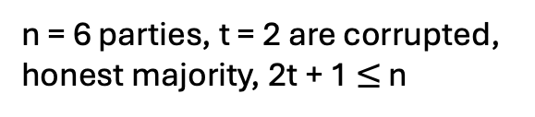
Robust and Secure Aggregation for DFL
Shamir’s Secret Sharing and DN multiplication Protocol
Additive secret sharing: needs all secret shares to reconstruct the secret
Shamie SS Properties
Denote [x]_{t} as a degree-t sharing of x. [(1,16), …, (6,341)] is a degree-2 sharing of 5.
[x]_{t}+[y]_{t} = [x+y]_{t}
k * [x]_{t} = [kx]_{t}
[x]_{t} * [y]_{t} = [x*y]_{2t} – needs 2t+1 shares to reconstruct the secret
Shamir’s n-t secret sharing
Any t+1 parties can reconstruct the secret
n = 6 parties, t = 2 are corrupted,
honest majority, 2t + 1 $≤$ n
Secret: 5
g₁(x) = 5 + 2x + 9x²
g₁(1) = 16
DN Multiplication Protocol
The parties prepare ([r]t, [r]2t), where r is a secret random value.
Each party locally computes [x]t * [y]t = [xy]2t and sets [e]2t := [xy]2t + [r]2t.
The parties select a coordinator Pking and send [e]2t to him.
Pking reconstructs e, generates [e]t, and distributes it to the parties.
Each party then locally computes [z]t = [xy]t = [e]t - [r]t.
During this process, any party, including Pking, may cheat.
This protocol provides only semi-honest security.
g₁(2) = 45
P1
g₁(6) = 341
P2
g₁(5) = 240
P6
g₁(4) = 157
g₁(3) = 92
P3
P4
P5

Slide 8
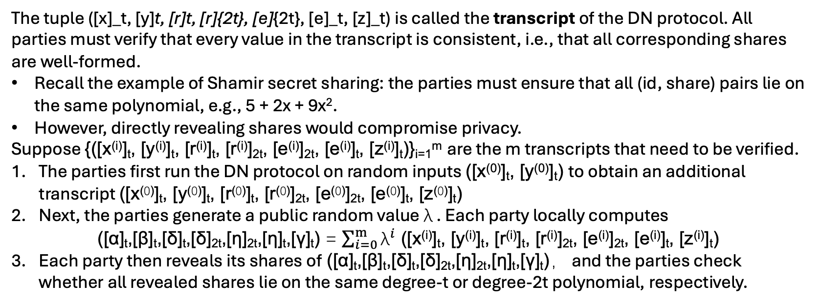
Robust and Secure Aggregation for DFL
g₁(x) = 5 + 2x + 9x²
g₁(1) = 16
g₁(2) = 45
P1
g₁(6) = 341
P2
g₁(5) = 240
P6
Secure with Abort
g₁(4) = 157
g₁(3) = 92
Secure with Abort
P3
P4
P5
The tuple ([x]_t, [y]t, [r]t, [r]{2t}, [e]{2t}, [e]_t, [z]_t) is called the transcript of the DN protocol. All parties must verify that every value in the transcript is consistent, i.e., that all corresponding shares are well-formed.
Recall the example of Shamir secret sharing: the parties must ensure that all (id, share) pairs lie on the same polynomial, e.g., 5 + 2x + 9x².
However, directly revealing shares would compromise privacy.
Suppose {([x^{(i)}]_{t}, [y^{(i)}]_{t}, [r^{(i)}]_{t}, [r^{(i)}]_{2t}, [e^{(i)}]_{2t}, [e^{(i)}]_{t}, [z^{(i)}]_{t})}_{i=1}^{m} are the m transcripts that need to be verified.
The parties first run the DN protocol on random inputs ([x⁽⁰⁾]_{t}, [y⁽⁰⁾]_{t}) to obtain an additional transcript ([x⁽⁰⁾]_{t}, [y⁽⁰⁾]_{t}, [r⁽⁰⁾]_{t}, [r⁽⁰⁾]_{2t}, [e⁽⁰⁾]_{2t}, [e⁽⁰⁾]_{t}, [z⁽⁰⁾]_{t})
Next, the parties generate a public random value λ . Each party locally computes
([α]_{t},[β]_{t},[δ]_{t},[δ]_{2t},[η]_{2t},[η]_{t},[γ]_{t}) = $\sum_{i=0}^{m}{{\text{λ}}^{i}}$ ([x^{(i)}]_{t}, [y^{(i)}]_{t}, [r^{(i)}]_{t}, [r^{(i)}]_{2t}, [e^{(i)}]_{2t}, [e^{(i)}]_{t}, [z^{(i)}]_{t})
Each party then reveals its shares of ([α]_{t},[β]_{t},[δ]_{t},[δ]_{2t},[η]_{2t},[η]_{t},[γ]_{t})， and the parties check whether all revealed shares lie on the same degree-t or degree-2t polynomial, respectively.

Slide 9
Robust and Secure Aggregation for DFL
Guaranteed Output Delivery
Guaranteed Output Delivery
For each share that a sender Pd distributes to a receiver Pi, denote it by σi(d). All other parties Pv act as verifiers for this share.
Each verifier Pv prepares an authentication key µ_{v→i}, for the receiver Pi. The verifier and the sender Pd then run a protocol to compute an authentication tag τ_{d,i,v} = µ_{v→i} * σ_{i}(d)，and the result is delivered only to Pi (neither Pd nor Pv receives the output. That is, x_{d} = σ_{i}(d), x_{v} = µ_{v→i}, y_{i} = τ_{d,i,v}, and all other inputs and outputs are empty.
Whenever σ_{i}(d) is disputed — for example, when all other shares lie on a certain polynomial but this one does not — Pi reveals the corresponding authentication tags to all verifiers. The verifiers then perform a majority vote to determine whether the sender Pd or the receiver Pi is cheating.
The cheating party is eliminated, and the computation is restarted.

Slide 10
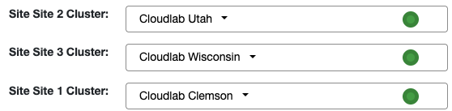
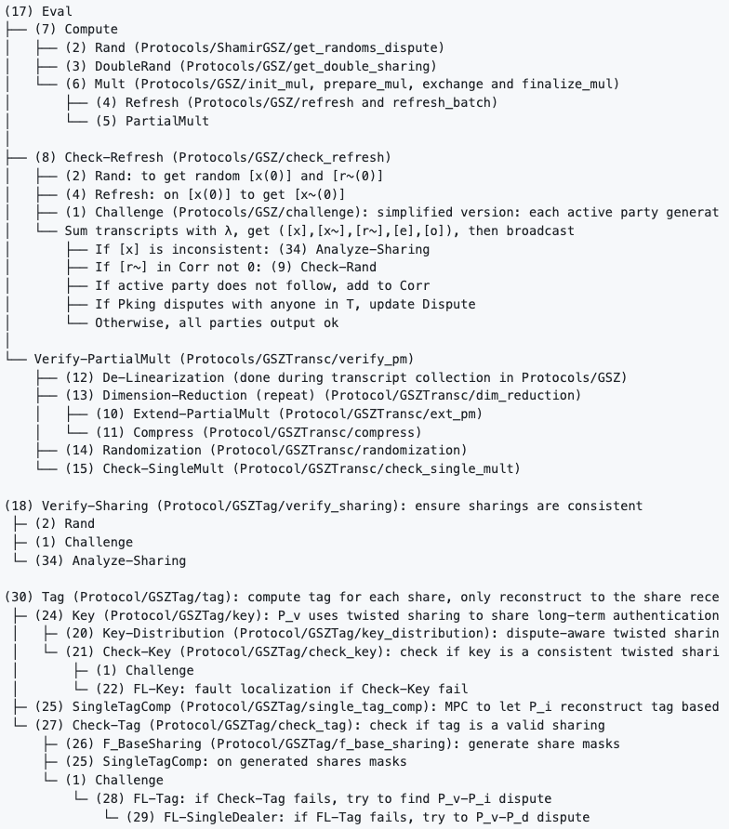
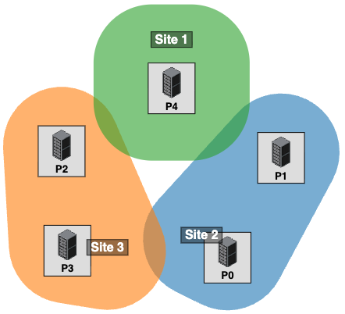
Robust and Secure Aggregation for DFL
Remainder questions and Experimental Results
During the computation of authentication keys and authentication tags, parties may still behave maliciously.
When a party is eliminated due to detected misbehavior, the number of remaining parties may fall below 2t+1, in which case degree-2t secret sharings can no longer be reconstructed.
In addition to addition and multiplication, protocols are required for other types of operations as well.
Machine learning computations typically use floating-point numbers, whereas secret sharing schemes operate over fixed-point representations.
All of the above issues are addressed by specialized secure multiparty computation protocols. This project involves approximately 40 such protocols.
Implementation: Based on the semi-honest DN multiplication protocol in MP-SPDZ, we incorporated additional operation logic and ensured that all operations provide guaranteed output delivery under malicious behavior. The implementation consists of 3,000+ lines of C++ code.
The protocol was successfully executed in a distributed network with nodes located in Utah, Wisconsin, and South Carolina.

