Slide 1


Secure Dissemination of Data in
Vehicle-to-Vehicle Systems
Presentation for:
ADI (Sypris), Feb 22nd, 2017
B. Bhargava¹, D. Ulybyshev¹, M. Villarreal-Vasquez¹,
R. Ranchal¹, G. Izera M.¹ L. Lilien²
¹Computer Science Department/CERIAS, Purdue University, West Lafayette, IN, USA
²Department of Computer Science, Western Michigan University, Kalamazoo, MI, USA

Slide 2
Outline
Motivation
Objectives
Deliverables
Related Work
Impact of Attacks on Safety
Impact of Implementing Security Features
  6.1 Case of Study: Security vs. Safety
Active Bundle Core Design
7.1. Key Generation / Encryption
7.2. Tamper – resistance
8. Lightweight encryption
9. Encrypted Search over Encrypted Data
10. References
2

Slide 3
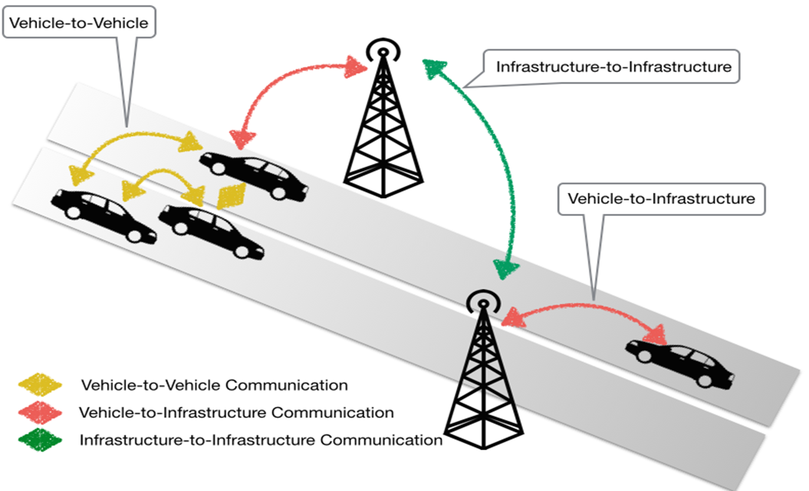
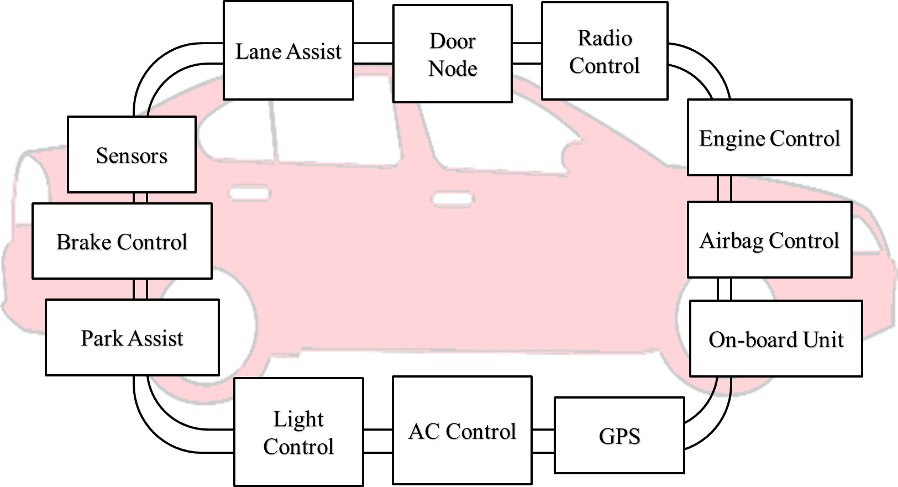

Motivation
Vehicle has more than 60 sensors and 30 or more Electronic Control Units (ECUs), i.e. Brake Control, Engine Control, GPS, Airbag Control, etc [6]
OBU allows heterogeneous and homogenous communications between vehicles and infrastructures (roadside equipment)
CAN (Control
Area
Network) Bus
Radio Interface or On-Board Unit
(OBU) enables short-range wireless
ad hoc networks to be formed
3

Slide 4
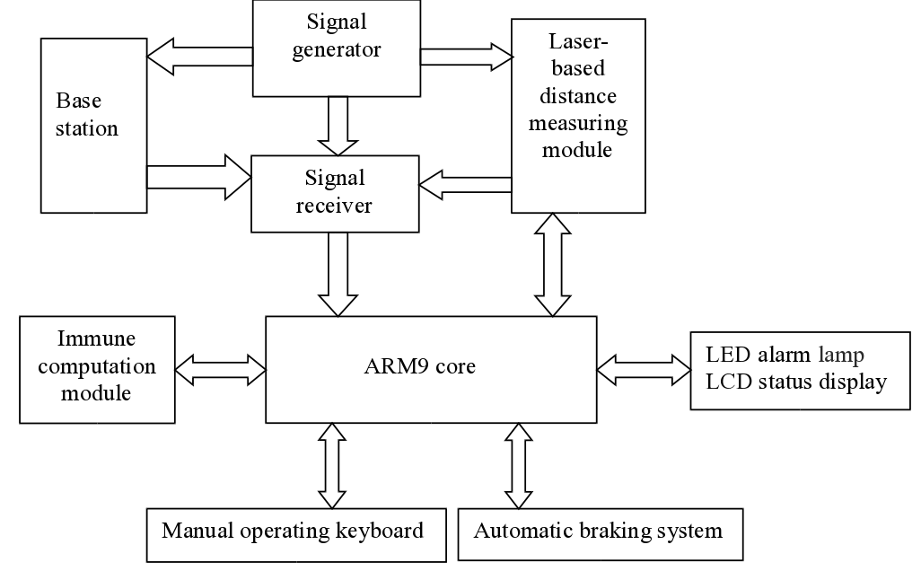
Motivation
ARM9 – based intelligent immune system for avoiding rear-end collision [14]
Communications between modules and ARM9 core need to be secure !
4

Slide 5
Motivation
Connected vehicles deploy signals to communicate with other vehicles, roadside units, personal devices and cloud services
  Goal: provide assistance to drivers and prevent collisions
Connected vehicle consists of electronic control units (ECUs) communicating via CAN (Controller Area Network) bus to transfer messages and execute queries sent from other ECUs
Vehicle-to-vehicle (V2V) and vehicle-to-infrastructure (V2I) communications are prone to security threats
Lightweight encryption – based protection mechanisms:
  Active Bundle [5], [9], [10], [11], [12], [13]
  Digital Signature
  HMAC
5

Slide 6
Objectives
Provide vehicle collision avoidance
Ensure data security and privacy
Measure the cost/overhead associated with proving security in V2V communication and its impact on safety
Provide system’s self-backup, the software fault detection and the software system repairing
6

Slide 7
Deliverables
Prototype demonstrating the evaluation of schemes to avoid collisions
Evaluation of tradeoff between ensuring security and safety
Evaluation of using cloud for computing versus dedicated chip
7

Slide 8
Related Work
Research report "Vehicle-to-Vehicle Communications: Readiness of V2V Technology for Application” [3] by National Highway Traffic Safety Administration
=> What policy should V2V system contain in order to minimize the likelihood of unauthorized access to insider information that could impose risks to privacy, e.g. facilitate tracking?
EVITA [4] project (developed in EU):
=> Identified and evaluated security requirements for automotive on-board networks based on a set of use cases and an investigation of security threat (dark-side) scenarios
8

Slide 9
Impact of Attacks on Safety
Threats
  Denial of Service Attack
  Masquerade Attack
  Malware Attack
  Message Tampering
Mitigation Schemes
  Active Bundle
  Digital Signatures
  HMAC
Cost of Deployment
  Detection and mitigation of attack require the following costs:
    Performance overhead
    Memory overhead
    CPU and energy usage
9
ffmpeg

Slide 10
Impact of Attacks on Safety
Miller and Valasek demonstrated in DEF CON 21 a set of attacks [7], [8], including very serious attacks.
Hard braking/ no braking attack
  Locked brake
  Sudden stop
  Braking distance increase
Acceleration attack
  Sudden uncontrollable acceleration
Steering wheel attack
  Sudden uncontrollable rotation of a steering wheel
Engine shutdown
Light out attack
  Dashboard indication is misrepresented
  Dashboard indication is off
10
ffmpeg

Slide 11
Impact of Deploying Security
Mechanism | Security | Safety
Digital Signature | Data comes from a known trusted node | Delay: validating undetected data
Encryption | Security depends on the key size | Delay: Undetected modifications can compromise safety
Active Bundle | Privacy–preserving policy-based and context-based data dissemination | Delay: validating undetected data
Levels of operation | Need to override access control for log and subsystems to handle emergencies | Way to bypass security and keep normal behavior
11

Slide 12
Impact of Implementing Security Features
V2V |  | Security | Safety
No security features | No attacks | Do nothing
 | Under attacks | Misleading dashboard and gps; firmware and data wiped out; compromised vehicle’s sensors, part of botnet framework | Human damage, collisions, delays in traffic
With security features | No attacks | Power consumption and computation overhead | Do nothing
 | Under attacks | Isolate intruder, warn other nodes about attack, deviate attacks to targets with less damage | Faster response time
12

Slide 13

CASE OF STUDY: SECURITY VS SAFETY
Category of traffic messages:
Traffic information messages: Used to disseminate the current conditions of specific areas and they indirectly affect safety
General safety messages: Used for cooperative driving and collision avoidance, and require an upper bound on the delivery delay of messages
Liability-related messages: Exchanged after an accident occurs
13

Slide 14
CASE OF STUDY: SECURITY VS SAFETY
Scenario 1: Sudden stop on a highway
  Vehicles move to same speed on the highway
  Pre-determined distance between them
  Reaction time with and without V2V
  Reaction time with secured V2V
High way scenario with only two vehicles involved
14

Slide 15
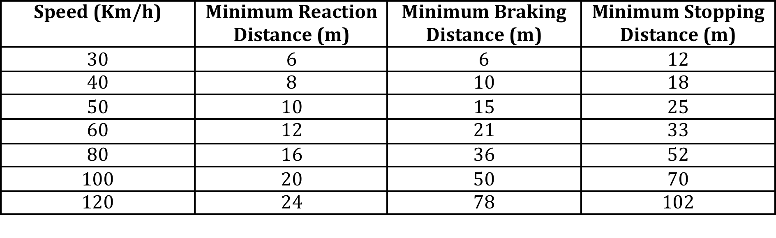
CASE OF STUDY: SECURITY VS SAFETY
Stopping distance:
  Driver’s perception time
  Driver’s reaction time
  Vehicle’s reaction time
  Vehicle’s braking capability
Table 1 – The RSA recommended minimum stopping distance under dry conditions
15

Slide 16
CASE OF STUDY: SECURITY VS SAFETY
System Model:
Network:
  IEEE 802.11a compliant
  6Mbps minimum
Security mechanism on V2V:
  PKI infrastructure
  Every vehicle is assigned a public and private key
  Public key distributed through a certificated signed by the CA
  Authenticated message:
16

Slide 17
CASE OF STUDY: SECURITY VS SAFETY
System Model:
Security costs on V2V:
  Processing cost
  Communication cost:
    Distance: 120m
    Bandwidth: 6Mbps
    Speed of communication link: 3x10^8m/s
17

Slide 18
CASE OF STUDY: SECURITY VS SAFETY
Experiment 1: Measurement of delays of V2V messages with and without security
  Speed: 120Km/h
  Distance: 120m
18

Slide 19
CASE OF STUDY: SECURITY VS SAFETY
Experiment 2: Measurement of the capacity of the link
  Speed: 120Km/h
  Distance: 120m
19

Slide 20
CASE OF STUDY: SECURITY VS SAFETY
Experiment 3: Reaction time with V2V
  Size of the message: 200 bytes
  Distance: 120m
20

Slide 21
CASE OF STUDY: SECURITY VS SAFETY
Conclusion:
  Vehicular networks strictly require integrity and authentication but not confidentiality.
  Reaction times achieved via V2V (with or without security) are significantly smaller than a those of systems without V2V.
  V2V without security allows shorter reaction times than V2V with security.
  Lightweight cryptography must be applied to speed up processing.
  Alternative mechanisms for key management need to be explored.
21

Slide 22
AB Core Design
Active Bundle (AB) consists of:
Sensitive data: encrypted data items
=> applicable policy of AB ensures secure distribution of the corresponding data item
Metadata: describes AB and its policies which manage AB interaction with services and hosts
Policy Engine
Metadata
Sensitive Data
Policy
Policy Engine: enforces policies specified in AB
  Additionally, provides tamper-resistance of AB
22

Slide 23
Key Generation
Aggregation{di} ( - Generated AB modules execution info;
- Digest(AB Modules),
- Resources: authentication code + CA certificate, authorization code, applicable policies + evaluation code)
Key Derivation Module (javax.crypto SecetKeyFactory)
Ki
ENCki (di)
AB Template [5] used to generate new ABs with data and policies (specified by data owner)
AB Template includes implementation of invariant parts (monitor) and placeholders for customized parts (data and policies)
AB Template is executed to simulate interaction between AB and service requesting access to each data item of AB
23

Slide 24
Key Generation
Info generated during the execution and digest (modules) and AB resources are collected into a single value
Value for each data item is input into a Key Derivation module (such as SecretKeyFactory, PBEKeySpec, SecretKeySpec from javax.crypto library)
Key Derivation module outputs the specific key relevant to the data item
This key is used to encrypt the related data item [5]
24

Slide 25
Key Derivation
Aggregation{di} ( - Generated AB modules execution info;
- Digest(AB Modules),
- Resources: authentication code + CA certificate, authorization code, applicable policies + evaluation code)
Key Derivation Module (javax.crypto SecetKeyFactory)
Ki
DECki (Enc[di])
AB receives data item request from a service
AB authenticates the service and authorizes its request (evaluates access control policies)
"Cross-Domain Data Dissemination and Policy Enforcement", R. Ranchal, PhD Thesis, Purdue University, Jun. 2015.
25

Slide 26
Decryption Key Derivation
Info generated during the AB modules execution in interaction with service, and digest (AB modules) and AB resources are aggregated into a single value for each data item [5]
Value for each data item is input into the Key Derivation module
Key Derivation module outputs specific key relevant to data item
This key is used decrypt the requested data item
If any module fails (i.e. service is not authentic or the request is not authorized) or is tampered, the derived key is incorrect and the data is not decrypted
26

Slide 27
Other key distribution methods
Centralized Key Management Service
  TTP used for key storage and distribution
  TTP is a single point of failure
Key included inside AB
  Prone to attacks!
27

Slide 28

Tamper Resistance of AB
Key is not stored inside AB
Separate symmetric key is used for each separate data value
Ensure protection against tampering attacks
Aggregation{di}
(Execution info;
Digest(AB Modules);
Resources)
Key Derivation
Module
Ki
DECki (di)
di
Aggregation{di} ( Tampered (
Execution info;
Digest(AB Modules);
Resources) )
wrong di
Key Derivation
Module
K’i
DECk’i (di)
28

Slide 29
Lightweight encryption
Can be used in Active Bundle instead of regular AES [1]
Cipher | Key size [bits] | Block size [bits] | Throughput at 4 MHz [kbit/sec] | Relative Throughput (% of AES)
Hardware-oriented block ciphers
DES | 56 | 64 | 29.6 | 38.4
DESXL | 184 | 64 | 30.4 | 39.3
Hight | 128 | 64 | 80.3 | 104.2
Software-oriented block ciphers
AES | 128 | 128 | 77.1 | 100.0
IDEA | 128 | 64 | 94.8 | 123
29

Slide 30
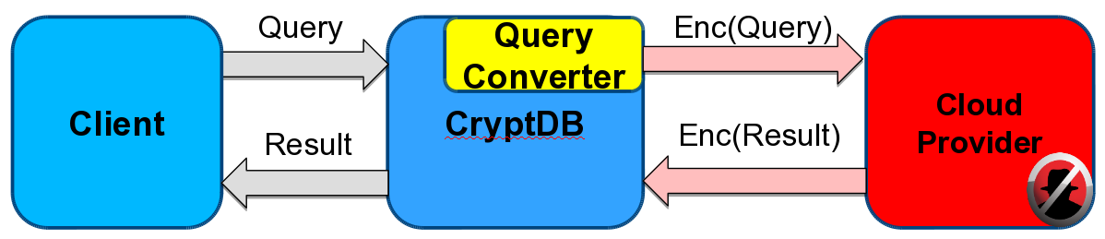
Encrypted Search over Encrypted Data
Cloud provider hosts database of Abs
AB contains vehicle data in encrypted form
Query example:
  select video from Vehicle_DB where description LIKE %highway%;
Converted query:
select c1 from Alias1
where ESRCH ( Enc(description), Enc(highway) );
30

Slide 31
Advantages
Data dissemination mechanism works in untrusted environments
Data owner (source) availability is not required
Independent from trusted third parties
Agnostic to policy language and evaluation engine
On-the-fly key generation
Light-weight encryption is supported
Encrypted search over encrypted data is supported
31

Slide 32
References
[1] T. Eisenbarth, C. Paar, A.Poschmann, S. Kumar, L. Uhsadel, “A Survey of Lightweight-Cryptography Implementations”, IEEE Design and Test of Computers, 2007
[2] The OpenCV Library Dr. Dobb’s Journal of Software Tools (2000) by G. Bradski
[3] J. Harding, G. Powell, R. Yoon, J. Fikentscher, C. Doyle, D. Sade, M. Lukuc, J. Simons, J. Wang, “Vehicle-to-vehicle communications: Readiness of V2V technology for application,” Report No. DOT HS 812 014, National Highway Traffic Safety Administration, Washington, DC, August 2014
[4] A. Ruddle, D. Ward, B. Weyl, S. Idrees, Y. Roudier, M. Friedewald, T. Leimbach, A. Fuchs, S. Grgens, O. Henniger, R. Rieke, M. Ritscher, H. Broberg, L. Apvrille, R. Pacalet, G. Pedroza,”Deliverable d2.3: Security requirements for automotive on-board networks based on dark-side scenarios,” 2009
[5] R. Ranchal, "Cross-Domain Data Dissemination and Policy Enforcement", PhD Thesis, Purdue University, Jun. 2015.
[6] G. Izera M., and B. Bhargava.”Security Protection Methods in Vehicle-to-Vehicle Systems.” Computer Science Department Poster Showcase, Purdue University. Sept 2015.
[7] C. Miller and C. Valasek, “Adventures in automotive networks and control units,” DEF CON 21 Hacking Conf., 2013. Accessed in Mar. 2014, http://www.youtube.com/watch?v=n70hIu9lcYo.
[8] C. Miller and C. Valasek. Adventures in automotive networks and control units. Technical White Paper, IOActive, 2014
32

Slide 33
References
[9] P. Angin, B. Bhargava, R. Ranchal, N. Singh, L. Lilien, L. Othmane and M. Linderman. "An entity-centric approach for privacy and identity management in cloud computing." 29th IEEE Symp. on Reliable Distributed Systems, Oct. 2010.
[10] R. Ranchal, B. Bhargava, L. Othmane, L. Lilien, A. Kim, M. Kang and M. Linderman. "Protection of identity information in cloud computing without trusted third party." 29th IEEE Symp. on Reliable Distributed Systems, Oct. 2010.
[11] B. Bhargava, P. Angin, R. Ranchal, R. Sivakumar, A. Sinclair and M. Linderman. "A trust based approach for secure data dissemination in a mobile peer-to-peer network of AVs." Intl. J. of Next-Generation Computing, vol.3(1), Mar. 2012.
[12] L. Ben Othmane and L. Lilien, “Protecting Privacy in Sensitive Data Dissemination with Active Bundles,” .Seventh Annual Conf. on Privacy, Security and Trust (PST 2009), Saint John, New Brunswick, Canada, Aug. 2009, pp. 202-213.
[13] L. Ben Othmane, “Protecting Sensitive Data throughout Their Lifecycle,” Ph.D. Dissertation, Dept. of Computer Science, Western Michigan University, Kalamazoo, Michigan, Dec. 2010.
[14] Lei Yao, Tao Gong, Jin Fan, Bharata Bhargava, “Research on ARM9-Based Intelligent Immune System for Avoiding Rear-End Collision”, Intl. Journal of Immune Computation (IC) Vol. 1, No. 1, pp. 4-8, 2013
[15] G. Izera M., A. Johnson, B. Bhargava, “Secure protection methods in vehicle-to-vehicle networks”, submitted, 2017
33

