Slide 1
COLLABORATIVE ATTACKS AND DEFENSE
Bharat Bhargava
CERIAS and CS department
Purdue University
www.cs.purdue.edu/homes/bb

Slide 2
Trusted Router and Protection Against Collaborative Attacks
Characterizing collaborative/coordinated attacks
Types of collaborative attacks
Identifying Malicious activity
Identifying Collaborative Attack

Slide 3
Collaborative Attacks
Informal definition:
“Collaborative attacks (CA) occur when more than one attacker or running process synchronize their actions to disturb a target network”

Slide 4
Collaborative Attacks (cont’d)
Forms of collaborative attacks
  Multiple attacks occur when a system is disturbed by more than one attacker
  Attacks in quick sequences is another way to perpetrate CA by launching sequential disruptions in short intervals
  Attacks may concentrate on a group of nodes or spread to different group of nodes just for confusing the detection/prevention system in place
  Attacks may be long-lived or short-lived
  Collaborative attacks can be launched intentionally or accidentally
  Attacks on routing

Slide 5
Collaborative Attacks (cont’d)
Open issues
  Comprehensive understanding of the coordination among attacks and/or the collaboration among various attackers
  Characterization and Modeling of CAs
  Intrusion Detection Systems (IDS) capable of correlating CAs
  Coordinated prevention/defense mechanisms

Slide 6
Collaborative Attacks (cont’d)
From a low-level technical point of view, attacks can be categorized into:
  Attacks that may overshadow (cover) each other
  Attacks that may diminish the effects of others
  Attacks that interfere with each other
  Attacks that may expose other attacks
  Attacks that may be launched in sequence
  Attacks that may target different areas of the network
  Attacks that are just below the threshold of detection but persist in large numbers

Slide 7
Examples of Attacks that can Collaborate
Denial-of-Messages (DoM) attacks
Blackhole attacks
Wormhole attacks
Replication attacks
Sybil attacks
Rushing attacks
Malicious flooding
We are investigating the interactions among these forms of attacks
Example of probably
incompatible attacks:
Wormhole attacks need fast connections, but DoM attacks reduce bandwidth!

Slide 8
Current Proposed Solutions
Blackhole attack detection
  Reverse Labeling Restriction (RLR)
Wormhole Attacks: defense mechanism
  E2E detector and Cell-based Open Tunnel Avoidance (COTA)
Sybil Attack detection
  Light-weight method based on hierarchical architecture
Modeling Collaborative Attacks using Causal Model
Detecting Collaboration using Machine Learning

Slide 9
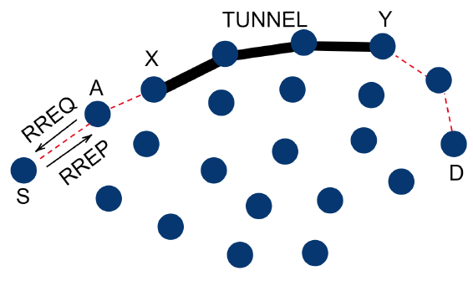
An example: blackhole attack and wormhole attack collaboration
The attacker aims to attract as many packets as possible
  to extract information about the system by packet inspection
  or, to selectively drop the packets
The goal is achieved by blackhole attack - wormhole attack collaboration

Slide 10
An example: blackhole attack and wormhole attack collaboration (cont’d)
A is a blackhole attacker that attracts packets by sending fake RREP.
X and Y are two ends of a wormhole that attract packets by advertising the one-hop route between them, namely, the wormhole.
If A forward packets it attracted to X instead of dropping them like a normal blackhole, X will have more packets collected compared with not launching an attack or launching a wormhole attack only. The attack goal is achieved.

Slide 11
Modeling collaborative attacks with causal graph model
A collaborative attack can be modeled as a causal graph model <S,E,M,L>, where
S is the set of attack states
E is the set of events triggering state transition, which can be further defined by
  Message exchange between attackers where messages are from set E, and
  Local attack operations from operation set L
The goal is to identify the malicious event sequences of collaborative attacks and stop it from reaching the key state (f3 in the above example)

Slide 12
Modeling collaborative attacks with causal graph model
To prevent the attack model from reaching f3, the defender should collaborate to
stop Attacks 1, 2 and 3 from reaching e2, f2 and g2, respectively, or
stop the communication between attackers.

Slide 13
A defense strategy consists of multiple defensive events
A defense strategy consists of a set of defensive events, in the above example
Defense 1 = {m₁, m₂, m₃, m₄}
Defense 2 = {p₁, p₂, p₃, p₄}
Defense 3 = {q₁, q₂}

Slide 14

Defensive events collaborating to interfere with Attack events
The defensive events collaborate to interfere with attack events or inter-attack communications to stop collaborative attack state transitions.

Slide 15
Graphs for blockhole attacks and wormhole attacks
For blackhole attacker A:
For each of two ends of the wormhole, X and Y:

Slide 16

Defend against single attacks by detecting abnormal events
For blackhole attacker A:
Detector D_{A} = {d_{A1,} d_{A2}}
  d_{A1}: monitors fake RREP
  d_{A2}: monitors packet drop

Slide 17
Defend against single attacks by detecting abnormal events (cont’d)
For two ends of the wormhole X and Y:
Detector D_{B} = {d_{B1,} d_{B2}}
  d_{B1}: monitors abnormal RREP
  d_{B2}: monitors abnormal packet transmission

Slide 18
Modeling and detecting collaborative attacks
The ‘bad’ state (X receives pkt) becomes ‘worse’.
Detection d_{A2} becomes ineffective since A no longer drops packets.
The bad state can be reached through more paths due to collaboration.
Thus, the detectors DA and DB have to collaborate to defend. D_{collab} = {d_{A1}, d_{B1}, d_{B2}}
Worse

Slide 19
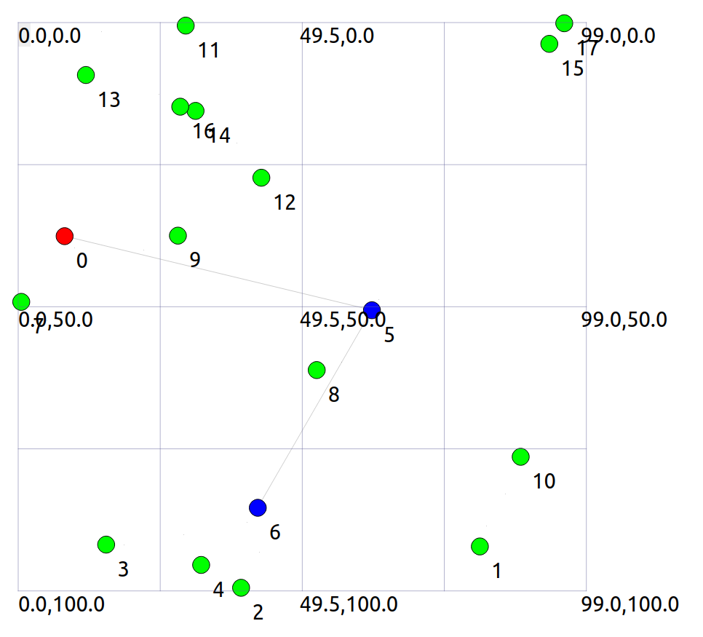
Evaluate the detection and defend mechanisms with ns3
We have implemented the above example with ns3
Red node is the blackhole attacker A
Blue nodes are wormhole attackers X and Y
Gray lines are tunnel and wormhole
We will evaluate our solution mechanism with ns3

Slide 20
Follow-up research questions
Given more single attack patterns (e.g., replication attacks, rushing attacks), we need to define causal rules to automatically judge whether and how those attacks can collaborate.
As the number of attackers increases, the collaborative attack graph becomes more complex, we need more advanced techniques to exhaust the paths from initial states to bad states.
In a system, how do we know that abnormal events are happening which may lead the system to a bad state?
  We plan to use machine learning approaches (next slides)

Slide 21
Why to use Machine Learning
The ML algorithm can continuously learn and adapt to new attack patterns.
It can analyze large amounts of data to detect advanced threats and reduce false positives/negatives.
It is initially resource-intensive but more economical in the long term.
It reduces manual updates.

Slide 22
Hidden Markov Model
A sudden spike in port scans on critical servers, coupled with a surge in message traffic and repeated login failures, potentially indicates a collaborative attack.
HMM leverages temporal relationships and probabilistic state transitions to dynamically monitor and identify potential network attacks.

Slide 23
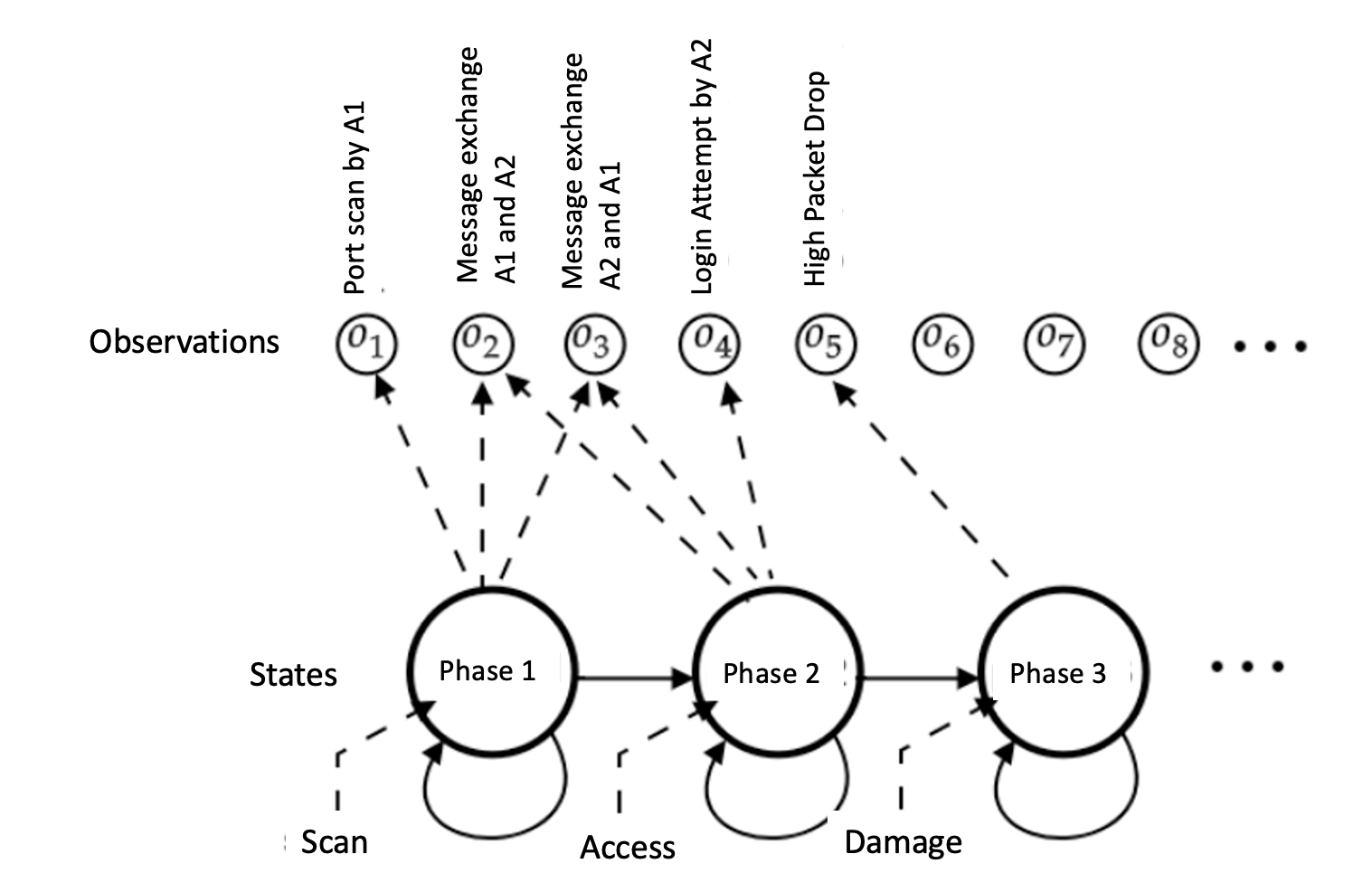
Hidden Markov Model

Slide 24
How Hidden Markov Model works?
System States can be Normal, Port Scan, Access, Damage
The system observes events called observations.
The algorithm can be trained on data including port activities, message logs, etc.
Baum-Welch (BW) and Viterbi algorithms can be used for training.
HMM can be applied to real-time data for state sequence analysis.
If there are suspicious activities, the IP address of the attacker can be blocked, and notifications can be provided

Slide 25
Utilizing LSTM (Long Short-Term Memory) Network
LSTM's strength lies in its ability to process sequential data and capture long-term patterns, making it highly effective for real-time network security monitoring.
For instance, LSTMs can detect irregular patterns, such as identifying a mild port scan followed by spikes in messages and unusual login attempts (both could happen days later “mild port scan”). This capability allows LSTM to flag such sequences as potential collaborative attacks.

Slide 26
How can LSTM work
Dataset:
  Timestep 1: event 1 [Normal Traffic]
  Timestep 2: event 2 [Port Scan]
  Timestep 3: event 3 [Increased Messaging]
  Timestep 4: event 4 [Failed Logins]
LSTM Processing: LSTM can process all previous states to predict collaboration
  input: event 1 => output: No Attack
  input: event 1, event 2 => output: Port Scan
  input: event 1, event 2, event 3 => output: Access
  input: event 1, event 2, event, event 4 => output: Potential collaborative attack

Slide 27
Contrastive Learning
Contrastive Learning's strength lies in its ability to learn nuanced differences between normal and malicious behaviors.
A model trained with Contrastive Learning could recognize irregular message exchanges and login attempts, distinguishing them from normal behavior and flagging them as potential attacks.
Not every login attempt failure is malicious; contrastive learning can help distinguish between normal login attempt failure and malicious login attempt failure.

Slide 28
How does Contrastive Learning work?
The algorithm is provided an event that is an Anchor (without anomaly) during training.
All other events are positive (P) or negative (N). The positive (P) event is an anomaly. The negative (N) is a legitimate data point.
The algorithm maximizes the distance between A and P while minimizing the distance between A and N.
In real-time, the algorithms compute the distance between the event and anchor to predict whether the event is an anomaly or legitimate.

Slide 29
Problem Statement
Packet drop attacks put severe threats to Ad Hoc network performance and safety
Directly impact the parameters such as packet delivery ratio
Will impact security mechanisms such as distributed node behavior monitoring
Different approaches have been proposed
  Vulnerable to collaborative attacks
  Have strong assumptions of the nodes

Slide 30
Problem Statement
Many research efforts focus on individual attackers
The effectiveness of detection methods will be weakened under collaborative attacks
  E.g., in “watchdog”, multiple malicious nodes can provide fake evidences to support each other’s innocence
  In wormhole and Sybil attacks, malicious nodes may share keys to hide their real identities

Slide 31
Problem Statement
We focus on collaborative packet drop attacks. Why?
Secure and robust data delivery is a top priority for many applications
The proposed approach can be achieved as a reactive method: reduce overhead during normal operations
Can be applied in parallel to secure routing

Slide 32
Related Work
Detecting packet drop attacks
Audit based approaches
  Whether or not the next hop forward the packets
  Use both first hand and second hand evidences
  Problems:
    Energy consumption of eavesdropping
    Can be cheated by directional antenna
    Authenticity of the evidence
Incentive based approaches
  Nuggets and credits
Multi-hop acknowledgement

Slide 33
Related Work
Collaborative attacks and detection
Classification of the collaborative attacks
Collusion attack model on secure routing protocols
Collaborative attacks on key management in MANET
Detection mechanisms:
    Collaborative IDS systems
    Ideas from immune systems
    Byzantine behavior based detection

Slide 34
REAct system and Vulnerability
REAct system:
Proposed by researchers in Arizona, ACM WiSec 2009
Random audit based detector of packet drop
A reactive approach: will be activated only when something bad happens
Assumptions:
  At least two node disjoint paths b/w any pair of nodes
  Know the identity of the intermediate nodes
  Pair-wise keys b/w the source and the intermediate nodes

Slide 35
REAct system and Vulnerability
Working procedure of REAct
Destination detects the drop in packet arriving rate and notifies the source
Source randomly selects an intermediate node and asks it to generate a behavioral proof of the received packets
Intermediate node constructs a bloom filter using these packets
Source compares the bloom filter to its own value
  If match: the attacker is after the intermediate node
  Otherwise, it is before the intermediate node
Repeat the procedure until the bad link is located

Slide 36
REAct system and vulnerability
Example of REAct: the source selects n4 to be the first audited node. n4 generates the correct bloom filter, so the attacker is between n4 and D.

Slide 37
Collaborative attacks on REAct
n1 and n4 are collusive attackers. n1 discards the packets but delivers the bloom filter to n4. Now the source will think that the attacker is between n4 and D.
Why REAct is vulnerable to this attack: the source can verify the bloom filter, but not the generator of the filter.

Slide 38
Proposed approach
Assumptions:
Source shares a different secret key and a different random number with every intermediate node
All nodes in the network agree on a hash function h()
There are multiple attackers in the network
  They share their secret keys and random numbers
  Attackers have their own communication channel
  An attacker can impersonate other attackers

Slide 39
Proposed approach
Hash based approach:
Every node will add a fingerprint into the packet
S1 sends out the packet to n1:
S → n1: (S, D, data packet, random number t0)
Node n1 will combine the received packet and its random number r1 to calculate the new fingerprint:
t1 = h( r1 || S || D || data packet || t0 || r1 )
n1 → n2: (S, D, data packet, t1 )
The audited node will generate the bloom filter based on the data packets and the fingerprints
The source will generate its own bloom filter and compare it to the value of the audited node

Slide 40
Proposed approach
Why our approach is safe
The node behavioral proofs in our proposed approach contain information from both the data packets and the intermediate nodes.
Theorem 1. If node ni correctly generates the value ti, then all innocent nodes in the path before ni (including ni) must have correctly received the data packet selected by S.

Slide 41
Proposed approach
Why this approach is safe
The ordered hash calculations guarantee that any update, insertion, and deletion operations to the sequence of forwarding nodes will be detected.
Therefore, we have:
  if the behavioral proof passes the test of S, the suspicious set will be reduced to {ni, ni+1, ---, D}
  if the behavioral proof fails the test of S, the suspicious set will be reduced to {S, n1, ---, ni}

Slide 42
Discussion
Indistinguishable audit packets
  The malicious node should not tell the difference between the data packets and audited packets
  The source will attach a random number to every data packet
Reducing computation overhead
  A hash function needs 20 machine cycles to process one byte
  We can choose a part of the bytes in the packet to generate the fingerprint. In this way, we can balance the overhead and the detection capability.

Slide 43
Discussion
Security of the proposed approach
  The hash function is easy to compute: very hard to conduct DoS attacks on our approach
  It is hard for attackers to generate fake fingerprint: they have to have a non-negligible advantage in breaking the hash function
The attackers will adjust their behavior to avoid detection
  The source may choose multiple nodes to be audited at the same time
  The source should adopt a random pattern to determine the audited nodes

Slide 44
Dealing with Collaborative Attacks
Earlier approach is vulnerable to collaborative attacks
Propose a new mechanism for nodes to generate behavioral proofs
  Hash based packet commitment
  Contain both contents of the packets and information of the forwarding paths
  Introduce limited computation and communication overhead
Extensions:
  Investigate other collaborative attacks
  Integrate our detection method with secure routing protocols

