Slide 1
Privacy-Preserving Cross-Domain Data Dissemination and Adaptability in Trusted and Untrusted Cloud
Bharat K. Bhargava
Purdue University
Department of Computer Science

Slide 2



Problem Statement
Trust Domain
Service B
Service A
Service C
Service D
SOA: Loosely coupled independent services are composed to accomplish tasks
Involves interactions of trusted and untrusted services
No client control on the chain of service invocations
Problems:
Attackers can gain control of a number of services, modify a service or get access to in-transit messages
Client does not have ability to specify service interaction policies
Violations, malicious activities and failures in a trusted service domain may remain undetected
Services are not verified or validated dynamically (uninformed selection of services)
Malicious activity may cause service disruptions

Slide 3
Problem Statement
Trust Domain
Service B
Service A
Service C
Service D
There is a need for novel techniques to
Monitor service activity
Discover and report service misbehavior
Share information across domains on security threats using a unified model
Ensure security and privacy of data in SOA and clouds
If a service is compromised or misbehaves, the service monitor should
Discover malicious activity
Provide feedback
Take remedial actions
Adapt according to changes in context

Slide 4
Monitoring-Based Approach for Adaptability & Resiliency
We propose a novel method of dealing with security problems in trusted & untrusted cloud:
Monitoring all interactions among services in a domain
Proactive treatment of potentially malicious service invocations
Dynamic trust management of services in a domain
Agile and resilient defense mechanisms
  Ability to detect anomalies and adapt
  Dynamic reconfiguration of service compositions
Privacy preservation in service interactions
Benefits of the monitoring-based security solution:
Provides enforcement of security policies in addition to auditing capability
Offers a proactive security solution by detecting anomalies across individual service interactions and at the domain level
Ensures uninterrupted service even under attacks and failures
Provides a transparent mechanism for service monitoring that can be used in standard web service frameworks

Slide 5
Distributed Service Monitoring Approach
Service monitor intercepts all client-service/service-service interactions.
The approach aims to provide a unified security architecture for SOA and cloud by integrating components for:
  Service trust management
  Interaction authorization between different services
  Anomaly detection based on service behavior
  Dynamic service composition
  Secure data dissemination using active bundles

Slide 6
Distributed Service Monitoring
Each service domain has a monitor that tracks interactions among the services in the domain and outside the domain
Local service monitors gather performance and security data for each service, logged in the local database of the monitors and mined using unsupervised machine learning algorithms
Local analysis results are reported to a central monitor using a common language (STIX & TAXII)
Central monitor uses information from local monitors to update trust values of services and reconfigures service compositions to provide resiliency against attacks and failures
Threat intelligence data gathered from multiple domains are analyzed by central monitor and stored as intelligence feeds in the form of active bundles
Detection of service failures and/or suboptimal performance triggers restoration of optimal behavior through replication of services and adaptable live migration of services to different platforms

Slide 7
Agile Defense and Adaptability
Goals:
  Replace anomalous services with reliable versions
  Reconfigure service orchestrations in response to anomalous service behavior
  Swiftly adapt to changes in context:
    Services may be in trusted or untrusted environments (e.g. public clouds)
    Choose services in orchestration to comply with SLA requirements (e.g. response time, latency, security level etc.) based on context (e.g. trust may be important in one context, response time in another)
    Choose data dissemination policy based on context (coarse-grain access in untrusted cloud, fine-grain access in trusted domain)
  Ensure continuous availability even under attacks and failures

Slide 8
Agile Defense and Adaptability
Components:
  Monitor service status and determine action
    Update service health status in case of significant deviations from normal behavior
    Create service backup in case of suspicion of anomaly
    Re-deploy service in case of complete failure
  Dynamic service reconfiguration based on changes in context
    Adapt priorities (e.g. response time vs. level of detail/accuracy)
    Adapt constraints (e.g. trust levels of all services > T for critical mission)
    Dynamically replace failed services in composition with healthy ones to avoid complete restart of business process
  Controlled sharing of data
    Determine data dissemination based on the requirements and authorization level of the subscriber
    Limit data disclosure based on trust level of subscriber
    Control dissemination based on changes in context (e.g. emergency, attack, etc.)

Slide 9
Anomaly Detection Approach
Statistical analysis of multivariate time-series data collected by service monitors to detect significant deviations from normal behavior
Adjusts service threat levels based on duration, extent & type of anomalies
Correlation of time-series data from multiple services allows for detection of bigger threats (affecting the whole domain, collaborative attacks etc.)
Ability to detect zero-day attacks as opposed to signature-based models
Diagnosis: Anomaly affecting S1
Response: Replace S1
Diagnosis: Anomaly affecting whole domain
Response: Re-deploy all services in different domain /switch to backup versions in different domain

Slide 10
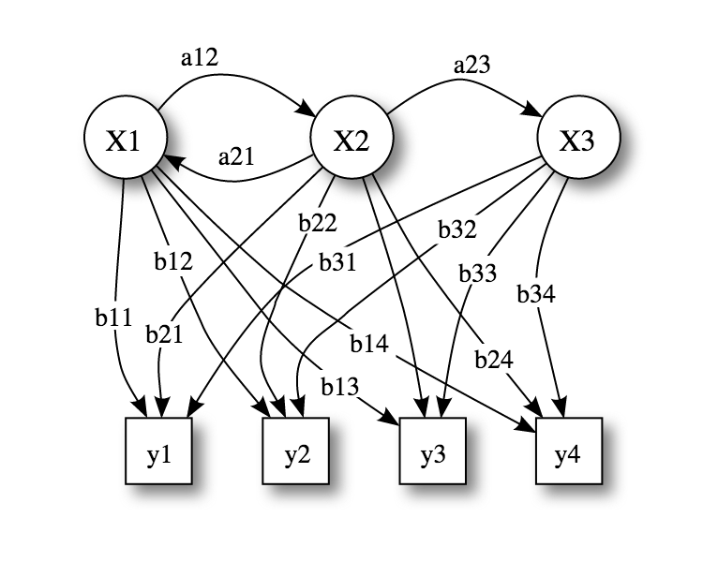
Hidden Markov Models (HMM) for
Anomaly Detection
HMM: Simplest dynamic Bayesian network model
Consists of states X and an observation sequence Y, whose probability of occurrence depends on the state
States are hidden, but outputs of each state are observed
Sequence of observations are related to each other
a_{ij}: State transition probabilities, b_{ij}: Output probabilities
X_{i}: States, y_{i}: Observations
Task: Given model’s parameters and sequence of observations, compute distribution over the hidden states of the last variable in the sequence

Slide 11
Hidden Markov Models (HMM) for
Anomaly Detection (cont.)
Example:
Possible service states:
X1: Normal, X2: Under attack, X3: Failed
Possible service CPU usage observations:
y1:(0-20%], y2:(20-40%], y3:(40-100%], y4:0
Based on trained model we have b34=1, hence y4 only observed in state X3
i.e. if we observe CPU usage = 0, prob(X3|y4)=100%, we rule that service has failed
Model allows us to use past service data (service health/response status/interactions etc.) gathered by service monitor to make inferences about the current state of the service:
  i.e. Given CPU usage = 0, what is the state of the service?
Model evolves in time with new data gathered by service monitor, i.e. if a particular observation was never recorded before (e.g. CPU=0%), it belongs to a new state (e.g. Failed)
Continuous data (observation) collection by service monitor allows for detection of anomalies
    No training on anomalous data needed as opposed to signature-based techniques

Slide 12
Performance and Security Parameters for Anomaly Detection

Slide 13
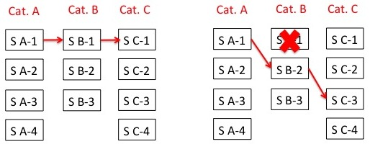
Dynamic Service Composition Reconfiguration
An SOA service orchestration is composed of a series of services that interact with each other based on a service interaction graph
One of the multiple services in each service category can be selected for specific service functionality,
  E.g. category: weather, services: weather.com, Yahoo weather, accuweather
Challenge: Configuring set of services to comply with SLA and security policy requirements
Dynamic service composition reconfiguration is based on
  Changes in context
  Type, duration, extent of attacks and failures

Slide 14
Dynamic Service Composition Approach
Input
  A set of service categories (each with a set of services), a set of security constraints, a set of target performance parameters
Output
  Service composition with a service from each category that complies with the given security constraints and has best performance
Approach
  Sort services in each category based on given performance parameters
  Select highest performing service from each category to form a composition
  Check composition against given security constraints
  Switch to alternate services if the constraints are not satisfied (acceptance test fails)

Slide 15
Dynamic Service Composition Experiment 1:
Dynamic service composition overhead is especially important in time-critical settings
Task: Dynamic composition of business process involving varying number of service categories each with 3 services to choose from, with a single SLA constraint
Measurement: Response time overhead of dynamic service composition for different number of service categories involved in composition
Setting: Central service monitor on Amazon EC2 m3.medium instance (1 vCPU, 3.75 GB memory)
Conclusion: Composition time is not affected significantly by the number of service categories (database access time dominates response time) and composition overhead is reasonable for most settings.

Slide 16
Dynamic Service Composition Experiment 2:
Task: Dynamic composition of business process involving 3 service categories, with a single SLA constraint
Measurement: Response time overhead of dynamic service composition for different number of services to choose from for each category
Setting: Central service monitor on Amazon EC2 m3.medium instance (1 vCPU, 3.75 GB memory)
Conclusion: Composition time is not affected significantly by the number of possible services in a category and composition overhead is reasonable for most settings.

Slide 17
Agile Defense Demo
https://dl.dropboxusercontent.com/u/79651021/AgileDefenseDemo.mp4
  Scenario: Surveillance mission with Unmanned Combat Air System
  Analysis Process: UAV video surveillance + radar plot integrator + radar plot analyzer + video analyzer to detect suspicious object location
  Dynamic service composition reconfiguration based on SLA requirements
  Detection of anomalous service behavior / attacks
    Authentication failures, Malicious code injection, DoS, Service failure
  SLA requirement change in emergency context

Slide 18

Data Privacy in SOA and Cloud
Data (D) = {d₁,.., d_{n}}
D
TRUSTED
DOMAIN
Point-to-Point authentication is
unable to protect data dissemination in unknown domains
Service 1 may not want to disclose its service composition to the user
D
SERVICE 1
d₁
D
SERVICE 2
d₂
Secure channel but lack of policy communication,
evaluation, enforcement infrastructure
Unauthorized
data disclosure resulting in undetected user privacy violation
Opaque data sharing by Service 1 to services in
unknown domain
D
D
SERVICE 4
d₄
SERVICE 3
d₃
UNKNOWN
DOMAIN

Slide 19
Data Sharing Issues in SOA
Problems with the current model
  Loss of control
  No access control
  No sharing control
  Information gathering/aggregation
  Information selling to interested parties
  Information disclosures for Subpoenas
  Hacking attacks
  Insider abuse
  Lack of trust

Slide 20
Policy Enforcement at Data Source
Requires source visibility and availability
E.g. client-server paradigm
  Server authenticates
  client requests
Source becomes a
single point of failure
Scalability issues
  Source becomes bottleneck
Messages
  Source: O(n)
  Receiver: O(1)
Policy enforcement by the source
Data Receiver
Data Owner
Data Receiver
Data Receiver
Notes:
If there are n receivers, there is a burden of n interactions over the source

Slide 21
Policy Enforcement at Data Mediator
Trusted Third Party (TTP) becomes a single point of trust and failure
E.g. Pub-Sub system
Attacks on TTP lead
to data leakage
TTP can aggregate
private information
  Disclosure for profit
  Disclosure for subpoenas
Messages
  Source: O(1)
  Receiver: O(1)
  TTP: O(n)
Policy enforcement by the mediator
Data Receiver
Data Owner
Trusted Third Party
Data Receiver
Data Receiver

Slide 22

Policy Enforcement at Data Receiver
Requires presence of a trusted EM on the receiver
  Trusted hardware
  Trusted software
Requires advance
knowledge of receivers
Distribution of
trusted EM to external
domains is a challenge
Messages
  Source: O(n)
  Receiver: O(1)
Policy enforcement by the receiver
Data Receiver
Data Owner
Data Receiver
Data Receiver

Slide 23
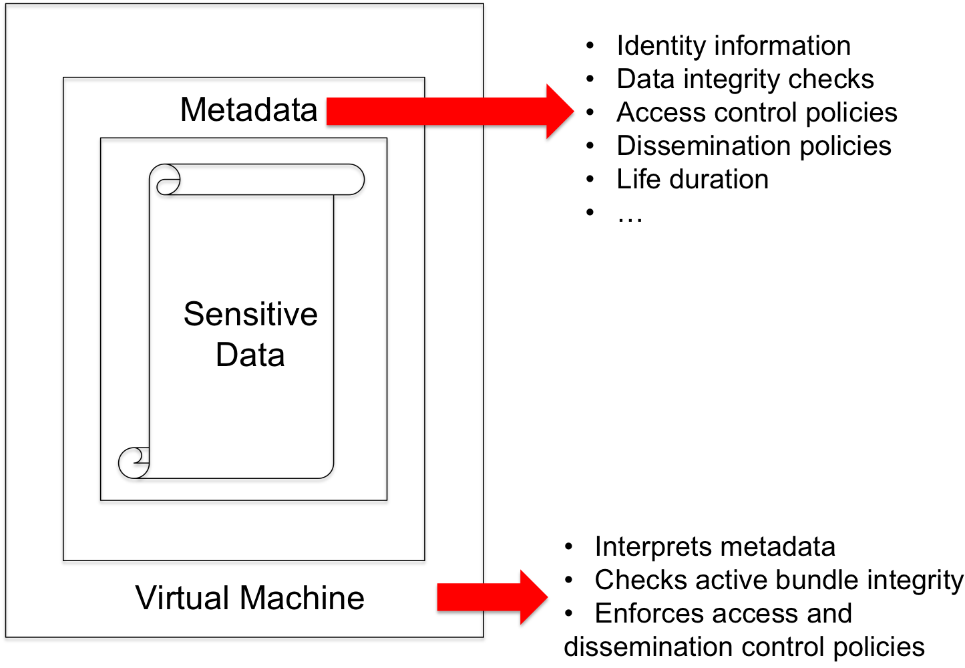
Secure Data Dissemination with
Active Bundles
Active Bundle (AB) approach for secure data dissemination
  Self-protecting data encapsulation
  mechanism
  Provides secure cross-domain
  information exchange
Sensitive data
  Encrypted data items
Metadata
  Access control and operational
  policies
Virtual Machine
  Protection mechanism (self-integrity check)
  Policy evaluation, enforcement and data dissemination

Slide 24
Secure End-to-End Information Flow in Cloud
Client sends request to the service using browser and shares data by means of Active Bundle (AB)
Service checks the request source (secure or insecure browser)
  Based on W3C Crypto standards
Service executes AB in Cloud if created by an insecure browser
Service interacts with AB and requests data
AB behaves differently under different contexts
  Full data dissemination based on service authorization/trust level
  Context-based partial data dissemination based on insufficient authorization level
  No data dissemination for unauthorized access/attacks
Cross-domain information exchange with trustworthy/untrustworthy subscribers
  Data dissemination is done on a “need to know” basis by limiting the disclosure of decryption keys
  Incremental disclosure of keys based on increase in the “need”

Slide 25

End-to-End Information Flow
Service request
Browser
Insecure browser
analyze request source based on W3C standards
Secure browser
CAC
authentication
PIN
Send active
bundle to cloud
for execution
Trust = X + Y
Trust = X
execute active
bundle in cloud
Low trust
High trust
Active Bundle
Service Domain
Service X
Data access
request
Encrypted
search
Data
Service X
is authorized
to access
Data
request
Filtered/lower
quality data
Filtered search
results
Active Bundle
UNTRUSTED
TRUSTED

Slide 26
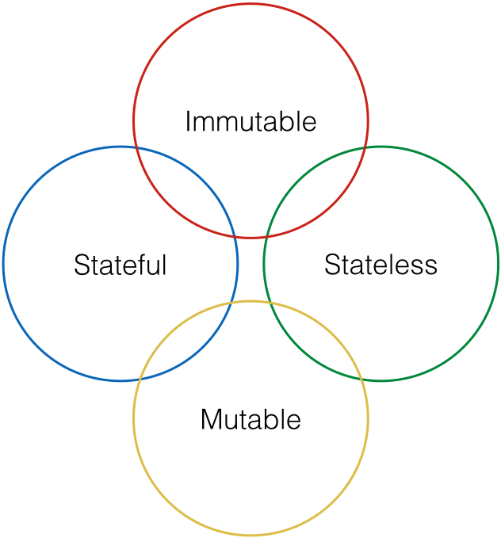
Classifications of AB

Slide 27
Classification of AB
Immutable AB
  Static data and policies that cannot be modified after creation
  Prevents inconsistencies and offers better security
Mutable AB
  Data and policies can be updated after creation
  Local storage of state information and interaction logs
Stateless AB
  Self-sufficient execution using inherent knowledge
  No external information exchange and state maintenance
Stateful AB
  Communicates with a third party to exchange state information and store interaction logs
  Uses external information for policy evaluation and data disclosure decisions
  Data provenance and context-aware disclosure capabilities

Slide 28
Solution Components
Service authentication can be based on
  Password, Certificate, Biometric, PKI
Service request authorization is based on policy evaluation
  Flexible policy specification based on access control models such as Attribute/Role-based
Key management for data disclosure
  Key inclusion (prone to attacks)
  Centralized key management service (use of trusted third party for key storage and distribution)
  Distributed key management that splits the keys into shares using threshold secret sharing and uses a Distributed Hash Table (DHT) to store the shares and reconstruct the key by retrieving minimum threshold number of shares (unsuitable for real-time interactions in a service environment)
  Dynamic key derivation based on the unique information generated in AB execution control flow steps only if the service is authenticated and authorized
Tamper Resistance
  Correct data dissemination depends on the correct execution of AB control flow steps
  Verify the integrity of the execution steps to ensure there is no difference from the original code (using secure one-way hash function)
  Derive keys based on digests of AB execution steps and their resources
  Any modification of AB changes the digest resulting in incorrect key derivation

Slide 29
AB Features
Policy-based access control
Privacy-preserving selective data dissemination
Context-based adaptable data dissemination
Independent of third party data and policy management
Independent of source availability after initial AB transfer
Ability to operate in external environment
Reduced service liability for protecting PII
Compatible with standard service infrastructure
Agnostic to policy language and evaluation engine

Slide 30
Key Generation during AB Creation
An AB Template is used to generate new ABs with data and policies specified by a user
  An AB Template includes the implementation of the invariant parts (monitor) and placeholders for customized parts (data and policies)
User specified data and policies are included in the AB Template
AB Template is executed to simulate the interaction process between an AB and a service requesting access to each data item of AB
The information generated during the execution of different AB modules and the digests of these modules and their resources (such as authentication (authentication code, CA certificate that it uses), authorization (authorization code, applicable policies, policy evaluation code)) are collected and aggregated into a single value for each data item
The value for each data item is input into a Key Derivation module (such as SecretKeyFactory, PBEKeySpec, SecretKeySpec provided by javax.crypto library)
The Key Derivation module outputs the specific key relevant to the data item
This key is used encrypt the related data item

Slide 31
Key Derivation during AB Execution
AB receives access request to a data item from a service
AB authenticates the service and authorizes its request
The information generated during the execution of different AB modules and the digests of these modules and their resources (such as authentication (authentication code, CA certificate that it uses), authorization (authorization code, applicable policies, policy evaluation code)) are collected and aggregated into a single value for each data item
The value for each data item is input into the Key Derivation module (such as SecretKeyFactory, PBEKeySpec, SecretKeySpec provided by javax.crypto library)
The Key Derivation module outputs the specific key relevant to the data item
This key is used decrypt the requested data item
If any module fails (i.e. service is not authentic or the request is not authorized) or is tampered, the derived is incorrect and the data is not decrypted

Slide 32
Online Shopping using AB
Name
Email
Credit card type
Credit card
Shipping preference
Mailing address
order request
+
1
Active Bundle
verify request
Active Bundle
+
Shopping Service
Seller
Service
2
payment request
+
shipping request
+
4
3
Active Bundle
Active Bundle
Payment Service
Shipping Service
Notes:
O(n) messages for source
O(n) messages per receiver

Slide 33
Online Shopping using AB
Name
Email
Credit card type
Credit card
Shipping preference
Mailing address
order request
+
Name
Email
Payment type
E(Credit card)
E(Shipping preference)
E(Mailing address)
1
E(Name)
E(Email)
E(Payment type)
E(Credit card)
Shipping preference
E(Mailing address)
Active Bundle
verify request
Active Bundle
+
Shopping Service
Seller
Service
2
payment request
+
shipping request
+
Name
Email
Payment type
E(Credit card)
E(Shipping preference)
E(Mailing address)
Name
E(Email)
E(Payment type)
E(Credit card)
E(Shipping preference)
Mailing address
4
3
Active Bundle
Active Bundle
Payment Service
Shipping Service

Slide 34
Unauthorized Data Access
Name
Email
Credit card type
Credit card
Shipping preference
Mailing address
order
request
+
1
Unauthorized access to credit card
Data access: DENIED
Active
Bundle
Name
Email
Payment type
E(Credit card)
E(Shipping preference)
E(Mailing address)
verify
request
Active
Bundle
E(Name)
E(Email)
E(Payment type)
E(Credit card)
Shipping preference
E(Mailing address)
+
Shopping
Service
Seller
Service
2
payment
request
+
shipment
request
+
4
3
Name
E(Email)
E(Payment type)
Credit card
E(Shipping preference)
E(Mailing address)
Active
Bundle
Active
Bundle
Name
E(Email)
E(Payment type)
E(Credit card)
E(Shipping preference)
Mailing address
Payment
Service
Shipping
Service

Slide 35
Context-based Data Dissemination
Medical data
Medical history
E(Patient ID)
E(Insurance ID)
E(Medical test prescription)
E(Prescription)
E(Treatment code)
Emergency context
Data access: GRANTED
Patient ID
Medical data
Medical history
Medical test prescription
Prescription
E(Insurance ID)
E(Treatment code)
Paramedic’s
App
Doctor’s
App
Active
Bundle
Active
Bundle
Active
Bundle
Medical
Information
System
Laboratory’s
App
Patient ID
Insurance ID
Treatment code
E(Medical data)
E(Medical history)
E(Medical test prescription)
E(Prescription)
Patient ID
Medical test prescription
E(Medical data)
E(Insurance ID)
E(Medical history)
E(Prescription)
E(Treatment code)
Active
Bundle
Active
Bundle
Patient ID
Insurance ID
Medical data
Medical history
Medical test
prescription
Prescription
Treatment code
Pharmacy’s
App
Insurance’s
App
Patient ID
Prescription
E(Medical data)
E(Insurance ID)
E(Medical history)
E(Medical test prescription)
E(Treatment code)

Slide 36
Trust-based Data Dissemination
Name
Email
Credit card type
Credit card
Shipping preference
Mailing address
SERVICE MONITOR
Trust
Request
order
request
+
Trust
Request
Trust
level: 5
Trust
level: 1
1
Active
Bundle
Low trust level of Seller Data access: DENIED
Name
Email
Payment type
E(Credit card)
E(Shipping preference)
E(Mailing address)
verify
request
Active
Bundle
+
Shopping
Service
Seller
Service
2
Payment
Service
Shipping
Service

Slide 37
Data Dissemination under Tamper attack
Tampering attack on AB
Data access: DENIED
Paramedic’s
App
Attacker’s
App
Active
Bundle
Active
Bundle
Active
Bundle
Medical
Information
System
Laboratory’s
App
Patient ID
Insurance ID
Treatment code
E(Medical data)
E(Medical history)
E(Medical test prescription)
E(Prescription)
Patient ID
Medical test prescription
E(Medical data)
E(Insurance ID)
E(Medical history)
E(Prescription)
E(Treatment code)
Active
Bundle
Active
Bundle
Patient ID
Insurance ID
Medical data
Medical history
Medical test
prescription
Prescription
Treatment code
Pharmacy’s
App
Insurance’s
App
Patient ID
Prescription
E(Medical data)
E(Insurance ID)
E(Medical history)
E(Medical test prescription)
E(Treatment code)

Slide 38
Context-Sensitive Data Disclosure
Perfect data dissemination not always desirable
  Example: Confidential business data shared within an office but not outside
Context-sensitive AB evaporation
  AB evaporates in proportion to their “distance” from their owner
“Closer” subscribers trusted more than “distant” ones
Illegitimate disclosures more probable at less trusted “distant” guardians
Different distance metrics
  Context-dependent

Slide 39



Examples of Distance Metrics
Examples of one-dimensional distance metrics
  Distance ~ business type
  Distance ~ distrust level: more trusted entities are “closer”
Multi-dimensional distance metrics
  Security/reliability as one of dimensions
Insurance Company C
Bank I -Original Guardian
Used Car Dealer 1
    If a bank is the original guardian, then:
    -- any other bank is “closer” than any insurance company
    -- any insurance company is “closer” than any used car dealer
2
5
Used Car Dealer 3
2
5
Insurance Company A
1
1
5
2
Used Car Dealer 2
Bank II
Bank III
Insurance Company B

Slide 40





Example of Controlled Data Distortion
Distorted data reveal less, protects privacy
Examples:
  accurate data more and more distorted data
  250 N. Salisbury Street
  West Lafayette, IN
  250 N. Salisbury Street
  West Lafayette, IN
  [home address]
  765-123-4567
  [home phone]
  Salisbury Street
  West Lafayette, IN
  250 N. University Street
  West Lafayette, IN
  [office address]
  765-987-6543
  [office phone]
  somewhere in
  West Lafayette, IN
  P.O. Box 1234
  West Lafayette, IN
  [P.O. box]
  765-987-4321
  [office fax]

Slide 41



Example of Controlled Data Filtering of Electronic Healthcare Record (EHR)
EHRs stored in a database and filtered for different data consumers using SQL queries run in the AB’s VM
a. Data consumer verified as doctor at the hospital can get all patient data
b. Hospital Receptionist gets filtered data
c. Insurance company gets only the minimal required data

Slide 42
Demo: Data Dissemination with AB in Healthcare Scenario
https://dl.dropboxusercontent.com/u/3723150/AB-Healthcare.mp4

Slide 43
Demo: Active Bundle created in secure browser for rescue mission
https://dl.dropboxusercontent.com/u/3723150/AB-Secure.mp4

Slide 44
Demo: Active Bundle created in insecure browser and sent to cloud
https://dl.dropboxusercontent.com/u/3723150/AB-Insecure.mp4

Slide 45
Demo: P2P Secure Data Sharing in UAV Network
https://dl.dropboxusercontent.com/u/79651021/UAVdemo.mp4
Each UAV creates active bundle with captured image data and trust-based dissemination policies
When active bundle is sent to a UAV, image data is filtered based on trust level
Trust levels of UAVs change based on context, distance, communication bandwidth

Slide 46




P2P Secure Data Sharing in UAV Network
Original image
Dissemination Policy:
If 2.5 > trust ≥ 2.2 => blur level = 20
If 2.2 > trust ≥ 2.0 => blur level = 40
If 2.0 > trust => blur level = 80
trust = 2.4
trust = 2.1
trust = 1.5

Slide 47




P2P Secure Data Sharing in UAV Network
Original image
Dissemination Policy:
If context = emergency => contrast = 0.4
If 2.5 > trust ≥ 2.2 => contrast = 0.2
If 1.8 > trust => contrast = 0.1
trust = 2.0
context = emergency
trust = 2.4
trust = 1.7

Slide 48
Active Bundle Attack Resilience
Type of attacks on the framework
  Repudiation attack
    Attacker sends a malicious AB
  Man in the middle attack during AB transfer
    Attacker intercepts the AB and tries to gain unauthorized access
  Man in the middle attack during AB-Service interaction
    Attacker eavesdrops and alters the communication to gain unauthorized access
  Tamper attack
    Attacker compromises the AB by modifying its policies and code
  Execution Hijack attack
    Attacker reverse engineers the execution control flow of AB to gain unauthorized access

Slide 49
Active Bundle Attack Resilience
Trusting the AB and its execution
  Digital signatures to validate the authenticity and integrity of AB
  Isolated execution of AB using containers e.g. Docker
  Cloud-based execution
Protecting AB against attacks
  Secure communication e.g. HTTPS
    During AB transfer
    During AB-Service interaction (getSecureValue() method)
  Tamper resistant code (code integrity checks)
    Correct secret key generation only in case of correct execution
  Execution Hijack Avoidance
    Use of type safe language e.g. Java
    Digitally signed code in AB JAR file
      JVM validates signatures at runtime and prevents execution of malicious code
    Secure hardware based execution (e.g. TPM, Encrypted write protected memory)
  Cloud-based execution
    Third party code execution platform that does not broker any data or policies

Slide 50
Active Bundle Experiments
Measurements
  Experiment 1: Growth in AB size with increase in the number of policies
  Experiment 2: Growth in AB and Service interaction time with increase in the number of policies
  Experiment 3: Tamper Resistance overhead in AB execution
Variations
  AB versions
    ABx – XACML-based policies and WSO2 Balana-based policy evaluation
    ABxt – ABx with tamper resistance capabilities
    ABc – JSON-based policies and JAVA-based policy evaluation
    ABct – ABc with tamper resistance capabilities
  Number of AB policies
Environment
  Amazon EC2 C3 Large and XLarge instances
Data collection
  5 runs of each experiment
  100 requests per run

Slide 51
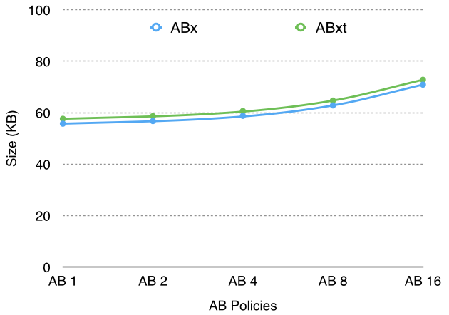
Experiment 1: AB Size vs Number of policies
Observations
  Tamper resistance adds a slight overhead to AB size (< 2 KB)

Slide 52
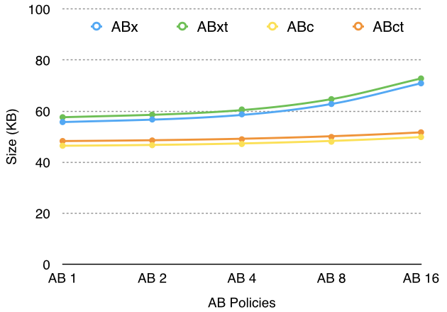
Experiment 1: AB Size vs Number of policies
Observations
  78% reduction per policy (0.79 KB) with JSON-based policies
    Additional one-time reduction of 8.5 KB with Java-based policy engine

Slide 53
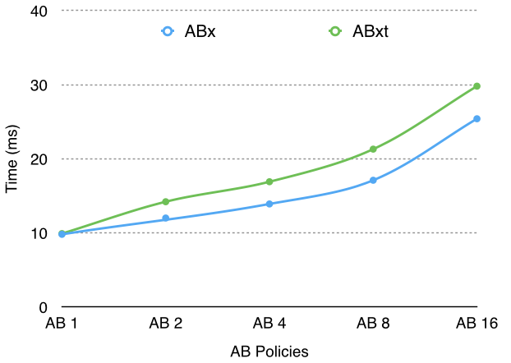
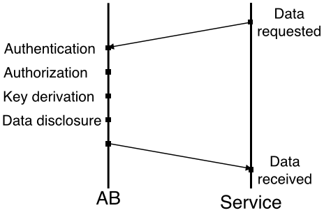
Experiment 2.1: AB-Service Interaction Time vs Number of policies (EC2 Large)

Slide 54
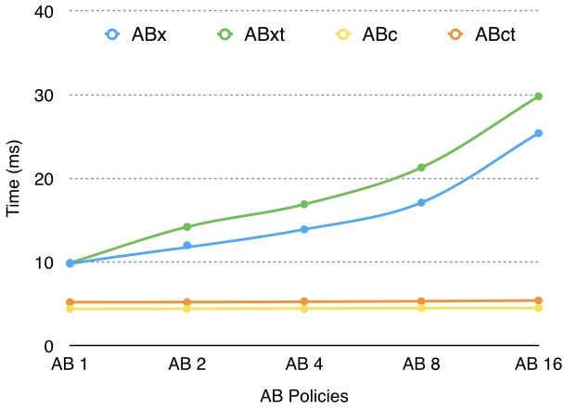
Experiment 2.1: AB-Service Interaction Time vs Number of policies (EC2 Large)
Observations
  Significant reduction in time with the use of JSON-based policies and Java-based evaluation
    Evaluation of XACML policies involves the traversal of XML policy and request trees
    Evaluation of JSON policies involves execution of highly optimized Java code

Slide 55
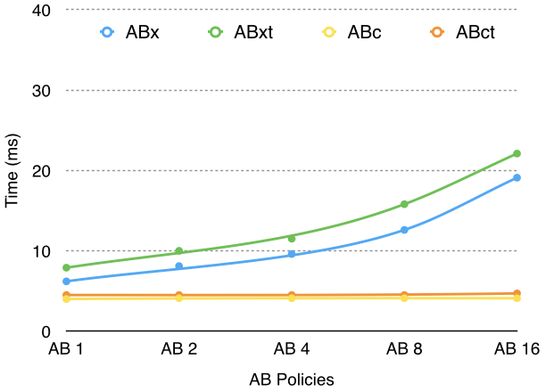
Experiment 2.2: AB-Service Interaction Time vs Number of policies (EC2 XLarge)

Slide 56
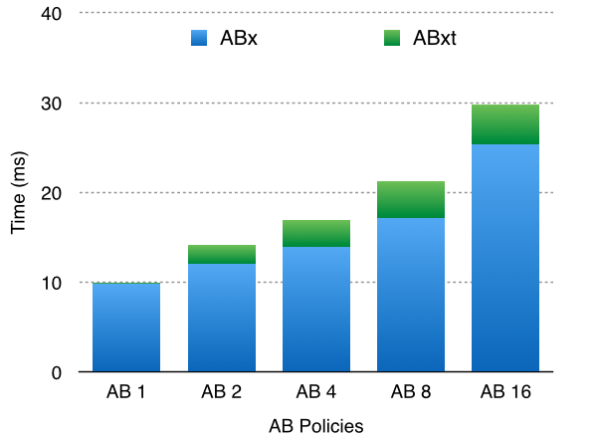
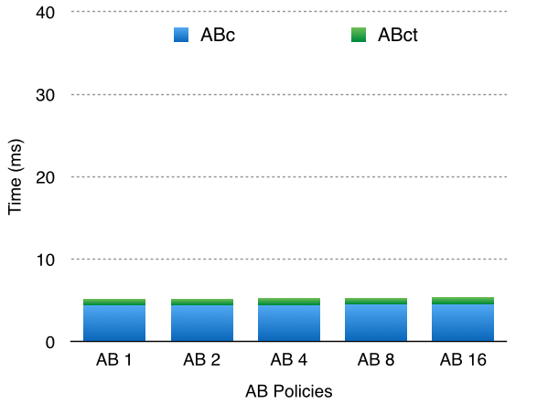
Experiment 3.1: AB Tamper Resistance Overhead (EC2 Large)
Observations
  Tamper resistance has higher overhead for XACML policies
    Digest calculation of XACML policies involves the traversal of XML policy and request trees
    Digest calculation of JSON policies takes less time due to smaller policy size

Slide 57
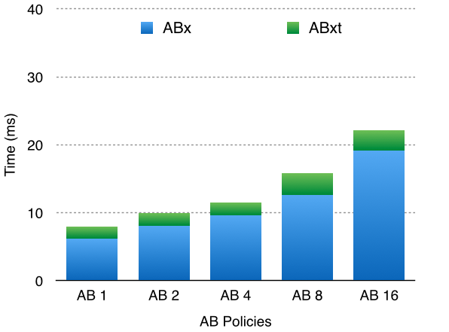

Experiment 3.2: AB Tamper Resistance Overhead (EC2 XLarge)

Slide 58
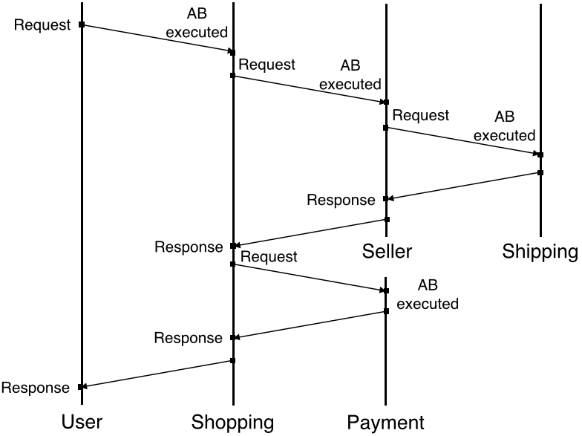
Experiment 4.1: Scenario Time

Slide 59
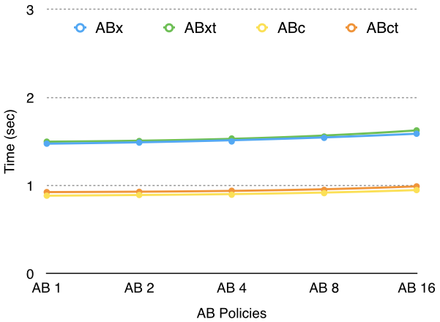
Experiment 4.1: Scenario Time
(EC2 Large)
Observations
  Less than 1.7 sec for XACML policies
  Less than 1 sec for JSON policies

Slide 60
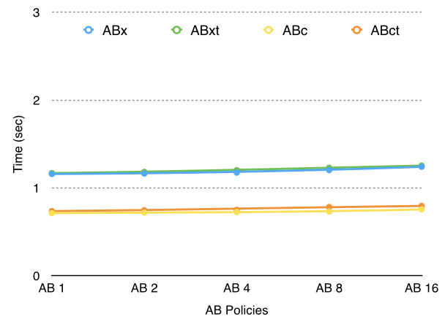
Experiment 4.2: Scenario Time
(EC2 XLarge)
Observations
  Less than 1.3 sec for XACML policies
  Less than 0.8 sec for JSON policies
Notes:
Large and xlarge configuration

Slide 61
Framework Capabilities
Policy-based access control
Privacy-preserving selective data dissemination
Context-based adaptable data dissemination
Independent of third party data and policy management
Independent of source availability after initial AB transfer
Ability to operate in external environment
Reduced service liability for protecting PII
Compatible with standard service infrastructure
Agnostic to policy language and evaluation engine

Slide 62
Cost-Analysis of Framework
Costs:
  Message size and network overhead due to AB
    Monitor adds a small constant overhead to every message containing AB
  Service response delay due to interaction between AB and service
    Interaction with EM at data owner, mediator, or receiver also has this overhead
  Increased resource usage in service domain
    Low interaction time does not have a significant impact on service performance
Notes:
It is possible to do as an extension of this research. It is interesting to explore the hardware limitations
The objective is to provide policy based access control

Slide 63
Impact
Comprehensive security auditing and enforcement architecture for trusted & untrusted cloud
  Continuous monitoring of SLA and policy compliance
  Swift detection of failures and attacks in the system
  Efficient mechanism to dynamically reconfigure service composition based on the system context/state (failed, attacked, compromised) and resiliency requirements
  Resilient architecture to ensure continuous service availability under failures and attacks
  Privacy-preserving data sharing approach for client-to-service and service-to-service interactions
  Compatibility of solution with industry standard SOA frameworks

Slide 64
References
PD3: Policy-based Distributed Data Dissemination, R. Ranchal, D. Ulybyshev, P. Angin, B. Bhargava, 16th CERIAS Security Symposium. (best poster award)
EPICS: A Framework for Enforcing Policies in Composite Web Services, R. Ranchal, B. Bhargava, IEEE Transactions on Parallel and Distributed Systems. (in submission)
Protection of Identity Information in Cloud Computing without Trusted Third Party, R. Ranchal, B. Bhargava, L. Othmane, L. Lilien, M. Linderman, M. Kang, A. Kim, 29th IEEE SRDS.
Protecting PLM Data throughout their Lifecycle, R. Ranchal, B. Bhargava, 9th QSHINE.
An Entity-centric Approach for Privacy and Identity Management in Cloud Computing, P. Angin, B. Bhargava, R. Ranchal, N. Singh, L. Othmane, L. Lilien, M. Linderman, 29th IEEE SRDS.
A Trust-based Approach for Secure Data Dissemination in a Mobile Peer-to-Peer Network of Avs, B. Bhargava, P. Angin, R. Ranchal, R. Sivakumar, A. Sinclair, M. Linderman, International Journal of Next Generation Computing.
An End-to-End Security Auditing Approach for Service Oriented Architecture. M. Azarmi, B. Bhargava, P. Angin, R. Ranchal, N. Ahmed, A. Sinclair, M. Linderman, L. B. Othmane, 31st IEEE SRDS 2012.
Secure Information Sharing in Digital Supply Chains. B. Bhargava, R. Ranchal, L. Othmane, 3rd IEEE IACC 2013.
A Distributed Monitoring and Reconfiguration Approach for Adaptive Network Computing. B. Bhargava, P. Angin, R. Ranchal, S. Lingayat, 6th International Workshop on Dependable Network Computing & Mobile Systems 2015.
Consumer-Oriented Privacy-Preserving Access Control for Electronic Health Records in the Cloud, R. Fernando, R. Ranchal, L. Othmane, B. Bhargava. (in submission)

