Slide 1
Secure Dissemination of Video Data in Vehicle-to-Vehicle Systems
C. Qu¹, D. Ulybyshev¹, B. Bhargava¹, R. Ranchal¹,
G. Izera M.¹, L. Lilien²
¹Computer Science Department,
Purdue University, West Lafayette, IN, USA
²Department of Computer Science,
Western Michigan University, Kalamazoo, MI, USA

Slide 2
Outline
Motivation
Objectives
Related Work
Core Design
  4.1. Active Bundle Concept
  4.2. System Architecture
  4.3. Video Recording
  4.4. Face Recognition
  4.5. Video Recreation
Evaluation
Pros and Cons
Conclusions

Slide 3
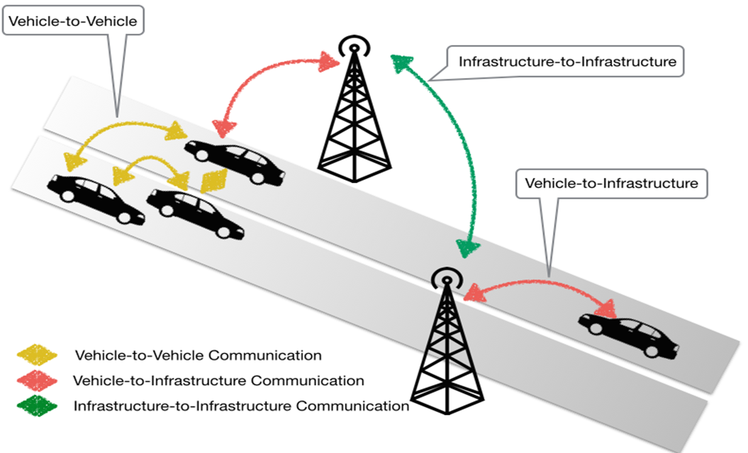
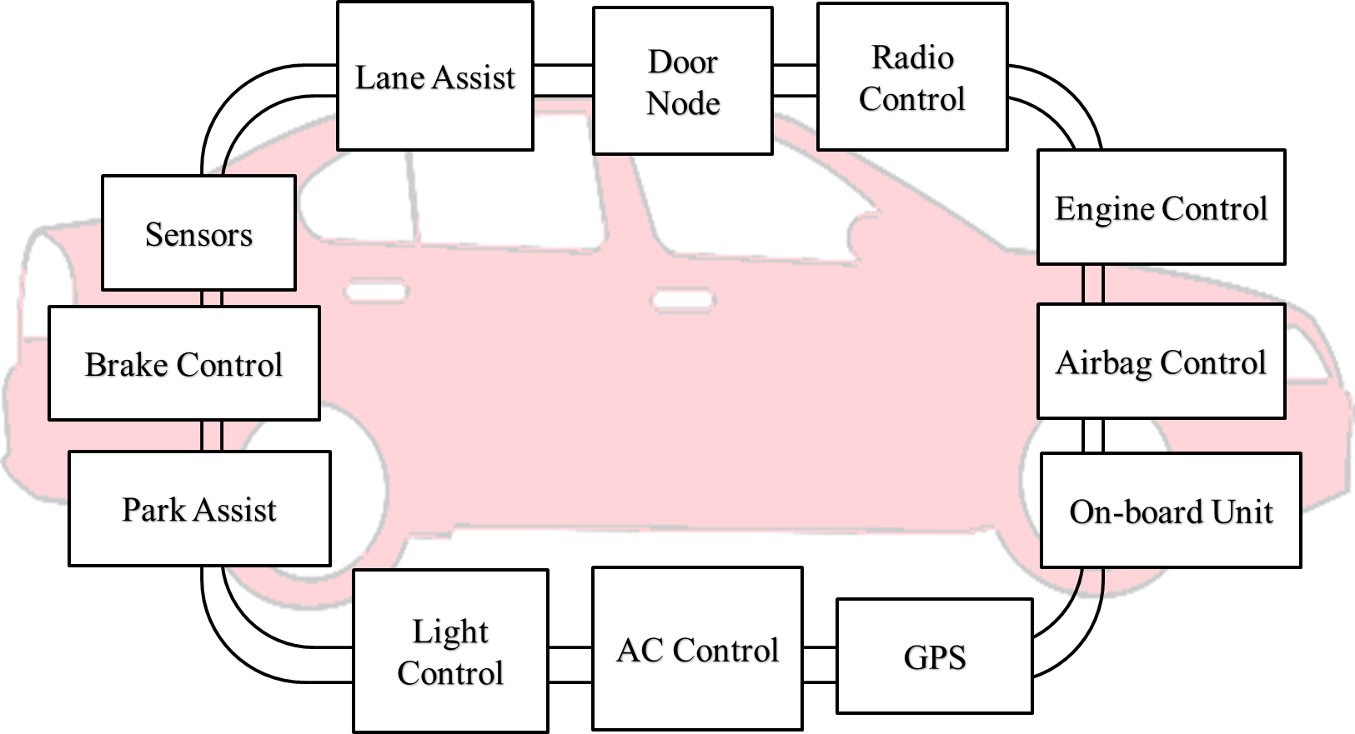

Motivation
Vehicle has more than 60 sensors and 30 or more Electronic Control Units (ECUs), i.e. Brake Control, Engine Control, GPS, Airbag Control, etc [6]
OBU allows heterogeneous and homogenous communications between vehicles and infrastructures (roadside equipment)
CAN (Control
Area
Network) Bus
Radio Interface or On-Board Unit
(OBU) enables short-range wireless
ad hoc networks to be formed
3
6-th Intl. Workshop on DNCMS’15

Slide 4
Motivation
Connected vehicles deploy signals to communicate with other vehicles, roadside units, personal devices and cloud services
  Goal: provide assistance to drivers and prevent accidents
Connected vehicle consists of electronic control units (ECUs) communicating via CAN (Controller Area Network) bus to transfer messages and execute queries sent from other ECUs
Vehicle-to-vehicle (V2V) and vehicle-to-infrastructure (V2I) communications are prone to security threats
Protection mechanisms
  Active Bundle [5], [9], [10], [11], [12], [13]
  Digital Signature
  HMAC

Slide 5
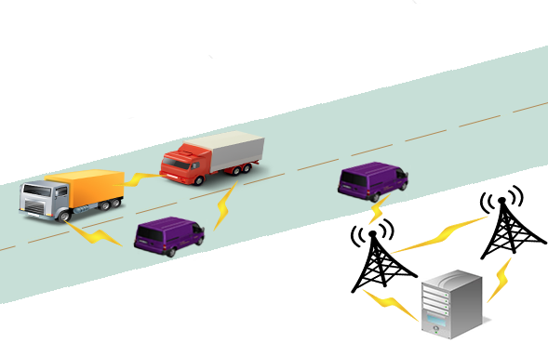
Motivation
Potential problems in vehicle-to-vehicle (V2V) and vehicle-to-infrastructure (V2I) systems:
Opaque data sharing (e.g. BS1=> BS2)
  Owner’s data can be shared with other parties but data owner does not know about it
Undetected privacy violations
  Topology of V2V networks is constantly changing
Lack of policy enforcement
Base
Station 2
(BS2)
Base
Station 1
(BS1)
Law Enforcement Server

Slide 6
Motivation
Data D = {d₁, … , d_{n} } where d_{i} is a separated data item
Data D is sent in encrypted form
E.g. d₁ is captured video data without human faces
d₂ is a traffic information
d₃ is vehicle’s health report
d₄ is captured video data with human faces
VEHICLE 1
D
D
VEHICLE 2
d₂
UNKNOWN
DOMAIN
D
D
LAW
ENFORCEMENT
STATION
d₁d₂d₃d₄
BASE STATION 2 d₂ , d₃
D
BASE STATION 1 d₁,d₂, d₃

Slide 7
Objectives
1. Develop a mechanism for privacy-preserving data dissemination in V2V and V2I systems, such that:
1.1. Each node is only able to access data items for which it is authorized
1.2. Vehicle manufacturers, law enforcement and drivers are able to define access control policies for vehicle’s data items
1.3. Secure data dissemination in untrusted V2V and V2I environments is provided
1.4. Message authenticity and integrity is provided
2. Analyze existing sets of regulations for data security policies in V2V and V2I systems in the U.S. and in EU
3. Develop a framework for detecting whether human face is present in video data captured by vehicle's camera
  Face detection result is used in policies

Slide 8
Related Work
Research report "Vehicle-to-Vehicle Communications: Readiness of V2V Technology for Application” [3] by National Highway Traffic Safety Administration
=> What policy should V2V system contain in order to minimize the likelihood of unauthorized access to insider information that could impose risks to privacy, e.g. facilitate tracking ?
EVITA [4] project (developed in EU):
=> Identified and evaluated security requirements for automotive on-board networks based on a set of use cases and an investigation of security threat (dark-side) scenarios

Slide 9
Impact of Attacks on Safety
Threats
  Denial of Service Attack
  Masquerade Attack
  Malware Attack
  Message Tampering
Mitigation Schemes
    Active Bundle
  Digital signature
  HMAC
  Checksums
Cost of Deployment
  Detection and mitigation of attack require the following costs:
    Performance overhead
    Memory overhead
    CPU and energy usage
ffmpeg

Slide 10
Impact of Attacks on Safety
Miller and Valasek demonstrated in DEF CON 21 a set of attacks [7], [8], including very serious attacks.
Hard braking/ no braking attack
  Locked brake
  Sudden stop
  Braking distance increase
Acceleration attack
  Sudden uncontrollable acceleration
Steering wheel attack
  Sudden uncontrollable rotation of a steering wheel
Engine shutdown
Light out attack
  Dashboard indication is misrepresented
  Dashboard indication is off
ffmpeg

Slide 11
Core Design
Active Bundle (AB) consists of:
Sensitive data: encrypted data items
=> applicable policy of AB ensures secure distribution of the corresponding data item
Metadata: describes AB and its policies which manage AB interaction with services and hosts
Policy Engine
Metadata
Sensitive Data
Policy
Policy Engine: enforces policies specified in AB
  Additionally, provides tamper-resistance of AB

Slide 12
Proposed Solution
Data item (D) = <k_{i}, v_{i}>
Policies (P) = {p₁,.., p_{m}}
Ciphertext (C) = {c₁,.., c_{n}}
Function set (F)
  F encapsulates AB and maps C to D considering P
VEHICLE 1
D, P, C, F
P, C, F
VEHICLE 2
k₂, C, F
P, C, F
P, C, F
LAW
ENFORCEMENT
STATION
k₁, k₂, k₃, k₄, C, F
BASE STATION 2 k₂, k₃ C, F
P, C, F
BASE STATION 1 k₁, k₂, k₃ , C, F

Slide 13
Key Generation
AB Template [5] is used to generate new ABs with data and policies specified by a user
  AB Template includes the implementation of invariant parts (monitor) and placeholders for customized parts (data and policies)
User-specified data and policies are included in AB Template
AB Template is executed to simulate the interaction process between an AB and a service requesting access to each data item of AB
Collect and aggregate into a single value for each data item the information generated during the execution of different AB modules and the digests of these modules and their resources such as:
  Authentication: authentication code, CA certificate that it uses
  Authorization: authorization code, applicable policies, policy evaluation code

Slide 14
Key Generation
Value for each data item is input into a Key Derivation module (such as SecretKeyFactory, PBEKeySpec, SecretKeySpec provided by javax.crypto library)
Key Derivation module outputs the specific key relevant to the data item
This key is used to encrypt the related data item [5]

Slide 15
Decryption Key Derivation
AB receives access request to a data item from a service
AB authenticates the service and authorizes its request
Information generated during the execution of different AB modules and the digests of these modules and their resources (authentication (authentication code, CA certificate that it uses), authorization (authorization code, applicable policies, policy evaluation code)) are collected and aggregated into a single value for each data item [5]
Value for each data item is input into the Key Derivation module (such as SecretKeyFactory, PBEKeySpec, SecretKeySpec provided by javax.crypto library)

Slide 16
Decryption Key Derivation
Key Derivation module outputs the specific key relevant to the data item [5]
This key is used decrypt the requested data item
If any module fails (i.e. service is not authentic or the request is not authorized) or is tampered, the derived key is incorrect and the data is not decrypted
Other methods for key distribution
Centralized Key Management Service
  TTP used for key storage and distribution
Key included inside AB
  Prone to attacks!
ffmpeg

Slide 17
System Architecture
Vehicle
Camera
On-Board
Video processor
AB
Generator
Video
stream
Video as
a set of
frames
AB
Video recompiled from pictures
w/o faces
ffmpeg
Traffic Monitoring
Base Station
AB
Video recompiled from pictures
with faces
ffmpeg
Law Enforcement
Station
ffmpeg

Slide 18
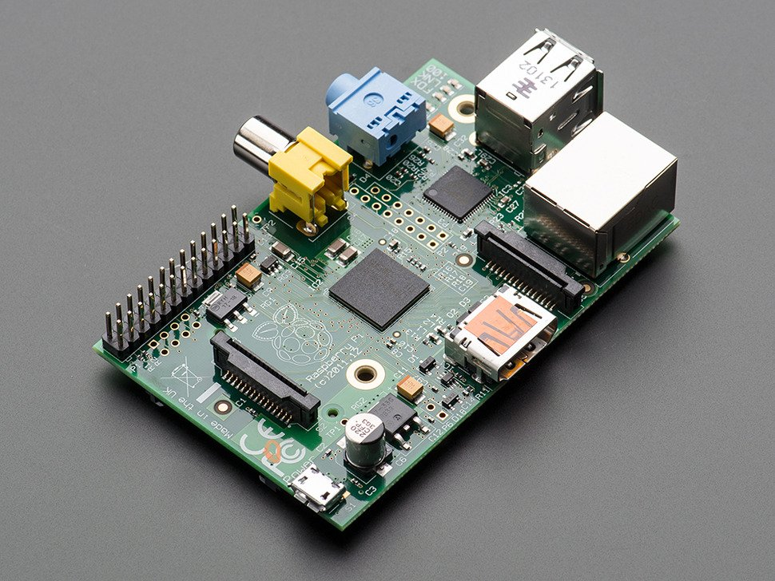
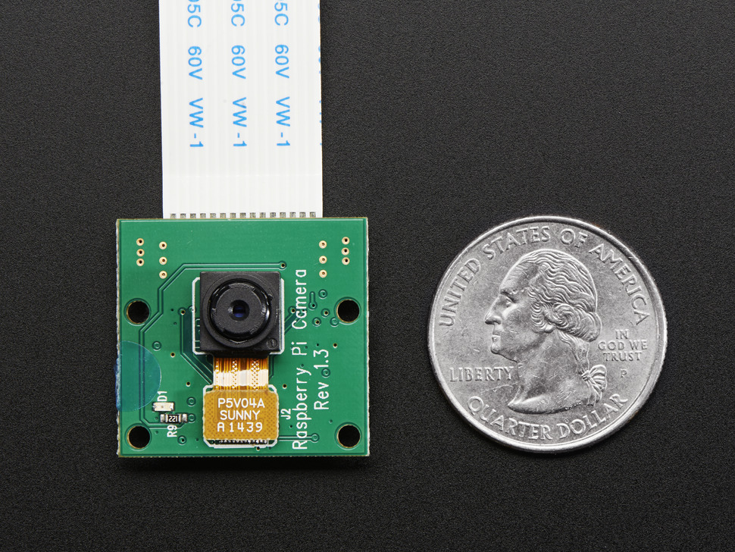
Hardware Setup
Hardware Setup to record and process video data
Raspberry Pi (model B)
  4’’ x 3’’ x 1.5’’ credit-card size development board
  5V of DC power
  700 MHz ARM CPU
  512 MB RAM
Pi camera
  Up to 2592 x 1944 pixels for static frames
  Up to 1080p for video recording

Slide 19
Software application
Developed C++ application running on Raspberry Pi board.
Goals:
  Specify parameters for camera configuration (video resolution, video length and frame rate)
  Restore video data as an array of “Mat” objects from OpenCV[2] library
  Apply existing face recognition algorithms (cascade classifiers) from OpenCV [2] library
  According to the result of face recognition function, separate frames into two groups (“frames with human faces” and “frames without human faces”)
  Use “ffmpeg” [1] to recreate videos from different groups of frames

Slide 20
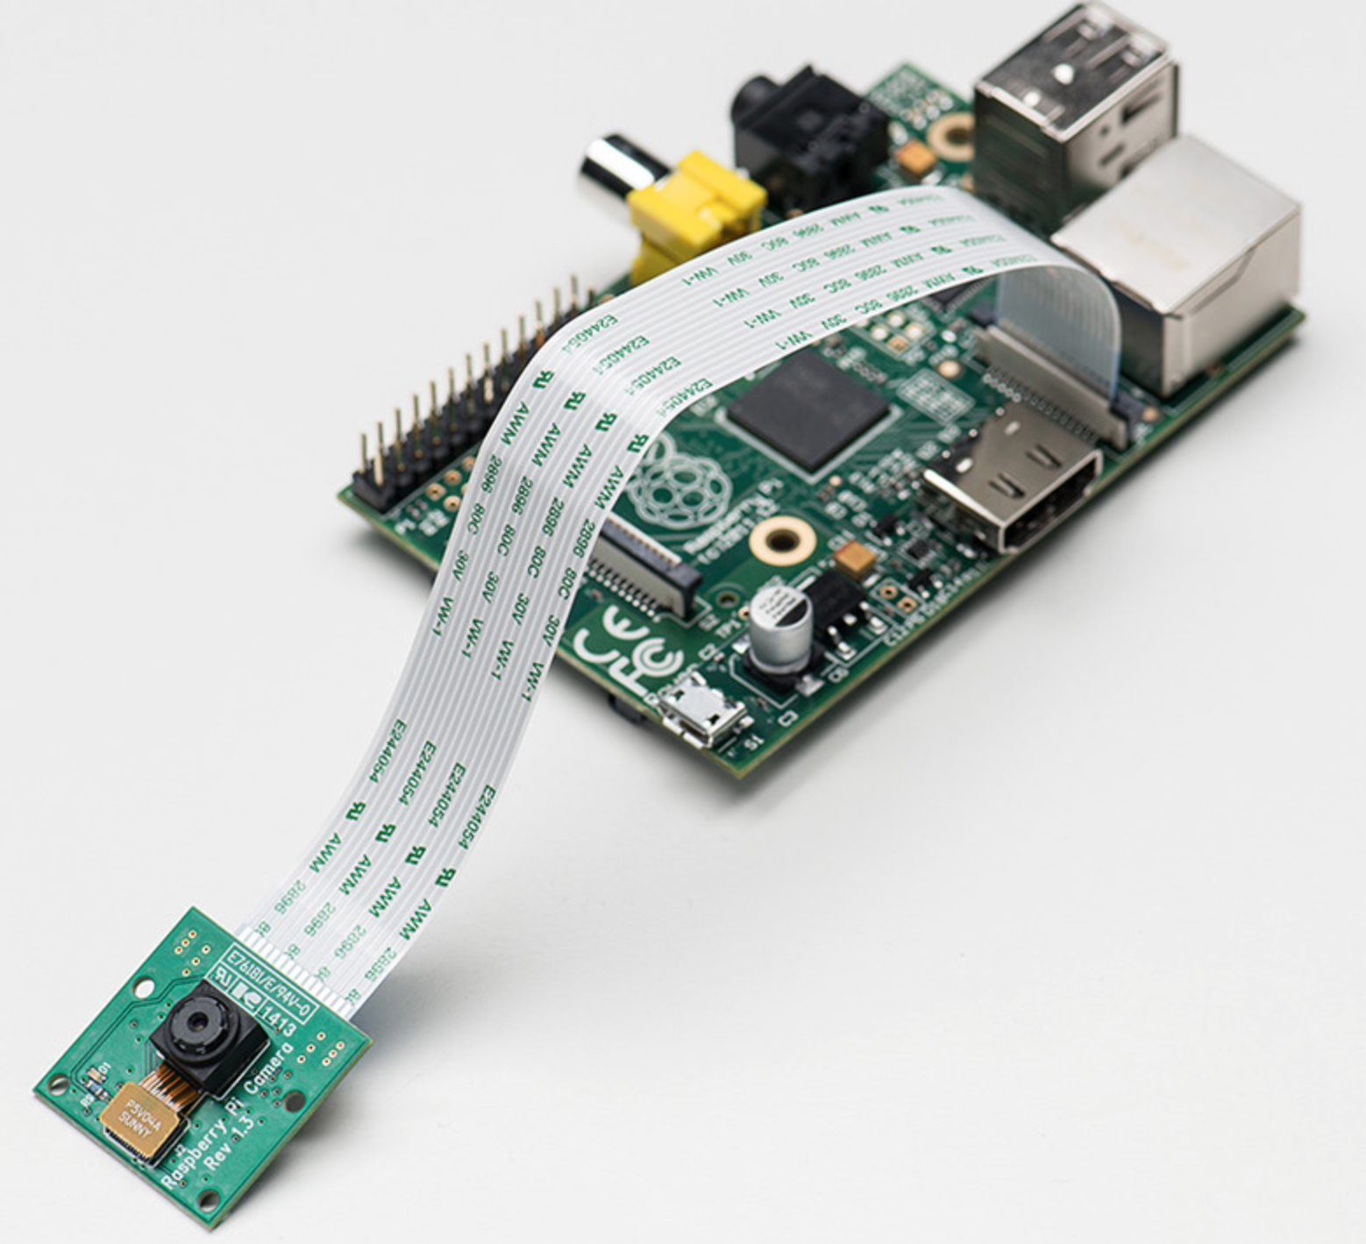
Video Recording
CSI (Camera Serial Interface) bus between Pi camera and CPU
  High-speed communication (up to 1 Gbits/s data rate)¹
C++ application for video recording
  User-specified resolution, video length and frame rate
  Restore image as an array of “Mat“ objects
¹ Online Source: http://www.electronicproducts.com/Digital_ICs/Communications_Interface/Camera_Serial_Interface_CSI-2_sensors_in_embedded_designs.aspx

Slide 21
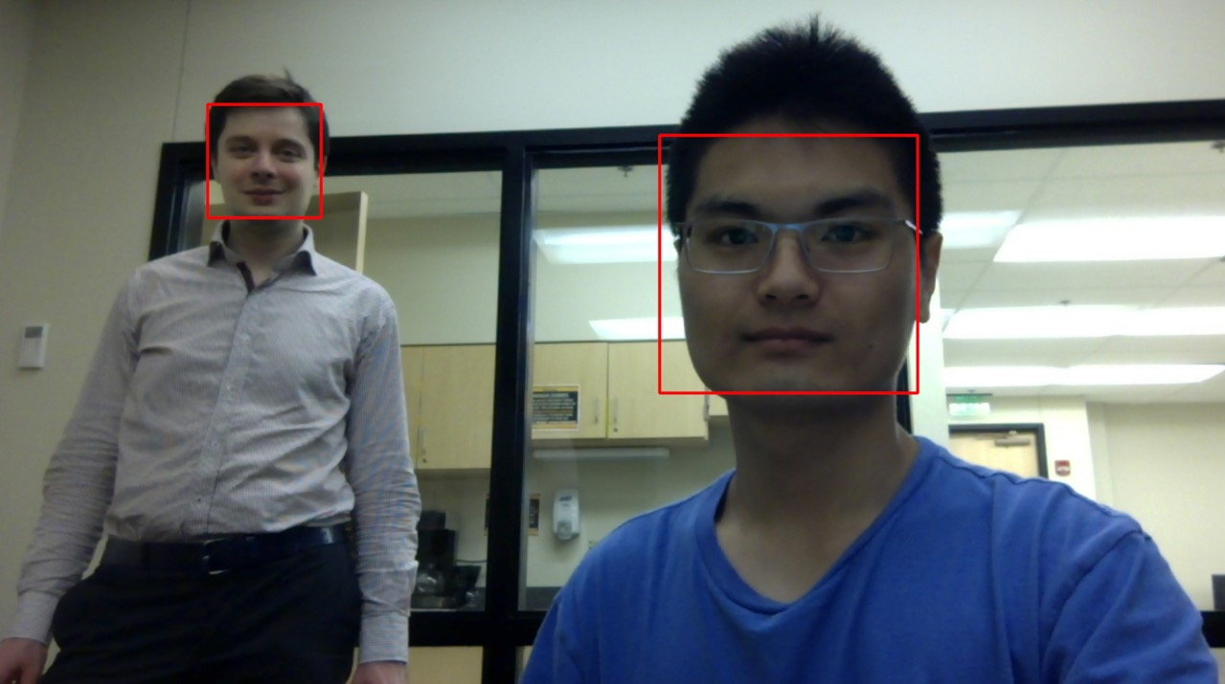
Face Recognition
4 face recognition algorithms (cascade classifiers) from
OpenCV [2] library:
  haarcascade_frontalface_alt
  haarcascade_frontalface_alt2
  haarcascade_frontalface_default
  lbpcascade_frontalface
C++ application for face recognition
  Process all frames of video data
  Apply face recognition algorithm to each frame
  Report whether human face was detected

Slide 22
Video Recreation
Frames with human faces are sensitive data => their privacy must be ensured in untrusted environments
Result of face recognition is used in policies
Every node is able to extract from AB only those frames for which it is authorized
Use “ffmpeg [1]” to recreate video from a set of accessible frames at receiver’s side
  Frame rate can be specified

Slide 23
Scenario of AB Transfer
AB
AB
AB
VEHICLE 1
VEHICLE 2
BASE
STATION
LAW
ENFORCEMENT
STATION
AB
Traffic Info
Video with human faces
Video w/o human faces
Vehicle’s health report
Location of captured video
AB
Traffic Info
E(Video with human faces)
E(Video w/o human faces)
E(Vehicle’s health report)
E(Location of captured video)
AB
Traffic Info
E(Video with human faces)
Video w/o human faces
Vehicle’s health report
Location of captured video
AB
Traffic Info
Video with human faces
Video w/o human faces
Vehicle’s health report
Location of captured video

Slide 24
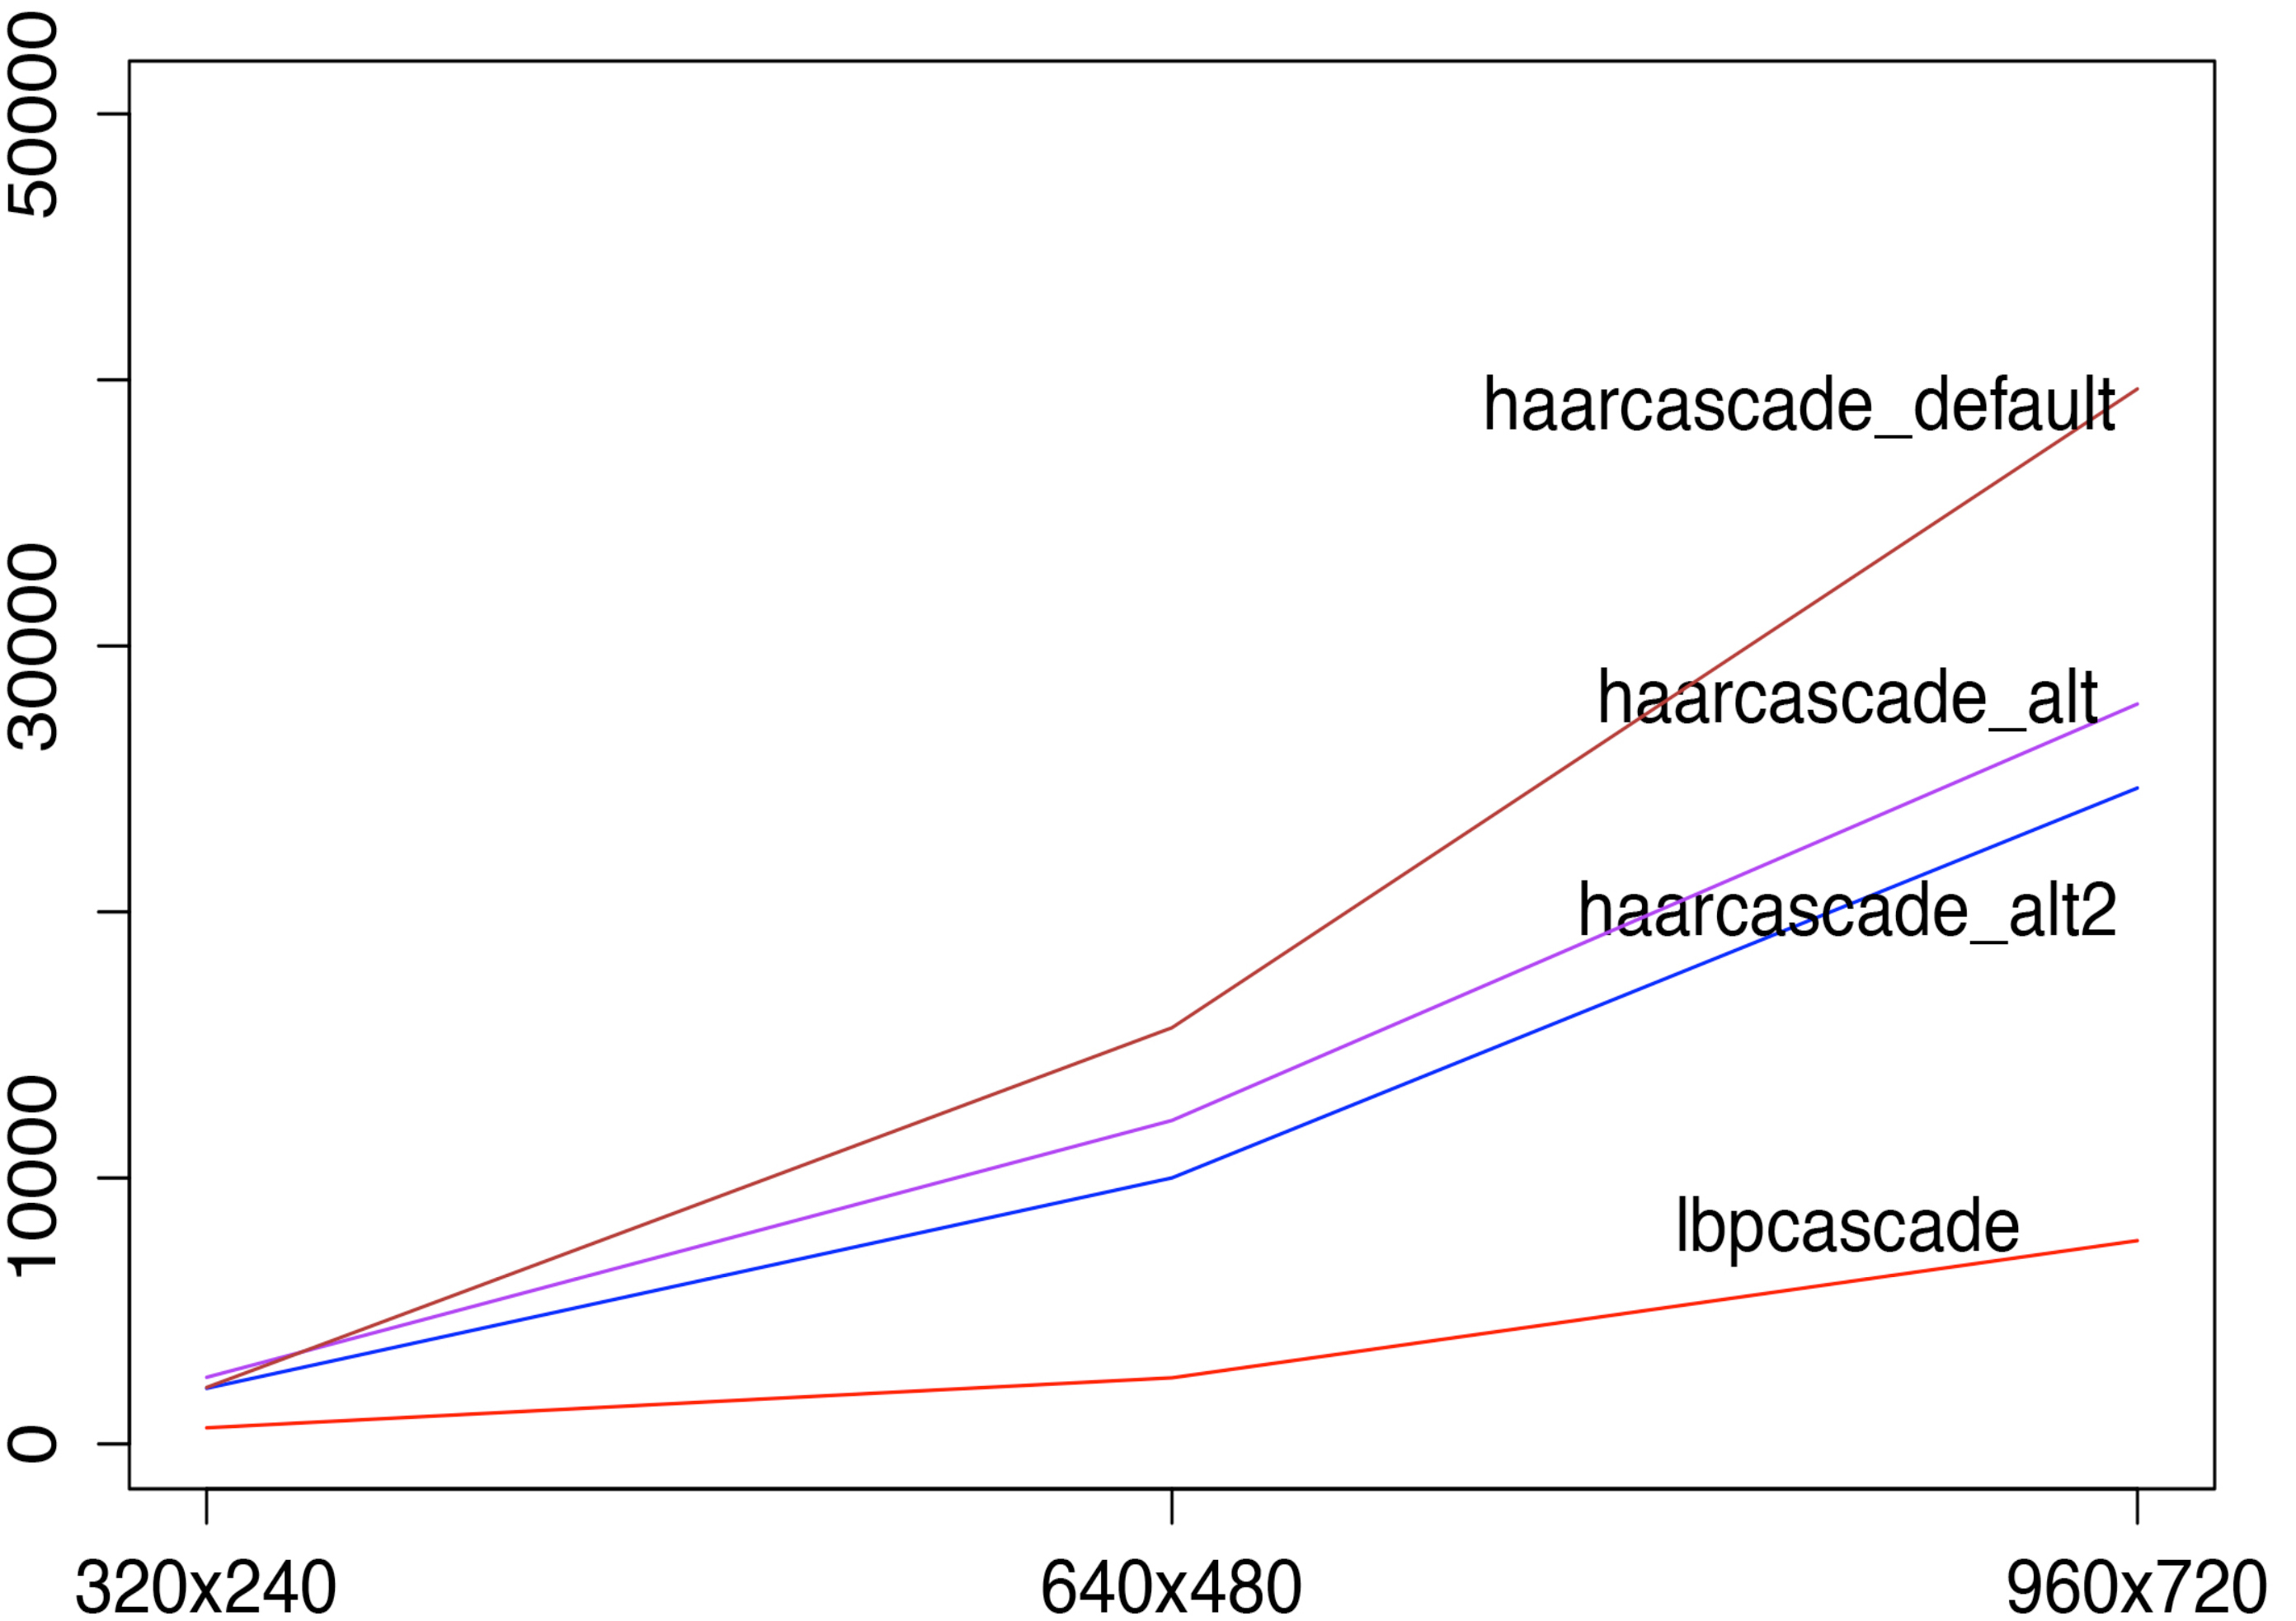
Evaluation
Face recognition algorithms performance
System Overhead [msec]
Resolution [pixels]
“Haar Cascade Alternative 2” has the highest detection rate with the second lowest overhead

Slide 25
Pros and Cons
Advantages:
Data dissemination mechanism works in untrusted environments
Data owner (source) availability is not required
Independent from trusted third parties
Agnostic to policy language and evaluation engine
Four face recognition algorithms are supported

Slide 26
Pros and Cons
Disadvantages:
Interaction time between service and AB is more than 1 sec (in case of only one policy) => currently not applicable for vehicle’s critical systems
Future Work:
Currently a set of policies is defined once by data owner => allow other parties to add new policies to AB
Need a mechanism to merge policies added by different parties, e.g. to resolve contradicting policies

Slide 27
Conclusions
Developed a policy-based approach for controlled and secure video data dissemination in untrusted environments in V2V and in V2I communication systems by means of Active Bundles [5]
Approach is illustrated on secure dissemination of video data captured by vehicle’s camera
Among 4 face recognition algorithms - “Haar Cascade Alternative 2” has the highest detection rate with the second lowest overhead

Slide 28
Acknowledgement
This publication was made possible by NPRP grant # [7-1113-1-199] from the Qatar National Research Fund (a member of Qatar Foundation). The statements made herein are solely the responsibility of the authors.

Slide 29
References
[1] ffmpeg http://www.ffmpeg.org
[2] The OpenCV Library Dr. Dobb’s Journal of Software Tools (2000) by G. Bradski
[3] J. Harding, G. Powell, R. Yoon, J. Fikentscher, C. Doyle, D. Sade, M. Lukuc, J. Simons, J. Wang, “Vehicle-to-vehicle communications: Readiness of V2V technology for application,” Report No. DOT HS 812 014, National Highway Traffic Safety Administration, Washington, DC, August 2014
[4] A. Ruddle, D. Ward, B. Weyl, S. Idrees, Y. Roudier, M. Friedewald, T. Leimbach, A. Fuchs, S. Grgens, O. Henniger, R. Rieke, M. Ritscher, H. Broberg, L. Apvrille, R. Pacalet, G. Pedroza,”Deliverable d2.3: Security requirements for automotive on-board networks based on dark-side scenarios,” 2009
[5] R. Ranchal, "Cross-Domain Data Dissemination and Policy Enforcement", PhD Thesis, Purdue University, Jun. 2015.
[6] 1. G. Izera M., and B. Bhargava.”Security Protection Methods in Vehicle-to-Vehicle Systems.” Computer Science Department Poster Showcase, Purdue University. Sept 2015.
[7] C. Miller and C. Valasek, “Adventures in automotive networks and control units,” DEF CON 21 Hacking Conf., 2013. Accessed in Mar. 2014, http://www.youtube.com/watch?v=n70hIu9lcYo.

Slide 30
References
[8] C. Miller and C. Valasek. Adventures in automotive networks and control units. Technical White Paper, IOActive, 2014 http://www.ioactive.com/pdfs/IOActive_Adventures_in_Automotive_Networks_and_Control_Units.pdf
[9] P. Angin, B. Bhargava, R. Ranchal, N. Singh, L. Lilien, L. Othmane and M. Linderman. "An entity-centric approach for privacy and identity management in cloud computing." 29th IEEE Symp. on Reliable Distributed Systems, Oct. 2010.
[10] R. Ranchal, B. Bhargava, L. Othmane, L. Lilien, A. Kim, M. Kang and M. Linderman. "Protection of identity information in cloud computing without trusted third party." 29th IEEE Symp. on Reliable Distributed Systems, Oct. 2010.
[11] B. Bhargava, P. Angin, R. Ranchal, R. Sivakumar, A. Sinclair and M. Linderman. "A trust based approach for secure data dissemination in a mobile peer-to-peer network of AVs." Intl. J. of Next-Generation Computing, vol.3(1), Mar. 2012.
[12] L. Ben Othmane and L. Lilien, “Protecting Privacy in Sensitive Data Dissemination with Active Bundles,” .Seventh Annual Conf. on Privacy, Security and Trust (PST 2009), Saint John, New Brunswick, Canada, Aug. 2009, pp. 202-213.
[13] L. Ben Othmane, “Protecting Sensitive Data throughout Their Lifecycle,” Ph.D. Dissertation, Dept. of Computer Science, Western Michigan University, Kalamazoo, Michigan, Dec. 2010.

