Slide 1
A Distributed Monitoring and Reconfiguration Approach for Adaptive Network Computing
Bharat Bhargava, Pelin Angin, Rohit Ranchal
Department of Computer Science, Purdue University
Sunil Lingayat
Northrop Grumman Corporation

Slide 2
Motivation
Rise of cloud computing has brought network computing to a whole new level
Context plays a very important role in achieving high quality of service with both mobile and cloud computing, as both face highly dynamic conditions
Adaptability to different contexts is significant for high performance in network computing. Elements of context in network computing include:
User preference
Workload
Data connection type & bandwidth
Resource availability
Situational context

Slide 3
Problem Statement
Current cloud/mobile computing systems lack generic and effective mechanisms to adapt to changes in performance and security contexts
In order to ensure the enforcement of service level agreements (SLAs) and provide high security assurance in network computing in real time, a monitoring framework needs to be developed to inspect the services dynamically during their execution. If a service is compromised, misbehaves or is underperforming, the service monitor needs to discover this inadequate performance, provide feedback, take remedial actions and adapt according to the changes in context
There is a need for novel techniques to:
Monitor service activity
Discover and report service behavior changes
Enforce security and quality of service requirements in cloud and mobile services

Slide 4
Agile Defense and Adaptability
Goals:
Replace anomalous/underperforming services with reliable versions
Reconfigure system service orchestrations to respond to anomalous service behavior
Swiftly self-adapt to changes in context
Enforce proactive and reactive response policies to achieve system security goals
Continuous availability even under attacks
Components:
Detection of anomalies/deviations from SLAs
Dynamic service composition

Slide 5
Adaptability for Increased Resilience
Dynamic service reconfiguration based on changes in context:
Updated priorities (e.g. response time vs. level of detail/accuracy)
Updated constraints (e.g. need to have trust levels of all services > x for critical mission)
Replacing failed services in composition with healthy ones dynamically to avoid complete restart of process
Monitor services status and determine action
Adapt services in a domain in response to attacks/failure
Update service health status in case of significant deviations from normal behavior
Create service backup in case of suspicion of anomaly
Re-deploy service in case of complete failure

Slide 6
Adaptive Computing Research Problems
How to detect changes in service context
Centralized or distributed monitoring?
What service behavior constitutes context change?
What is the most effective and efficient way to detect anomalies?
How to react to changes in context across domains
What is the most effective way to create fail-safe service orchestrations?
How can we efficiently reconfigure an orchestration to take into account the new context?
How can we tailor the response based on the extent, duration and type of anomalies?

Slide 7
Distributed Service Monitoring for Anomaly Detection and Adaptability
S4
*
MB
*
S5
S1
S6
*
Domain B
*
*
S2
MC
*
S7
MA
*
S3
*
S9
Domain A
*
Domain C
*
*
S10
*
S11
*
MD
*
*
ME
*
S12
Domain D
Domain E
Central Monitor
*: service request data
*: summary service health data

Slide 8
Distributed Service Monitoring for Anomaly Detection and Adaptability
Distributed service monitoring allows for the collection, analysis and reaction to dynamic cyber events across all domains involved, and prevents propagation of threats within or outside the domain of the anomalous service by taking proactive measures (service isolation, replication).
The data (service requests, service performance data etc.) gathered by the monitor M_{x} of each service domain x is stored in the monitoring database of the domain.
Service monitoring is distributed across domains, with one monitor for each domain. Each monitor is responsible for reporting the health status of the services in its own domain to the central monitor.
Service monitor of each domain mines the data stored in its database to detect anomalies with services in the domain and takes measures accordingly (re-deployment, backup service creation).
Service monitor of each domain sends summary health status data of services to the central monitor, which is utilized for dynamic service composition.

Slide 9
What Service Behavior Constitutes Context Change?
Significant deviations from normal performance parameter values
Violations of SLA compliance
Consecutive failures in service invocation
Changes in service composition (e.g. replacement of trusted services with untrusted ones)
Operation context changes (different platform, emergency, endpoint change etc.)

Slide 10
Performance and Security Parameters

Slide 11
Anomaly Detection
Anomaly affecting S1
Anomaly affecting whole domain

Slide 12
Anomaly Detection
Statistical analysis of multivariate time-series data collected by service monitors to detect significant deviations from normal behavior
Adjusts service threat levels based on duration, extent & type of anomalies
Correlation of time-series data from multiple services allows for detection of bigger threats (affecting the whole domain, collaborative attacks etc.)
Ability to detect zero-day attacks as opposed to signature-based models

Slide 13
Anomaly Detection
Training:
Input: Matrix V _{d x t} of service performance record
d: number of performance parameters
t: number of time points observed
Cluster each set of performance parameter values using K-means algorithm
Testing (system operation):
for each service interaction log
measure distance of performance parameter
values to each cluster, assign time point to closest
cluster
if latest interaction does not belong to any cluster
raise anomaly signal

Slide 14
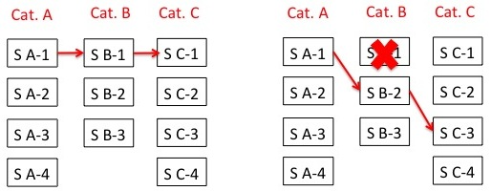
Dynamic Service Reconfiguration
An SOA service orchestration is composed of a series of services that interact with each other based on a service interaction graph
One of the multiple services in each service category can be selected for specific service functionality, e.g. category: weather, services: weather.com, Yahoo weather, accuweather
Challenge: Configuring set of services that conform to QoS and security policy requirements
Dynamically reconfigured service composition is based on changes in the context with respect to timeliness and accuracy of information as well as the type, duration, extent of attacks and the complexity of the environment

Slide 15
Dynamic Service Reconfiguration Implementation
Developed a module that dynamically determines the service endpoints involved in a specific composition
Given the description of a business process (service composition) including the categories of the services involved in the process, the dynamic service composition module updates the process with specific service endpoints to be utilized in that process.
The dynamic service composition mechanism allows services meeting specific requirements to be included in a composition
Utilizes service and interaction data logged in the central database to create the best possible composition given a service request with policy specifications
Enables the dynamic replacement of failed services in a composition with services of equivalent capability to prevent interruption of tasks
Dynamic replacement of service endpoints implemented in compliance with the BPEL standard for service composition, using dynamic partner links
Apache ODE engine used for the deployment of the composed processes

Slide 16
Dynamic Service Composition Problem
The problem of finding an optimal service composition subject to a set of performance and security constraints is NP-hard
As achieving low response times for dynamic service composition requests is important in real-time computing, we propose a greedy heuristic-based approach to find near-optimal solutions
Each service in the problem has a utility measured by the value of the parameter selected as the target for the optimization problem (i.e. the value we would like to maximize, such as the total trust value of services)
Additional service parameters such as response time can be specified as performance/security constraints (e.g. total response time < X)

Slide 17
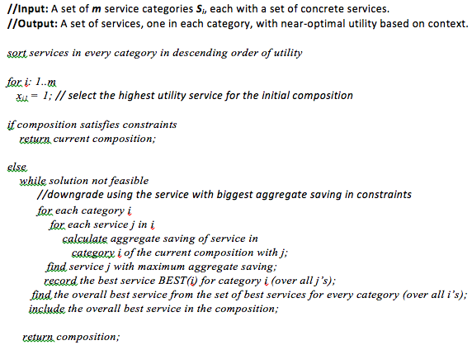
Dynamic Service Composition Algorithm

Slide 18
Implementation Details
Local (domain-level) service monitor
Apache Axis2 valves for interception
MySQL database for logging
Central monitor
Web service on Amazon EC2
Dynamic service composition module
Dynamic partner links in BPEL

Slide 19
Dynamic Service Composition Experiments
Dynamic service composition overhead is especially important in time-critical settings
Experiment 1: Measure response time overhead of dynamic service composition for different number of service categories in a composition
Setting: Central service monitor on Amazon EC2 m3.medium instance (1 vCPU, 3.75 GB memory)
Composition involving varying number of service categories, with 3 possible services for each category

Slide 20
Dynamic Service Composition Experiments (cont.)
Experiment 2: Measure response time overhead of dynamic service composition for different number of services to choose from for each category
Setting: Central service monitor on Amazon EC2 m3.medium instance (1 vCPU, 3.75 GB memory)
Composition involving 3 service categories, with varying number of services for each category
Composition time dominated by the database access time and not affected significantly by the number of possible services in a category or the number of service categories involved in the composition.
Composition overhead reasonable for most settings.

Slide 21
Adaptability Cost and Benefit Consideration
Benefits:
Increased availability of services (measured by up-time and throughput)
Increased performance by obviating the need to restart invocations of service compositions with failed/attacked services (measured by total response time)
Increased security and flexibility in service composition based on priorities and constraints in a specific environment (measured by success of avoiding attacks)
Costs:
Dynamic service composition time cost
Cost to maintain central service monitor
Service response delay due to monitoring
Increased resource usage in service domain
Overhead of re-deploying service in same/different domain

Slide 22
Conclusion
Main impact: Proposal of a comprehensive monitoring and reconfiguration architecture for network computing involving mobile and cloud services
Proposed model achieves high performance and continuous availability even under highly-dynamic contexts involving attacks and service failures and provides increased resiliency
The results of the experiments with the proposed dynamic service composition model and the reliance of the approach on standard technologies make it promising as a preliminary basis for a high-performance distributed architecture in network computing
Future work will involve comprehensive experiments with the proposed model under
Highly variable contexts such as fluctuating network bandwidth
Changes in service behavior (e.g. CPU/memory utilization patterns),
Different service loads
Various types of attacks on services that affect performance.

