Slide 1
Reinforcement Learning in Monopoly Games
Purdue Team

Slide 2
Purdue Contributions
We designed two smart baseline agents - for the Monopoly simulator - that can make decisions of what actions to take in each round of the game, as well as learn how to handle complex situations (e.g., negative cash balance).
We are using Deep Reinforcement Learning to implement our baseline agents as simple rule-based agents can not adapt to novelties, while RL agents can. So, an RL agent introduces a stronger baseline.
For future work, we can tune our RL agent to learn to recognize complex players’ behaviors/interactions (e.g. collusions) that might be involved in Monopoly.
Currently, we are working on generating interaction novelties in Monopoly. Specifically, we are designing colluding agents that cooperate to maximize their joint win rates.
Collaborate with Eric Kildebeck and Novelty Working Group (NWG) to finalize the SAIL-ON Novelty Hierarchy and define hierarchies in Monopoly domain (Slides 18 - 21).
Collaborate with Terry Boult and NWG to come up with a unifying framework for formal theories of novelty (Slides 22 - 24).
Collaborate with Josh Alspector and NWG to formulate a framework for theories of adaptation to novelty (Slides 25 - 28).

Slide 3
Research Progress
Checkpoint 1: Designed and implemented state space, action space and reward function have been. These are needed for the baseline RL agent. (Slides 13 - 15).
Checkpoint 2: An independent code for Deep Q-Learning Network (DQN) has been developed and has been integrated with the USC monopoly simulator.
Checkpoint 3: An imitation learning approach has been developed to establish a strong initial policy for our baseline agents. (Slides 11 & 12).
Checkpoint 4: Our two baseline agents were trained for > 1 million episodes to achieve success rate of more than 45 % (i.e., win more than 45% of the games). (Results in slides 16 & 17).
Note that our two baseline agents differ in their imitation learning and self-play techniques in order to maximize their win rates.
Checkpoint 5: Designed dissimilarity and regret measures for Monopoly, following the unified framework for theories of novelty developed by the NWG. (Slides 22 - 24).
Checkpoint 6: Investigated methods for Graph Edit Distance (GED) approximation to assess the difficulty to detect/adapt to novelties (Slides 25-28).
Checkpoint 7: A Multi-agent RL approach for colluding agents is being designed. (Slides 5 & 6).

Slide 4
Future Directions
Improve the baseline agents by designing more complex RL techniques –if needed- to win majority of the games.
Train the agents with other adaptive agents and with previous version of itself to make it more robust.
Run experiments, in collaboration with USC, to see how the baseline agents perform against other players/agents.
Investigate how will cooperation and competition between multiple RL agents affect the learning process.
Novel algorithms will be considered that deal with partnership games (two players on same team, where we will use aspects of centralized training and decentralized execution).
To generate novelty, hard/soft Attention algorithms will be utilized to decide on colluding agents within the environment.

Slide 5
Novelty Generation: Colluding Agents
In Monopoly, novelties can appear in the form of behavior changes of external agents (not the SAIL-ON agent): multiple agents colluding to win or to knock out another player. Thus, The game play may change from individual play to partnership play.
Given the novelty hierarchy recommendations, this can be categorized as either:
Interaction Novelty: Change in the distribution of interactions (e.g., trades in Monopoly) between two players would change from the non-colluding to the colluding instance.
Goal Novelty: The goal of the external agents changes from maximizing the individual reward to maximizing the joint rewards.
These collusions could also change over time, one player might switch from supporting a certain player to competing against him/her. A player may also form a collusion with another player against whom it was competing previously.
We differentiate collusion from cheating: If players violate the game rules (for instance by exposing their cards), this is not considered collusion but cheating.

Slide 6
Core Research Questions
How can we learn the complex game rationale using RL techniques?
How can we learn complex human player behavior that may not defined in the game rules?
Are we able to detect novelty in the environment and adapt to it? Can we predict player behavior changes (collusion vs. cooperation with other players)?
How can we learn to reason about the given situation (i.e., current game board) and sometimes beat the human logic?
How to play partnership games using RL?
Can we use game theory to learn different player strategy and explore if reaching an equilibrium might be possible in such complex environments?
How will agents communicate/interact and how will this communication introduce novelties in the environment?

Slide 7
Workshop on Novelties in Open World In conjunction with International Semantic Intelligence Conference (ISIC-2021) Conference Website: https://www.ifis.uni-luebeck.de/~groppe/isic/
Organizer: Professor Bharat Bhargava,
Purdue University, West Lafayette, Indiana, USA - https://www.cs.purdue.edu/homes/bb/
Scope:
Novelties are surprises that a system encounters.
System must learn about the characteristics and detect, understand, and adapt to novelty.
The context, timing, duration, extent, duration of novelty must be considered in agent’s adaption and accommodation. There is a need to build AI/ML system that can adapt to fluid novelties in open world.
This workshop contributes to scientific principles to quantify and characterize novelty in open-world domains.
It attempts to develop measures and evaluation criterion for behaviour of AI system.

Slide 8
Workshop on Novelties in Open World In conjunction with International Semantic Intelligence Conference (ISIC-2021) Conference Website: https://www.ifis.uni-luebeck.de/~groppe/isic/
Organizer: Professor Bharat Bhargava, Purdue University, West Lafayette, Indiana, USA
Speakers:
1. Prof Terrance E. Boult
El Pomar Prof. of Innovation and Security & Co-director Bachelor of Innovation U. Colorado at Colorado Springs
Title of Talk: On Semantics in a Unified Framework for theories of novelty
2. Eric J. Kildebeck, M.D., Ph.D.
Research Scientist, Center for Engineering Innovation, The University of Texas at Dallas
Title of Talk: Characterization of realistic novelties in 3D open world tasks
3. Prof Larry Holder
Professor, School of Electrical Engineering and Computer Science, Washington State University
Title of Talk: Measuring Task Novelty and Difficulty in Sequential Decision-Making Domains
4. Prof. Vaneet Aggarwal, Associate Professor and Marina W. Haliem, Ph.D. Candidate
Purdue University, West Lafayette, Indiana, United States
Title of Talk: Novelty Detection and Adaptation: A Domain Agnostic Approach

Slide 9
The papers generated so far on this project
Marina Haliem, Trevor Bonjour, Aala Alsalem, Shilpa Thomas, Vaneet Aggarwal, Bharat Bhargava, and Mayank Kejriwal, “Learning Monopoly Gameplay: A Hybrid Model-Free Deep Reinforcement Learning and Imitation Learning Approach”, Submitted to The IEEE Transactions on Games, (Feb. 2021).
Marina Haliem, Vaneet Aggarwal, and Bharat Bhargava, “Novelty Detection and Adaptation: A Domain Agnostic Approach”, in Proceedings of the International Semantic Intelligence Conference (ISIC 2021), Feb. 2021.
Marina Haliem, Vaneet Aggarwal, and Bharat Bhargava, “AdaPool: An Adaptive Model-Free Ride-Sharing Approach for Dispatching using Deep Reinforcement Learning”, in Proceedings of the 7th ACM International Conference on Systems for Energy-Efficient Buildings, Cities, and Transportation Environments (BuildSys 2020) and Under Revision at The IEEE Transactions on Intelligent Transportation Systems, (T-ITS).
Kaushik Manchella, Marina Haliem, Vaneet Aggarwal, and Bharat Bhargava, “PassGoodPool: Joint Passengers and Goods Fleet Management with Reinforcement Learning aided Pricing, Matching, and Route Planning”, Under Revision at The IEEE Transactions on Intelligent Transportation Systems, (T-ITS).
Kaushik Manchella, Marina Haliem, Vaneet Aggarwal, and Bharat Bhargava, “A Distributed Delivery-Fleet Management Framework using Deep Reinforcement Learning and Dynamic Multi-Hop Routing”, Workshop on Machine Learning for Autonomous Driving (ML4AD), Dec. 2020, at NeurIPS 2020.

Slide 10
Technical Details

Slide 11
Hybrid Deep RL Monopoly Player
Utilize Imitation Learning for a strong start:
Our agent starts by imitating a strong rule-based baseline to initialize its strategy and avoid learning from scratch.
We use DQN to train our baseline agent to take the best possible action, given a set of possible actions and a representation of the state space.
As learning proceeds, our agent learns a winning strategy and its exploration rate decreases in favor of more exploitation of its own experience memory using deep RL.
Utilize Deep RL:
Thus, resulting in a hybrid agent that not only utilizes its own experience memory but also leverages the intelligent behavior of a smart rule-based agent that mimics human logic.

Slide 12
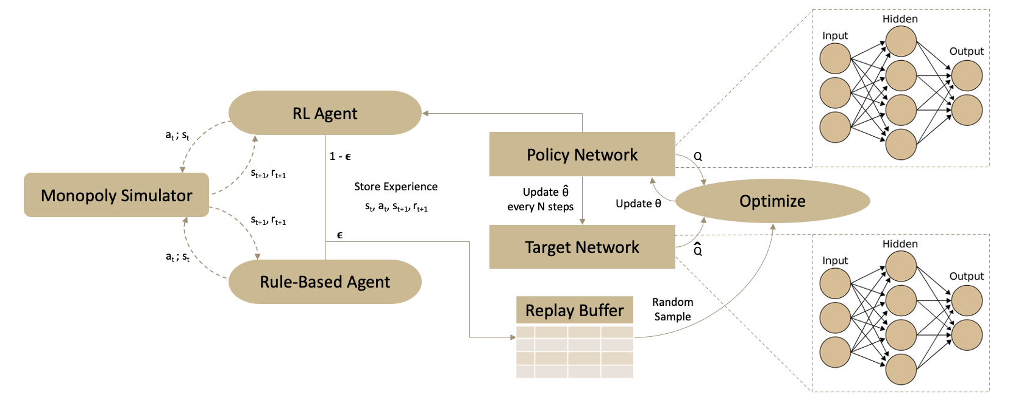
Approach Architecture

Slide 13
State Space
We represent the current game board from the perspective of our player using a 3-dimensional vector of objects containing information about the game’s (area, position and finance) current status at time t:
The area object: indicates the properties possessed from the current player and his opponents at time t.
The position variable: determines the player’s current position on the board in relation to its color-group.
The finance vector: specifies the current player’s number of properties in comparison to those of his opponents’ as well as a calculation of his current amount of money.

Slide 14
Action Space
We represent the action space using a 66-dimensional vector. We consider 12 different actions, 6, associated with a property group, and 6 that are not.
Property Group Actions | Non-Group Actions
Free Mortgage | Skip Turn
Sell Property | Conclude Actions
Buy Property | Pay Jail Fine
Mortgage Property | Use Get Out of Jail Card
Improve Property | Accept Sell Property Offer
Make Trade Offer | Accept Trade Offer
Once an action is selected by the agent, we use handwritten rules to select parameters, if required.

Slide 15
Reward Function
We use a dense reward function defined as the ratio of the current players net-worth to sum of net-worth of other active players.
$nw_{x}$: Net worth of player $x$
$c_{x}$ : Current cash with player $x$
$p_{a}$ : Price of asset $a$
$A_{x}$ : set of assets owned by player $x$
$$nw_{x}=c_{x}+\sum_{a∈A_{x}}{p_{a}}$$
$$r_{x}=\frac{{nw}_{x}}{\sum_{x^{′}∈X\backslash x}{{ nw}_{x′}}}$$
$r_{x}$ : Reward for player $x$
$X$ : Set of all active players

Slide 16
Evaluation Results: Baseline 1
Our RL baseline agent against different combinations of the previous two rule-based baseline agents:
We refer to our simple rule-based baseline as P₁, and to the sophisticated rule-based baseline as P₂
Evaluation Setting | Players
 | P₁ | P₁ | RL Agent | P₁
Win Rate per 100 games | 10 | 9 | 45 | 36
Evaluation Setting | Players
 | P₁ | P₂ | RL Agent | P₂
Win Rate per 100 games | 5 | 34 | 39 | 22
Evaluation Setting | Players
 | P₂ | P₂ | RL Agent | P₂
Win Rate per 100 games | 21 | 25 | 36 | 18

Slide 17
Evaluation Results: Baseline 2
Our RL baseline agent against different combinations of the previous two rule-based baseline agents:
We refer to our simple rule-based baseline as P₁, and to the sophisticated rule-based baseline as P₂
Evaluation Setting | Players
 | P₁ | P₁ | RL Agent | P₁
Win Rate per 100 games | 10 | 7 | 73 | 10
Evaluation Setting | Players
 | P₁ | P₂ | RL Agent | P₂
Win Rate per 100 games | 10 | 22 | 45 | 23
Evaluation Setting | Players
 | P₂ | P₂ | RL Agent | P₂
Win Rate per 100 games | 20 | 20 | 41 | 19

Slide 18
SAIL‐ON Novelty Hierarchy Segmentation for Monopoly Domain Objects and Agents
‘Level’ | Easy | Medium | Hard | Explanation
Objects | New Action Card - Forces player to take an action | New Card that can be used by the player later (i.e., to avoid paying rent) | New Card with multiple choices and the agent needs to decide when and which one to use | - Same but in different level (different types of same object) - change in object, but as a result agent must adapt to this change - the harder for agent to adapt, the harder the task
Attribute of Objects | Object: Dice Dice Change from 6 to 4 (Observing) | Object: Property Property Price (somebody must bid to detect change) | Object: Building Number of floors (an individual property) | Observation level
Agents | Agents with Blind bidding - not able to see other players bids (just bids, other things in environment is still observable) | Partially observable environment | Not observable unless agent’s turn | - For each agent, other agent is part of environment - Agent with different Visibility of Aspects of Environment - New kind of agent during testing time
Attribute of Agents | Higher Degree of visibility (Different attributes of State space) | Moderate degree of visibility | Lower degree of visibility | Visibility of Aspects of Environment (Inter-connected with 2)

Slide 19
SAIL‐ON Novelty Hierarchy Segmentation for Monopoly Domain Actions and Interactions*
‘Level’ | Easy | Medium | Hard | Explanation
Actions | Change how Agents move forward in board | Change how agent can buy property | Different metric for different agents die roll | - Same but in different level (different types of same object) - change in object, but as a result agent has to adapt to this change - the harder for agent to adapt, the harder the task
Attribute of Actions | Action Mapping changes from one to one, to one to many | Buy Property Attribute Change | New Attribute introduced for keeping track of die roll | More subtle changes would be harder to detect and potentially react to
Interactions (between agents) | Introduce 1 stronger adversarial agent | Introduce 2 or 3 independent adversarial agents | Introduce colluding agents | - Complexity of inter-agent interactions increases
Interactions (between agent and object) | Inflation in a set number of moves | Inflation randomly | Prices/Rents etc. can go up or down randomly | Increasing complexity with difficulty
Attribute of Interactions | Fixed trading at market price | Only buy property offers allowed in trading | No exchange trading allowed, either only buy or sell a property trade | More constraints connected with higher difficulty

Slide 20
SAIL‐ON Novelty Hierarchy for Monopoly Domain Rules, Goals, Relations, Events
‘Level’ | Easy | Medium | Hard | Explanation
Rules | Agent moves extra steps than number shown on die, only forward | Agent moves extra or less steps than number shown on die, only forward (randomly chosen) | Agent allowed to move in either direction | Allowed moves by Agent
Attribute of Rules | Roll die to a certain number to avoid going to jail | Changing the amount of Jail fine, which results in making a decision by agent | Introducing bail by another agent | - Rule for Go to Jail Card - Can be used as Rule-Novelty too
Goals | Maximize hotel count | Maximize cash | Go bankrupt | Current goal: Improve total worth (cash + Property)
Attribute of Goals | Achievement Goal | Team Goal instead of individual | Destructive or Collaborative Goal (Go bankrupt to help your collaborator win)
Relations | Reverse order of players who roll die randomly in a game a fixed number of times | Reverse order of players who roll die everytime | Randomize the order of players every cycle (or move) | More chaotic relations with increasing difficulty
Attribute of Relations | Order of players who roll dice | Change Property Value irrespective of Location | Add a tax rate to properties at marginal rate customized to each player
Events | Natural Disaster - lose turn | Natural Disaster - lose house/hotel | Natural Disaster - lose properties or randomly wipe out a property from the board | - Natural Disaster resembles open world incident, happens once during each game - Different consequence defines difficulty of novelty
Attribute of events | No of Players losing turn (Player is wiped out) | Uniform or randomized number of house/hotel lost | Amount of property

Slide 21
SAIL‐ON Novelty Hierarchy for Other Domains
‘Level’ | Easy | Medium | Hard
Objects | Normal Test data from similar distribution, but in different area (trained in WL, run in MIT) | Different Kind of Video dataset, not from surveillance camera | Introduction of New Object, i.e., a new surveillance camera position
Attribute of Objects | Suspect has new attributes | Include Area Search | Suspect Tracking Over time, variant attributes change with time
Goals | Person Re-Identification (Similar Goal Space) | Continuous Tracking over Multiple Camera | Suspect Tracking Over time
Attribute of Goals | Partial Change in Suspect Profiling System | Surveillance camera video quality | Variant attributes change with time
Events | Saturday Night | Football game | Riot/ Snowstorm
Attribute of events | Drinking increases | Students out of town | Vandalism/ Closed Roads

Slide 22
Unifying Framework for Formal Theories of Novelty
Dissimilarity Measure: Dissimilarity between the pre-novelty and post-novelty world (or observation) space. Dissimilarity measures produce non-negative values that are a generalization of distance metrics. Dissimilarity may be an actual distance metric, a statistical measure, an information-theoretic measure, or such measures combined with ontological or hierarchical information.
Regret Function: Not all novel items are of interest or present a risk to the agent. While we cannot know the risk of an unknown item until it becomes known, we can, after the fact, assign a regret score associated with post-novelty world. This regret score is calculated using a Regret Function defined for each task.

Slide 23
Dissimilarity Score in Monopoly
Distance Metric: We can use distance metrics to define the dissimilarity measure in Monopoly. For instance, the observation space in Monopoly contains Real Estate locations, each of which has a price and mortgage. A possible novelty could be a change in one or more such values in the Monopoly environment and a dissimilarity between two worlds can be calculated using a simple distance metric (e.g., Euclidean distance).
Novelty Detection using Replay Memory: We note that we can adapt the approach of change point detection on data consisting of experience tuples to detect the change in the environment dynamics. Novelty detection on experience tuples can, for instance, be used to detect the change in the set of rules that govern the environment dynamics, for instance: getting a 6 on dice is giving additional turn rather than stopping there, or getting a 1 on the dice moves 3 steps rather than 1. These types of novelties will cause the transition probability to change, which will -in turn- disrupt the distribution across memory samples. So, we adopt Online Dirichlet Change Detection (ODCP) algorithm for this purpose.

Slide 24
Regret Function in Monopoly
Agent Regret Function: Assume, we train an agent in the pre-novelty world $ω$ with 3 fixed policy agents as opponents and obtain a near-optimal policy ,π∗, for this environment. Given a state s_{t} ∈ S, the learnt policy π∗, guides the player to choose the best action a_{t} ∈ A at time step t.
Then, we define the regret as the difference in the win rates (WinG) using the optimal policy π in the new world $\check{ω}$and the win rates (WinG) using the policy π∗ in the new world $ω$*. Thus, Regret for the agent’s policy (π∗):
We note that the above definition of regret assumed a non-adaptive agent, that is learning policy π∗ in the pre-novelty world, and is using the policy π∗ in the post-novelty world. However, the agent can be adaptive, and keep learning the policies. Then, the regret, for an adaptive policy over T tournaments, can be defined as follows:

Slide 25
A Framework for Theories of Adaptation to Novelty
In Novelty Working subgroup, Josh Alspector presented the paper ‘A Framework for Theories of Adaptation to Novelty’. We investigated GED approximation methods as part of that framework and formalized research questions as a result of the discussion.
How difficult it is for a certain model to adapt in a certain task in a domain?
Adaptation to novelty as learning to augment existing skills to confront unfamiliar situations.
Measures of difficulty for adaptation
Number of actions required to react to a novelty (increases the required exploration space to successfully adapt) [#actions]
Amount of editing of a prior set of skill programs
Measure of divergence from the optimal pre-novelty policy to the optimal post-novelty policy [policy change]
The necessary editing is proposed to operate on an effective representation in an agent’s mental model.

Slide 26
Research Questions
Can we find a structured representation to quantify adaption?
Can the structured representations be generalized?
Can we detect the changes in representation pre-novelty vs post-novelty?
What kind of distance functions need to be defined based on the difficulty metrics?
Can we approximate the edit distance between pre-novelty and post-novelty representation (RED)?
Is there an approximation model that can adapt to generalized domains each with their own definition of novelty?

Slide 27
A Framework for Theories of Adaptation to Novelty
Structured Representation
Bit strings (change in information content in program bit strings)
Approximation to optimality – Minimum Description Length (MDL)
Semantic Models
Graphs representing the environment with nodes (neurons/entities) and connections (relations)
Include search space, policies, priors, experiences, difficulties in task and skills of the models
RED Approximation via Graph Edit Distance
Exact Method - A* Search
Heuristic Method - Minimum of VJ, Hungarian and Beam
Neural Network based Approximation via loss optimization - SimGNN

Slide 28
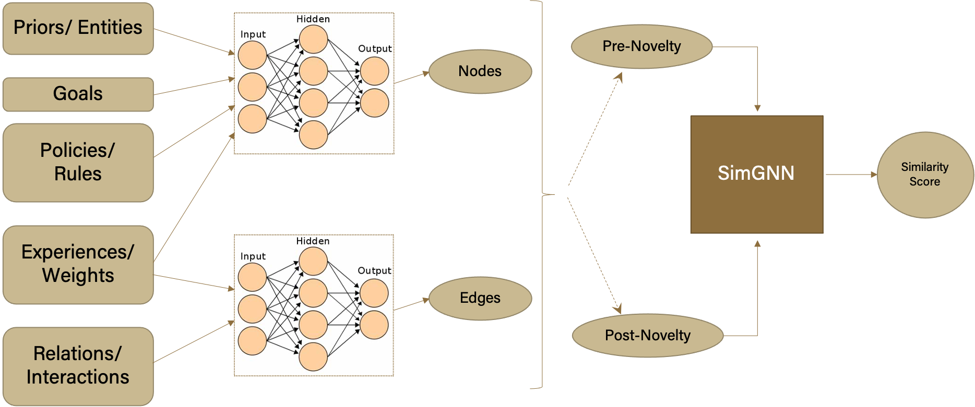
Approach Architecture

Slide 29
Thank You

