Slide 1
Adaptable safety and security in v2x systems
Miguel Villarreal-Vazquez¹, Bharat Bhargava¹, Pelin Angin²
¹ Department of Computer Science, Purdue University
² Department of Computer Engineering, Middle East Technical University
Acknowledgments: This publication was made possible by NPRP grant # [7-1113-1-199] from the Qatar National Research Fund (a member of Qatar Foundation). The statements made herein are solely the responsibility of the authors. The authors would also like to thank Dr. Weichao Wang and Dr. Leszek Lilien for their valuable comments and discussions.

Slide 2
motivation
Vehicle-to-vehicle (V2V) and vehicle-to-infrastructure (V2I) networks, i.e. V2X systems (Internet of vehicles) receiving increased attention because of significant contribution to improving safety
V2X systems hot targets for attackers trying to exploit software vulnerabilities → Compromised security, privacy and safety
V2V system needs security to ensure the trustworthiness of communication between vehicles
The source of each message needs to be trusted and message content needs to be protected from outside interference

Slide 3
Issues with existing v2x safety and security approaches
Safety, security and performance considered separately for V2X systems
Networking services have critical shortcomings, hurting time-critical safety applications
V2X research based on unrealistic conditions/limited operating conditions
Static selection of security, networking and safety features

Slide 4
focus
Developing a systematic approach to figure out:
  How V2X technologies increase safety
  How much the use of secure communication negatively affects safety
Security versus safety analysis
  Categories of safety messages
  Semantics of safety messages
  Different driving scenarios
  Examples: Highways, Streets on populated areas, Traffic lights
Developing an adaptive security model for V2X networks that changes the configuration of the secure channel based on sensitivity, context, safety level

Slide 5

Categories of safety messages
Traffic information messages: Used to disseminate the current conditions of specific areas and they indirectly affect safety
General safety messages: Used for cooperative driving and collision avoidance, and require an upper bound on the delivery delay of messages
Liability-related messages: Exchanged after an accident occurs
Our target: Critical-time messages!

Slide 6
Driving Scenario
Scenario 1: Sudden stop on a highway
  Vehicles move at same speed on the highway
  Pre-determined distance between them
  Reaction time with and without V2V
  Reaction time with secured V2V

Slide 7
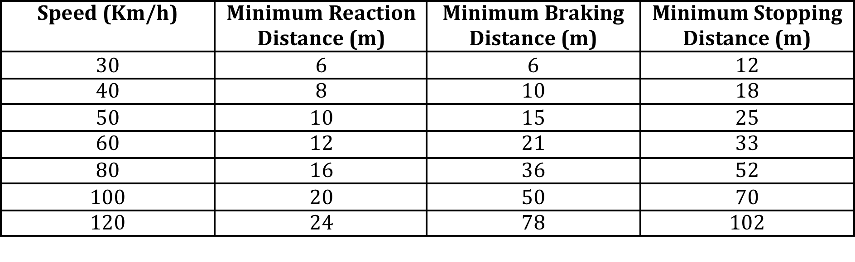
Driving Scenario
Stopping distance:
  Driver’s perception time
  Driver’s reaction time
  Vehicle’s reaction time
  Vehicle’s braking capability
The RSA recommended minimum stopping distance under dry conditions

Slide 8
System Model
Network:
  IEEE 802.11a compliant
  6Mbps minimum
Security mechanism on V2V:
  PKI infrastructure
  Every vehicle is assigned a public and private key
  Public key distributed through a certificated signed by the CA
  Authenticated message:

Slide 9
System Model
Security costs on V2V:
  Processing cost
  Communication cost:
    Distance: 120m
    Bandwidth: 6Mbps
    Speed of communication link: 3x10^8m/s
Signature generation and verification times

Slide 10
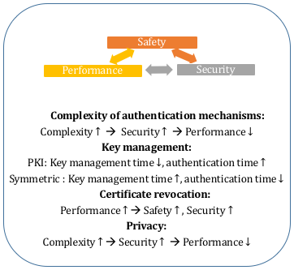
Safety-security tradeoffs

Slide 11
Adaptable safety/security approach
Self-adaptive software solutions capable of adjusting behavior at runtime to achieve functional or QoS goals
Self-protecting software detecting security threats and mitigating through runtime adaptation techniques
Monitoring activity needs to be isolated from V2X system activities → same resources used
AOP to monitor software behavior and adapt

Slide 12
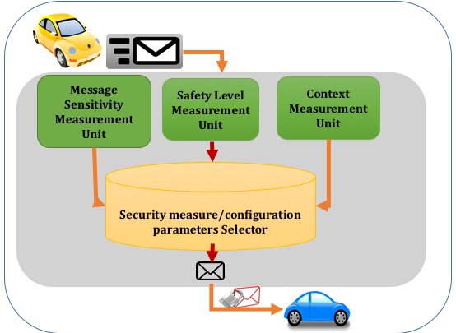
Adaptable security model

Slide 13
Adaptable security system components
Message sensitivity measurement unit: Measures the security sensitivity of the messages.
Safety level measurement unit: Measures the instantaneous safety level of the vehicle based on the mobility of the vehicles, traffic congestions etc.
Context measurement unit: Measures the current network throughput, latency, and packet losses for the vehicle with respect to surrounding vehicles. Based on this information the configuration parameters of the secure channel are adapted dynamically.

Slide 14
Performance metrics
Number of outgoing/incoming packets
Signature generations/verifications per second
Packet delays
Transmission delays
Message encryption/decryption delays
Number of neighboring vehicles, RSUs
Signal strength indicator
…

Slide 15
Experiments
Experiment 1: Measurement of delays of V2V messages with and without security
  Speed: 120Km/h
  Distance: 120m

Slide 16
Experiments
Experiment 2: Measurement of the capacity of the link
  Speed: 120Km/h
  Distance: 120m

Slide 17
Experiments
Experiment 3: Reaction time with V2V
  Size of message: 200 bytes
  Distance: 120m

Slide 18
Future work
Extended evalution with iTETRIS simulation platform under different scenarios and conditions
Development of quantitative model of tradeoffs between safety/security/performance aspects
Development of full adaptability framework

