Slide 1
An MTD-based Self-Adaptive Resilience Approach for Cloud Systems
Miguel Villarreal-Vasquez¹, Bharat Bhargava¹, Pelin Angin², Noor Ahmed³, Daniel Goodwin⁴, Jason Kobes⁴, Kory Brin⁴
¹ Department of Computer Science, Purdue University
² Department of Computer Engineering, Middle East Technical University
³ Air Force Research Laboratory
⁴ Northrop Grumman Corporation
Acknowledgments: This work was funded by the Northrop Grumman Cybersecurity Research Consortium. The prototype was implemented in collaboration with Northrop Grumman and internally presented to them in April 2017. The authors would also like to thank Dr. Leszek Lilien and Dr. Weichao Wang for their valuable comments.

Slide 2


MOTIVATION
Attack Surface

Slide 3
MOTIVATION
Attack Surface
Replication approaches in cloud computing increase the attack surface
We need resilient/self-healing systems that can accurately detect anomalies and dynamically adapt themselves to keep performing mission-critical functions even under attacks and failures.

Slide 4
RESEARCH QUESTION
Is it possible to construct a generic attack-resilient framework for distributed cloud systems with a combination of dynamic network configuration and continuous replacement of virtual machines?

Slide 5
Moving Target Defense (MTD)
Attack Vectors Resilient Approaches
- Data
- Code
- Infrastructure
- Communications
- People
- Moving Target Defense
(MTD)
- Proactive Restore/C2
- Least Privilege
Enforcement
- Trust Zone Segmentation
- Identity Attribution
- Encryption
- Root Trust

Slide 6
Moving Target Defense (MTD)
The proposed Moving Target Defense (MTD) solution introduces resiliency and adaptability to the system through live monitoring, which transforms systems to be able to adapt and self-heal when ongoing attacks are detected

Slide 7
Moving Target Defense (MTD)
Adversaries have an asymmetric advantage: They have the time to study a system, identify its vulnerabilities, and choose the time and place of attack to gain the maximum benefit
The idea of moving-target defense (MTD): Imposing the same asymmetric disadvantage on attackers by making systems dynamic and therefore harder to explore and predict
Threat Avoidance Techniques!

Slide 8
State of the Art and Limitations
REPLICATION/REDUNDANCY
DIVERSIFICATION/RANDOMIZATION
Fault-Tolerance Systems
- Solution: Replication/
Redundancy:
- Examples: Quorum, Chain
- Limitation: Gives fault
resiliency but increases
attack surface at application
level (common code base)
Fault-Tolerance Systems
- Solution: MTD
- Examples: ASLR [9],
NVersion [10] & IP-
Hopping [11]
- Limitation: Do not protect
the entire host
7

Slide 9
State of the Art and Limitations
The traditional defensive security strategy for distributed systems is to prevent attackers from gaining control of the system using well established techniques: Replication/Redundancy, Encryption, etc.
    Limitation: Given sufficient time and resources, existing defensive methods can be defeated

Slide 10
State of the Art and Limitations
The state of the art of MTD solutions focus on randomization and diversification in particular layers of the system
    Limitation: Do not protect the entire host

Slide 11
PROPOSED APPROACH
“Stay one-step ahead” of sophisticated attack
  Protect the entire stack through dynamic interval-based spatial randomization
  Avoid threats in-time intervals rather than defending the entire runtime of systems through Mobility and Direction
  System will start secure, stay secure and return secure
  Increase agility, anti-fragility and adaptability of the system
  Unified generic MTD framework that enables reasoning about behavior of deployed systems on cloud platforms

Slide 12
OBJECTIVES OF THE MTD SOLUTION
Aims to reduce the need to continuously fight against attacks by decreasing the gain-loss balance perception of attackers.
Narrows the exposure window of a node to attacks, which increases the cost of attacks on a system and lowers the likelihood of success and the perceived benefit of compromising it.

Slide 13
OBJECTIVES OF THE MTD SOLUTION
The reduction in the vulnerability window of nodes is mainly achieved through three steps:
  Partitioning the runtime execution of nodes in time intervals
  Allowing nodes to run only with a predefined lifespan (as low as a minute) on heterogeneous platforms (i.e. different OSs)
  Proactively monitoring their runtime below the OS

Slide 14

BENEFITS OF THE PROPOSED SOLUTION
State of the Art System View:
Application
OS
Network
At a given time only some layers of the stack (Application, OS or Network) are checked/ protected
Replica 1 Replica 2 Replica 3
Application
Randomization Space
OS
Network
Application
OS
Network
1
2
3
n
Sate Verification
Time Intervals (< 1 sec)

Slide 15
BENEFITS OF THE PROPOSED SOLUTION
Proposed Solution System View:
Application
OS
Network
At a given time all layers of the stack (Application, OS or Network) are checked/protected.
Replica 1 Replica 2 Replica 3
Application
Randomization Space
OS
Network
Application
OS
Network
1
2
3
n
Sate Verification
Time Intervals (< 1 sec)

Slide 16
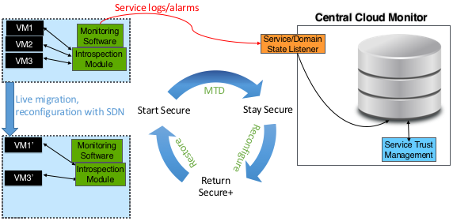
APPROACH OVERVIEW
Notes:
The system starts with trusted
components
- Continue to operate maintaining
level of trust
- Return to trusted state case of an
event

Slide 17
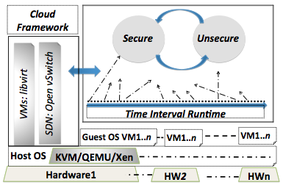
MTD ARCHITECUTRE
Components:
(1) Virtual Reincarnation (ViRA) (3) SDN Network Dynamics
(2) Proactive Monitoring (4) Systems States and Application Runtime

Slide 18
MTD ARCHITECUTRE
The MTD framework consists of the following four components:
  Virtual Machine Reincarnation (ViRA)
  Proactive Monitoring
  SDN Network Dynamics
  Systems States and Application Runtime
The framework will protect the whole stack; not only particular layers

Slide 19

APPROACH DETAILS
Nodes run a distributed application on a given platform for a controlled period of time
The running time is chosen in a way that successful ongoing attacks become ineffective
The new fresh machine will integrate to the system and continue running the application after its data is updated
SDN Network

Slide 20
APPROACH DETAILS
Nodes run a distributed application on a given platform for a controlled period of time
The running time is chosen in a way that successful ongoing attacks become ineffective
The new fresh machine will integrate to the system and continue running the application after its data is updated
SDN Network

Slide 21

VIRTUAL REINCARNATION
Randomization and diversification technique where nodes (virtual machines) running a distributed application vanish and reappear on a different virtual state with different guest OS, Host OS, hypervisor, and hardware .
Virtualized
Environment
Improve
Resiliency
Improve
Anti-Fragility

Slide 22
Creation of REPLICAS
How do we create replicas?
Primary VM runs as no failures are detected.
Alternate VM takes place when a failure occurs
Acceptance tests are adjusted independently to guarantee system operation
Alternate learn from Primary and become more robust to failures/attacks experimented by primary
PRIMARY
ALTERNATE
OK
OK
FAIL
FAIL
Acceptance Test
Acceptance Test

Slide 23
Creation of REPLICAS
Challenges:
Reduce downtime when Primary is replaced by Alternate and vice versa
Keep the state of the machine (either Primary or Alternate) after the replacement to achieve uninterrupted operation
Keeping the state (stateful reincarnation) allows the system to be application-agnostic
PRIMARY
ALTERNATE
OK
OK
FAIL
FAIL
Acceptance Test
Acceptance Test

Slide 24
Creation of REPLICAS
Stateful Reincarnation Ideas:
VM1
VM2
VM3
Quorum
D’
D’’
D
T
T’
T’’
VM4
D’’’
D*: Synchronized Data
T*: Different version of Text
VM4 replaces VM1
T’’’

Slide 25
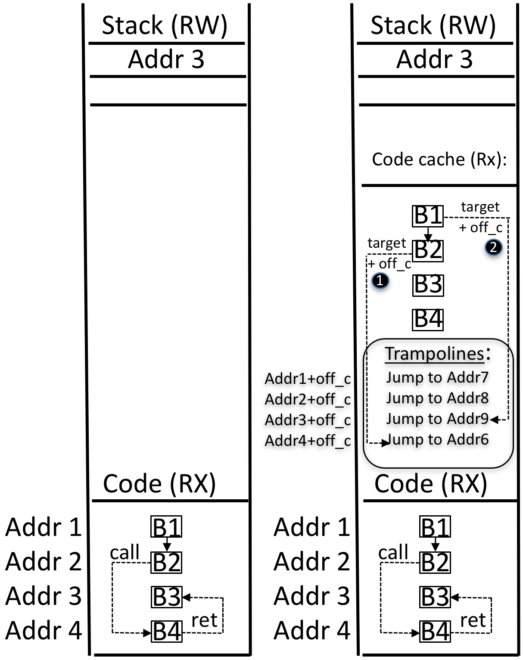
Creation of REPLICAS
Stateful Reincarnation Ideas:
Create different versions of binaries
The original code is kept and set with read-only permission so that it can be used as part of the reference to the new locations of the blocks in the re-randomized version.
We avoid identifying and updating code position pointers in each randomization process by keeping a table of trampolines as shown in (b). Each block is located at a fixed offset (i.e., off_c) with respect to the trampoline table.
The pointers (in the original code space) are dynamically redirected to its respective address in the code variant when it is de-referenced
Z. Wang, C. Wu, J. Li, Y. Lai, X. Zhang, W. Hsu and Y. Cheng. ReRANZ: A Ligh-Weight Virtual Machine to Mitigate Memory Disclosure Attacks. To appear in VEE2017.
(a) (b)

Slide 26
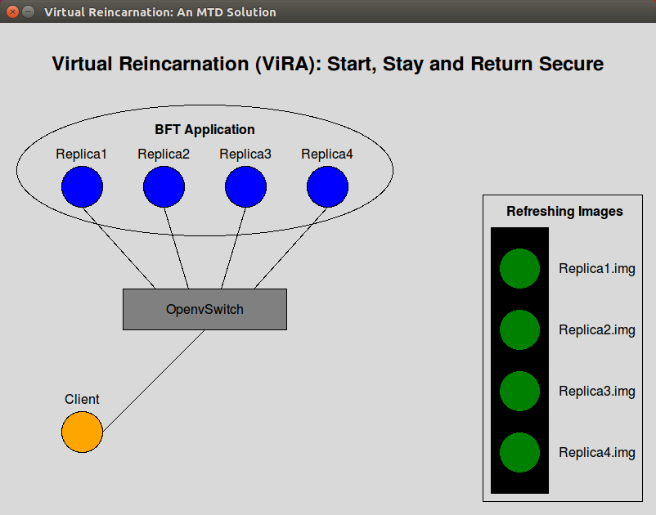
VIRTUAL REINCARNATION
“Active machines are replaced by new ones with a totally new image”
https://www.dropbox.com/s/fqjh75su0p908ic/NGCRC-2017-Bhargava-DEMO2.mp4?dl=0

Slide 27
PROACTIVE MONITORING
Operates at the hypervisor level
Helps for performing node reincarnation effectively rather than blindly
Based on Virtual Machine Introspection (VMI)
Proactively gathers live memory data (at host OS) in intervals and reacts if anomalous behavior is detected
Use libvmi library for introspection with negligible performance overhead
  When application is hijacked, address offsets show new entries for injected code
  When application is terminated and a new malicious one created, it could end up with a different process ID or memory address offset

Slide 28
SDN NETWORK DYNAMICS
Network devices are reconfigured via OpenFlow on-the-fly
New added flows redirect traffic intended for the old machine to the new machine
SDN Network

Slide 29
SDN NETWORK DYNAMICS
Network devices are reconfigured via OpenFlow on-the-fly
New added flows redirect traffic intended for the old machine to the new machine
OpenFlow Tables:
table=0,priority=0,actions=…
:
table=1,priority=0,actions=…
:
table=2,ip,nw_dst=10.0.0.10,...
SDN Network

Slide 30
SDN NETWORK DYNAMICS
New machines can be integrated to the system with their own IP addresses
No waiting for the IP address of the old machine
Downtime is reduced

Slide 31
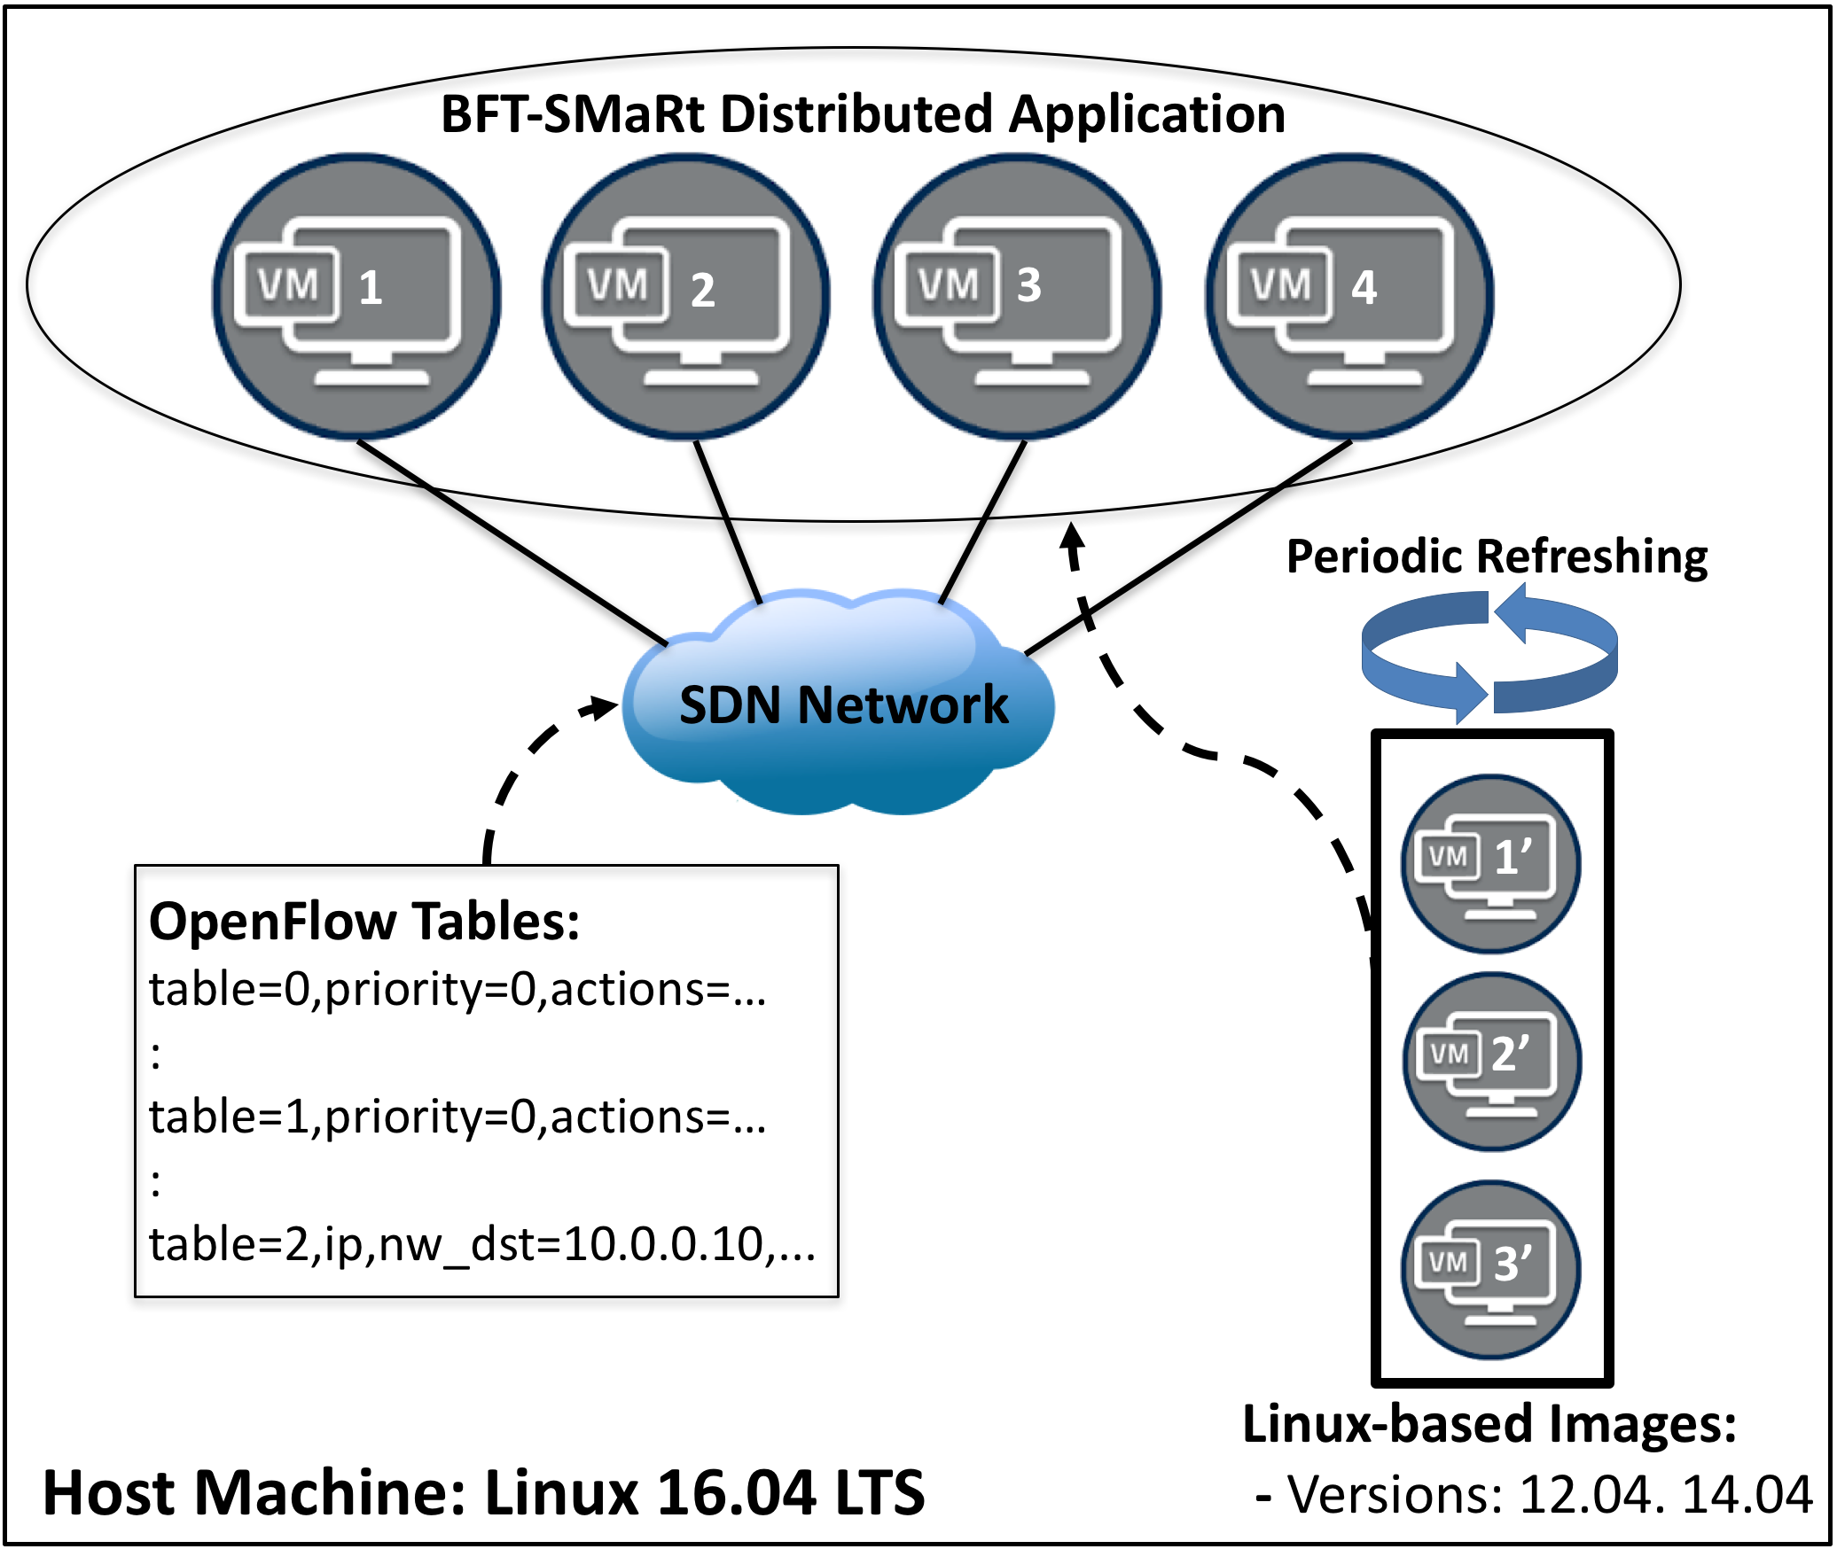
Measurements
A Byzantine fault tolerant (BFT-SMaRt) distributed application was run on a set of Ubuntu (either 12.04 or 14.04 randomly selected).
VMs run in a private cloud, and are connected with an SDN network using Open vSwitch
The reincarnation is stateless, i.e. the new node (e.g. VM1’) does not inherit the state of the replaced node (e.g. VM1).
The set of new VMs are periodically refreshed to start clean and the network is reconfigured using OpenFlow when a VM is reincarnated to provide continued access to the application.

Slide 32
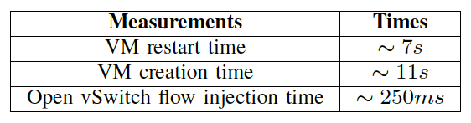
Measurements
VM restart time: Time it takes the machine to respond to be full operational since it is started.
Virtual creation time: Time to create the new image of the VM.
Open vSwitch flow injection time: Time it takes to inject new flows to Open vSwitch
Note: that the important factor for system downtime here is the Open vSwitch flow injection time, as VM creation and restart take place before the reincarnation process

Slide 33
Measurements
Aim to estimate the time it takes the new machine to be full operational.
VM creation and restart take place before the reincarnation process
The important factor for system downtime here is the Open vSwitch flow injection time

Slide 34
FUTURE WORK
Enhanced live monitoring techniques
Instrumentation to measure overhead more accurately
Test other stateless applications on the MTD framework
  E.g.: Upright (Public and Subscribe System)

Slide 35
FUTURE WORK
Stateful Virtual Reincarnation Support:
  Can we preserve the state of the virtual machine during the reincarnation process to make the solution application-agnostic?
  Test the framework with Secure SOA Services (stateful reincarnation)

Slide 36
PRESENTATION AND PUBLICATIONS
NGC Cyber Resilient Systems IRAD (http://www.northropgrumman.com)
Enterprise Resiliency IRAD (http://www.northropgrumman.com)
Ahmed, N., and Bhargava, B. Towards Targeted Intrusion Detection Deployments in Cloud Computing. In the Int. Journal of Next-Generation Computing Vol. 6, No 2, IJNGC - JULY 2015.
N. Ahmed. Design, Implementation, and Experiments for Moving Target Defense. PhD Thesis, Purdue University, 2016.
N. Ahmed and B. Bhargava. From Byzantine Fault-Tolerance to Fault-Avoidance: An Architectural Transformation to Attack and Failure Resilience. To Appear in IEEE Transactions on Cloud Computing, TCC 2016.
N. Ahmed and B. Bhargava. Disruption-Resilient Publish/Subscribe: A Moving Target Defense Approach. The 6th International Conference on Cloud Computing and Services Science, CLOSER 2016.
N. Ahmed and B. Bhargava. Mayflies: A Moving Target Defense Framework for Distributed Systems. 3rd ACM workshop on MTD in conjunction with ACM Conference on Computer and Communications Security (CCS), Vienna, 2016.
R. Ranchal, D. Ulybyshev, P. Angin, and B. Bhargava. Policy-based Distributed Data Dissemination. CERIAS Security Symposium, April 2015 (Best poster award)
V. Pappas, M. Polychronakis and A. Keromytis. Smashing the gadgets: Hindering return-oriented programming using in-place code randomization.” In IEEE Security and Privacy (SP), 2012.
L. Chen and A. Avizienis. N-version programming: A fault-tolerance approach to reliability of software operation. Digest of Papers FTCS-8: Eighth Annual International Conference on Fault Tolerant Computing. 1978.
M. Carvalho and R. Ford. Moving-target defenses for computer networks. IEEE Security & Privacy 12.2 (2014).

