Slide 1
IEEE Cloud 2017
Privacy – Preserving Data Dissemination in Untrusted Cloud
Denis Ulybyshev, Bharat Bhargava, Donald Steiner, Leon Li, Jason Kobes, Harry Halpin, Miguel Villarreal – Vasquez, Aala Alsalem, Rohit Ranchal
  Computer Science, CERIAS, Purdue University
  Northrop Grumman
  MIT
  IBM
1
1
2
2
2
3
1
1
4
1
2
3
4
Notes:
1

Slide 2
Outline
Problem Statement
Related Work
Core Design
Thesis contributions
Demonstrations and Experiments
Future Work
ACKNOWLEDGMENT
This work was funded by the Northrop Grumman Cybersecurity Research Consortium. Paper approved for public release by Northrop Grumman, Case #17-0995. The prototype was implemented in collaboration with Northrop Grumman and W3C / MIT and presented internally to Northrop Grumman in April, 2016. We are thankful to Prof. Leszek Lilien and Prof. Weichao Wang for their collaboration and valuable feedback.
2

Slide 3
Problem Statement
Privacy – preserving role – based and attribute – based data dissemination
Authorized service can only access data items for which it is authorized
Role – based data dissemination
Attribute- and context – based data dissemination
Periodic computation of trust level of services
3

Slide 4

Problem Statement
Data
Owner
Active Bundle
Cloud Server
Patient’s EHR (Active Bundle)
Contact, Medical and Billing Information
Web Crypto Authentication
Doctor
- Contact Info
- Medical Info
- Billing Info
Web Crypto Authentication
Insurance
- Contact Info
- E(Medical Info)
- Billing Info
Web Crypto Authentication
Researcher
- E(Contact Info)
- Medical Info
- Billing Info
Doctor
Insurance
Researcher
Scenario of EHR Dissemination in Cloud (suggested by Dr. Leon Li, NGC)
4

Slide 5

Problem Statement
Data dissemination in SOA
Data (D) = {d₁,.., d_{n}}
Access Control Policies
(P) = {p₁,.., p_{k}}
`
D
TRUSTED
DOMAIN
D, P
CLOUD
PROVIDER 1
D, P
Service 2 forwards
D and P
to other cloud
CLOUD
PROVIDER 2
D, P
Data
Leaks ?
D, P
D, P
D, P
SERVICE 1
d₁
SERVICE 2
d₂
UNKNOWN
DOMAIN
SERVICE 3
d₃
5

Slide 6
Research Solutions
Privacy – Preserving Data Dissemination based on:
- Active Bundles with policies and policy enforcement engine
- Central Monitor constantly re-computing trust level of services
- Secure Browser with detection of its cryptographic capabilities
R. Ranchal, D. Ulybyshev, P. Angin, and B. Bhargava. “Policy-based Distributed Data Dissemination,” CERIAS Security Symposium, April 2015 (Best poster award, 1 out of 43)
6

Slide 7
Research Solutions
Features:
Is independent from TTP
Data owner’s availability is not required
Dissemination considers client's attributes
  Crypto capabilities of a browser
  Trust level (which is constantly recomputed)
  Authentication method
  Type of client’s device
On-the-fly data updates are supported
Secure key generation scheme
7

Slide 8
Related Work
Policy-based Data Dissemination
Policy enforcement at browser's side [8] (Prof. Matteo Maffei, Saarland University, Germany)
  Micro-policies specified in terms of tags, used to label URLs, network connections, cookies, etc and a transfer function
  Transfer function defines permitted operations by the browser based on tags.
  Trust level of clients is not constantly monitored and recalculated in the data dissemination model
  Requires browser’s code modification
  Implemented as a Chrome plugin (MiChrome [9] )
8

Slide 9
Related Work
Policy-based Data Dissemination
“Encore” (sticky policies) system [7]
  Policies and data are made inseparable
  Policies are enforced by TTP
  Policies are prone to tamper attacks from malicious recipients
  Prone to Trusted Third Party (TTP)-related issues
Privacy – preserving information brokering (PPIB) [6]
  Divides processing among multiple brokers, no single component has enough control to make a meaningful inference from data disclosed to it
  Prone to centralized TTP (manages keys, metadata) issues
9

Slide 10
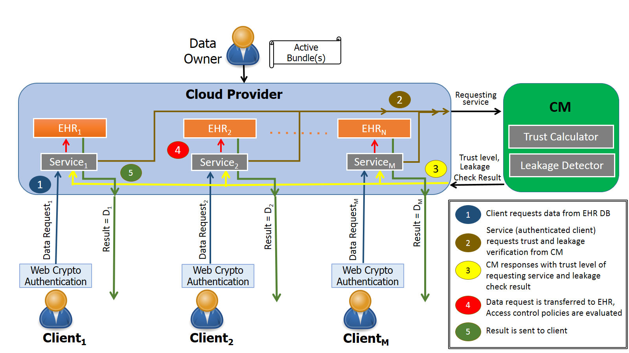
Framework Architecture
10

Slide 11
Attribute and Role–based Data Dissemination
Email
ACCESSIBLE TEXT
Browser’s Crypto Level: High
Authentication Method: Fingerprint
Client’s device: Desktop
Source network: Corporate Intranet
Role: Doctor
AUTHENTICATED
CLIENT
AUTHENTICATED
CLIENT
Browser’s Crypto Level: Low
Authentication Method: Password
Client’s device: Mobile
Source network: Unknown
Role: Insurance Agent
Email
INACCESSIBLE TEXT 1
ACCESSIBLE TEXT
INACCESSIBLE TEXT 2
11

Slide 12
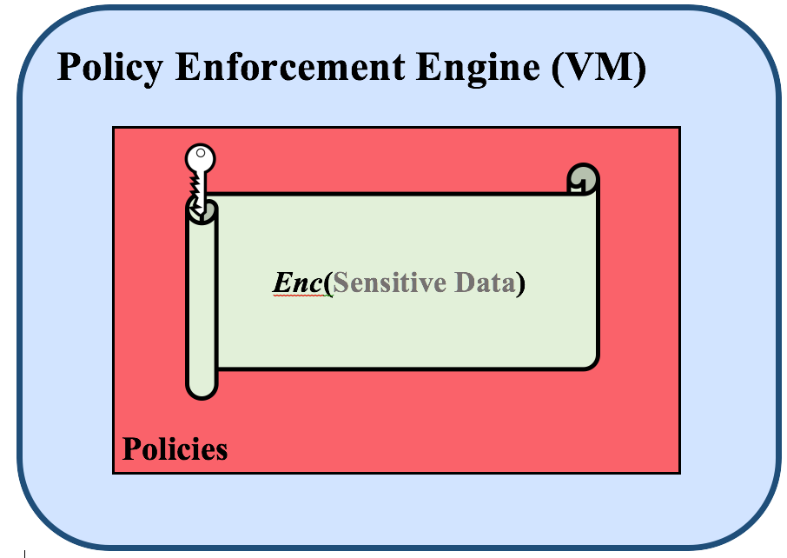
AB Core Design
Active Bundle (AB) parts:
[10], [11]
Sensitive data:
  Encrypted data items
Metadata: describe AB and its access control policies
  Policies [14], [15] manage AB interaction with services and hosts
Policy Engine [18]: enforces policies specified in AB
  Provides tamper-resistance of AB [1]
12

Slide 13
AB Example
Key-value pair stored in the Active Bundle:
{ “ab.patientID” : “Enc(0123456789)” }
{ “ab.name” : “Enc(‘Monica Latte’)” }
ALLOW
Resource | patientID
Subject's Role | Doctor, Insurance, Researcher
Action | Read
  Policy Examples:
ALLOW
Resource | name
Subject's Role | Doctor, Insurance
Action | Read
13

Slide 14
Key Generation
Aggregation{di} ( - Generated AB modules execution info;
- Digest(AB Modules),
- Resources: authentication code + CA certificate, authorization code, applicable policies + evaluation code)
Key Derivation Module (javax.crypto SecetKeyFactory)
Ki
ENCki (di)
AB Template [1] used to generate new ABs with data and policies (specified by data owner)
AB Template includes implementation of invariant parts (monitor) and placeholders for customized parts (data and policies)
AB Template is executed to simulate interaction between AB and service requesting access to each data item of AB
14

Slide 15
Key Generation (Cont.)
Info generated during the execution and digest (modules) and AB resources are collected into a single value
Value for each data item is input into a Key Derivation module (such as SecretKeyFactory, PBEKeySpec, SecretKeySpec from javax.crypto library)
Key Derivation module outputs the specific key relevant to the data item
This key is used to encrypt the related data item [1]
15

Slide 16
Key Derivation
Aggregation{di} ( - Generated AB modules execution info;
- Digest(AB Modules),
- Resources: authentication code + CA certificate, authorization code, applicable policies + evaluation code)
Key Derivation Module (javax.crypto SecetKeyFactory)
Ki
DECki (Enc[di])
AB receives data item request from a service
AB authenticates the service and authorizes its request (evaluates access control policies) [1]
1. "Cross-Domain Data Dissemination and Policy Enforcement", R. Ranchal, PhD Thesis, Purdue University, Jun. 2015.
16

Slide 17
Key Derivation (Cont.)
Info generated during the AB modules execution in interaction with service, and digest (AB modules) and AB resources are aggregated into a single value for each data item [1]
Value for each data item is input into the Key Derivation module
Key Derivation module outputs specific key relevant to data item
This key is used decrypt the requested data item
If any module fails (i.e. service is not authentic or the request is not authorized) or is tampered, the derived key is incorrect and the data is not decrypted
17

Slide 18
Other Key Distribution Methods
Centralized Key Management Service
  TTP used for key storage and distribution
  TTP is a single point of failure
Key included inside AB
  Prone to attacks!
18

Slide 19

Tamper Resistance of AB
Key is not stored inside AB [2]
Separate symmetric key is used for each separate data value
Ensure protection against tampering attacks
Aggregation{di}
(Execution info;
Digest(AB Modules);
Resources)
Key Derivation
Module
Ki
DECki (di)
di
Aggregation{di} ( Tampered (
Execution info;
Digest(AB Modules);
Resources) )
wrong di
Key Derivation
Module
K’i
DECk’i (di)
19

Slide 20
AB Use Cases
Hospital Information System (collection of EHRs)
  Doctor, Researcher and Insurance are authorized for different parts of patient's EHR [5]
  Database of EHRs is hosted by untrusted cloud provider
Secure Email
  Email is AB
  Entire email can be sent to the whole mailing list
  Recipients are authorized for different fragments of email
  It is guaranteed for the sender that each recipient will only see those email fragments it is authorized for
  No need for multiple mailing lists for different authorization levels
Online shopping
  Decentralized data accesses: data can travel across the services
C. Qu, D. Ulybyshev, B. Bhargava, R. Rohit, and L. Lilien. "Secure Dissemination of Video Data in Vehicle-to-Vehicle Systems.” 6th Intl. Workshop on Dependable Network Computing and Mobile Systems (DNCMS2015), Sep. 2015
20

Slide 21
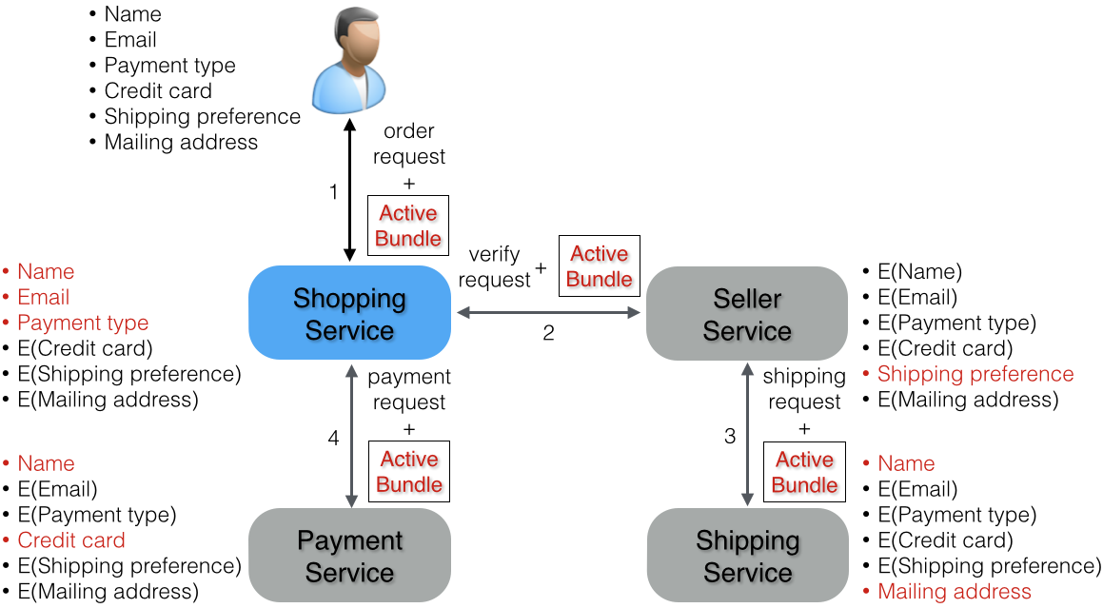
AB Use Cases: Online Shopping
21

Slide 22
NGC TechFest’16 Demo: Electronic Health Record Dissemination in Cloud
Active Bundle: Contact, Medical and Billing Information
Hospital
(NodeJS Server)
Researcher
- E(Contact Info)
- Medical Info
- Billing Info
Insurance
- Contact Info
- E(Medical Info)
- Billing Info
Doctor
- Contact Info
- Medical Info
- Billing Info
(10)
(2)
(4)
(9)
(1)
(3)
(1) HTTP GET Request
(2) Hospital’s Web Page
(3) HTTP POST with
Data Request and Role
(5)
Authentication Server
(6)
Client
(Browser)
(7)
(8)
(4) HTTP 302 with AB Request and Role (5) HTTP Get Request (6) AS Web Page
(7) HTTP POST with Credentials (8) HTTP 302 with Ticket (9) HTTP Get Request with Ticket (10) Data provided by AB
22

Slide 23
Data dissemination features
Data Dissemination based on:
  Access control policies
  Trust level of a subject (service, user)
  Context (e.g. emergency vs. normal)
  Security level of client’s browser (crypto capabilities) [16], [17]
  Authentication method (password-based, fingerprint, etc)
  Source network (secure intranet vs. unknown network)
  Type of client’s device: desktop vs. mobile (detected by Authentication Server)
23

Slide 24
Lightweight encryption
Can be used in Active Bundle instead of regular AES [1]
Cipher | Key size [bits] | Block size [bits] | Throughput at 4 MHz [kbit/sec] | Relative Throughput (% of AES)
Hardware-oriented block ciphers
DES | 56 | 64 | 29.6 | 38.4
DESXL | 184 | 64 | 30.4 | 39.3
Hight | 128 | 64 | 80.3 | 104.2
Software-oriented block ciphers
AES | 128 | 128 | 77.1 | 100.0
IDEA | 128 | 64 | 94.8 | 123
24

Slide 25
Notes
1. Assumption: hardware and OS are trusted
2. Data is extracted from Active Bundle at a server side and send to client via https
      - Data can't be tampered
25

Slide 26
Contributions
Contributes to Data Privacy, Integrity and Confidentiality
  Dissemination does not require data owner’s availability
  TTP-independent for recipient’s key generation
  Trust level of subjects is constantly recalculated
  On-the-fly key generation
  Supports data updates for multiple subjects
  Agnostic to policy language and evaluation engine
  Tamper-resistance: data and policies integrity is provided
  Compatible with industry-standard SOA / cloud frameworks
26

Slide 27
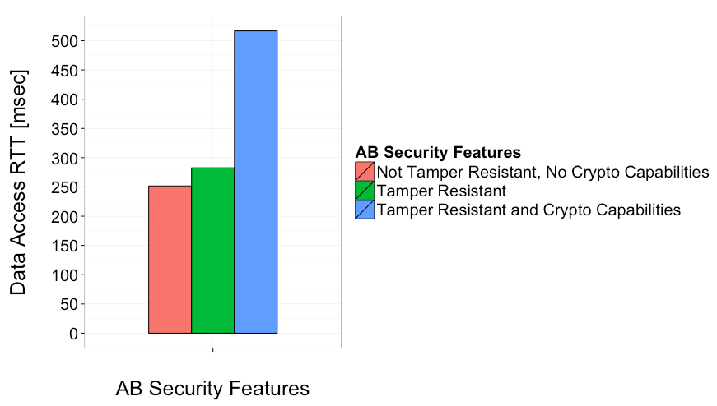
Evaluation
  Performance overhead of Active Bundle with detection of browser's crypto capabilities on / off
27

Slide 28
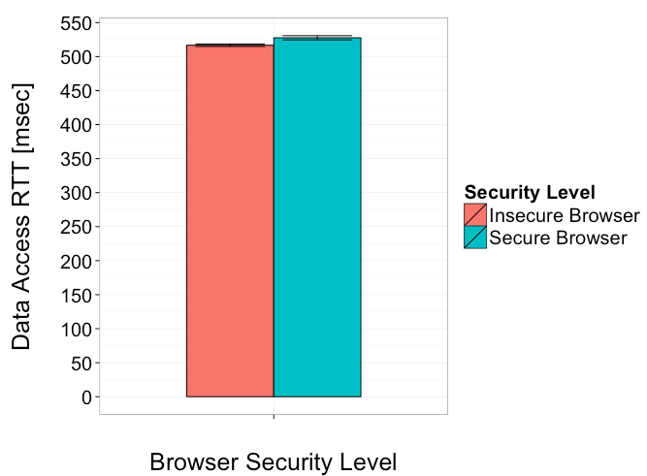
Evaluation
  Performance overhead of Active Bundle for data request from insecure / secure browser
28

Slide 29
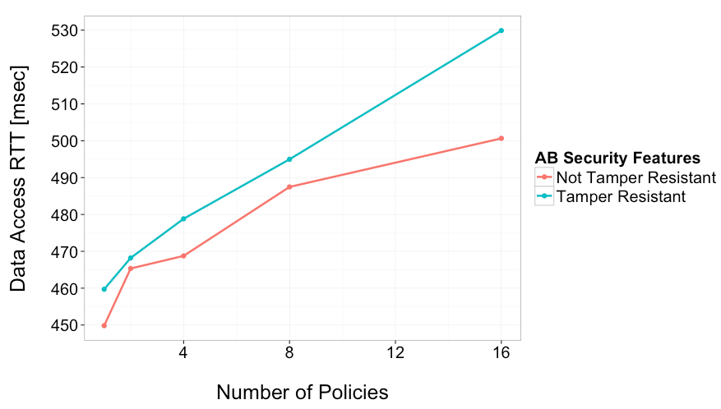
Evaluation
Performance overhead of Active Bundle, hosted by Google Cloud
29

Slide 30
Deliverables
Prototype implementation:
  Privacy – Preserving Data Dissemination Prototype
  Active Bundle Module
    AB implementation as an executable JAR file
    AB API implementation using Apache Thrift RPC framework
    Policy specification in JSON and evaluation using WSO2 Balana
Source code: http://github.com/Denis-Ulybysh/absoa16
Documentation:
  Deployment and user manual
  Demo video [13] “Data dissemination/provenance in untrusted cloud”
30

Slide 31
Future Work
Lightweight encryption schemes in Active Bundle instead of AES
Isolated AB Execution (Linux Docker Containers)
Data Leakage Detection
Encrypted Search over Database of Active Bundles
31

Slide 32
References
R. Ranchal, “Cross-domain data dissemination and policy enforcement,” PhD Thesis, Purdue University, Jun. 2015
C. Qu, D. Ulybyshev, B. Bhargava, R. Rohit, and L. Lilien. "Secure Dissemination of Video Data in Vehicle-to-Vehicle Systems.” 6th Intl. Workshop on Dependable Network Computing and Mobile Systems (DNCMS2015), Sep. 2015
L. Lilien and B. Bhargava, ”A scheme for privacy-preserving data dissemination,” IEEE Trans. on Systems, Man and Cybernetics, Part A: Systems and Humans, vol. 36(3), May 2006, pp. 503-506.
R. Ranchal, D. Ulybyshev, P. Angin, and B. Bhargava. “Policy-based Distributed Data Dissemination,” CERIAS Security Symposium, April 2015 (Best poster award)
D. Ulybyshev, B. Bhargava, L. Li, J. Kobes, D. Steiner, H. Halpin, B. An, M. Villarreal, R. Ranchal. “Authentication of User’s Device and Browser for Data Access in Untrusted Cloud,” CERIAS Security Symposium, April 2016.
F. Li, B. Luo, P. Liu, D. Lee, and C.-H. Chu, “Enforcing secure and privacy- preserving information brokering in distributed information sharing,” IEEE Transactions on Information Forensics and Security, vol. 8, no. 6, pp. 888–900, 2013.
S. Pearson and M. C. Mont, “Sticky policies: an approach for managing privacy across multiple parties,” IEEE Computer, no. 9, pp. 60–68, 2011.
S. Calzavara, R. Focardi, N. Grimm, M. Maffei, “Micro-policies for web session security”. Computer Security Foundations Symp. (CSF), 2016 IEEE 29th (pp. 179-193), Jun. 2016
Anonymus, “Micro-policies for web session security,” 2016, available at https://sites.google.com/site/micropolwebsese, accessed: Feb.2017

Slide 33
References
10. L. Ben Othmane and L. Lilien, “Protecting privacy in sensitive data dissemination with active bundles,” 7-th Annual Conf. on Privacy, Security and Trust (PST 2009), Saint John, New Brunswick, Canada, Aug. 2009, pp. 202-213
11. L. Lilien and B. Bhargava, ”A scheme for privacy-preserving data dissemination,” IEEE Trans. on Systems, Man and Cybernetics, Part A: Systems and Humans, vol. 36(3), May 2006, pp. 503-506.
12. B. Bhargava, “Secure/resilient systems and data dissemination/provenance,” NGCRC Project Proposal, CERIAS, Purdue University, Aug.2016
13. D. Ulybyshev, B.Bhargava, “Secure dissemination of EHR,” demo video
https://www.dropbox.com/s/30scw1srqsmyq6d/BhargavaTeam_DemoVideo_Spring16.wmv?dl=0
14. “Lightweight data-interchange format JSON,” http://json.org/ , accessed: Oct.2016
15. “eXtensible access control markup language (XACML) version 3.0,”
http://docs.oasis-open.org/xacml/3.0/xacml-3.0-core-spec-os-en.html, accessed: Oct. 2016
16. “W3C Web Cryptography API,”https://www.w3.org/TR/WebCryptoAPI/, accessed: Oct.2016
17. “Web authentication: an API for accessing scoped credentials,”
http://www.w3.org/TR/webauthn , accessed: Oct.2016
http://www.regularexpressions.info/creditcard.html , accessed: Oct.2016
18. “WSO2 Balana Implementation,” https://github.com/wso2/balana , accessed: Oct.2016

