Slide 1

Northrop Grumman Cybersecurity
Research Consortium (NGCRC)
Fall 2016 Kick-Off Meeting
Secure / Resilient Systems and Data Dissemination / Provenance
04 November 2016
Bharat Bhargava
Purdue University
Technical Champion(s): Donald Steiner, Jason Kobes, Leon Li, Sunil Lingayat, Daniel Goodwin, Frank Wilson
Notes:
1

Slide 2
Problem Statement
Focus: Secure Data Dissemination / Provenance
Authorized service can only access data items for which it is authorized
  Encrypted Search over Active Bundles
Detect data leakage to unauthorized services and report them to data owner
Track provenance to support data lineage, reproducibility
Measure data leakage (what got leaked, when, to where, how sensitive was the data)
Experiments and Prototype
2

Slide 3
Outline
Problem Statement
Collaboration with NGC IRADs
State of Current Technology
Research Approach
Benefits
Core Design
Demos and Experiments
Proposed Deliverables
Ongoing tasks
3

Slide 4
Collaboration with NGC
“WaxedPrune” project: Web-based Access to Encrypted Data - Processing in Untrusted Environments
  Preserves privacy and integrity of data
    Donald Steiner
    Leon Li
    Jason Kobes
CURATE2 project (Jason Kobes)
“Authentication of User’s Device and Browser for Data Access in Untrusted Cloud,” D. Ulybyshev, B. Bhargava, L. Li, J. Kobes, D. Steiner, H. Halpin, B. An, M. Villarreal, R. Ranchal. CERIAS Security Symposium, April 2016.
Paper submitted for ICDE-2017 Data Engineering conference: D. Ulybyshev, B. Bhargava, L. Li, D. Steiner, J. Kobes, H. Halpin, M. Villarreal and R. Ranchal
“Privacy-Preserving Data Dissemination and Data Leakage Detection in SOA”
4

Slide 5
Examples of Recent Data Leakages
Company | Time | Incident Details
Adobe Systems | Oct.2013 | 150 million accounts of software subscription database got leaked
Anthem | Feb.2015 | 78.8 million of PII records got leaked
Experian Information Solutions and T-Mobile, USA | Sep.2015 | Data (SSN, credit card information) of about 15 million customers who applied for credit got leaked
U.S. Office of Personnel Managenet: Agency of the U.S. Federal government | Jun.2015 | SSN, names, addresses, places of birth of 22 million people got leaked
5

Slide 6
State of Current Technology
Policy-based Data Dissemination
“Encore” (sticky policies) system is prone to Trusted Third Party (TTP)-related issues
Digital Rights Management (DRM) Systems
Windows Media DRM (Microsoft)
  Disseminates audio and video data over IP network
“MediaSnap” (protects pdf documents)
Hardware-based DRM
  Resistant to security breaches in OS
  Infeasible to change, bypass or uninstall security features
  Cons: higher costs, limited flexibility and less interoperability
Watermarking
  Digital (e.g. DCT for images), can be checked by web crawlers
  Visual: supported by modern printers
6

Slide 7
Research Approach
Data Dissemination based on:
  Access control policies
  Trust level of a subject (service, user)
  Context (e.g. emergency vs. normal)
  Security level of client’s browser (crypto capabilities)
  Authentication method (password-based, fingerprint etc)
  Source network (secure intranet vs. unknown network)
  Type of client’s device: desktop vs. mobile (detected by Authentication Server)
7

Slide 8
Research Approach (cont.)
Data Leakage Detection
For leaked encrypted data:
  Based on Obligations: how data is used by authorized party
  Obligations are enforced by Central Monitor
For leaked decrypted data:
  Based on watermarks embedded into sensitive data
    Digital watermarks
    Visual watermarks
8

Slide 9
Benefits
  Contributes to Data Privacy, Integrity and Confidentiality
  Does not require data owner’s availability
  Trust level of subjects is constantly recalculated
  Supports data and policy updates for multiple subjects
  Tamper-resistance: data and policies integrity is provided
  Supports encrypted search over database of ABs
  Data leakage detection and leakage damage assessment
  Captures data provenance for use in leakage measure and forensics
  Compatible with industry-standard SOA/cloud frameworks
9

Slide 10

Data Leakage in Untrusted Cloud
Data (D) = {d₁,.., d_{n}}
Access Control Policies
(P) = {p₁,.., p_{k}}
`
D
TRUSTED
DOMAIN
D, P
CLOUD
PROVIDER 1
D, P
Service 2 forwards
D and P
to other cloud
CLOUD
PROVIDER 2
D, P
Data
Leaks ?
D, P
D, P
D, P
SERVICE 1
d₁
SERVICE 2
d₂
UNKNOWN
DOMAIN
SERVICE 3
d₃
* This work is used in PhD Thesis Proposal of Denis Ulybyshev, Purdue University
10

Slide 11

Extended Prototype for TechFest’17: EHR Dissemination with Data Leakage Detection
Data
Owner
Active Bundle
Cloud Server
Active Bundle
Contact, Medical and Billing Information
Web Crypto Authentication
Doctor
- Contact Info
- Medical Info
- Billing Info
Web Crypto Authentication
Insurance
- Contact Info
- E(Medical Info)
- Billing Info
Web Crypto Authentication
Researcher
- E(Contact Info)
- Medical Info
- Billing Info
Doctor
Insurance
Researcher
Leakage of Medical Info
Scenario of EHR Dissemination in Cloud (by Dr. Leon Li, NGC)
11

Slide 12
AB Use Case and Data Leakage
Recipients are authorized for different fragments of email
Email is AB, can be sent to mailing list
Email
ACCESSIBLE TEXT
Browser’s Crypto Level: High
Authentication Method: Fingerprint
Client’s device: Desktop
Source network: Corporate Intranet
Role: Doctor
AUTHENTICATED
CLIENT
AUTHENTICATED
CLIENT
Browser’s Crypto Level: Low
Authentication Method: Password
Client’s device: Mobile
Source network: Unknown
Role: Insurance Agent
Email
INACCESSIBLE TEXT 1
ACCESSIBLE TEXT
Q: What if Doctor leaks data to insurance agent for which the agent is not authorized?
INACCESSIBLE TEXT 2
12

Slide 13

Core Design: Data Leakage Detection
CENTRAL
MONITOR
P, D
Src ID (of X)
Dest ID (of Y)
Time
Class (Type) of data d1
d1 or Enc(d1) leakage
SERVICE A
AB
AB
SERVICE X
AB, d₁
SERVICE Y
Enc(d₁)
AB contains:
- Enc [Data(D)] = {Enc_{k1} (d₁), ... , Enc_{kn} ( d_{n}) }
- Access Control Policies (P) = {p₁,.., p_{k}}
X is authorized to extract and read d1 from AB
X may leak plain d1 or Enc(d1) to Y
13
AB
AB
AB
AB
AB
AB
AB

Slide 14
Types of Data Leakage
d1 can be leaked as:
Ciphertext
  Data protected by AB
  Leakage is detected by obligation enforcement
Decrypted plaintext with watermark
  Data not protected by AB anymore
    Leakage can be detected by digital and visual watermarks
    Watermarks can be used by web crawlers to detect copyright violations
Decrypted plaintext without watermark
  Data not protected, no leakage detection
14
AB
AB
AB
AB
AB
AB
AB

Slide 15
Core Design: Data Leakage Detection
Make data inseparable from AB and prevent plaintext leakage
  Only our special software can decrypt and view data d1 from AB
  “Print Screen”, “Save As” functionalities disabled
  Additional activation on website is required
Software notifies CM: d1 arrived to Y from X
CM checks against centralized Database of obligations: whether d1 is supposed to be at Y. If NO then:
  Blacklist X, Y
  Reduce their trust level
  Mark data d1 as compromised and notify services about it
* Discussed at NGC Symposium (April, 2016) and during weekly NGC meetings with Jason Kobes, Leon Li, Donald Steiner, Paul Conoval
15
AB
AB
AB
AB
AB
AB
AB

Slide 16
Core Design: Type of Provenance Data
CM monitors each transaction between services and stores provenance data
  Who sent data
  To Whom
  What type (class) of data
  When
Data accesses / updates and policy updates are captured
Provenance data can be corrupted
  Send data provenance messages to CM via secure protocol (https)
  Backup with trusted server
Provenance data itself can be leaked
  Solution: encrypt it, key is stored at trusted party
Provenance data is used to investigate data leakage
  Example: find to whom did subject A send emails within last 10 days
* Data leakage detection and provenance are part of NGC Proposal for 2016-2017
16

Slide 17
Mitigation
  Layered Approach: Don't give all the data to the requester at once
    First give part of data (incomplete, less sensitive)
    Watch how it is used and monitor trust level
    If trust level is sufficient – give next portion of data
  Use provenance data stored at CM to identify the list of suspects
  Raise the level of classification of data to prevent leakage repetition
  Intentional leakage to create uncertainty and lower data value
  Monitor network messages
    Check whether they contain e.g. credit card number which satisfies specific pattern and can be validated using regular expressions
17
AB
AB
AB
AB
AB
AB
AB

Slide 18
Data Leakage Damage Assessment
After data leakage is detected we assess damage based on:
  To whom was the data leaked (unknown service with low trust level vs. service with high level of trust)
  Sensitivity (Classification) of leaked data (classified vs. unclassified)
  When was leaked data leaked received (recent or old data)
  Can other sensitive data be derived from the leaked data (i.e. diagnosis can be derived from leaked medical prescriptions)
18

Slide 19
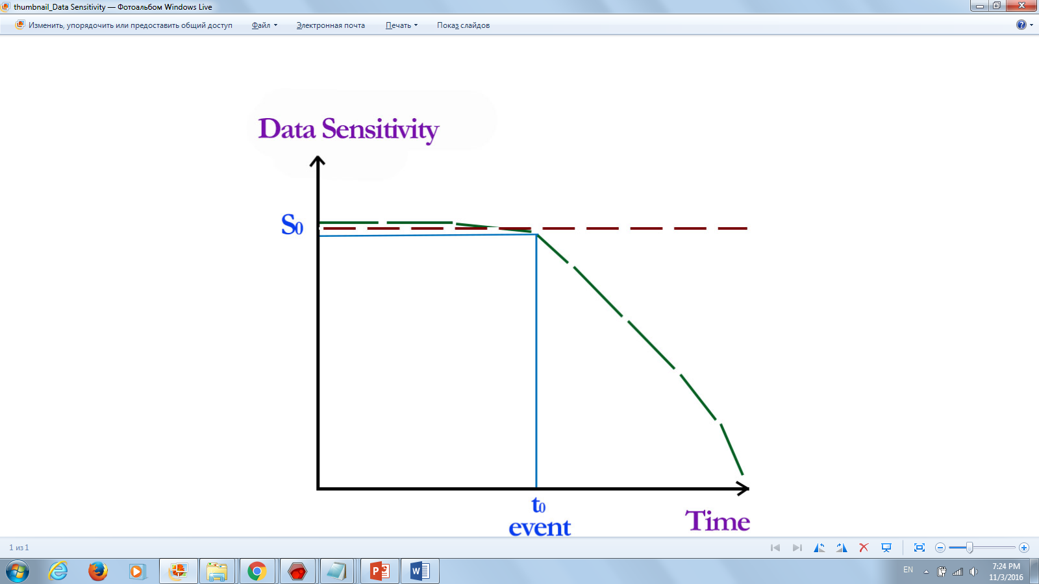
Timing of Leaked Data
Data-related event (e.g. final exam) occurs at to
Threat from data being leaked before to is high
Threat from data being leaked after to:
  No threat at all
  Linearly decreases with time
  Remains constant (for highly-sensitive data)
3
1
2
*Figure created by Ganapathy Mani, Purdue Univ.
19

Slide 20
Encrypted Database of ABs
Collection agent gathers intelligence feeds (ABs)
CryptDB is a proxy to a database server
  Stores encrypted data (keywords, abstract of AB) and provides SQL query capability over encrypted data
  Never releases decryption key to a database
  When compromised, only ciphertext is revealed and data leakage is limited to data for currently logged in users
  Subscription API to provide methods for authorized access to data
TF-IDF and Latent Semantic Indexing (LSI) retrieval models can be used for search engine
Search query example:
  “insomnia diagnosis” - find EHRs (ABs) of patients with diagnosis “insomnia” and retrieve data from them
20
Result of weekly meetings with Dr. Leon Li, Jason Kobes, NGC

Slide 21
Experiments
Purpose:
  Identify details of what data, to whom, from where and when got leaked
  Isolate data leakage
  Identify vulnerabilities in the system
  Assess data leakage damage
Input:
  Data (Electronic Health Record of a patient) stored in cloud in the form of Active Bundle
  Access Control Policies
  3 services exchanging data: Doctor, Insurance, Researcher
Output parameters:
  Data Provenance Log
  Sensitivity of Leaked Data
  Vulnerability for data leakage
  Timing of leakage
  Extent of Damage
  Identify malicious services participating in data leakage
21
Notes:
21

Slide 22
Experimental Setup
Experimental Setup:
  Three Node.JS services (Doctor, Insurance Agent, Researcher) exchanging data
  Active Bundle containing data D (EHR of a patient) and access control policies P, hosted by cloud provider
  Central Monitor with database of obligations (policies)
  Doctor authorized to access contact info of a patient leaks it to Researcher who is not authorized to access it
CLOUD
PROVIDER
AB {P, D}
CENTRAL
MONITOR
P, D
Src ID (of Doctor)
Dest ID (of Researcher)
Time
Class of data d1
AB
d1 or Enc(d1) leakage
DOCTOR
AB, d₁=contact info
RESEARCHER
d₁ or Enc(d₁)
22
Notes:
22

Slide 23
Deliverables
Prototype implementation:
  Data Leakage prototype
  Active Bundle Module
    AB implementation as an executable JAR file
    AB API implementation using Apache Thrift RPC framework
    Policy specification in JSON and evaluation using WSO2 Balana
Source code: http://github.com/Denis-Ulybysh/absoa16
Documentation:
  Deployment and user manual
  Demo video “Data dissemination/provenance in untrusted cloud”
23

Slide 24
Ongoing Tasks
Implementation of data leakage based on obligations and watermarks
  Deploy CryptDB storing encrypted AB-related data and providing SQL query capability over encrypted data
  Running AB in isolated container (e.g. Linux Docker)
Experiments:
  Tampering attacks on services (code injection etc.)
  Man in the middle attacks (using an intercepted active bundle)
  Attacks against data privacy (trying to bypass active bundle protection mechanism)
  Tampering attacks on active bundle’s policies and code
  Cloud experiments: Framework scalability on industry standard cloud platforms (e.g. Amazon EC2)
Integration with NGC projects:
  WaxedPrune (with Donald Steiner/Jason Kobes/Leon Li of NGC)
  CURATE 2 (with Jason Kobes)
24

Slide 25
Presentations and Publications
“Privacy-Preserving Data Dissemination and Data Leakage Detection in SOA” , D. Ulybyshev, B. Bhargava, L. Li, D. Steiner, J. Kobes, H. Halpin, M. Villarreal and R. Ranchal. Submitted for ICDE-2017
“Policy-based Distributed Data Dissemination,” R. Ranchal, D. Ulybyshev, P. Angin, and B. Bhargava. CERIAS Security Symposium, April 2015 (Best poster award)
“Authentication of User’s Device and Browser for Data Access in Untrusted Cloud,” D. Ulybyshev, B. Bhargava, L. Li, J. Kobes, D. Steiner, H. Halpin, B. An, M. Villarreal, R. Ranchal. CERIAS Security Symposium, April 2016.
"Cross-Domain Data Dissemination and Policy Enforcement", R. Ranchal, PhD Thesis, Purdue University, June 2015.
“End-to-End Security in Service-Oriented Architecture,” Mehdi Azarmi. PhD Thesis, Purdue University, April 2016.
“Consumer Oriented Privacy Preserving Access Control for Electronic Health Records in the Cloud,” R. Fernando, R. Ranchal. B. An, L. Ben Othmane, B. Bhargava. Submitted to IEEE CLOUD 2016.
“A Self-Cloning Agents-based Model for High Performance Mobile-Cloud Computing,” P. Angin, B. Bhargava, and Z. Jin. IEEE CLOUD 2015.
25

Slide 26

Secure/Resilient Systems
Moving Target Defense (MTD) Solution

Slide 27
Outline
Collaboration with NGC IRADS
Moving Target Defense (MTD)
State of the Art and Limitations
Research Approach
Proposed Solution
Benefits of the Proposed Solution
Components of the Solution
Research Tasks
MTD Framework Prototype
Experiments
Future Directions

Slide 28
Collaboration with NGC IRADS
During the TechExpo 2016: Discussion with Daniel Goodwin and Frank Wilson of NGC
Contribute on the following IRADs:
  Cyber Resilient Systems: Start Secure, Stay Secure and Return Secure (Daniel Goodwin)
  Enterprise Resiliency (Frank Wilson)

Slide 29
Collaboration with NGC IRADS
Cyber Resilient Systems IRAD¹:
  Cyber resiliency is based on the ability of the system to start secure, stay secure and return secure
- The system starts with trusted
components
- Continue to operate maintaining
level of trust
- Return to trusted state case of an
event
Start
Secure
Stay Secure
Return
Secure
¹NGC Cyber Resilient Systems IRAD (Daniel Goodwin)

Slide 30
Collaboration with NGC IRADS
Cyber Resilient Systems IRAD¹:
Attack Vectors Resilient Approaches
- Data
- Code
- Infrastructure
- Communications
- People
- Moving Target Defense
(MTD)
- Proactive Restore/C2
- Least Privilege
Enforcement
- Trust Zone Segmentation
- Identity Attribution
- Encryption
- Root Trust
¹NGC Cyber Resilient Systems IRAD (Daniel Goodwin)

Slide 31
Collaboration with NGC IRADS
Cyber Resilient Systems IRAD¹:
Attack Vectors Resilient Approaches
- Data
- Code
- Infrastructure
- Communications
- People
- Moving Target Defense
(MTD)
- Proactive Restore/C2
- Least Privilege
Enforcement
- Trust Zone Segmentation
- Identity Attribution
- Encryption
- Root Trust
Approaches followed in our Active Bundle (AB)⁸ solution
¹NGC Cyber Resilient Systems IRAD (Daniel Goodwin)

Slide 32
Collaboration with NGC IRADS
Cyber Resilient Systems IRAD¹:
Attack Vectors Resilient Approaches
- Data
- Code
- Infrastructure
- Communications
- People
- Moving Target Defense
(MTD)
- Proactive Restore/C2
- Least Privilege
Enforcement
- Trust Zone Segmentation
- Identity Attribution
- Encryption
- Root Trust
Related to the proposed Moving Target Defense (MTD)^{4,5,6} solution
¹NGC Cyber Resilient Systems IRAD (Daniel Goodwin)

Slide 33
Collaboration with NGC IRADS
Enterprise Resiliency IRAD²:
  Monitoring a family of systems and performing real-time analytics to provide actionable artifacts that can automatically address system anomalies
  Identifies agnostics technologies and architecture patterns that facilitate solutions to maximize computation resources for the enterprise
  Enterprise Anomaly Discovery
  Enterprise Automatic Healing
²NGC Enterprise Resiliency IRAD (Frank Wilson)

Slide 34
Collaboration with NGC IRADS
Enterprise Resiliency IRAD²:
  Monitoring a family of systems and performing real-time analytics to provide actionable artifacts that can automatically address system anomalies
  Identifies agnostics technologies and architecture patterns that facilitate solutions to maximize computation resources for the enterprise
  Enterprise Anomaly Discovery
  Enterprise Automatic Healing
Directed related to the proposed Moving Target Defense (MTD)^{4,5,6} solution
²NGC Enterprise Resiliency IRAD (Frank Wilson)

Slide 35
Collaboration with NGC IRADS
The proposed Moving Target Defense (MTD) solution introduces resiliency and adaptability to the system through live monitoring, which transforms systems to be able to adapt and self-heal when ongoing attacks are detected

Slide 36
Moving Target Defense (MTD)
Adversaries have an asymmetric advantage: They have the time to study a system, identify its vulnerabilities, and choose the time and place of attack to gain the maximum benefit
The idea of moving-target defense (MTD): Imposing the same asymmetric disadvantage on attackers by making systems dynamic and therefore harder to explore and predict
Threat Avoidance Techniques!

Slide 37
State of the Art and Limitations
MTD: Diversification and Randomization
Fault-Tolerance Systems
- Solution: Replication/
Redundancy:
- Examples: Quorum, Chain
- Gives fault-resiliency but
increases attack surface at
application level (common
code base)
Fault-Tolerance Systems
- Solution: MTD
- Examples: NVersion &
NVariant Programming,
etc.
System level attacks
- Solution: MTD
- Examples: ASR, ISR, Inherent Issue- Low Entropy (JIT-ROP)
    - New solutions: Isomeron, IP-Hopping in space

Slide 38
State of the Art and Limitations
The traditional defensive security strategy for distributed systems is to prevent attackers from gaining control of the system using well established techniques: Replication/Redundancy, Encryption, etc.
Limitation: Given sufficient time and resources, existing defensive methods can be defeated

Slide 39
State of the Art and Limitations
The state of the art MTD solutions focus on randomization and diversification in particular layers of the system
Limitation: Do not protect the entire host

Slide 40
Research Approach
“Stay one-step ahead” of sophisticated attack
  Protect the entire stack through dynamic interval-based spatial randomization
  Avoid threats in-time intervals rather than defending the entire runtime of systems through Mobility and Direction
  System will start secure, stay secure and return secure
  Increase agility, antifragility and adaptability of the system
  Unified generic MTD framework that enables reasoning about behavior of deployed systems on cloud platforms

Slide 41
Proposed Solution
Attack-resilient virtualization-based framework
Aims to reduce the need to continuously fight against attacks by decreasing the gain-loss balance perception of attackers.
Narrows the exposure window of a node to such attacks, which increases the cost of attacks to systems and lowers the likelihood of success and the perceived benefit of compromising it

Slide 42
Proposed Solution
The reduction in the vulnerability window of nodes is mainly achieved through three steps:
  Partitioning the runtime execution of nodes in time intervals
  Allowing nodes to run only with a predefined lifespan (as low as a minute) on heterogeneous platforms (i.e. different OSs)
  Proactively monitoring their runtime below the OS

Slide 43

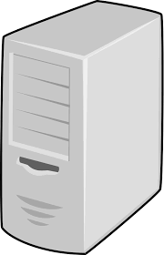

Proposed Solution
t1
t3
t2
t1
t8
t7
t6
t5
t12
t11
t10
t9
Virtual
Machine (VM)
t16
t15
t14
t13
I couldn’t succeed.
Where is my target?
Network
Bad Guy

Slide 44
Proposed Solution
Virtual
Machine (VM)
VM Reincarnation
Network
“VM Reincarnation need to be fast”
Bad Guy

Slide 45
Proposed Solution
Virtual Reincarnation: Randomization and diversification technique where nodes (virtual machines) vanish and reappear on a different virtual state with different guest OS, Host OS, hypervisor, and hardware
Nodes run on a given computing platform only for a controlled period of time
The running time is chosen in a way that successful ongoing attacks become ineffective

Slide 46
Proposed Solution
The new fresh machine will integrate to the system and continue running the application after getting up to date
Two research directions: Stateless vs. Stateful applications
Stateless application examples: BFT and pub/sub systems

Slide 47

Benefits of the Proposed Solution
State of the Art System View:
Application
OS
Network
Replica 1 Replica 2 Replica 3
Application
Randomization Space
OS
Network
Application
OS
Network
1
2
3
n
Sate Verification
Time Intervals (< 1 sec)

Slide 48
Benefits of the Proposed Solution
Proposed Solution System View:
Application
OS
Network
Replica 1 Replica 2 Replica 3
Application
Randomization Space
OS
Network
Application
OS
Network
1
2
3
n
Sate Verification
Time Intervals (< 1 sec)

Slide 49
Components of the Framework
The framework will consist of the following four components:
  Proactive Virtual Reincarnation (ViRA)
  Proactive Monitoring
  SDN Network Dynamics
  Systems States and Application Runtime
The framework will protect the whole stack; not only particular layers

Slide 50
Components of the Framework
Proactive Virtual Reincarnation (ViRA):
  OpenStack: Widely adopted industry open source framework (key component: Nova)
  Nova: The cloud management software of OpenStack, which provides virtual machines on demand
  One approach is setting a fixed period of time for each machine and reincarnating them after that lifespan
  Machines to be reincarnated are selected either in Round Robin or random fashion
  Attacks can occur within the lifespan of each machine, which makes proactive monitoring mechanisms a crucial element component

Slide 51
Components of the Framework
Proactive Monitoring:
  Virtual Machine Introspection (VMI)
  Open Source Prototype
  Will trigger reincarnations when attacks are detected
  Deployment Challenges: Semantic Gap, Interoperability Issues with Cloud Frameworks
  Solution Approach³: Ahmed, N., and Bhargava, B. Towards Targeted Intrusion Detection Deployments in Cloud Computing. In the Int. Journal of Next-Generation Computing Vol. 6, No 2, IJNGC - JULY 2015.

Slide 52
Components of the Framework
SDN Network Dynamics:
  Based on Neutron, a component of Open Stack
  Neutron: An Open Stack implementation of Software Defined Networks (SDN), which provides networking as a service
  Fresh VM must keep the same network configuration as the vanishing VM

Slide 53
Components of the Framework
System States and Application Runtime:
  System State: The state of the system at any given time (Secure vs. Unsecure)
  Application Runtime: At the application layer, we refresh and map one or more Apps/VMs (App1. . . Appn) to different platforms (Hardware1. . . HWn) in pre-specified time intervals, referred as time-interval runtime

Slide 54
Research Tasks
Defining metrics to quantify effectiveness of system components (services, data, networks etc.)
Defining costs of software-based reconfiguration/monitoring/healing of system components
Developing models and mechanisms for optimized automated monitoring and reconfiguration of system architectures to achieve maximum possible resiliency with minimum operational cost
Build a prototype of the MTD framework to conduct experiments to measure these metrics

Slide 55
Framework Prototype
MTD Framework
Cloud Framework
Secure
Unsecure
Horizon
Glance
Compute
libvmi
Neutron
Time Interval Runtime
OpenStack
GuestOS VM1..n
VM1..n
VM1..n
Host OS
KVM/QEMU/Xen
Hardware1
HW2
HWn

Slide 56
Framework Prototype
The framework will be implemented using two main components: Nova, the cloud management software of OpenStack and the Software Defined Networking (SDN) tool Neutron
Nova provides and de-provides virtual machines for cloud users on demand while Neutron provides networking as a service and runs on top of OpenStack
The library libvmi will be installed for virtual machine introspection. Memory snapshots will be taken in time intervals at the host OS as applications to be protected run in the VM. The live memory data structure will be analyzed in real time and alarm any runtime integrity violation of the applications runtime as an intrusion

Slide 57
Experiments
Purpose:
  With the increased sophistication of attacks, is it possible to construct a generic attack-resilient framework for distributed systems (stateless application) with a combination of mobility and direction capabilities?
  Taking into account the main components of the state of a virtual machine (i.e. memory and network), is it possible to build a generic resilient and application-agnostic platform without service (stateful applications) interruptions in the reincarnation process?

Slide 58
Experiments
Purpose:
  With the increased sophistication of attacks, is it possible to construct a generic attack-resilient framework for distributed systems (stateless application) with a combination of mobility and direction capabilities?
  Taking into account the main components of the state of a virtual machine (i.e. memory and network), is it possible to build a generic resilient and application-agnostic platform without service (stateful applications) interruptions in the reincarnation process?

Slide 59
Experiments
Problem Statement:
  Verify the effectiveness of the virtual reincarnation process of the Moving Target Defense solution against system attacks, specifically attacks executed from compromised guest OS
  Measure the impact of system attacks (compromised guest OS) on the Resilient Systems using the MTD solution

Slide 60
Experiments
Inputs (types of systems to test ViRA):
  Experiments will be run on BFT-SMaRt (synchronous system)
  Experiments will be run on a basic Publish and Subscribe system (asynchronous system)
Inputs (attacks to test proactive monitoring):
  Attack 1: We mimic a node compromise by logging into the VM, stopping the victim process, and starting a malicious one with the same name but different functionality; presumably stealing data
  Attack 2: We hijack the application by loading/injecting a shared library and diverting to make additional function calls without stopping the process

Slide 61
Experiments
Outputs:
  Time required for virtual machine reincarnations triggered by ended lifespan for both BFT-SMaRt and Publish and subscribe systems
  Time required for virtual machine reincarnations for both BFT-SMaRt and Publish and subscribe systems under system attacks
  Detection rate of the Virtual Machine Instrospection technique.

Slide 62
Experiments
Methods:
  The framework will be implemented according to the prototype
  Nodes will be reincarnated without attacks. Reincarnation times will be measured
  Attacks will be launched. The library libvmi will be installed for virtual machine introspection. Effectiveness rate of the detection mechanism will be measured along with the time of reincarnation times under attack.

Slide 63
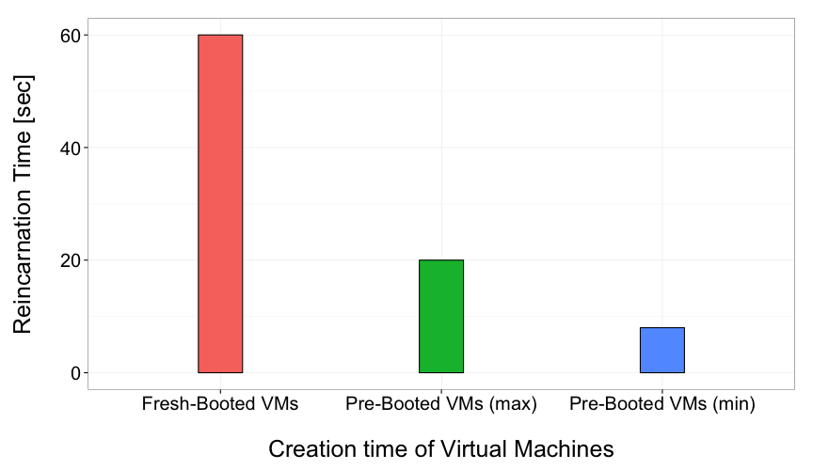
Experiments
Preliminary Results:

Slide 64
Experiments
Observations:
  Impact on Cyber Resilient Systems and providing Enterprise Resiliency
  Prototype will be extended to produce a demo for Tech Expo 2017
  The work will closely be conducted with NGC to find feasible solutions for Cyber Resilient Systems and Enterprise Resiliency
  It will include publishing the collaborative work and exploring funding opportunities at BAA in AFRL and NSF to secure funding and realize MTD as a viable solution

Slide 65
Future Directions
Test other stateless applications on the MTD framework:
  E.g.: Upright (Public and Subscribe System)
Stateful application support:
  Can we preserve the state of the virtual machine during the reincarnation process to make the solution application-agnostic?
  Test the framework wit Secure SOA Services (stateful applications)

Slide 66
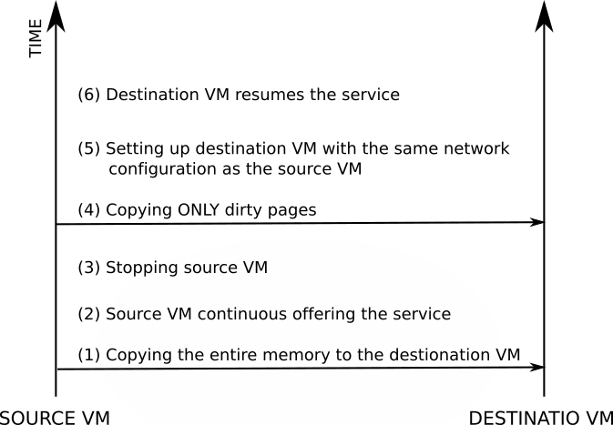
Future Directions
Stateful Application Support (Cont…):
  Virtual reincarnation must be fast. The source VM can continue running until the destination VM is ready to take over

Slide 67
Presentations and Publications
NGC Cyber Resilient Systems IRAD (http://www.northropgrumman.com)
Enterprise Resiliency IRAD (http://www.northropgrumman.com)
Ahmed, N., and Bhargava, B. Towards Targeted Intrusion Detection Deployments in Cloud Computing. In the Int. Journal of Next-Generation Computing Vol. 6, No 2, IJNGC - JULY 2015.
N. Ahmed. Design, Implementation, and Experiments for Moving Target Defense. PhD Thesis, Purdue University, 2016.
N. Ahmed and B. Bhargava. From Byzantine Fault-Tolerance to Fault-Avoidance: An Architectural Transformation to Attack and Failure Resilience. To Appear in IEEE Transactions on Cloud Computing, TCC 2016.
N. Ahmed and B. Bhargava. Disruption-Resilient Publish/Subscribe: A Moving Target Defense Approach. The 6th International Conference on Cloud Computing and Services Science, CLOSER 2016.
N. Ahmed and B. Bhargava. Mayflies: A Moving Target Defense Framework for Distributed Systems. 3rd ACM workshop on MTD in conjunction with ACM Conference on Computer and Communications Security (CCS), Vienna, 2016.
R. Ranchal, D. Ulybyshev, P. Angin, and B. Bhargava. Policy-based Distributed Data Dissemination. CERIAS Security Symposium, April 2015 (Best poster award)

Slide 68
Thank you!

