Slide 1

Northrop Grumman Cybersecurity
Research Consortium (NGCRC)
2016 Fall Symposium
Privacy-Preserving Data Dissemination and Adaptable Service Compositions in Trusted and Untrusted Cloud
04 November 2016
Bharat Bhargava
Purdue University
Technical Champion(s): Leon Li, Jason Kobes, Sunil Lingayat, Donald Steiner

Slide 2
COLLABORATION WITH NGC
“WaxedPrune” Project:
Web-based Access to Encrypted Data - Processing in Untrusted Environments
Researchers at NGC
Leon Li
Donald Steiner
Sunil Lingayat
Jason C Kobes

Slide 3
COLLABORATION WITH NGC
Weekly meetings to:
Advance research based on vision of Donald Steiner, Leon Li, Jason Kobes
Install and configure software at MIT side
Integrate work with MIT (Harry Halpin)
Researchers at Purdue
Bharat Bhargava
Denis Ulybyshev
Pelin Angin
Miguel Villarreal
Byungchan An
Rohit Ranchal
Tim Vincent
Leszek Lilien

Slide 4
Outline
Problem Statement
Benefits of Proposed Research
Prototype Demo
Impact
State of the Art
Year 7 (2015-2016) Final Report
  Methodology
  Results
Year 8 (2016-2017) Proposal

Slide 5
Problem Statement
Focus: Secure Data Dissemination in Cloud
Authorized service can only access data items for which it is authorized
Unauthorized service denied
Provide data dissemination based on cryptographic capabilities of client’s browser and authentication methods
Support different authentication methods for client service
*Adaptable service compositions in cloud

Slide 6
Benefits of Proposed Research
Independent of data owner's (source) availability
Dissemination is based on access control policies and client's attributes:
    Browser’s cryptographic capabilities
    Authentication method (password- vs. hardware-based vs. fingerprint)
    Source network (corporate vs. unknown)
    Type of the device (mobile vs. desktop)
    Trust level (is continuously monitored)
Context-based dissemination supported
Different authentication methods supported
Ability to operate in untrusted environments
Reduced host liability for data

Slide 7
Applications and Demonstration of Prototypes
Electronic Health Records (EHRs) dissemination in untrusted cloud
Dynamic service composition and trust management

Slide 8

Prototype for TechFest’16: Electronic Health Record Dissemination in Cloud
Data
Owner
Active Bundle
Cloud Server
Active Bundle
MIT:
Web Crypto Authentication
Authorized
Info
for
Doctor
Web Crypto Authentication
Authorized
Info
for
Insurance
Web Crypto Authentication
Authorized
Info
for
Researcher
Doctor
Insurance
Researcher
Scenario of EHR Dissemination in Cloud (by Dr. Leon Li, NGC)
8

Slide 9
Impact
Comprehensive security and privacy auditing and enforcement architecture for trusted and untrusted cloud
  Privacy-preserving data sharing approach for client-to-service and service-to-service interactions
  Independence of data owner's (source) availability
  Continuous monitoring of SLA and policy compliance
  Swift detection of failures and attacks in the system
  Efficient mechanism to dynamically reconfigure service composition based on the system context/state (failed, attacked, compromised) and resiliency requirements
  Resilient architecture to ensure continuous service availability under failures and attacks
  Compatible with industry-standard SOA/cloud frameworks
9

Slide 10
State of the Art
EnCoRe: Sticky policies to manage privacy of shared data across domains
  Prone to TTP related issues
  Sticky policies vulnerable to attacks from malicious recipients
DataSafe: Software-hardware architecture supporting confidentiality throughout data lifecycle
  Require special architecture limited to well-known hosts
CloudWatch: Coarse-grain monitoring capabilities of industry-standard cloud systems (such as Amazon EC2)
Splunk (log management and analysis tool), GrayLog, Kibana
  provide storage, search and analysis of big data, but require human intelligence for detection and action for resiliency

Slide 11

2015/2016 Methodology
AUTHENTICATED
CLIENT
Browser’s Crypto Level: High
Authentication Method: Fingerprint
Client’s device: Desktop
Source network: Corporate Intranet
AB
ACCESSIBLE DATA
AUTHENTICATED
CLIENT
Browser’s Crypto Level: Low
Authentication Method: Password
Client’s device: Mobile
Source network: Unknown
AB
INACCESSIBLE DATA
ACCESSIBLE DATA
INACCESSIBLE DATA
11

Slide 12
2015/2016 Methodology
Redirect unauthenticated client’s request from Cloud Provider to Authentication Server (AS)
Selective Data dissemination based on:
  Role-based access control policies
  Security level of client’s browser (crypto capabilities)
  Authentication method (password-based, fingerprint etc)
  Source network (secure intranet vs. unknown network)
  Type of client’s device: desktop vs. mobile (detected by Authentication Server)
12

Slide 13

Active Bundle Solution Components
Policy Enforcement
Engine
Sensitive data
- Encrypted data items, each value encrypted with its
own key: { “ab.patientPhone” : “Enc(1234567890)” }
Metadata
- Access control and operational policies
Virtual Machine (Policy Enforcement Engine)
- Protection mechanism (self-integrity check)
- Policy evaluation, enforcement; data dissemination
Policies
Enc(
Sensitive
Data)
ACTIVE BUNDLE IMPLEMENTATION
Executable JAR file
Apache-thrift based API
JSON-based policies
WSO2 Balana-based policy engine
Node.js-based SOA architecture
13

Slide 14
Data Dissemination and Leakage Detection in Untrusted Cloud
Data (D) = {d₁,.., d_{n}}
Access Control Policies
(P) = {p₁,.., p_{k}}
`
D
TRUSTED
DOMAIN
D, P
CLOUD
PROVIDER 1
D, P
Service 2 forwards
D and P
to other cloud
CLOUD
PROVIDER 2
D, P
Data
Leaks ?
D, P
D, P
D, P
SERVICE 1
d₁
SERVICE 2
d₂
UNKNOWN
DOMAIN
SERVICE 3
d₃
“Authentication of User’s Device and Browser for Data Access in Untrusted Cloud,” D. Ulybyshev, B. Bhargava, L. Li, J. Kobes, D. Steiner, H. Halpin, B. An, M. Villarreal, R. Ranchal. CERIAS Security Symposium, April 2016.
14
* This work is used in PhD Thesis Proposal of Denis Ulybyshev, Purdue University

Slide 15
Key Generation during AB Creation
Aggregation{di} ( - Generated AB modules execution info;
- Digest(AB Modules),
- Resources: authentication code + certificate, authorization code, applicable policies with evaluation code)
Key Derivation Module (javax.crypto SecetKeyFactory)
Ki
ENCki (di)
AB Template is used to generate new ABs with data and policies (specified by data owner)
Template includes implementation of invariant parts (monitor) and placeholders for customized parts (data and policies)
Template is executed to simulate interaction between AB and service requesting access to each data item of AB
15
Notes:
15

Slide 16
Key Derivation during AB Execution
Aggregation{di} ( - Generated AB modules execution info;
- Digest(AB Modules),
- Resources)
Key Derivation Module (javax.crypto SecetKeyFactory)
Ki
DECki (di)
AB receives access request to data item from service
AB authenticates the service and authorizes its request
If any module fails (i.e. service is not authentic or the request is not authorized) or is tampered: derived decryption key Ki is incorrect => data is not decrypted
"Cross-Domain Data Dissemination and Policy Enforcement", R. Ranchal, PhD Thesis, Purdue University, Jun. 2015.
16
Notes:
16

Slide 17

Key Management in AB
Key is not stored inside AB
Separate symmetric key is used for each separate data value
Ensure protection against tampering attacks (discussed with Jason Kobes)
Aggregation{di}
(Execution info;
Digest(AB Modules);
Resources)
Key Derivation
Module
Ki
DECki (di)
di
Aggregation{di} ( Tampered (
Execution info;
Digest(AB Modules);
Resources) )
K’i
wrong di
Key Derivation
Module
DECk’i (di)
17
Notes:
17

Slide 18
TechFest’16 Demo: Electronic Health Record Dissemination in Cloud
Active Bundle: Contact, Medical and Billing Information
Hospital
(NodeJS Server)
Researcher
- E(Contact Info)
- Medical Info
- Billing Info
Insurance
- Contact Info
- E(Medical Info)
- Billing Info
Doctor
- Contact Info
- Medical Info
- Billing Info
(10)
(2)
(4)
(9)
(1)
(3)
Authentication Server
(5)
Client
(Browser)
(1) HTTP GET Request
(2) Hospital’s Web Page
(3) HTTP POST with
Data Request and Role
(6)
(7)
(8)
(4) HTTP 302 with AB Request and Role (5) HTTP Get Request (6) AS Web Page
(7) HTTP POST with Credentials (8) HTTP 302 with Ticket (9) HTTP Get Request with Ticket (10) Data provided by AB
18

Slide 19
Authentication Ticket Creation and Validation
Authentication Server:
Knows shared secret K and Private Key PrivKey
Ticket_Info = (Auth_Level, Expiration_Time, Client_ID, Client_Role, Request_Field)
Enc_Ticket_Info = EncAES256_{K}(Ticket_Info)
Ticket_Signature = Enc_{PrivKey}(SHA512(Enc_Ticket_Info))
Ticket = <Enc_Ticket_Info, Ticket_Signature>
Doctor, Insurance or Researcher Service:
Knows shared secret K and Public Key PubKey
Receives Ticket = <Enc_Ticket_Info, Ticket_Signature>
Checks: Dec_{PubKey}(Ticket_Signature) = SHA512(Enc_Ticket_Info)
Gets data: DecAES256_{K}(Enc_Ticket_Info)
Doctor is authorized for Contact, Medical and Billing Info of either “only her own patients” or “her own and other doctor’s patients”
Clients are directed to the corresponding services according to their role (researcher, insurance or doctor)
Authorization level (included in ticket) and role define the data accessible by requester
19

Slide 20
Scenario 2: Electronic Health Record Dissemination in Cloud
Cloud Server
Cloud Server
Insurance Company Forwards AB to Researcher
Active Bundle
Active Bundle
Active Bundle
Doctor
Web Crypto Authentication
Authorized
Information
for
Insurance
Company
Web Crypto Authentication
Authorized
Information
for
Researcher
Insurance Company
Researcher
Scenario of EHR Dissemination in Cloud (by Dr. Leon Li, NGC)
20

Slide 21
2015/2016 Results Overview
Prototype for EHR dissemination in cloud (collaboration with W3C/MIT)
  Demonstrated at TechFest 2016
“Privacy-Preserving Data Dissemination and Data Leakage Detection in SOA” , D. Ulybyshev, B. Bhargava, L. Li, D. Steiner, J. Kobes, H. Halpin, M. Villarreal and R. Ranchal. Submitted for ICDE-2017
“Authentication of User’s Device and Browser for Data Access in Untrusted Cloud,” D. Ulybyshev, B. Bhargava, L. Li, J. Kobes, D. Steiner, H. Halpin, B. An, M. Villarreal, R. Ranchal. CERIAS Security Symposium, April 2016.
"Cross-Domain Data Dissemination and Policy Enforcement", R. Ranchal, PhD Thesis, Purdue University, June 2015.
“End-to-End Security in Service-Oriented Architecture,” Mehdi Azarmi. PhD Thesis, Purdue University, April 2016.

Slide 22
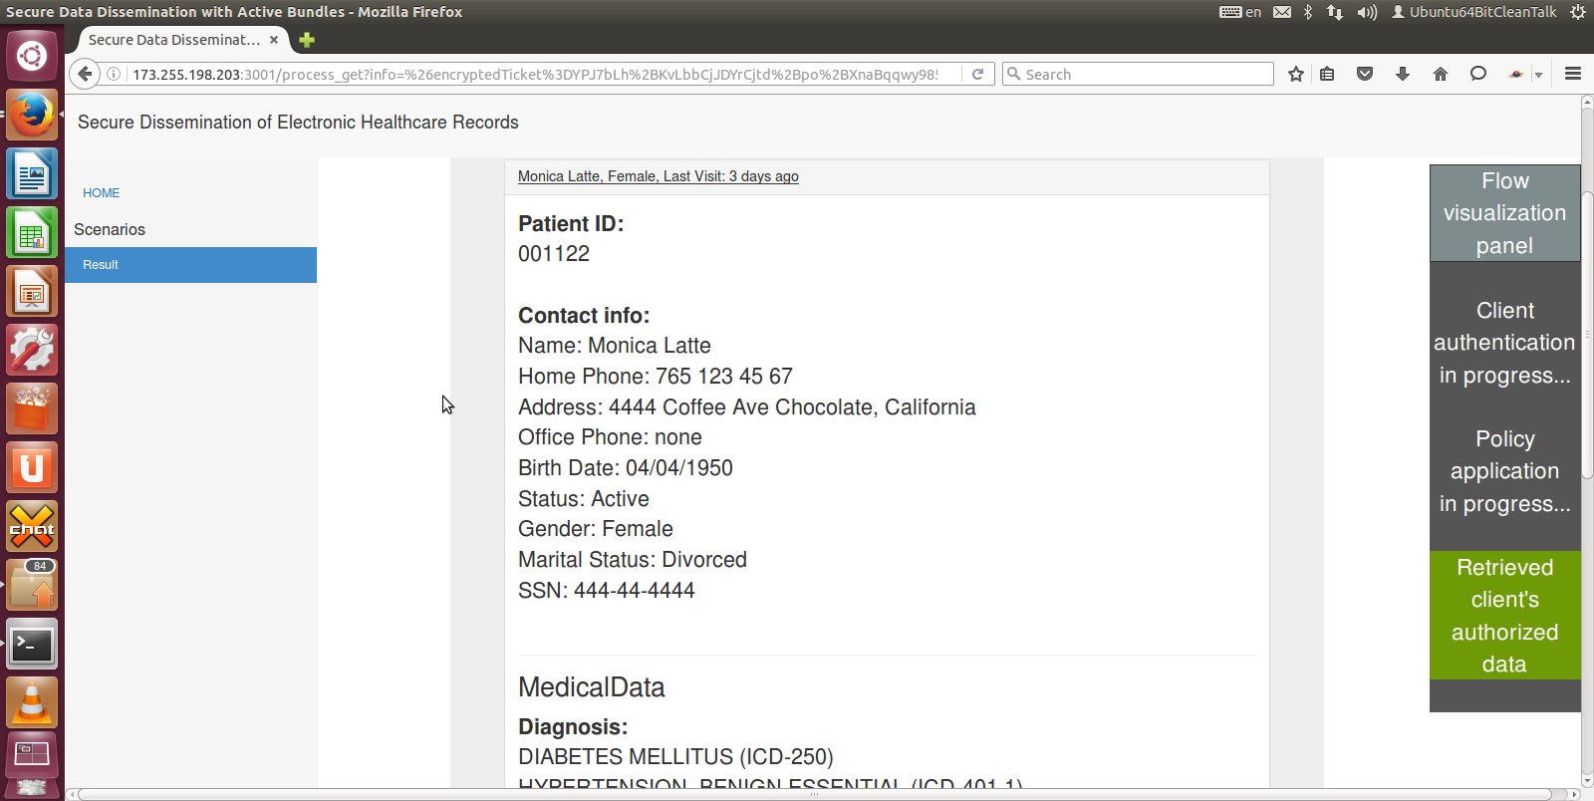
TechFest’16 Scenario: Data Available for Doctor
Doctor can access Contact, Medical and Billing Info of a patient
22

Slide 23
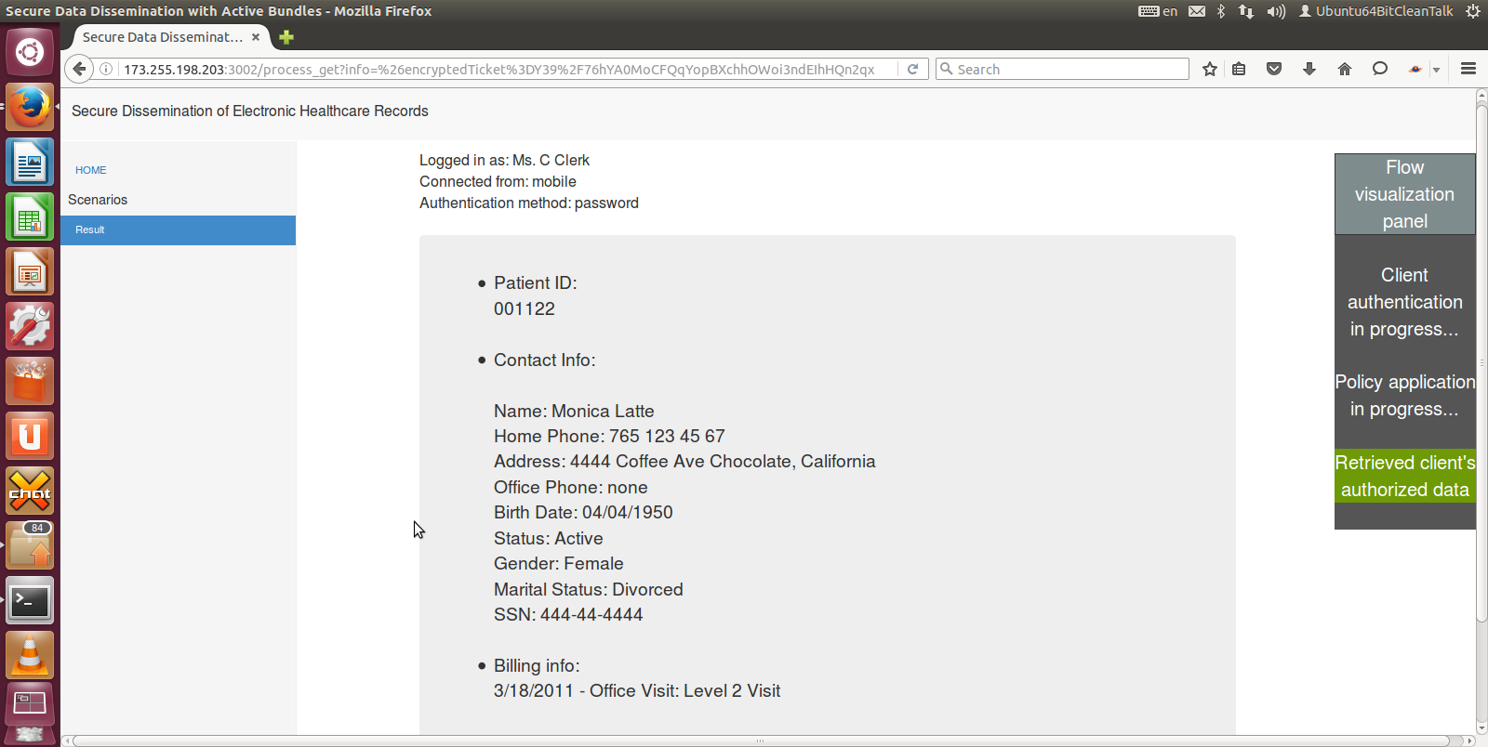
TechFest’16 Scenario: Data Available for Insurance
Insurance can get access to Contact and Billing Info of a patient (not to Medical)
23

Slide 24
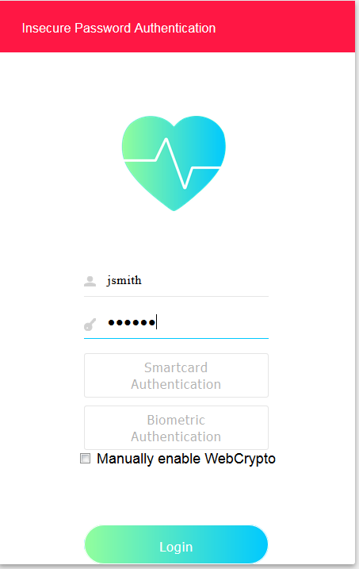
TechFest’16 Scenario: Client Authentication
Password-based authentication of a client at Authentication Server
24

Slide 25
Focus: Adaptable Service Compositions in Cloud
Need systematic monitoring of service operations and data dissemination for:
  Resiliency (withstand cyber-attacks, sustain and recover critical function)
  Antifragility (increase in resilience and robustness as a result of failures)
  Adaptability (swiftly adapt to changes in context, choose services in orchestration to comply with QoS requirements)
25

Slide 26
System Overview
*
Central Monitor
Service 1
Monitor A
AB logs
Active Bundle
Service 2
*
Log Analysis
+
*
Active Bundle
Intelligence
Feeds
Service 3
Active Bundle Log Listener
Service 4
*
Monitor B
Log Analysis
+
Service State Listener
Threat
Analysis
Service 5
*
Data dissemination with
Service 6
*
Monitor C
Service Reconfiguration
+
Service Trust Management
Service 7
*
Log Analysis
*
Service 8
*: service performance & security parameter values
+: summary service health data
26

Slide 27
Core Technology & Benefits
A novel distributed monitoring tool to:
  Audit and detect service behavior and performance changes*
  Gather service trust data and share them securely in various domains
  Dynamically reconfigure service orchestrations based on security context and QoS requirements**
A secure and adaptable data dissemination technology to deal with:
  Context changes (e.g. crypto capabilities of web browser, user location/device),
  Trust
  Sharing policies of data owner
System modules for service anomaly detection, service performance monitoring and trust management can be easily integrated into NGC cybersecurity software.
The modular architecture and use of standard software in the monitoring framework allows for easy plugin to any system.
* “ A Distributed Monitoring and Reconfiguration Approach for Adaptive Network Computing,” Bharat Bhargava, Pelin Angin, Rohit Ranchal, Sunil Lingayat. DNCMS in conjunction with SRDS 2015 (Best paper award)
** “End-to-End Security in Service-Oriented Architecture,” Mehdi Azarmi. PhD Thesis, Purdue University, April 2016.
27

Slide 28
Service Monitoring / Anomaly Detection System Details
Service 1
Anomaly Training/Detection
Module
Service 2
HMM
One-class SVM
K-means
clustering
Other learning
algorithms
Service 3
Request Interceptors / Performance Monitor
EM
Service 4
Interaction/
performance
data stream
Analysis
results
…
Local
monitor
DB
Central
Monitor
28

Slide 29
Core Machine Learning Technique Used for Service Anomaly Detection in System
Model training parameters used:
No class labels needed for training.
Training data: input vectors without any corresponding target values
Unsupervised learning with security and performance parameters used to find clusters
Values outside clusters will be detected as outliers and help detection of anomalies.
Algorithms: K-means clustering, one class support vector machines (SVM)
Parameter | Cloud services | Cloud data services
Number of requests/sec | X
Bytes downloaded/sec | X | X
Bytes uploaded/sec | X | X
Total error rate | X
CPU utilization | X
Memory utilization | X
Number of authentication failures | X
Number of connections | X
Number of connection failures | X
Number of disk reads/writes | X | X
Network latency | X
Service response time | X
Disk space usage | X | X
Throughput | X
Number of database connections | X | X
Service/cluster health status | X
29

Slide 30
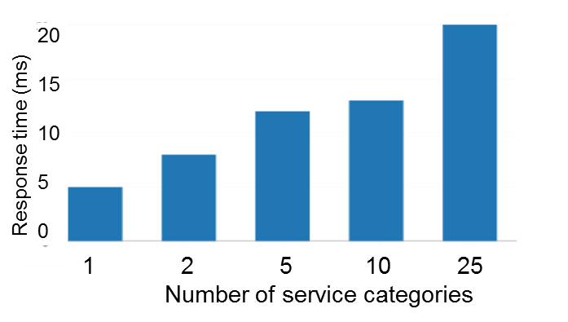

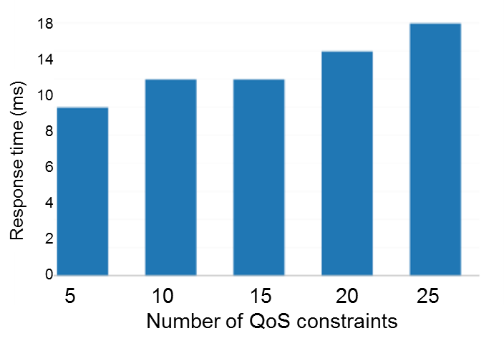
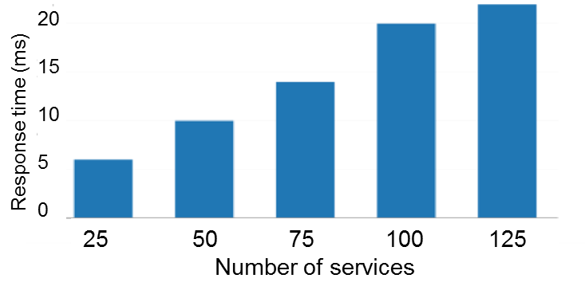
Dynamic Service Composition Experiments
Experiment settings:
Overhead evalution for three cases:
  Different number of service categories in composition
  Different number of services to choose from for each category
  Different number of QoS contraints
Composition time not affected significantly by the number of QoS constraints. Number of services and service categories have more visible effect, with still reasonable overhead.
30

Slide 31
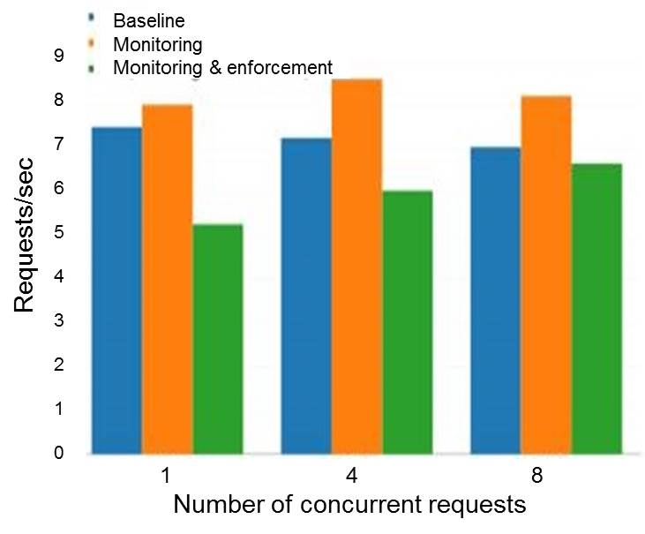
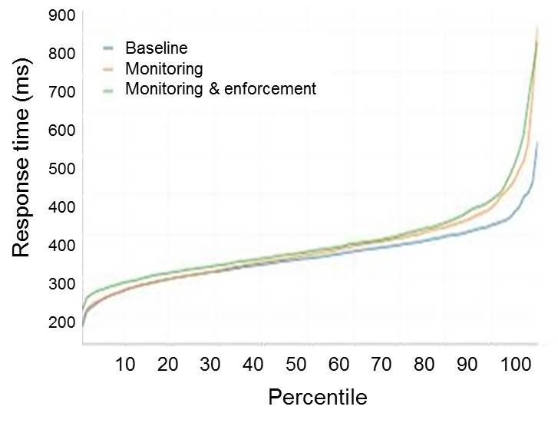
Overhead of Service Monitoring / Request Interception
Performance evaluation of service domain in terms of throughput and service response time
Negligible overhead incurred by monitoring
Experiment settings:
31

Slide 32
Demonstration
Secure data dissemination in untrusted cloud
https://www.dropbox.com/s/30scw1srqsmyq6d/BhargavaTeam_DemoVideo_Spring16.wmv?dl=0
https://www.youtube.com/watch?v=SIUupq5V6zk&feature=youtu.be
Dynamic service composition and trust management
  Composite trust algorithms
https://www.youtube.com/watch?v=6uHEfoxjEgs
  Trust update mechanisms
https://www.youtube.com/watch?v=xnm0-MzGBzw
  Policy enforcement in service interactions
https://www.youtube.com/watch?v=ePtAM0N7jdY
  Service redirection
https://www.youtube.com/watch?v=e8xkCgZcQ1s
  Adaptive and secure service composition
https://www.youtube.com/watch?v=VQDbPD2q9-8
32
Notes:
32

Slide 33
Deliverables
Prototype implementation of monitoring framework:
  Active Bundle Module
    AB implementation as an executable JAR file
    AB API implementation using Apache Thrift RPC framework
    Policy specification in XACML/JSON and evaluation using WSO2 Balana
    Healthcare scenario with services running on a remote host with functionality to communicate with remote Authentication Server
  Local (domain-level) Service Monitor (Apache Axis2 valves for interception, MySQL database for logging)
  Central Monitor (as Web service on Amazon EC2)
  Anomaly Detection Module (with pluggable algorithms)
  Dynamic Service Composition Module (algorithm)
33

Slide 34
Deliverables (cont.)
Documentation
    Source code
          http://github.com/Denis-Ulybysh/absoa16
    Deployment and user manual
    Final report for 2015 – 2016
    https://www.cs.purdue.edu/homes/bb/NGC2016/NGCRC_Final_Report-Sept-2016.pdf
34

Slide 35
Presentations and Publications
“Policy-based Distributed Data Dissemination,” R. Ranchal, D. Ulybyshev, P. Angin, and B. Bhargava. CERIAS Security Symposium, April 2015 (Best poster award)
“A Distributed Monitoring and Reconfiguration Approach for Adaptive Network Computing,” B. Bhargava, P. Angin, R. Ranchal, S. Lingayat. DNCMS in conjunction with SRDS 2015 (Best paper award)
“Privacy-Preserving Data Dissemination and Data Leakage Detection in SOA” , D. Ulybyshev, B. Bhargava, L. Li, D. Steiner, J. Kobes, H. Halpin, M. Villarreal and R. Ranchal. Submitted for ICDE-2017
“Authentication of User’s Device and Browser for Data Access in Untrusted Cloud,” D. Ulybyshev, B. Bhargava, L. Li, J. Kobes, D. Steiner, H. Halpin, B. An, M. Villarreal, R. Ranchal. CERIAS Security Symposium, April 2016.
"Cross-Domain Data Dissemination and Policy Enforcement", R. Ranchal, PhD Thesis, Purdue University, June 2015.
“End-to-End Security in Service-Oriented Architecture,” Mehdi Azarmi. PhD Thesis, Purdue University, April 2016.
“Consumer Oriented Privacy Preserving Access Control for Electronic Health Records in the Cloud,” R. Fernando, R. Ranchal. B. An, L. Ben Othmane, B. Bhargava. Submitted to IEEE CLOUD 2016.
“A Self-Cloning Agents-based Model for High Performance Mobile-Cloud Computing,” P. Angin, B. Bhargava, and Z. Jin. IEEE CLOUD 2015.
35

Slide 36

Notes:
36

Slide 37
Back-up Slides

Slide 38
Active Bundle Experiments
Measurements
  Experiment 1: Growth in AB size with increase in the number of policies
  Experiment 2: Growth in AB and Service interaction time with increase in # of policies
  Experiment 3: Tamper Resistance overhead in AB execution
Variations
  AB versions
    ABx – XACML-based policies and WSO2 Balana-based policy evaluation
    ABxt – ABx with tamper resistance capabilities
    ABc – JSON-based policies and JAVA-based policy evaluation
    ABct – ABc with tamper resistance capabilities
  Number of AB policies
Environment
  Amazon EC2 C3 Large and XLarge instances
Data collection
  5 runs of each experiment
  100 requests per run
* Experiments were conducted by Rohit Ranchal

Slide 39
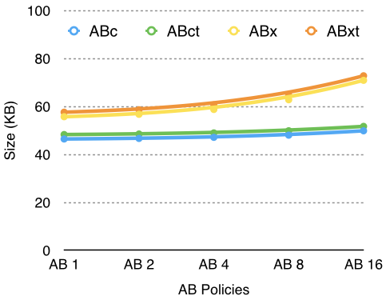
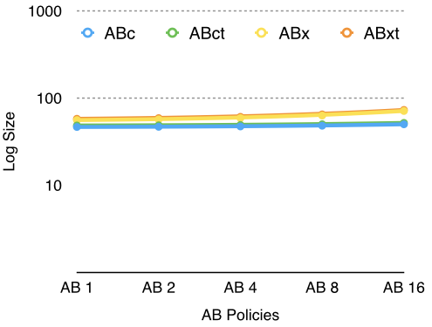
Experiment 1: AB Size vs. Number of policies
Observations
  Linear growth in AB size with increase in number of policies for all versions
  Tamper resistance adds a slight overhead to AB size (< 2 KB)
  79% reduction in policy size (0.79 KB) with JSON-based policies
    Additional reduction of 8.5 KB with Java-based policy engine

Slide 40
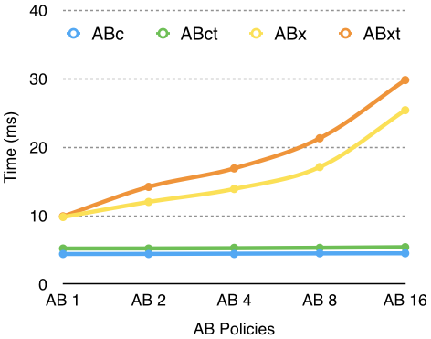
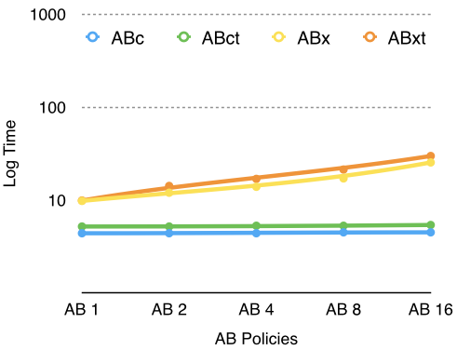
Experiment 2: AB-Service Interaction Time vs. Number of policies
growth in interaction time with
Observations
  Linear growth in interaction time with increase in policies for ABx and ABxt
    Use of XACML-based policies and external library (WSO2 Balana) for policy evaluation
    Evaluation of XACML policies involve the traversal of XML policy and request trees
  Constant growth in interaction time with increase in policies for ABc and ABct
    Use of JSON-based policies and Java code for policy evaluation
    Highly optimized Java code evaluation

Slide 41
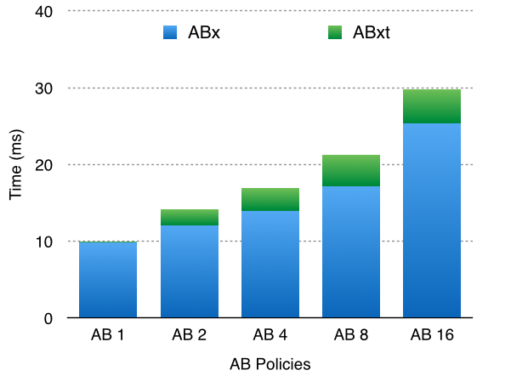
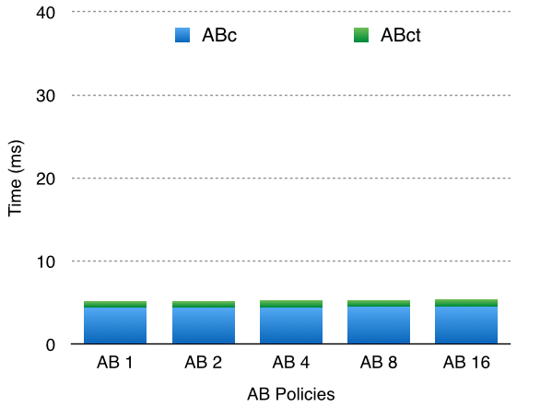
Experiment 3: Tamper Resistance Overhead
Observations
  Tamper resistance has higher overhead for XACML policies
    Digest calculation of XACML policies involves the traversal of XML policy and request trees
    Digest calculation of JSON policies takes less time due to smaller policy size

Slide 42
Isolated AB Execution
Recipient may be reluctant to execute AB => we support the isolated execution of AB by means of Docker.
  Docker is based on Linux container which is light-weight virtual machine
  When AB arrives at recipient machine, one virtual machine is created and AB is copied into that virtual machine.
  AB can be executed inside virtual machine. Only the result returns to host machine

Slide 43
Key Generation during AB Creation
An AB Template is used to generate new ABs with data and policies specified by a user
  An AB Template includes the implementation of the invariant parts (monitor) and placeholders for customized parts (data and policies)
User specified data and policies are included in the AB Template
AB Template is executed to simulate the interaction process between an AB and a service requesting access to each data item of AB
The information generated during the execution of different AB modules and the digests of these modules and their resources (such as authentication (authentication code, CA certificate that it uses), authorization (authorization code, applicable policies, policy evaluation code)) are collected and aggregated into a single value for each data item
The value for each data item is input into a Key Derivation module (such as SecretKeyFactory, PBEKeySpec, SecretKeySpec provided by javax.crypto library)
The Key Derivation module outputs the specific key relevant to the data item
This key is used encrypt the related data item

Slide 44
Key Derivation during AB Execution
AB receives access request to a data item from a service
AB authenticates the service and authorizes its request
The information generated during the execution of different AB modules and the digests of these modules and their resources (such as authentication (authentication code, CA certificate that it uses), authorization (authorization code, applicable policies, policy evaluation code)) are collected and aggregated into a single value for each data item
The value for each data item is input into the Key Derivation module (such as SecretKeyFactory, PBEKeySpec, SecretKeySpec provided by javax.crypto library)
The Key Derivation module outputs the specific key relevant to the data item
This key is used decrypt the requested data item
If any module fails (i.e. service is not authentic or the request is not authorized) or is tampered, the derived is incorrect and the data is not decrypted

Slide 45
Context-Sensitive Data Disclosure
Perfect data dissemination not always desirable
  Example: Confidential business data shared within an office but not outside
Context-sensitive AB evaporation
  AB evaporates in proportion to their “distance” from their owner
“Closer” subscribers trusted more than “distant” ones
Illegitimate disclosures more probable at less trusted “distant” guardians
Different distance metrics
  Context-dependent

