Slide 1
COLLABORATIVE ATTACKS AND DEFENSE
Bharat Bhargava
CERIAS and CS department
Purdue University
www.cs.purdue.edu/homes/bb

Slide 2
Acknowledgement
Thanks to all my sponsors in Motorola, Northrup Grumman corporation, Air Force
Thanks to my students
Thanks to Infosys Cyber security initiative
With respect to Bharat Mata whose Matti is my Chandan
and all great people of India.

Slide 3
Intruder Identification in Ad Hoc Networks
Problem Statement
Intruder identification in ad hoc networks is the procedure of identifying the user or host that conducts the inappropriate, incorrect, or anomalous activities that threaten the connectivity or reliability of the networks and the authenticity of the data traffic in the networks
Some old Papers with fundamentals:
“On Security Study of Two Distance Vector Routing Protocols for Mobile Ad Hoc Networks”, in Proceedings of IEEE International Conference on Pervasive Computing and Communications (PerCom), 2003.
“On Vulnerability and Protection of Ad Hoc On-demand Distance Vector Protocol”, in Proceedings of 10th IEEE International Conference on Telecommunication (ICT), 2003.

Slide 4
Research Motivation
More than ten routing protocols for Ad Hoc networks have been proposed
  Incl. AODV, DSR, DSDV, TORA, ZRP
Research focuses on performance comparison and optimizations such as multicast and multiple path detection
Research is needed on the security of Ad Hoc networks.
Applications: Battlefields, disaster recovery.

Slide 5
Research Motivation
Two kinds of attacks target Ad Hoc network
  External attacks:
    MAC Layer jam
    Traffic analysis
  Internal attacks:
    Compromised host sending false routing information
    Fake authentication and authorization
    Traffic flooding

Slide 6
Research Motivation
Protection of Ad Hoc networks
  Intrusion Prevention
    Traffic encryption
    Sending data through multiple paths
    Authentication and authorization
  Intrusion Detection
    Anomaly pattern examination
    Protocol analysis study

Slide 7
Research Motivation
Deficiency of intrusion prevention
  increase the overhead during normal operation period of Ad Hoc networks
  The restriction on power consumption and computation capability prevent the usage of complex encryption algorithms
  Flat infrastructure increases the difficulty for the key management and distribution
  Cannot guard against internal attacks

Slide 8
Research Motivation
Why intrusion detection itself is not enough
  Detecting intrusion without isolating the malicious host leaves the protection in a passive mode
  Identifying the source of the attack may accelerate the detection of other attacks

Slide 9
Research Motivation
Research problem: Intruder Identification
Research challenges:
  How to locate the source of an attack ?
  How to safely combine the information from multiple hosts and enable individual host to make decision by itself ?
  How to achieve consistency among the conclusions of a group of hosts ?

Slide 10
Related Work
Vulnerability model of ad hoc routing protocols [Yang et al., SASN ’03]
A generic multi layer integrated IDS structure [Zhang and Lee, MobiCom ’00]
IDS combining with trust [Albert et al., ICEIS ’02]
Information theoretic measures using entropy [Okazaki et al., SAINT ’02]
SAODV adopts both hash chain and digital signature to protect routing information [Zapata et al, WiSe’03]
Security-aware ad hoc routing [Kravets et al, MobiHOC’01]

Slide 11
Related Work in wired Networks
Secure routing / intrusion detection in wired networks
  Routers have more bandwidth and CPU power
  Steady network topology enables the use of static routing and default routers
  Large storage and history of operations enable the system to collect enough information to extract traffic patterns
  Easier to establish trust relation in the hierarchical infrastructure

Slide 12
Related Work in wired Networks
Attack on RIP (Distance Vector)
  False distance vector
Solution (Bellovin 89)
  Static routing
  Listen to specific IP address
  Default router
  Cannot apply in Ad Hoc networks

Slide 13
Related Work in wired Networks
Attack on OSPF (Link State)
  False connectivity
  Attack on Sequence Number
  Attack on lifetime
Solution
  JiNAO:NCSU and MCNC
  Encryption and digital signature

Slide 14
Related Work in Ad Hoc Networks
Lee at GaTech summarizes the difficulties in building IDS in Ad Hoc networks and raises questions:
  what is a good architecture and response system?
  what are the appropriated audit data sources?
  what is the good model to separate normal and anomaly patterns?
Haas at Cornell lists the 2 challenges in securing Ad Hoc networks:
  secure routing
  key management service

Slide 15
Related Work in Ad Hoc Networks
Agrawal at University of Cincinnati presents the general security schemes for the secure routing in Ad Hoc networks
Nikander at Helsinki discusses the authentication, authorization, and accounting in Ad Hoc networks
Bhargavan at UIUC presents the method to enhance security by dynamic virtual infrastructure
Vaidya at UIUC presents the idea of securing Ad Hoc networks with directional antennas

Slide 16
Related Work ongoing projects
TIARA: Techniques for Intrusion Resistant Ad-Hoc Routing Algorithm (DARPA)
  develop general design techniques
  focus on DoS attack
  sustain continued network operations
Secure Communication for Ad Hoc Networking (NSF)
  Two main principles:
    redundancy in networking topology, route discovery and maintenance
    distribution of trust, quorum for trust

Slide 17
Related Work ongoing projects
On Robust and Secure Mobile Ad Hoc and Sensor Network (NSF)
  local route repair
  performance analysis
  malicious traffic profile extraction
  distributed IDs
  proposed a scalable routing protocol
Adaptive Intrusion Detection System (NSF)
  enable data mining approach
  proactive intrusion detection
  establish algorithms for auditing data

Slide 18
Evaluation Criteria
Accuracy
  False coverage: Number of normal hosts that are incorrectly marked as suspected.
  False exclusion: Number of malicious hosts that are not identified as such.
Overhead
  Overhead measures the increases in control packets and computation costs for identifying the attackers (e.g. verifying signed packets, updating blacklists).
  Workload of identifying the malicious hosts in multiple rounds

Slide 19
Evaluation Criteria - cont.
Effectiveness
  Effectiveness: Increase in the performance of ad hoc networks after the malicious hosts are identified and isolated. Metrics include the increase of the packet delivery ratio, the decrease of average delay, or the decrease of normalized protocol overhead (control packets/delivered packets).
Robustness
  Robustness of the algorithm: Its ability to resist different kinds of attacks.

Slide 20
Assumptions
A1. Every host can be uniquely identified, and its ID cannot be changed throughout the lifetime of the ad hoc network. The ID is used in the identification procedure.
A2. A malicious host has total control on the time, the target and the mechanism of an attack. The malicious hosts continue attacking the network.
A3. Digital signature and verification keys of the hosts have been distributed to every host. The key distribution in ad hoc networks is a tough problem and deserves further research. Several solutions have been proposed. We assume that the distribution procedure is finished, so that all hosts can examine the genuineness of the signed packets.
A4. Every host has a local blacklist to record the hosts it suspects. The host has total control on adding and deleting elements from its list. For the clarity of the remainder of this paper, we call the real attacker as “malicious host”, while the hosts in blacklists are called “suspected hosts”.

Slide 21
Applying Reverse Labeling Restriction to Protect AODV
Introduction to AODV
Attacks on AODV and their impacts
Detecting False Destination Sequence Attack
Reverse Labeling Restriction Protocol
Simulation results

Slide 22
Introduction to AODV
Introduced in 97 by Perkins at NOKIA, Royer at UCSB
12 versions of IETF draft in 4 years, 4 academic implementations, 2 simulations
Combines on-demand and distance vector
Broadcast Route Query, Unicast Route Reply
Quick adaptation to dynamic link condition and scalability to large scale network
Support multicast

Slide 23
Ideas
Monitor the sequence numbers in the route request packets to detect abnormal conditions
Apply reverse labeling restriction to identify and isolate attackers
Combine local decisions with knowledge from other hosts to achieve consistent conclusions
Combine with trust assessment methods to improve robustness

Slide 24
Security Considerations for AODV
“AODV does not specify any special security measures. Route protocols, however, are prime targets for impersonation attacks. If there is danger of such attacks, AODV control messages must be protected by use of authentication techniques, such as those involving generation of unforgeable and cryptographically strong message digests or digital signatures. ”
- http://www.ietf.org/internet-drafts/draft-ietf-manet-aodv-11.txt

Slide 25
Message Types in AODV
RREQ: route request
RREP: route reply
RERR: route error

Slide 26
Route Discovery in AODV (An Example)
D
S1
S3
S2
S4
S
Route to the source
Route to the destination

Slide 27
Attacks on routing in mobile ad hoc networks
Attacks on routing
Active attacks
Passive attacks
Routing procedure
Flood network
Packet silent discard
Routing information hiding
False reply
Wormhole attacks
Route request
Route broken message

Slide 28
Attacks on AODV
Route request flooding
  query non-existing host (RREQ will flood throughout the network)
False distance vector
  reply “one hop to destination” to every request and select a large enough sequence number
False destination sequence number
  select a large number (even beat the reply from the real destination)
Wormhole attacks
  tunnel route request through wormhole and attract the data traffic to the wormhole
Coordinated attacks
  The malicious hosts establish trust to frame other hosts, or conduct attacks alternatively to avoid being identified

Slide 29
Impacts of Attacks on AODV
We simulate the attacks and measure their impacts on packet delivery ratios and protocol overhead
 | Packet Delivery Ratio | Control packet / data packet
No Attacks | 96% | 0.38
Vicious Flooding | 91% | 2.93
False Distance | 75% | 0.38
False Destination Sequence | 53% | 0.66
Wormhole | 61% | 0.41

Slide 30
False Destination Sequence Attack
Sequence number 5
RREQ(D, 3)
RREP(D, 4)
S3
S4
D
RREQ(D, 3)
RREQ(D, 3)
S
S1
RREQ(D, 3)
RREP(D, 20)
S2
M
Packets from S to D are sinking at M.

Slide 31
During Route Rediscovery, False Destination Sequence Number Attack Is Detected, S needs to find D again.
Node movement breaks the path from S to M (trigger route rediscovery).
(1). S broadcasts a request that carries the old sequence + 1 = 21
D
(2) D receives the RREQ. Local sequence is 5, but the sequence in RREQ is 21. D detects the false desti-nation sequence number attack.
S3
RREQ(D, 21)
S
S1
S2
M
S4
Propagation of RREQ

Slide 32
Reverse Labeling Restriction (RLR)
Blacklists are updated after an attack is detected.
Basic Ideas
  Every host maintains a blacklist to record suspicious hosts who gave wrong route related information.
  The destination host will broadcast an INVALID packet with its signature. The packet carries the host’s identification, current sequence, new sequence, and its own blacklist.
  Every host receiving this packet will examine its route entry to the destination host. The previous host that provides the false route will be added into this host’s blacklist.

Slide 33
BL {}
S3
D
INVALID ( D, 5, 21, BL{}, Signature )
BL {}
S4
S
S1
BL {S2}
BL {S1}
M
S2
BL {}
BL {M}
S4
BL {}
Correct destination sequence number is broadcasted.
Blacklist at each host in the path is determined.

Slide 34
D1
D2
S4
[M]
[M]
S3
M
D3
D4
[M]
[M]
S1
S2
M attacks 4 routes (S1-D1, S2-D2, S3-D3, and S4-D4). When the first two false routes are detected, D3 and D4 add M into their blacklists. When later D3 and D4 become victim destinations, they will broadcast their blacklists, and every host will get two votes that M is malicious host.
Malicious site is in blacklists of multiple destination hosts.

Slide 35
Combine Local Decisions with Knowledge from Other Hosts
When a host is destination of a route and is victim by any malicious host, it will broadcast its blacklist.
Each host obtains blacklists from victim hosts.
If M is in multiple blacklists, M is classified as a malicious host based on certain threshold.
Intruder is identified.
Trust values can be assigned to other hosts based on past information.

Slide 36
Acceleration in Intruder Identification
D2
D3
D1
M2
M3
M1
S1
S2
S3
Coordinated attacks by M1, M2, and M3
Multiple attackers trigger more blacklists to be broadcasted by D1, D2, D3.

Slide 37
Reverse Labeling Restriction (RLR)
Update Blacklist by Broadcasted Packets from Destinations under Attack
  Next hop on the false route will be put into local blacklist, and a counter increases. The time duration that the host stays in blacklist increases exponentially to the counter value.
  When timer expires, the suspicious host will be released from the blacklist and routing information from it will be accepted.

Slide 38
Deal With Hosts in Blacklist
Packets from hosts in blacklist
  Route request: If the request is from suspicious hosts, ignore it.
  Route reply: If the previous hop is suspicious and the query destination is not the previous hop, the reply will be ignored.
  Route error: Will be processed as usual. RERR will activate re-discovery, which will help to detect attacks on destination sequence.
  Broadcast of INVALID packet: If the sender is suspicious, the packet will be processed but the blacklist will be ignored.

Slide 39
Attacks of Malicious Hosts on RLR
Attack 1: Malicious host M sends false INVALID packet
  Because the INVALID packets are signed, it cannot send the packets in other hosts’ name
  If M sends INVALID in its own name
    If the reported sequence number is greater than the real sequence number, every host ignores this attack
    If the reported sequence number is less than the real sequence number, RLR will converge at the malicious host. M is included in blacklist of more hosts. M accelerated the intruder identification directing towards M.

Slide 40
Attack 2: Malicious host M frames other innocent hosts by sending false blacklist
  If the malicious host has been identified, the blacklist will be ignored
  If the malicious host has not been identified, this operation can only make the threshold lower. If the threshold is selected properly, it will not impact the identification results.
  Combining trust can further limit the impact of this attack.

Slide 41
Attack 3: Malicious host M only sends false destination sequence about some special host
  The special host will detect the attack and send INVALID packets.
  Other hosts can establish new routes to the destination by receiving the INVALID packets.

Slide 42
Experimental Studies of RLR
The experiments are conducted using ns2.
Various network scenarios are formed by varying the number of independent attackers, number of connections, and host mobility.
The examined parameters include:
  Packet delivery ratio
  Identification accuracy: false positive and false negative ratio
  Communication and computation overhead

Slide 43
Simulation Parameter
Simulation duration | 1000 seconds
Simulation area | 1000 * 1000 m
Number of mobile hosts | 30
Transmission range | 250 m
Pause time between the host reaches current target and moves to next target | 0 – 60 seconds
Maximum speed | 5 m/s
Number of CBR connection | 25/50
Packet rate | 2 pkt / sec

Slide 44
Experiment 1: Measure the Changes in Packet Delivery Ratio
Purpose: investigate the impacts of host mobility, number of attackers, and number of connections on the performance improvement brought by RLR
Input parameters: host pause time, number of independent attackers, number of connections
Output parameters: packet delivery ratio
Observation: When only one attacker exists in the network, RLR brings a 30% increase in the packet delivery ratio. When multiple attacker exist in the system, the delivery ratio will not recover before all attackers are identified.

Slide 45
Increase in Packet Delivery Ratio: Single Attacker
X-axis is host pause time, which evaluates the mobility of host. Y-axis is delivery ratio. 25 connections and 50 connections are considered. RLR brings a 30% increase in delivery ratio. 100% delivery is difficult to achieve due to network partition, route discovery delay and buffer.

Slide 46
Increase in Packet Delivery Ratio: Multiple Attackers
X-axis is number of attackers. Y-axis is delivery ratio. 25 connections and 50 connections are considered. RLR brings a 20% to 30% increase in delivery ratio.

Slide 47
Experiment 2: Measure the Accuracy of Intruder Identification
Purpose: investigate the impacts of host mobility, number of attackers ,and connection scenarios on the detection accuracy of RLR
Input parameters: number of independent attackers, number of connections, host pause time
Output parameters: false positive alarm ratio, false negative alarm ratio
Observation: The increase in connections may improve the detection accuracy of RLR. When multiple attackers exist in the network, RLR has a high false positive ratio.

Slide 48
Accuracy of RLR: Single Attacker
 | 30 hosts, 25 connections |  | 30 hosts, 50 connections
Host Pause time (sec) | # of normal hosts identify the attacker | # of normal hosts marked as malicious | # of normal hosts identify the attacker | # of normal hosts marked as malicious
0 | 24 | 0.22 | 29 | 2.2
10 | 25 | 0 | 29 | 1.4
20 | 24 | 0 | 25 | 1.1
30 | 28 | 0 | 29 | 1.1
40 | 24 | 0 | 29 | 0.6
50 | 24 | 0.07 | 29 | 1.1
60 | 24 | 0.07 | 24 | 1.0
The accuracy of RLR when there is only one attacker in the system

Slide 49
Accuracy of RLR: Multiple Attackers
 | 30 hosts, 25 connections |  | 30 hosts, 50 connections
# of attackers | # of normal hosts identify all attackers | # of normal hosts marked as malicious | # of normal hosts identify all attackers | # of normal hosts marked as malicious
1 | 28 | 0 | 29 | 1.1
2 | 28 | 0.65 | 28 | 2.6
3 | 25 | 1 | 27 | 1.4
4 | 21 | 0.62 | 25 | 2.2
5 | 15 | 0.67 | 19 | 4.1
The accuracy of RLR when there are multiple attackers

Slide 50
Experiment 3: Measure the Communication Overhead
Purpose: investigate the impacts of host mobility and connection scenarios on the overhead of RLR
Input parameters: number of connections, host pause time
Output parameters: control packet overhead
Observation: When no false destination sequence attacks exist in the network, RLR introduces small packet overhead into the system.

Slide 51
Control Packet Overhead
X-axis is host pause time, which evaluates the mobility of host. Y-axis is normalized overhead (# of control packet / # of delivered data packet). 25 connections and 50 connections are considered. RLR increases the overhead slightly.

Slide 52
Research Opportunities: Improve Robustness of RLR
Protect the good hosts from being framed by malicious hosts
  The malicious hosts can frame the good hosts by putting them into blacklist.
  By lowering the trust values of both complainer and complainee, we can restrict the impacts of the gossip distributed by the attackers.
Avoid putting every host into blacklist
  Combining the host density and movement model, we can estimate the time ratio that two hosts are neighbors
  The counter for a suspicious host decreases as time passes
  Adjusting the decreasing ratio to control the average percentage of time that a host stays in the blacklist of another host

Slide 53
Defend against coordinated attacks
  The behaviors of collusive attackers show Byzantine manners. The malicious hosts may establish trust to frame other hosts or conduct attacks alternatively to avoid being identified.
  Look for the effective methods to defend against such attacks. Possible research directions include:
    Apply classification methods to detect the hosts that have similar behavior patterns
    Study the behavior histories of the hosts that belong to the same group and detect the pattern of malicious behavior (time-based, order-based)

Slide 54
An Architecture of Intruder Identification Agent

Slide 55
Intruder identification can be applied to detect more attacks in ad hoc networks:
  DoS attacks
  Malicious discard
  Trust abuse and privacy violation
Reverse labeling mechanism can be applied to identify the attackers that
  Disseminate false routing information
  Discard data packets
  Generate gossip to destroy other hosts’ reputation

Slide 56
Conclusions on Intruder Identification
False destination sequence attacks can be detected by the anomaly patterns of the sequence numbers
Reverse labeling method can reconstruct the false routing tree
Isolating the attackers brings a sharp increase in network performance
On going research will improve the robustness of the mechanism and the accuracy of identification

Slide 57
Trusted Router and Protection Against Collaborative Attacks
Characterizing collaborative/coordinated attacks
Types of collaborative attacks
Identifying Malicious activity
Identifying Collaborative Attack

Slide 58
Collaborative Attacks
Informal definition:
“Collaborative attacks (CA) occur when more than one attacker or running process synchronize their actions to disturb a target network”

Slide 59
Collaborative Attacks (cont’d)
Forms of collaborative attacks
  Multiple attacks occur when a system is disturbed by more than one attacker
  Attacks in quick sequences is another way to perpetrate CA by launching sequential disruptions in short intervals
  Attacks may concentrate on a group of nodes or spread to different group of nodes just for confusing the detection/prevention system in place
  Attacks may be long-lived or short-lived
  Collaborative attacks can be launched intentionally or accidentally
  Attacks on routing

Slide 60
Collaborative Attacks (cont’d)
Open issues
  Comprehensive understanding of the coordination among attacks and/or the collaboration among various attackers
  Characterization and Modeling of CAs
  Intrusion Detection Systems (IDS) capable of correlating CAs
  Coordinated prevention/defense mechanisms

Slide 61
Collaborative Attacks (cont’d)
From a low-level technical point of view, attacks can be categorized into:
  Attacks that may overshadow (cover) each other
  Attacks that may diminish the effects of others
  Attacks that interfere with each other
  Attacks that may expose other attacks
  Attacks that may be launched in sequence
  Attacks that may target different areas of the network
  Attacks that are just below the threshold of detection but persist in large numbers

Slide 62
Examples of Attacks that can Collaborate
Denial-of-Messages (DoM) attacks
Blackhole attacks
Wormhole attacks
Replication attacks
Sybil attacks
Rushing attacks
Malicious flooding
We are investigating the interactions among these forms of attacks
Example of probably
incompatible attacks:
Wormhole attacks need fast connections, but DoM attacks reduce bandwidth!

Slide 63
Current Proposed Solutions
Blackhole attack detection
  Reverse Labeling Restriction (RLR)
Wormhole Attacks: defense mechanism
  E2E detector and Cell-based Open Tunnel Avoidance (COTA)
Sybil Attack detection
  Light-weight method based on hierarchical architecture
Modeling Collaborative Attacks using Causal Model
Detecting Collaboration using Machine Learning

Slide 64
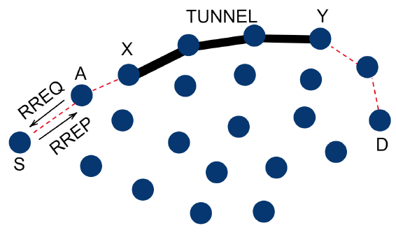
An example: blackhole attack and wormhole attack collaboration
The attacker aims to attract as many packets as possible
  to extract information about the system by packet inspection
  or, to selectively drop the packets
The goal is achieved by blackhole attack - wormhole attack collaboration

Slide 65
An example: blackhole attack and wormhole attack collaboration (cont’d)
A is a blackhole attacker that attracts packets by sending fake RREP.
X and Y are two ends of a wormhole that attract packets by advertising the one-hop route between them, namely, the wormhole.
If A forward packets it attracted to X instead of dropping them like a normal blackhole, X will have more packets collected compared with not launching an attack or launching a wormhole attack only. The attack goal is achieved.

Slide 66
Modeling collaborative attacks with causal graph model
A collaborative attack can be modeled as a causal graph model <S,E,M,L>, where
S is the set of attack states
E is the set of events triggering state transition, which can be further defined by
  Message exchange between attackers where messages are from set E, and
  Local attack operations from operation set L
The goal is to identify the malicious event sequences of collaborative attacks and stop it from reaching the key state (f3 in the above example)

Slide 67
Modeling collaborative attacks with causal graph model
To prevent the attack model from reaching f3, the defender should collaborate to
stop Attacks 1, 2 and 3 from reaching e2, f2 and g2, respectively, or
stop the communication between attackers.

Slide 68
A defense strategy consists of multiple defensive events
A defense strategy consists of a set of defensive events, in the above example
Defense 1 = {m₁, m₂, m₃, m₄}
Defense 2 = {p₁, p₂, p₃, p₄}
Defense 3 = {q₁, q₂}

Slide 69

Defensive events collaborating to interfere with Attack events
The defensive events collaborate to interfere with attack events or inter-attack communications to stop collaborative attack state transitions.

Slide 70
Graphs for blockhole attacks and wormhole attacks
For blackhole attacker A:
For each of two ends of the wormhole, X and Y:

Slide 71

Defend against single attacks by detecting abnormal events
For blackhole attacker A:
Detector D_{A} = {d_{A1,} d_{A2}}
  d_{A1}: monitors fake RREP
  d_{A2}: monitors packet drop

Slide 72
Defend against single attacks by detecting abnormal events (cont’d)
For two ends of the wormhole X and Y:
Detector D_{B} = {d_{B1,} d_{B2}}
  d_{B1}: monitors abnormal RREP
  d_{B2}: monitors abnormal packet transmission

Slide 73
Modeling and detecting collaborative attacks
The ‘bad’ state (X receives pkt) becomes ‘worse’.
Detection d_{A2} becomes ineffective since A no longer drops packets.
The bad state can be reached through more paths due to collaboration.
Thus, the detectors DA and DB have to collaborate to defend. D_{collab} = {d_{A1}, d_{B1}, d_{B2}}
Worse

Slide 74
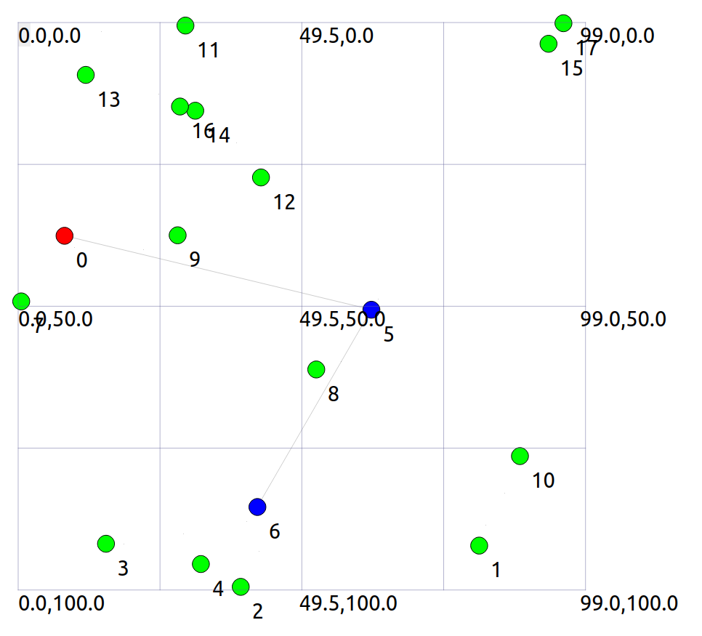
Evaluate the detection and defend mechanisms with ns3
We have implemented the above example with ns3
Red node is the blackhole attacker A
Blue nodes are wormhole attackers X and Y
Gray lines are tunnel and wormhole
We will evaluate our solution mechanism with ns3

Slide 75
Follow-up research questions
Given more single attack patterns (e.g., replication attacks, rushing attacks), we need to define causal rules to automatically judge whether and how those attacks can collaborate.
As the number of attackers increases, the collaborative attack graph becomes more complex, we need more advanced techniques to exhaust the paths from initial states to bad states.
In a system, how do we know that abnormal events are happening which may lead the system to a bad state?
  We plan to use machine learning approaches (next slides)

Slide 76
Why to use Machine Learning
The ML algorithm can continuously learn and adapt to new attack patterns.
It can analyze large amounts of data to detect advanced threats and reduce false positives/negatives.
It is initially resource-intensive but more economical in the long term.
It reduces manual updates.

Slide 77
Hidden Markov Model
A sudden spike in port scans on critical servers, coupled with a surge in message traffic and repeated login failures, potentially indicates a collaborative attack.
HMM leverages temporal relationships and probabilistic state transitions to dynamically monitor and identify potential network attacks.

Slide 78
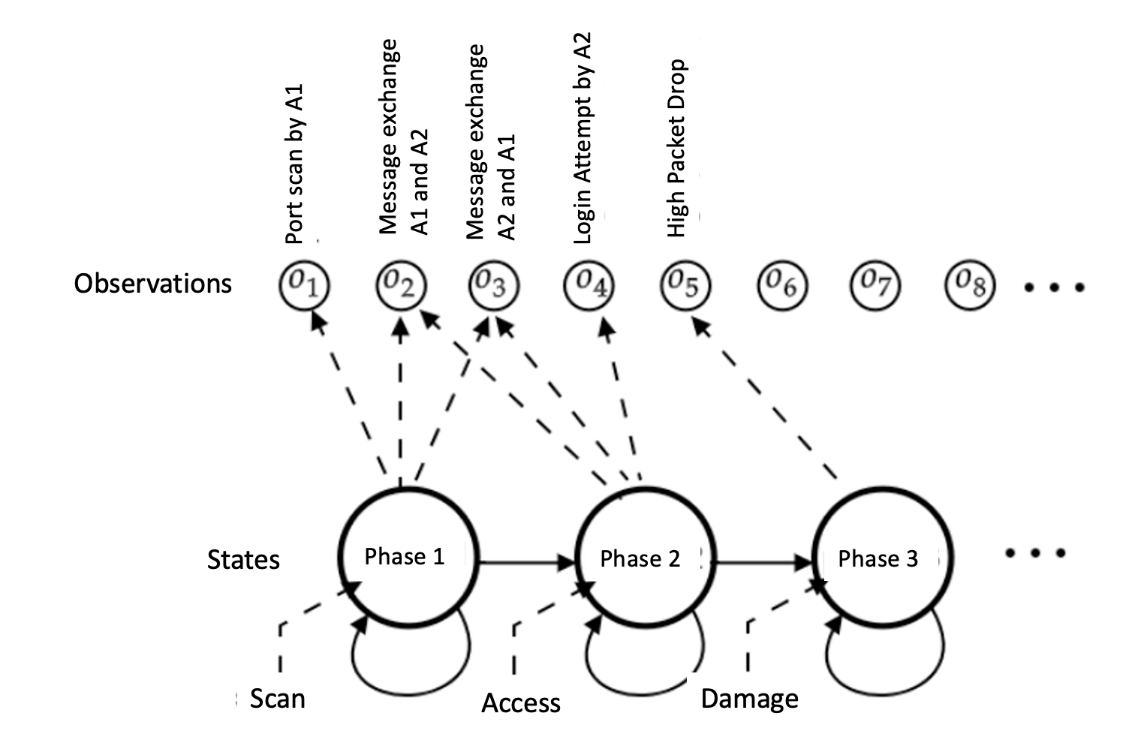
Hidden Markov Model

Slide 79
How Hidden Markov Model works?
System States can be Normal, Port Scan, Access, Damage
The system observes events called observations.
The algorithm can be trained on data including port activities, message logs, etc.
Baum-Welch (BW) and Viterbi algorithms can be used for training.
HMM can be applied to real-time data for state sequence analysis.
If there are suspicious activities, the IP address of the attacker can be blocked, and notifications can be provided

Slide 80
Utilizing LSTM (Long Short-Term Memory) Network
LSTM's strength lies in its ability to process sequential data and capture long-term patterns, making it highly effective for real-time network security monitoring.
For instance, LSTMs can detect irregular patterns, such as identifying a mild port scan followed by spikes in messages and unusual login attempts (both could happen days later “mild port scan”). This capability allows LSTM to flag such sequences as potential collaborative attacks.

Slide 81
How can LSTM work
Dataset:
  Timestep 1: event 1 [Normal Traffic]
  Timestep 2: event 2 [Port Scan]
  Timestep 3: event 3 [Increased Messaging]
  Timestep 4: event 4 [Failed Logins]
LSTM Processing: LSTM can process all previous states to predict collaboration
  input: event 1 => output: No Attack
  input: event 1, event 2 => output: Port Scan
  input: event 1, event 2, event 3 => output: Access
  input: event 1, event 2, event, event 4 => output: Potential collaborative attack

Slide 82
Contrastive Learning
Contrastive Learning's strength lies in its ability to learn nuanced differences between normal and malicious behaviors.
A model trained with Contrastive Learning could recognize irregular message exchanges and login attempts, distinguishing them from normal behavior and flagging them as potential attacks.
Not every login attempt failure is malicious; contrastive learning can help distinguish between normal login attempt failure and malicious login attempt failure.

Slide 83
How does Contrastive Learning work?
The algorithm is provided an event that is an Anchor (without anomaly) during training.
All other events are positive (P) or negative (N). The positive (P) event is an anomaly. The negative (N) is a legitimate data point.
The algorithm maximizes the distance between A and P while minimizing the distance between A and N.
In real-time, the algorithms compute the distance between the event and anchor to predict whether the event is an anomaly or legitimate.

Slide 84
Problem Statement
Packet drop attacks put severe threats to Ad Hoc network performance and safety
Directly impact the parameters such as packet delivery ratio
Will impact security mechanisms such as distributed node behavior monitoring
Different approaches have been proposed
  Vulnerable to collaborative attacks
  Have strong assumptions of the nodes

Slide 85
Problem Statement
Many research efforts focus on individual attackers
The effectiveness of detection methods will be weakened under collaborative attacks
  E.g., in “watchdog”, multiple malicious nodes can provide fake evidences to support each other’s innocence
  In wormhole and Sybil attacks, malicious nodes may share keys to hide their real identities

Slide 86
Problem Statement
We focus on collaborative packet drop attacks. Why?
Secure and robust data delivery is a top priority for many applications
The proposed approach can be achieved as a reactive method: reduce overhead during normal operations
Can be applied in parallel to secure routing

Slide 87
Related Work
Detecting packet drop attacks
Audit based approaches
  Whether or not the next hop forward the packets
  Use both first hand and second hand evidences
  Problems:
    Energy consumption of eavesdropping
    Can be cheated by directional antenna
    Authenticity of the evidence
Incentive based approaches
  Nuggets and credits
Multi-hop acknowledgement

Slide 88
Related Work
Collaborative attacks and detection
Classification of the collaborative attacks
Collusion attack model on secure routing protocols
Collaborative attacks on key management in MANET
Detection mechanisms:
    Collaborative IDS systems
    Ideas from immune systems
    Byzantine behavior based detection

Slide 89
REAct system and Vulnerability
REAct system:
Proposed by researchers in Arizona, ACM WiSec 2009
Random audit based detector of packet drop
A reactive approach: will be activated only when something bad happens
Assumptions:
  At least two node disjoint paths b/w any pair of nodes
  Know the identity of the intermediate nodes
  Pair-wise keys b/w the source and the intermediate nodes

Slide 90
REAct system and Vulnerability
Working procedure of REAct
Destination detects the drop in packet arriving rate and notifies the source
Source randomly selects an intermediate node and asks it to generate a behavioral proof of the received packets
Intermediate node constructs a bloom filter using these packets
Source compares the bloom filter to its own value
  If match: the attacker is after the intermediate node
  Otherwise, it is before the intermediate node
Repeat the procedure until the bad link is located

Slide 91
REAct system and vulnerability
Example of REAct: the source selects n4 to be the first audited node. n4 generates the correct bloom filter, so the attacker is between n4 and D.

Slide 92
Collaborative attacks on REAct
n1 and n4 are collusive attackers. n1 discards the packets but delivers the bloom filter to n4. Now the source will think that the attacker is between n4 and D.
Why REAct is vulnerable to this attack: the source can verify the bloom filter, but not the generator of the filter.

Slide 93
Proposed approach
Assumptions:
Source shares a different secret key and a different random number with every intermediate node
All nodes in the network agree on a hash function h()
There are multiple attackers in the network
  They share their secret keys and random numbers
  Attackers have their own communication channel
  An attacker can impersonate other attackers

Slide 94
Proposed approach
Hash based approach:
Every node will add a fingerprint into the packet
S1 sends out the packet to n1:
S → n1: (S, D, data packet, random number t0)
Node n1 will combine the received packet and its random number r1 to calculate the new fingerprint:
t1 = h( r1 || S || D || data packet || t0 || r1 )
n1 → n2: (S, D, data packet, t1 )
The audited node will generate the bloom filter based on the data packets and the fingerprints
The source will generate its own bloom filter and compare it to the value of the audited node

Slide 95
Proposed approach
Why our approach is safe
The node behavioral proofs in our proposed approach contain information from both the data packets and the intermediate nodes.
Theorem 1. If node ni correctly generates the value ti, then all innocent nodes in the path before ni (including ni) must have correctly received the data packet selected by S.

Slide 96
Proposed approach
Why this approach is safe
The ordered hash calculations guarantee that any update, insertion, and deletion operations to the sequence of forwarding nodes will be detected.
Therefore, we have:
  if the behavioral proof passes the test of S, the suspicious set will be reduced to {ni, ni+1, ---, D}
  if the behavioral proof fails the test of S, the suspicious set will be reduced to {S, n1, ---, ni}

Slide 97
Discussion
Indistinguishable audit packets
  The malicious node should not tell the difference between the data packets and audited packets
  The source will attach a random number to every data packet
Reducing computation overhead
  A hash function needs 20 machine cycles to process one byte
  We can choose a part of the bytes in the packet to generate the fingerprint. In this way, we can balance the overhead and the detection capability.

Slide 98
Discussion
Security of the proposed approach
  The hash function is easy to compute: very hard to conduct DoS attacks on our approach
  It is hard for attackers to generate fake fingerprint: they have to have a non-negligible advantage in breaking the hash function
The attackers will adjust their behavior to avoid detection
  The source may choose multiple nodes to be audited at the same time
  The source should adopt a random pattern to determine the audited nodes

Slide 99
Dealing with Collaborative Attacks
Earlier approach is vulnerable to collaborative attacks
Propose a new mechanism for nodes to generate behavioral proofs
  Hash based packet commitment
  Contain both contents of the packets and information of the forwarding paths
  Introduce limited computation and communication overhead
Extensions:
  Investigate other collaborative attacks
  Integrate our detection method with secure routing protocols

