Slide 1
Detect & Adapt: A Resiliency Enhancement Mechanism for Space Computing Platforms
Shafkat Islam, Nagender Aneja, Ruy de Oliveira, Sandhya Aneja, Bharat Bhargava, Jason Hamlet, Chris Jenkins
#SAND2023-11822A

Slide 2
Motivation
Applications of space systems:
Navigation
Communication
Weather forecast
Remote sensing
Heterogeneous Compute Platforms (HCP):
CPU
GPU
FPGA
DSP
HCP lacks in built-in security features
Spacecraft*
*https://www.google.com/url?sa=i&url=https%3A%2F%2Fwww.sierraspace.com%2Fnewsroom%2Fpress-releases%2Fsierra-space-and-ibm-collaborate-on-space-technology-and-software-platforms%2F&psig=AOvVaw1WCSZ-0fDGEDeuPY1ckW7f&ust=1701970010624000&source=images&cd=vfe&opi=89978449&ved=0CBQQjhxqFwoTCPC5g8Gq-4IDFQAAAAAdAAAAABAE

Slide 3
Introduction
Applications of HCP outside of space mission: critical infrastructure, autonomous vehicles, edge AI [LLH+22].
HCP integrates different processing units into single chip.
Provides efficient computing in terms of performance and power consumption.
HCP executes computation without the supervision of any central entity.
Gap exists in the literature regarding the security features of HCP platform in space systems [SMM+21, Cas10, VHJ19, MBH+21, ZLZT21].
There is a pressing need to explore ways to develop security solutions for the HCP-based computing environment.

Slide 4
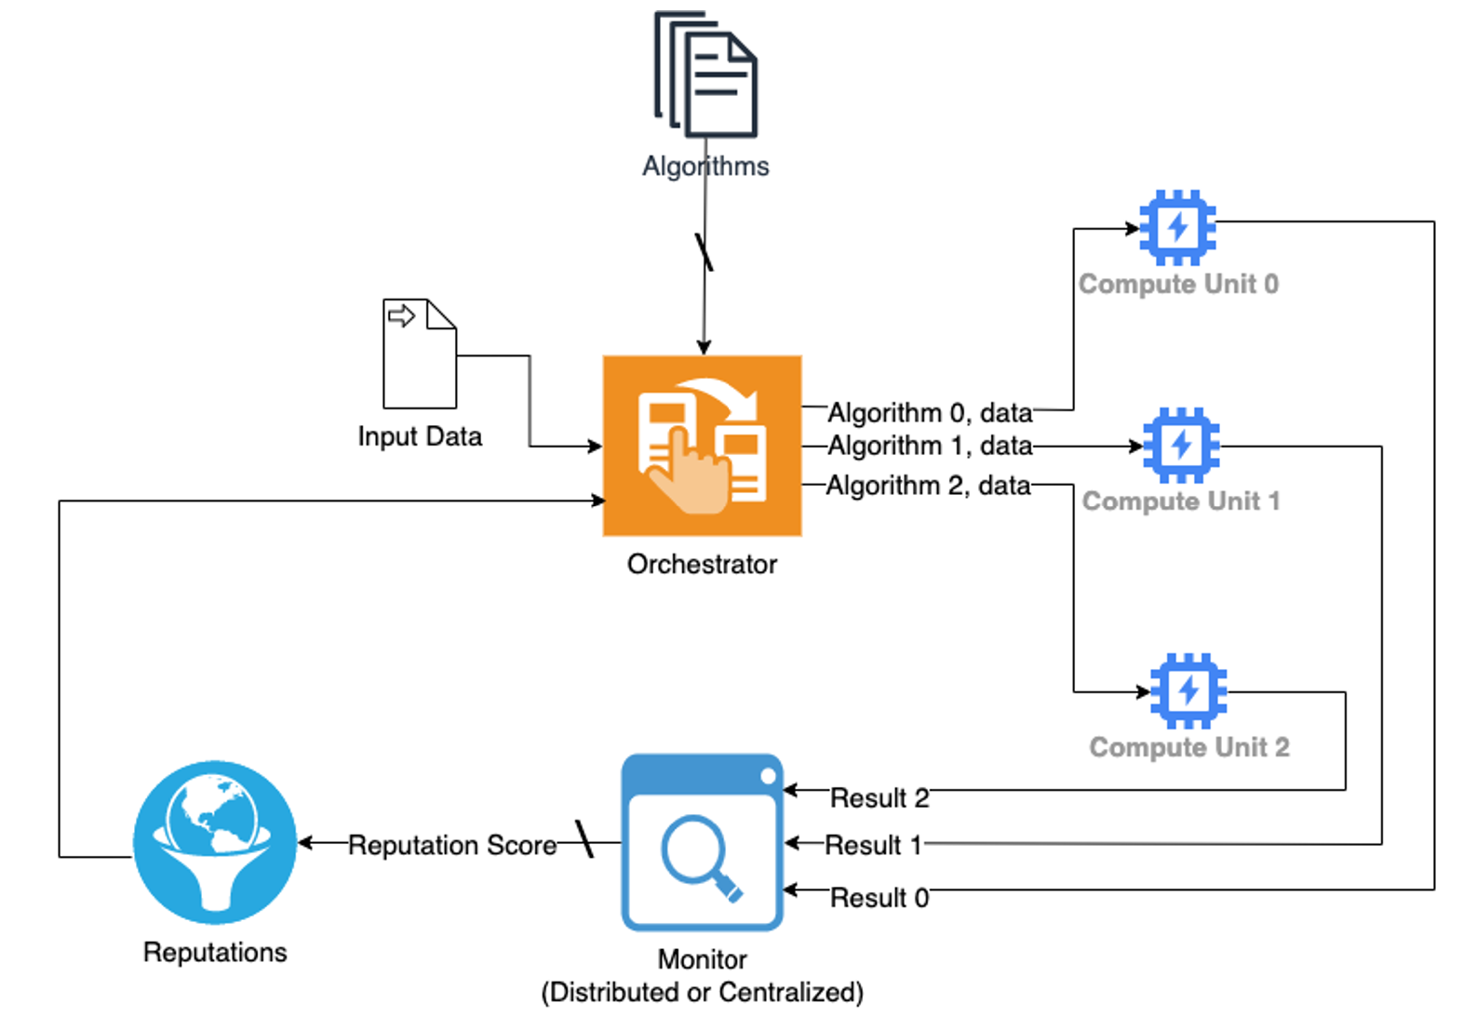
Heterogeneous Computing: Orchestration & Monitoring
Orchestrator assigns:
Data, algorithm, and task.
Compute units:
Execute task.
Send the result to the monitor.
Monitor:
Verifies results from each compute unit.
Outputs the final compute result.
Evaluates performance of each compute unit.
Sends the evaluation summary to the orchestrator.
Proposed HCP orchestration & Monitoring Mechanism.

Slide 5
Heterogeneous Computing: Threat Model
Trustworthy:
Orchestrator.
Monitor.
Attacks:
Manipulation of results.
Degradation of performance.
Manipulation of results:
Data manipulation.
Output alteration.
Packet drop.
Degradation of performance:
Algorithmic trojan (exploits worst case complexity of an algorithm).
Memory leakage.
Proposed HCP orchestration & Monitoring Mechanism.

Slide 6
Heterogeneous Computing: Computing Strategy
Computation Partition:
Partitioning a computation task into multiple sub-tasks.
Monitor combines the result of each subtask.
Triple Modular Redundancy:
Three compute units perform an identical task/sub-task, using the same algorithm or execution process.
Triple Modular Diversity:
Three compute units performing identical tasks/sub-tasks but with different task execution processes/algorithms.
Hybrid Strategy:
Both the algorithm and compute unit can change over time.
Can be performed consistently with the three other methods stated above.

Slide 7
Heterogeneous Computing: Hierarchical Detection
Hierarchical Detection:
Sequence of multiple detection strategies.
Brute Force Approach:
Monitor checks each small segment of results from compute units.
Probabilistic Approach:
Monitor checks certain portions (consecutive or discrete) of output result from compute units.
Fingerprinting:
Monitor accumulates execution statistics, such as memory usage, computation time consumed, etc.
Hashing based Approach:
Matches hash value of correct output (ideally partial).
Attribute-based Checksum Approach:
Monitor matches attributes of output results.

Slide 8
Heterogeneous Computing: Orchestration
Machine Learning based Adaptive Orchestration:
Data driven model.
Supervised or reinforcement learning.
Rule based Adaptation:
Follows certain rules to change orchestration process based on performance data provided by the monitor.
Random Orchestration (Baseline):
Orchestrator randomly assigns task to compute units.
Unresponsive to any adversarial incident.
Round-robin Orchestration(Baseline):
Assigns tasks in round robin manner.
Unresponsive to any adversarial incident.

Slide 9
Conclusion & Future Works
Observation:
We conducted preliminary experiments using a sorting application, and it shows that the platform can defend against abnormalities satisfactorily even if approximately two-thirds of the compute units are under attack. We have not considered colluding attacks in the experiments yet. We used baseline orchestration mechanisms in the experiments.
Targeted applications:
Sorting.
Compression.
Gradient descent calculation.
Machine learning algorithm.

Slide 10
References
[LLH+22] Dongqing Li, Yuegang Li, Haizhou Hu, Ting Zhang, and Congfeng Jiang. Heterogeneous platform-aware workload feature recognition for edge intelligence. Physical Communication, 52:101620, 2022. (Talks about HCP)
[SMM+21] Clementine G. Starling, Mark J. Massa, Christopher P. Mulder, Julia T. Siegel, James E. Cartwright, Deborah Lee James, Raphael Piliero, Brett M. Williamson, Dor W. Brown, Ross Lott, Christopher J. MacArthur, Alexander Powell Hays, Christian Trotti, and Olivia Popp. The future of security in space: A thirty-year us strategy. Technical report, Atlantic Council, 2021. (Talks about future of space technologies)
[Cas10] Christopher J. Castelli. Closer commercial ties urged: Dod sees space as increasingly congested, contested, competitive. Inside the Air Force, 21(11):10–12, 2010. (Talks about space-based economy)
[VHJ19] Ly Vessels, Kenneth Heffner, and Daniel Johnson. Cybersecurity risk assessment for space systems. In 2019 IEEE Space Computing Conference (SCC), pages 11–19, 2019. (Talks about cybersecurity risks in space)
[MBH+21] M. Manulis, C. P. Bridges, R. Harrison, V. Sekar, and A. Davis. Cyber security in new space. International Journal of Information Security, 20(3):287–311, Jun 2021. (Talks about cybersecurity risks in space)
[ZLZT21] Ming Zhuo, Leyuan Liu, Shijie Zhou, and Zhiwen Tian. Survey on security issues of routing and anomaly detection for space information networks. Scientific Reports, 11(1), November 2021. (Talks about cybersecurity risks in space networks)

