Slide 1
End-to-End Security in Mobile-Cloud Computing
Prof. Bharat Bhargava
Department of Computer Science, Purdue University
Center for Education and Research in Information Assurance and Security (CERIAS)
bbshail@purdue.edu (765-413-7312)

Slide 2
Outline
Definition, big picture, and challenges
End to end security challenges
System architecture
Taint analysis and AOP
Prototype evaluation
  Performance and security evaluation
  Cloud computing evaluation
Security in Mobile Cloud Computing (current efforts)
  MCC architecture
  Mobile agent for computation offloading
  Proposed MCC security framework
    Tamper resistant approach
    Active Bundle
Summary

Slide 3
Mobile-Cloud Computing Definition
Mobile cloud computing (MCC) at its simplest, refers to an infrastructure where both the data storage and data processing happen outside of the mobile device. [1,2]
Mobile cloud applications move the computing power and data storage away from the mobile devices and into powerful and centralized computing platforms located in clouds, which are then accessed over the wireless connection based on a thin native client.

Slide 4
Why Mobile-Cloud Computing?
Mobile devices face many resource challenges (battery life, storage, bandwidth etc.)
Cloud computing offers advantages to users by allowing them to use infrastructure, platforms and software by cloud providers at low cost and elastically in an on-demand fashion.
Mobile cloud computing provides mobile users with data storage and processing services in clouds, obviating the need to have a powerful device configuration (e.g. CPU speed, memory capacity etc.), as all resource-intensive computing can be performed in the cloud.

Slide 5
The Big Picture: End-to-End Security for MCC
Application code to be offloaded to the cloud for execution is bundled in a mobile agent
Upon arrival at the destination (cloud host) platform, the bundle enables itself and starts executing its code
Guards integrated into the agent code using AOP pointcuts check for tamper during execution (with code checksumming)
Upon tamper detection, the bundle moves to a different platform, reloads its data (code) and continues/restarts execution, using the associated AOP advice
Results to be sent to the request originator (mobile platform) are encrypted with a well-known authenticated encryption algorithm to ensure end-to-end authentication and integrity.

Slide 6
Security Challenges in SOA and MCC
Authentication and authorization may not take place across intended end points
Intermediate steps of service execution might expose messages to hostile threats
External services are not verified or validated dynamically (Uninformed selection of services by user)
User has no control on external service invocation within an orchestration or through a service in another service domain
Violations and malicious activities in a trusted service domain remain undetected

Slide 7
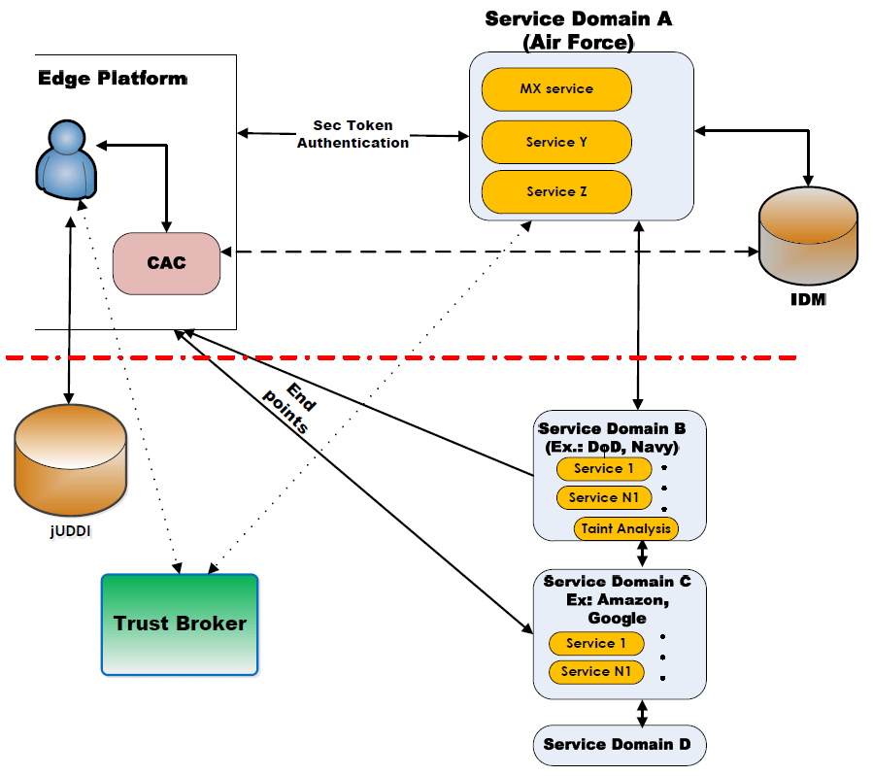
End to End Security Architecture

Slide 8
End to End Security Architecture-Description
Figure shows problems in end to end SOA security as follow:
In this figure the current Air Force infrastructure is shown above the red dashed line. In this architecture, all services are available in the local trusted service domain and everything is under the control of domain A.
Client at the edge platform decides to use a service from domain A. He will use his CAC (common access card) to authenticate into the system.
The security token is sent to the IDM (identity management system) for validation check.
If the user is authorized, IDM gives permission to the requested service (e.g. MX or mail service) for communication with user.
New security token (which is created temporarily for the current service session) is sent back to the user and user can use the service.
In a class of extended scenarios (use cases) the services in service domain A may want to use external services which are not in the same local trust boundary. In this case, other components come to the picture (below the dashed red line). This figure shows when service domain A (e.g. Air Force service portal) tries to access other governmental or public services (from external domains), it will lose track of end to end security. This figure shows that end points can be accessible to the client directly. We have addressed these issues by adding trust broker server and taint analysis modules (in external trusted service domains).

Slide 9
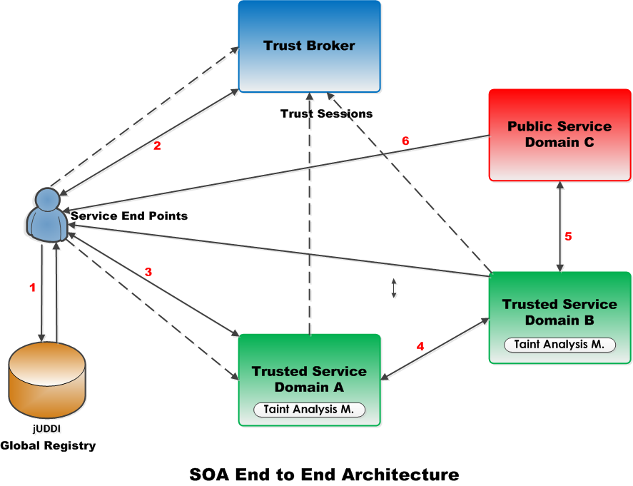
System Architecture and SOA Baseline Scenario
UDDI Registry request
Forwarding the service list to Trust Broker and receive a categorized list
Invoking a selected service
Second invocation by service in domain A
Invoking a service in public service domain
End points (Reply to user)
9

Slide 10
Baseline Scenario Details
Steps:
  Global UDDI Registry request
    User receives a list of services related to the requested category
  User sends a refined list of services to Trust Broker module
    Trust Broker categorizes the list of services and returns a classified list
    Trust categories: Certified, Trusted, Untrusted services
  Service Request
    User selects a service based on its criteria (QoS, Trust category of service, Security preference, etc.) and invokes that service.
    User creates a session with Trust Broker and selected service in Trusted Domain A. (Trust sessions are shown with dashed lines)
10

Slide 11
Baseline Scenario Details (Cont.)
  Trusted domain A will invoke another service in Trusted domain B.
    Taint Analysis module will intercept the communications and reports any illegal external invocation
    Trust session will be extended to this domain (a new trust link between domain A and trust broker)
  Step four is repeated.
    At this moment, an external service invocation to a public service is detected by Taint Analysis module
    This will be reported to Trust Broker. Trust Broker will maintain the trustworthiness of this SOA service orchestration and if needed can stop it.
    Service in service domain B invokes a service in an public (Maybe untrusted) domain C (Possibility of deploying Taint Analysis in this domain)
  Service end points to user
    The response of SOA invocation can be sent directly to the user
11

Slide 12
Taint Analysis
What is Taint Analysis?
  Related to IFC (Information Flow Control)
How it fits into solution for AFRL?
  Independent of services (We do not need to change the services or access the source code of services)
  Interception of Service execution (Service will remain transparent)
28

Slide 13
Taint Analysis
Using AOP (Aspect Oriented Programming)
  Instrumenting classes based on predefined pointcuts
  Low performance overhead (ideal solution)
How it works?
  Load-time instrumentation
  The whole Application server is under control
  Granularity
    Package/Class level
    Method level
    Field level
  Instrumenting classes in action pipeline
29

Slide 14
What is AOP?
  Some programming tasks cannot be neatly encapsulated in objects, but must be scattered throughout the program
  AOP is a programming methodology to help with crosscutting concerns
Crosscutting concerns:
  Functionality whose implementation spans multiple modules
  AOP helps to implement them without modifying the original code
  Many examples: Logging and tracing, Transaction management, security, caching, error handling, business rules, performance monitoring…

Slide 15
AOP Concepts
Join point
  An identifiable point in the execution of a program.
  An specific pattern of execution
  Example patterns: execution of a method, access to a class field, loading of a class, …
Pointcut
  A set of join points as a program construct.
Advice
  During the service execution, when a join point of a pointcut is matched then a piece of code called advice is executed.
  An advice may log the event or report the event back to a server (trust broker in the proposed project)
  Each advice is associated with one or more pointcuts.

Slide 16
Experience with AOP for End-to-End Cloud Service Security
Need to ensure trustworthiness of results from external services (which could outsource functionality to other services) → A general service-oriented architecture (SOA) problem
We proposed an information flow tracking approach [5]:
  Based on taint analysis (tracking external service calls) and trust broker (a trusted third party evaluating trustworthiness of services, keeping track of service invocation chains, reporting invocation history to clients)
  All interactions secured with WS-Security

Slide 17
AOP for Taint Analysis
Load-time instrumentation of classes as they are loaded into the JVM at runtime
  Access to source code is not required
Instrumenting classes based on predefined pointcuts
  Pointcuts are specified based on security policies and requirements
Low performance overhead
Independent of services (We do not need to change the services or access the source code of services)
Interception of Service execution (Service will remain transparent)

Slide 18
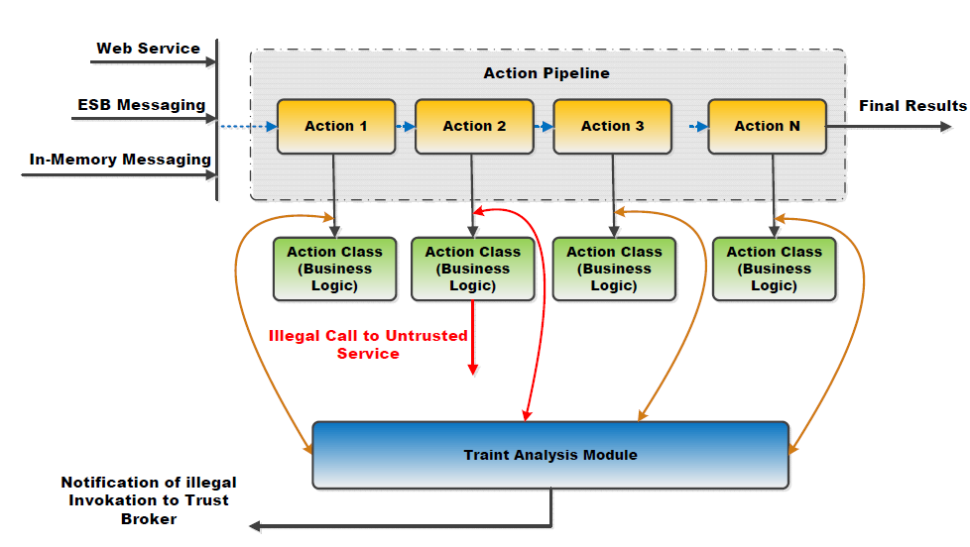
AOP for Taint Analysis

Slide 19
AOP for Taint Analysis
The previous diagram shows the internal of a service in an application server.
A service is composed of a series of actions called action pipeline which are invoked when a message is received.
Every class is associated with a business class (Java class)
Taint analysis monitors the execution of classes to find certain pointcuts (illegal service invocation in this scenario)
When an illegal service invocation is detected, taint analysis module reports the incident back to trust broker

Slide 20
Interaction of Taint Analysis and Trust Broker

Slide 21
Interaction of Taint Analysis and Trust Broker
The diagram illustrates how taint analysis (T.A) and trust broker modules work together.
It shows a SOA service which is composed of three services S1-S3 (S1 and S2 are trusted; S3 is untrusted/public)
T.A modules monitor the service invocations and then report the events back to trust broker through sessionFeedback.
Trust broker maintains the sessions of end to end service invocations and reports to the clients
  In policy enforcement scenarios, trust broker can decide to send a termination command to T.A modules (based on user policies)

Slide 22
Evaluation of the Proposed Solution
Security Evaluation
  The implemented prototype will be evaluated in terms of its effectiveness in mitigating various attacks including the following attacks
  XML Rewriting Attack
  DoS Attack
Performance Evaluation
  Response Time
  Throughput
37

Slide 23
SOA Security Evaluation
We are evaluating the proposed prototype in terms of its effectiveness in mitigating various attacks
In-transit Sniffing or Spoofing
  While information in SOAP message is in transit on the wire, various entities can see it
  SOAP messages could be spoofed by various tools
Attack Scenarios
  XML Rewriting Attack
    Replay Attacks
      They poison the SOAP messages and send them to a server with a forged client signature.
      This attack can be lethal since an attacker spoofs a user’s identity
  Denial of Service attack
38

Slide 24
XML Rewriting Attack
Exploring how certain XML rewriting attacks can be detected by the Tainted Analysis component and Trust Broker
XML rewriting attack commonly refers to the class of attacks which involve in modifying the SOAP message. (Replay, Redirect, Man in the middle, multiple header etc.)
WS Client
Attacker
Web service provider

Slide 25
XML Rewriting Attack-Cont.
Basic Replay Attack: Replace the entire current message with an old message. (Assuming no security headers present)
Replay when security headers present : Replace the current SOAP body with an old SOAP body but keep the current SOAP body at the same time to satisfy the security validations.
40

Slide 26
XML Rewriting (Replay Attack)
Cache the messages and replay old messages on Web service A which will then make subsequent calls from A to have older session ID/ Message ID.
Web Service B
Web Service A
MethodCall( param ) {
}
XML Rewriting
Attack
Web Service C

Slide 27
XML Rewriting Attack Generation
We extended TCPMon which is an Open source debugging utility for web service calls.
The tool listens on a specified port and collect the request and response messages.
Customized to intercept, change the SOAP message (redirect or replay) and resent to the receiver.
Examine how the Tainted analysis and Trust broker modules behave in this case.

Slide 28
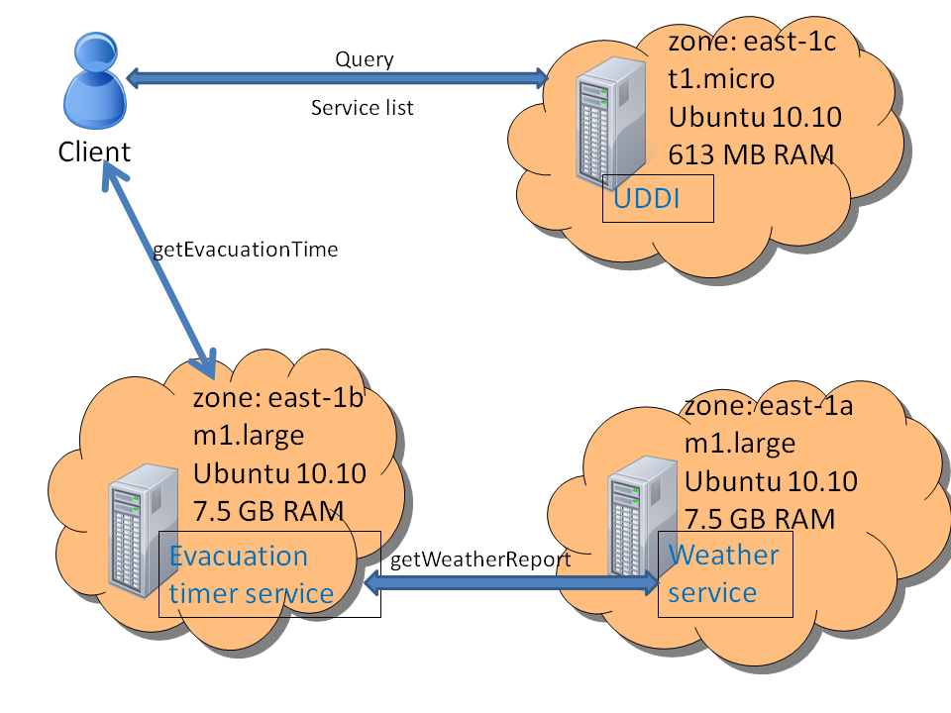
Cloud Setup – Baseline
51

Slide 29
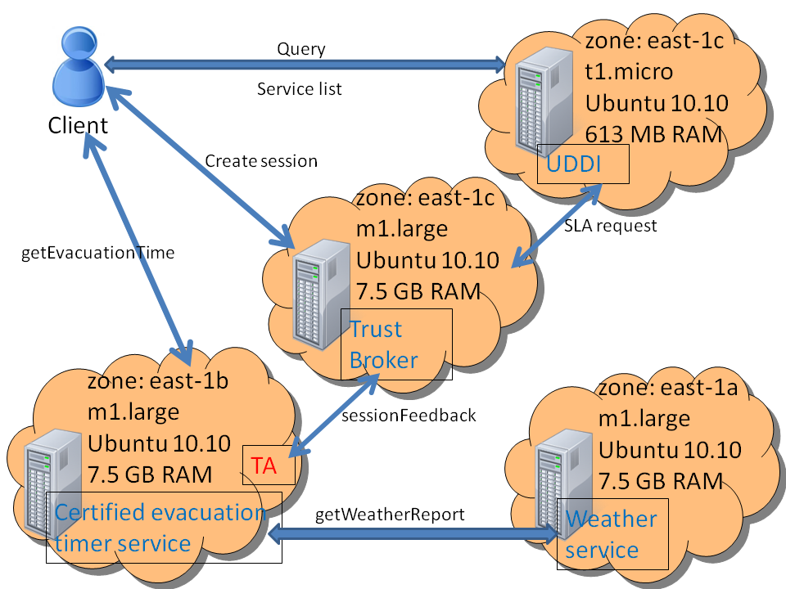
Taint Analysis Experiment Setup in Amazon EC2

Slide 30
Taint Analysis Experiments in Amazon EC2
AOP has low overhead, thus suitable for real-time MCC as well

Slide 31
Mobile Cloud Computing
Current Efforts

Slide 32
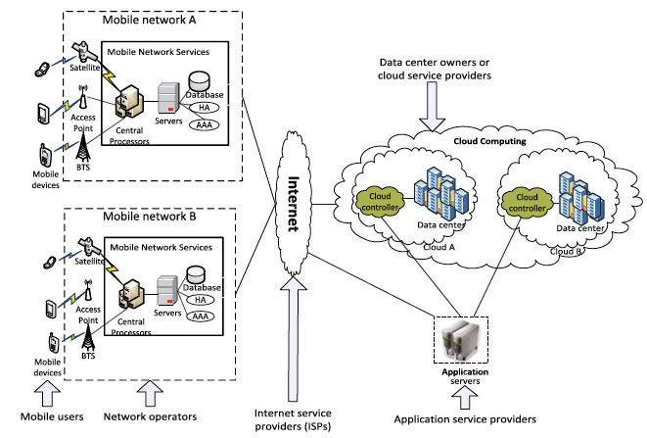
MCC General Architecture
AAA: Authentication, Authorization and Accounting
HA: Home Agent

Slide 33
MCC Architecture
Mobile devices are connected to the mobile networks via base stations that establish and control the connections and functional interfaces between the networks and mobile devices.
Mobile users’ requests and information are transmitted to the central processors that are connected to servers providing mobile network services.
The subscribers’ requests are delivered to a cloud through the Internet.
In the cloud, cloud controllers process the requests to provide mobile users with the corresponding cloud services.

Slide 34
MCC Security Challenges
Lack of control on resources and multi-tenancy of different users’ applications on the same physical machine make cloud platforms vulnerable to attacks → “Hey, You, Get Off of My Cloud!”[3]
In addition to privacy issues, programs running in the cloud are prone to:
  Tampering with code/data/execution flow/ communication
  Masquerading
Mobile code can navigate through multiple platforms before returning to the origin, giving rise to the end-to-end security problem, which involves decreasing control with every further hop in the chain of platforms.
Security mechanisms should satisfy the constraints of (1) real-time response under intermittent network connection; (2) keeping communication costs at minimum; (3) incurring limited computation overhead

Slide 35
Mobile Agents for Computation Offloading
A mobile agent is a software program with mobility, which can be sent out from a computer into a network and roam among the nodes in the network autonomously to finish its task on behalf of its owner.
Mobile agent migration follows these steps:
Process suspension/new process creation
Process conversion into a message with all state information
Message routing to destination server
Message reconstitution into executable
Execution continuation with next instruction

Slide 36
Advantages of Mobile (Autonomous) Agents for MCC
Mobile agents can provide better support for mobile clients (reduced network communication).
Mobile agents are capable of moving across different cloud machine instances transparently, which makes them capable of migrating to a different location for reasons including poor performance or an attack-prone runtime environment.
Mobile agents can be equipped with techniques to check self-integrity independent of the host platform, for tamper detection.
Mobile agents can clone themselves on multiple cloud hosts to achieve better runtime performance.

Slide 37
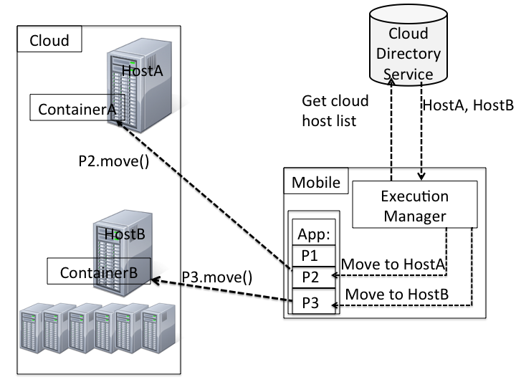
Proposed Computation Offloading Framework

Slide 38
Proposed Framework Components
Cloud directory service: A Web service (trusted third party) that maintains an up-to-date database of virtual machine instances (VMIs) available for use in the cloud
Execution manager (elasticity manager): Service on mobile platform that makes the decision regarding the execution platform of the different program partitions
Mobile agent containers: Provide an execution environment for program partitions
Virtual machine instances (cloud hosts): Host containers of the mobile agents (program partitions) sent to the cloud

Slide 39
Proposed Framework in Action
When a mobile application is launched, the execution manager contacts the cloud directory service to get a list of available machine instances in the cloud
An execution plan containing offloading decisions for the agent-based partitions is created by the execution manager
For partitions to be offloaded, a bridge is formed between the callers of those partitions and their selected cloud hosts, through which the partitions migrate to the selected hosts
Upon migration, the partitions start executing and communicate their output data to the callers through the same bridge

Slide 40
Experiments with Proposed Framework – Sudoku Solver
Execution time to find all possible solutions for a Sudoku puzzle with different numbers of initially filled cells, for mobile-device only vs. offloaded execution

Slide 41
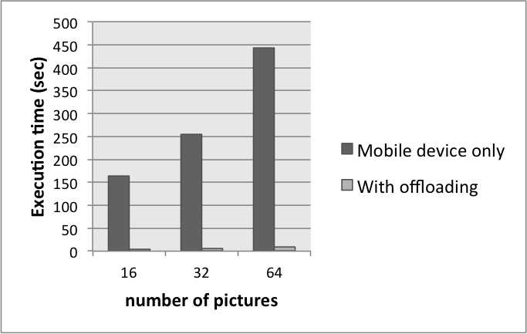
Experiments with Proposed Framework –
Face Recognition
Execution time for a face recognition program with different numbers of pictures to compare against, for mobile-device only vs. offloaded execution

Slide 42
Adding Security to MCC Framework
The performance results with the proposed MCC framework are promising for real-time mobile computing.
Need to add end-to-end tamper resistance (integrity verification) functionality without:
  Significantly increasing response time
  Increasing communication costs
  Incurring high computational overhead
Solution: Self-protecting application partitions

Slide 43
Proposed Tamper Resistance Approach
Self-protecting agents: The autonomous agents used in the MCC framework can be augmented with integrity verification constructs called software guards (similar to the work by Chang and Atallah [7]) that are executed during runtime
  Guard: is a piece of code responsible for performing certain security-related actions during program execution.
  Example Guard: checksum code which can be used for integrity verification
Integrity checkpoints are distributed throughout the agent code to ensure timely detection of tamper
Upon tamper detection, the agent stops execution, moves to a different platform and either (a) resumes execution from the last integrity-verified checkpoint or (b) starts execution from the beginning

Slide 44
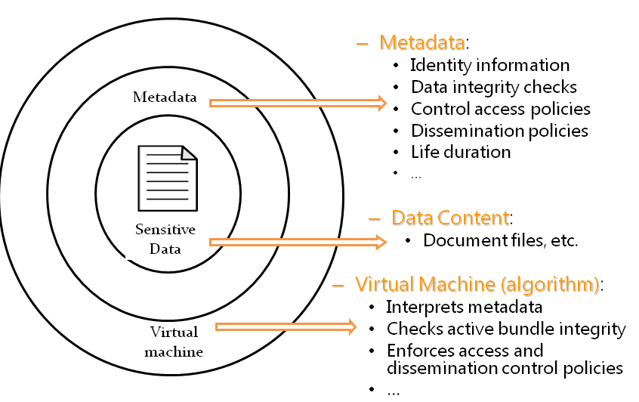
Experience with Self-Protecting Agents: Active Bundles
Active Bundle: Data protection mechanism encapsulating data with metadata and a virtual machine
Data protected from within instead of outside

Slide 45
Enabling of an Active Bundle

Slide 46
Active Bundles for MCC
We have successfully applied the idea of active bundles for
  Secure data dissemination in a peer-to-peer network of UAVs [8]
  Identity management in cloud computing [6]
A similar idea with some modifications can be applied to MCC:
  The data of the bundle now consists of application code to be executed on the foreign (cloud) platform
  The trustworthiness of a host is now determined by the bundle itself during runtime based on integrity checks instead of (or in addition to) information from a trusted third party.

Slide 47
How to Achieve Dynamic Tamper Detection?
Need to distribute integrity checkpoints throughout the agent code without needing to modify the software
Need to take the appropriate measures in case of tamper detection in a way that is transparent to the software
Need to keep runtime overhead at minimum
The solution is to use Aspect Oriented Programming (AOP) for guards

Slide 48
The Big Picture and Summary
Application code to be offloaded to the cloud for execution is bundled in a mobile agent
Upon arrival at the destination (cloud host) platform, the bundle enables itself and starts executing its code
Guards integrated into the agent code using AOP pointcuts check for tamper during execution (with code checksumming)
Upon tamper detection, the bundle moves to a different platform, reloads its data (code) and continues/restarts execution, using the associated AOP advice
Results to be sent to the request originator (mobile platform) are encrypted with a well-known authenticated encryption algorithm to ensure end-to-end authentication and integrity.

Slide 49
References
Hoang T. Dinh, Chonho Lee, Dusit Niyato, and Ping Wang. “A survey of Mobile Cloud Computing: Architecture, Applications, and Approaches,” Wireless Communications and Mobile Computing, 2011.
http://www.csie.ndhu.edu.tw/~showyang/MCloud2012/04MobileCloudSurvey.pdf
Thomas Ristenpart, Eran Tromer, Hovav Shacham, Stefan Savage, “Hey, you, get off of my cloud: exploring information leakage in third-party compute clouds,” ACM Conference on Computer and Communications Security, 2009.
Pelin Angin and Bharat Bhargava. “An Agent-based Optimization Framework for Mobile-Cloud Computing,” Journal of Wireless Mobile Networks, Ubiquitous Computing, and Dependable Applications, Vol 4, No 2, pp. 1-17, 2013.

Slide 50
References
M. Azarmi, B. Bhargava, P. Angin, R. Ranchal, N. Ahmed, A. Sinclair, M. Linderman, L.B. Othmane. “An End-to-End Security Auditing Approach for Service Oriented Architectures,” International Symposium on Reliable Distributed Systems (SRDS), 2012.
P. Angin, B. Bhargava, R. Ranchal, N. Singh, L. Othmane, L. Lilien, M. Linderman. “An Entity-centric Approach for Privacy and Identity Management in Cloud Computing,” International Symposium on Reliable Distributed Systems (SRDS), 2010.
Hoi Chang and Mikhail J. Atallah. “Protecting Software Code by Guards,” Digital Rights Management Workshop, 2001.
B. Bhargava, P. Angin, R Sivakumar, R. Ranchal, M. Linderman, A. Sinclair. “A Trust-based Approach for Secure Data Dissemination in a Mobile Peer-to-Peer Network of
Avs,” International Journal of Next Generation Computing, Vol 3, No 1, 2012.

