Slide 1

Security and Privacy Challenges in Cloud Services
Prof. Bharat Bhargava
Computer Science and CERIAS
Purdue University
(supported by Northrop Grumman Research Consortium)

Slide 2
Composite Services in Cloud (SOA)
Cloud marketplaces and API-centric service model enables quick composition of services
Loosely coupled independent web services composed to serve user requests
Dynamically orchestrated based on business requirements
Dynamic selection of component services to ensure high quality service delivery
A composite service invocation translates into multiple internal service interactions
Involves interactions of trusted and untrusted services
No client control on the chain of service invocations

Slide 3
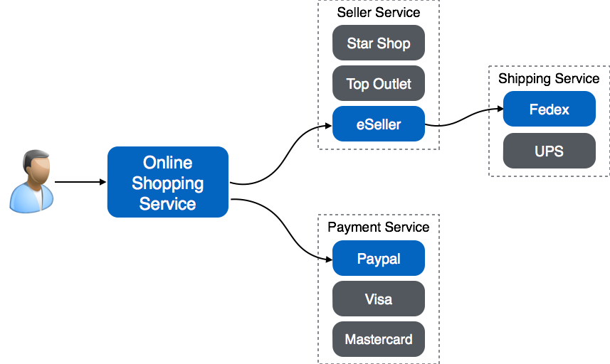
Service Composition Example

Slide 4


Problem: Service Attack
Trust Domain
Service B
Service A
Service C
Service D

Slide 5

Problem: Service Failure
Trust Domain
Service B
Service A
Service C
Service D

Slide 6
Problem: Data Leakage
Trust Domain
Service B
PII
PII
Service A
Service C
PII
Service D

Slide 7
Problems in Composite Services
Attackers can gain control of a number of services, modify a service or get access to in-transit messages
Client does not have ability to specify service interaction policies
Violations, malicious activities and failures in a trusted service domain may remain undetected
Services are not verified or validated dynamically (uninformed selection of services)
Malicious activity may cause service disruptions

Slide 8
Research Ideas for Solutions
Goal: Ensure Performance and Security Requirements, meet SLAs and on-demand Customization, while minimizing Cost
Service composition monitoring
  Detect anomalies, failures, attacks
Trust and reputation measures of services
Dynamic composition reconfiguration to meet availability
  Scalability, Availability, Resource constraints and Economics, Cost/Benefit Tradeoff
Adaptability to attacks in mission critical environment
  Resiliency, Agile Defense, Graceful degradation
Identity Management (Check Browser and Device capabilities)
  Authentication and Federation of identity information to external domains
Controlled data dissemination to services
  Active Bundle ( Data, Policies of publisher, authorization of subscriber, mobile code)
  Data dilution, distortion to increase/decrease entropy
Situation awareness to make context aware decisions
  Emergency environment, Attack environment

Slide 9

Integration with other Solutions
Service request
Browser
Insecure browser
analyze request source based on W3C standards
Secure browser
CAC
authentication
PIN
Send active
bundle to cloud
for execution
Trust = X + Y
Trust = X
execute active
bundle in cloud
Low trust
High trust
Active Bundle
Service Domain
Service X
Data access
request
Encrypted
search
Data
Service X
is authorized
to access
Data
request
Filtered/lower
quality data
Filtered search
results
Active Bundle
UNTRUSTED
TRUSTED

Slide 10




Example of P2P Secure Data Sharing in UAV Network
Original image
Dissemination Policy:
If context = emergency => contrast = 0.4
If 2.5 > trust ≥ 2.2 => contrast = 0.2
If 1.8 > trust => contrast = 0.1
trust = 2.0
context = emergency
trust = 2.4
trust = 1.7

Slide 11
Solution Requirements
Policies
Passive Listener
Active
Listener
Active Bundle
Listener
Heartbeat Module
Trust Management
Agile Defense
Resiliency & Adaptability
Agile Defense
Anomaly Detection

Slide 12
Distributed Service Monitoring for Cross-domain Anomaly Detection and Adaptability
*: service request data
*: summary service health data
S4
*
M_{B}
*
S5
S1
S6
*
Domain B
*
*
S2
M_{C}
*
S7
M_{A}
*
*
S3
*
S9
Domain A
Domain C
*
*
S10
*
S11
*
*
M_{D}
*
M_{E}
*
S12
Domain D
Central Monitor
Domain E
Each monitor M_{X} tracks all requests in its domain, gathering response time, heartbeat data, response status, authorization/authentication failures, and reports summary to central monitor.
Distributed monitoring allows for collection, analysis and reaction to dynamic cyber events, preventing propagation of threats within or outside the domain of anomalous service.

Slide 13
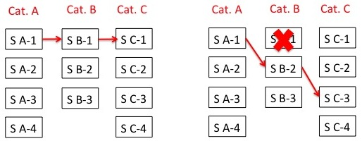
Dynamic Service Composition Reconfiguration
Goal: Given a set of service categories (each with a set of services), a set of security constraints, a set of target performance parameters; Create a service composition that complies with the given security constraints and has best performance
Approach:
Sort services in each category based on given SLA performance parameters
Select highest performing service from each category to form a composition
Check composition against given security constraints and switch to alternate services if the constraints are not satisfied (acceptance test fails)

Slide 14
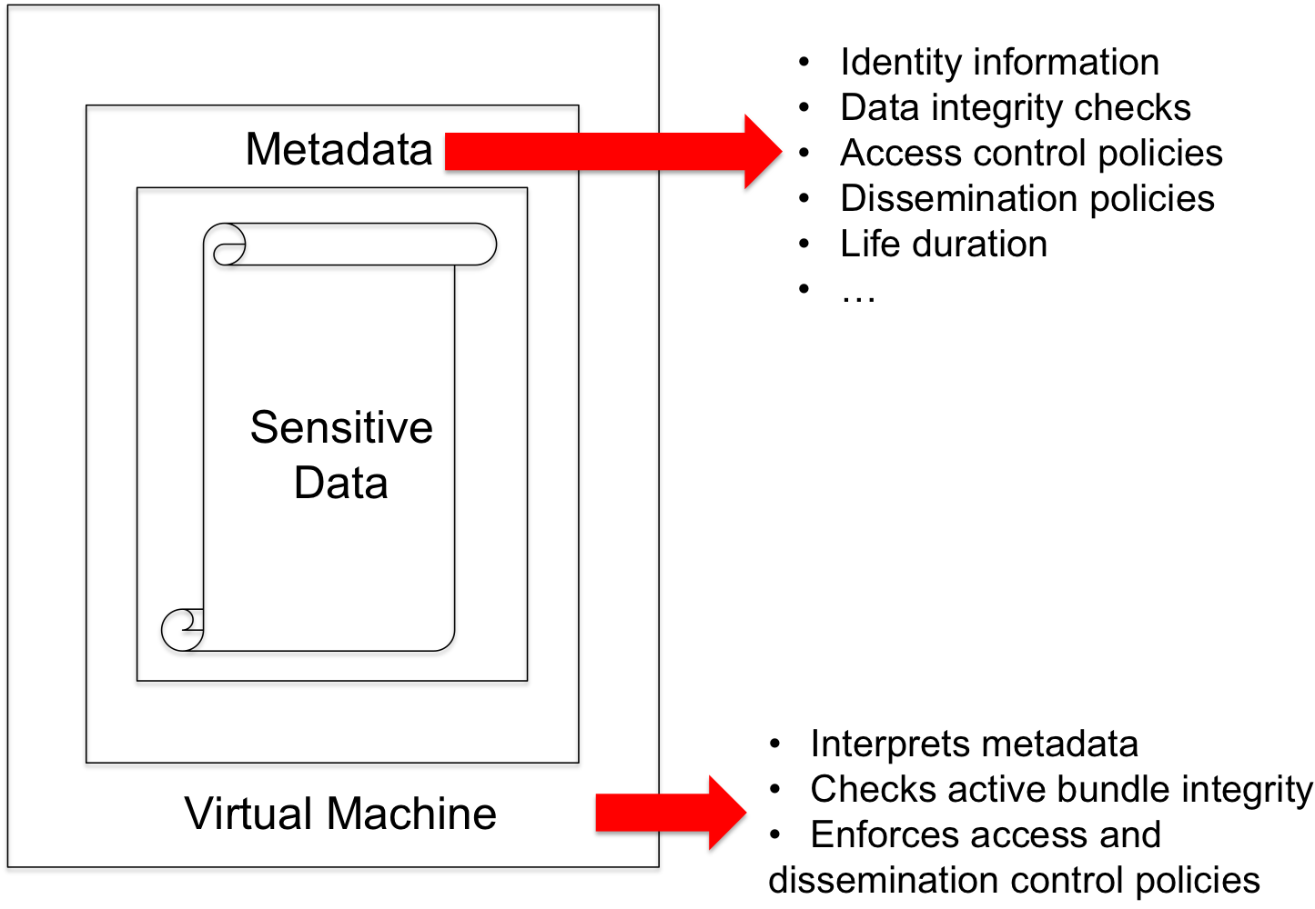
Privacy Preserving Data Dissemination
Active Bundle (AB) scheme
  Self-protecting data encapsulation mechanism
  Provides secure cross-domain data disclosure
Sensitive data
  Encrypted data items
Metadata
  Access control policies
Monitor
  Self-integrity check
  Policy evaluation
  Policy enforcement
  Data dissemination

Slide 18

Data Privacy in Composite Services
TRUSTED
DOMAIN
D
SERVICE 1
d₁
D
SERVICE 2
d₂
D
D
SERVICE 4
d₄
SERVICE 3
d₃
EXTERNAL
DOMAINS

Slide 19
Privacy Issues in Composite Services
Composite Web services don’t disclose their compositions to the clients
Opaque data sharing across unknown endpoints beyond primary service
Undetected privacy violations due to data sharing with unauthorized services in external domains
Message-based security mechanisms (HTTPS) are not applicable
  Provides point-to-point secure communication
  Unable to provide protection in remote domains
Lack of policy infrastructure to communicate, evaluate, and enforce policies in external domains for secondary service authorization

Slide 20
Example Privacy issues in Composite Service Interactions
Name
Email
Credit card type
Credit card
Shipping preference
Mailing address
order request
+
data A
1
Name
Email
Credit card type
Credit card
Shipping preference
Mailing address
verify request
+ data A1
?
?
?
Shopping Service
Seller
Service
2
payment request
+
data A3
shipping request
+
data A2
4
3
?
?
?
Payment Service
Shipping Service
?
?
?

Slide 21
Service Interactions using Active Bundle
Name
Email
Credit card type
Credit card
Shipping preference
Mailing address
order request
+
Name
Email
Payment type
E(Credit card)
E(Shipping preference)
E(Mailing address)
1
E(Name)
E(Email)
E(Payment type)
E(Credit card)
Shipping preference
E(Mailing address)
Active Bundle
verify request
Active Bundle
+
Shopping Service
Seller
Service
2
payment request
+
shipping request
+
Name
Email
Payment type
E(Credit card)
E(Shipping preference)
E(Mailing address)
Name
E(Email)
E(Payment type)
E(Credit card)
E(Shipping preference)
Mailing address
4
3
Active Bundle
Active Bundle
Payment Service
Shipping Service

Slide 22
Example of Context-based Data Dissemination
Medical data
Medical history
E(Patient ID)
E(Insurance ID)
E(Medical test prescription)
E(Prescription)
E(Treatment code)
Emergency context
Data access: GRANTED
Patient ID
Medical data
Medical history
Medical test prescription
Prescription
E(Insurance ID)
E(Treatment code)
Paramedic’s
App
Doctor’s
App
Active
Bundle
Active
Bundle
Active
Bundle
Medical
Information
System
Laboratory’s
App
Patient ID
Insurance ID
Treatment code
E(Medical data)
E(Medical history)
E(Medical test prescription)
E(Prescription)
Patient ID
Medical test prescription
E(Medical data)
E(Insurance ID)
E(Medical history)
E(Prescription)
E(Treatment code)
Active
Bundle
Active
Bundle
Patient ID
Insurance ID
Medical data
Medical history
Medical test
prescription
Prescription
Treatment code
Pharmacy’s
App
Insurance’s
App
Patient ID
Prescription
E(Medical data)
E(Insurance ID)
E(Medical history)
E(Medical test prescription)
E(Treatment code)

Slide 23
Example of Cross-Domain Data Dissemination
(disclosure based on classification level)
UAV 1
Infrared imagery
Location coordinates
UAV 2
Multispectral imagery
Location coordinates
UAV 3
Time period
Deployed personnel
Target locations
Intelligence reports
Mission expenses
Deployed weapons
Casualties
Press Release
Command
& Control
Time period
Deployed personnel
Target locations
Intelligence reports
Mission expenses
Deployed weapons
Casualties
Press Release
Top Secret
Secret
Confidential
Unclassified
Target locations
Intelligence reports
Mission expenses
Deployed weapons
Press Release
Mission expenses
Press Release
Press Release

Slide 24





Example of Controlled Data Distortion
Distorted data reveal less, protects privacy
Examples:
  accurate data more and more distorted data
  250 N. Salisbury Street
  West Lafayette, IN
  250 N. Salisbury Street
  West Lafayette, IN
  [home address]
  765-123-4567
  [home phone]
  Salisbury Street
  West Lafayette, IN
  250 N. University Street
  West Lafayette, IN
  [office address]
  765-987-6543
  [office phone]
  somewhere in
  West Lafayette, IN
  P.O. Box 1234
  West Lafayette, IN
  [P.O. box]
  765-987-4321
  [office fax]

Slide 25



Example of Controlled Data Filtering of Electronic Healthcare Record (EHR)
EHRs stored in a database and filtered for different data consumers using SQL queries run in the AB’s VM
a. Data consumer verified as doctor at the hospital can get all patient data
b. Hospital Receptionist gets filtered data
c. Insurance company gets only the minimal required data

Slide 26
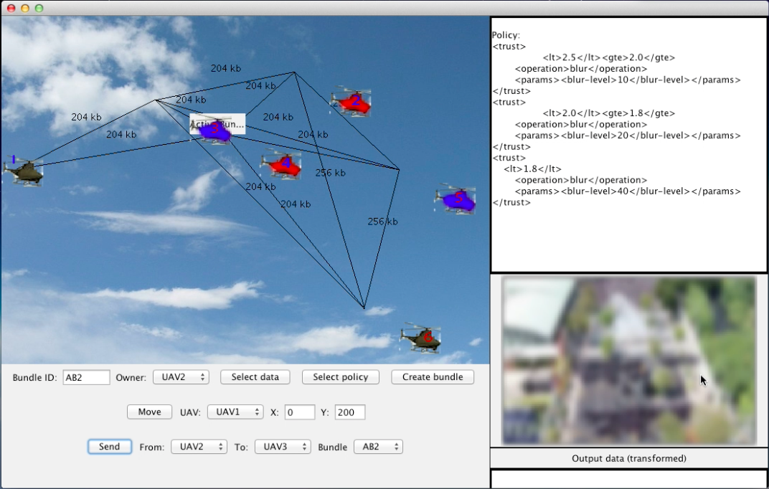
Example of P2P Secure Data Sharing in UAV Network
Each UAV creates active bundle with captured image data and trust-based dissemination policies
When active bundle is sent to a UAV, image data is filtered (blurred) based on trust level
Trust levels of UAVs change based on context, distance, communication bandwidth

Slide 27




Example of P2P Secure Data Sharing in UAV Network
Original image
Dissemination Policy:
If 2.5 > trust ≥ 2.2 => blur level = 20
If 2.2 > trust ≥ 2.0 => blur level = 40
If 2.0 > trust => blur level = 80
trust = 2.4
trust = 2.1
trust = 1.5

Slide 28
Example of P2P Secure Data Sharing in UAV Network
Original image
Dissemination Policy:
If context = emergency => contrast = 0.4
If 2.5 > trust ≥ 2.2 => contrast = 0.2
If 1.8 > trust => contrast = 0.1
trust = 2.0
context = emergency
trust = 2.4
trust = 1.7

Slide 29
Integration with other Solutions
Service request
Browser
Insecure browser
analyze request source based on W3C standards
Secure browser
CAC
authentication
PIN
Send active
bundle to cloud
for execution
Trust = X + Y
Trust = X
execute active
bundle in cloud
Low trust
High trust
Active Bundle
Service Domain
Service X
Data access
request
Encrypted
search
Data
Service X
is authorized
to access
Data
request
Filtered/lower
quality data
Filtered search
results
Active Bundle
UNTRUSTED
TRUSTED

Slide 30
Information Flow
Client sends request to the service using browser and shares data by means of Active Bundle (AB)
Service checks the request source (secure or insecure browser)
  Based on W3C Crypto standards
Service executes AB in Cloud if created by an insecure browser
Service interacts with AB and requests data
AB behaves differently under different contexts
  Full data dissemination based on service authorization/trust level
  Context-based partial data dissemination based on insufficient authorization level
  No data dissemination for unauthorized access/attacks
Cross-domain information exchange with trustworthy/untrustworthy subscribers
  Data dissemination is done on a “need to know” basis by limiting the disclosure of decryption keys
  Incremental disclosure of keys based on increase in the “need”

