Slide 1
Autonomous Aggregate Data Analytics in Untrusted Cloud
Ganapathy Mani, Denis Ulybyshev, Bharat Bhargava
Jason Kobes*, Puneet Goyal^
CS & CERIAS, Purdue University
*Northrop Grumman Corporation
^Department of CSE, IIT Ropar, India
AIKE 2018
1

Slide 2
  Intelligent Autonomous Systems
  Autonomous Systems should be
  Able to perform complex tasks without or with limited ongoing connection to humans.
  Cognitive enough to act without a human’s judgment lapses or execution inadequacies.
  Intelligent Autonomous Systems (IAS) are characterized as highly Cognitive, effective in Knowledge Discovery, Reflexive, and Trusted.
  The focus of this research will be on the smart cyber systems.
2

Slide 3
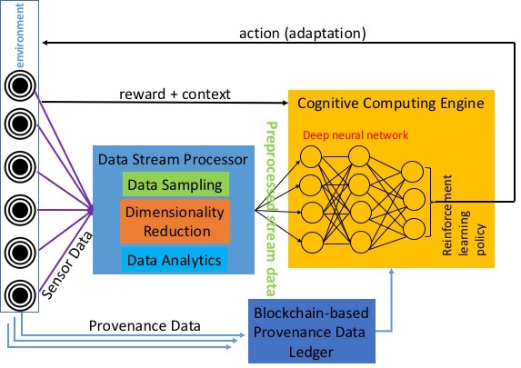
Comprehensive IAS Architecture
Adaptive action
Anomaly Detection
3

Slide 4
Motivation
  Autonomous systems operating in distributed environment have to collectively learn from one another.
  It is important to maintain the privacy of individual entities generating data and humans interacting with them.
  Autonomous systems should be able to
  Learn from restricted information
  Preserve privacy while collectively learning about the distributed environment.
4

Slide 5
Privacy Preserving Autonomous Data Aggregation
  Using Active Bundle (AB), a distributed self-protecting entity with policy enforcement engine, we implement
      One-time access certificate used to query other ABs
      Privacy preserving aggregation analytics on numerical data
  Instead of checking AB’s authentication protocol every time, an AB can obtain a one-time pass to access other ABs data per aggregate query.
  Numerical data is perturbed for the analytics and at the end the perturbation is removed.
5

Slide 6
Active Bundle (AB)
  Active Bundle (AB) is a distributed self-protecting entity with policy enforcement engine.
  Sensitive data is stored in a non relational database in the form of key-value pair. E.g. {PatientID = “ENC(123456)”}.
  Authentication of client services is based on digital certificates. The services present their X.509 certificates signed by a trusted Certificate Authority (CA).
  After authentication, policy enforcement engine enforces policies of data access depending upon the service’s access level.
6

Slide 7
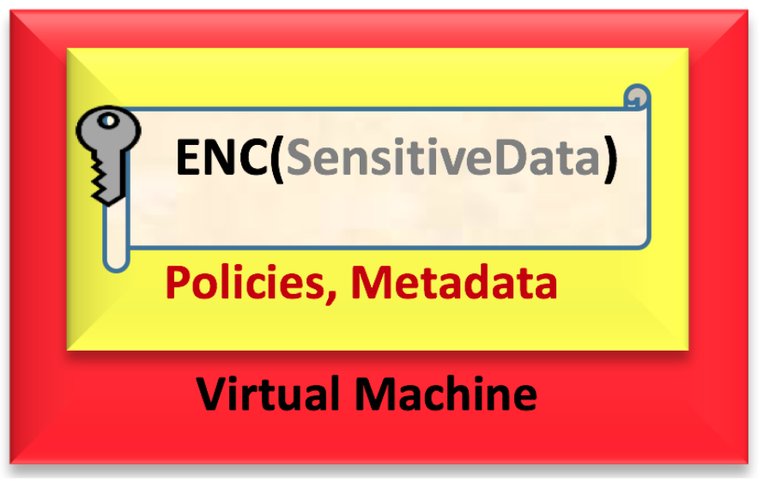
Active Bundle (AB)
7

Slide 8
AB Authentication Protocol - Problem
  Every time a service requests a particular data from active bundle, it has to go through authentication and enforcement policies.
  For each Active Bundle, based on number of policies, the data access time increases.
      Around 500 msec for 16 policies
  For each Active Bundle, based on security protocols of authentication, the authentication time increases.
      Around 550 msec for two-way encryption
  So the system is not scalable for large databases and data analytics will become enormously time consuming.
8

Slide 9
One-time AB Authentication Protocol - Solution
  We propose a solution: one-time authentication per aggregated query.
  Here, each autonomous entity such as active bundle can be given a one-time certificate to perform a specific task without going through policies and authentication for each AB.
  One trusted Certificate Authority (CA) can provide the autonomous entity a one-time access pass and restrict the pass to the requested data.
  With this one time authentication, AB can surpass other ABs’ policies and authentication, making it faster.
9

Slide 10
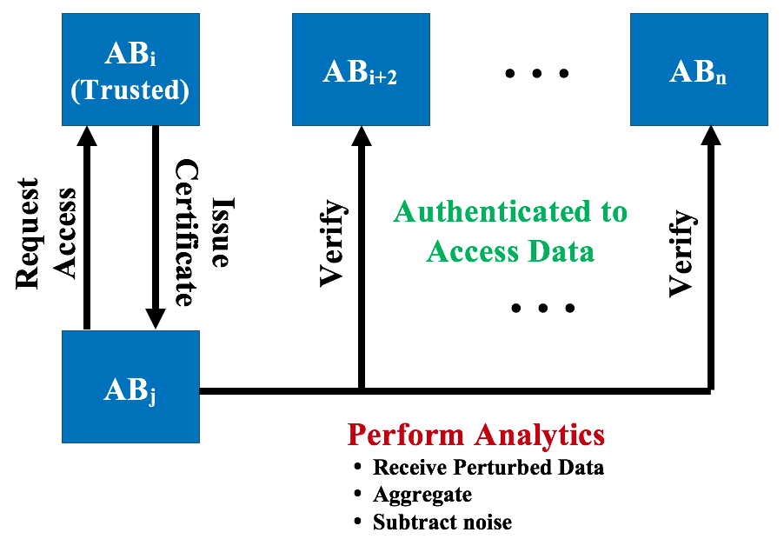
One-time AB Authentication Protocol
  Here, a trusted AB_{i} provides access certificate to another AB_{j}.
  AB_{j} uses the certificate to access other ABs without having to go through policies again.
10

Slide 11
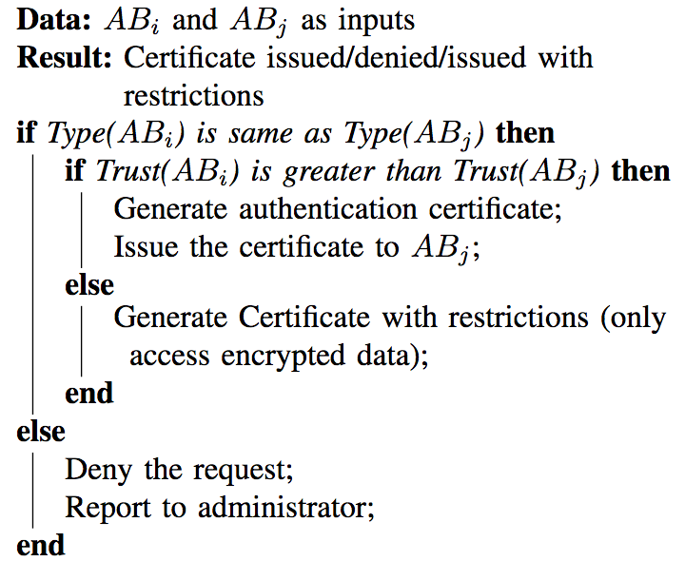
One-time AB Authentication Protocol
11

Slide 12
Privacy Preserving Data Aggregation
After passing the authentication and policies enforced by AB’s policy enforcement engine, aggregate data analytics can be performed.
AB’s provenance data is used for aggregated analytics such as Count, Average, etc. on qualified attributes.
These aggregate analytics guarantee privacy of individual ABs. Consider an aggregation,
  AB₁’s age attribute is perturbed: “Age (a) ” + “Random Perturbation (R)” ➔ 2AB₁(a + r = a_{n}) + 2AB₂(a + a_{n} = a_{n1}) + …
  Final average = (a_{nn} – R) / count(2AB)
12

Slide 13
Evaluation
We measure the latency of data request sent to AB, which is hosted by a local server, located in the same network with the client.
As a latency parameter, we record Round-Trip Time (RTT) for the data request processing at the server side (Note: we do not consider network delays in this experiment).
ApacheBench v2.3 is used to calculate RTT measurements. We run 50 requests in a row and compute RTT average.
13

Slide 14
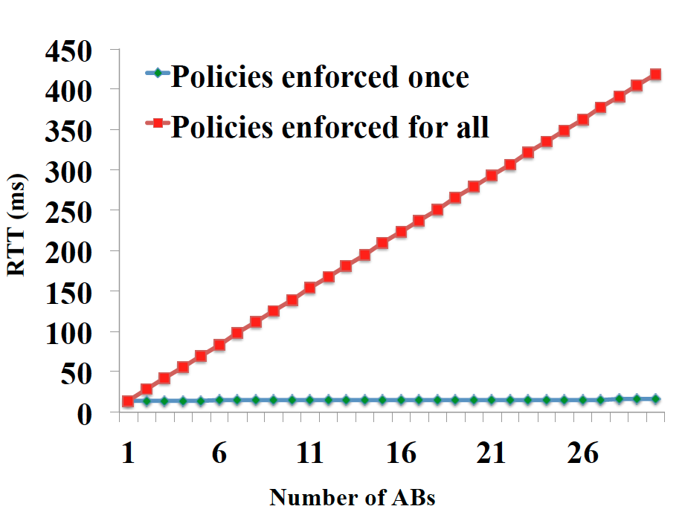
Evaluation
Our initial work shows that the policies enforced for each AB access raise the access time exponentially where as a simple python simulation of file access (one time authentication example) stays almost constant for multiple entities.
14

Slide 15
Future Work
Changing policies on-the-fly is a non-trivial problem in autonomous cyber systems.
Autonomous policy changes based on the data analytics can be achieved by introducing an adaptive block with probabilistic rules.
We plant to implement deep learning methodologies for adapting to new and unknown scenarios, learn from the data, and make probabilistic reasoning to enforce policies.
15

Slide 16
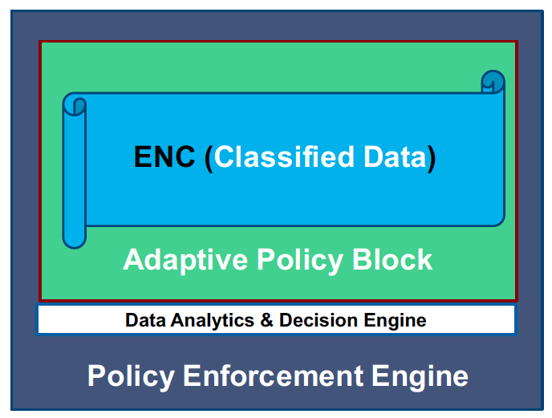
Future Work
Autonomous policy changes based on the data analytics.
16

Slide 17
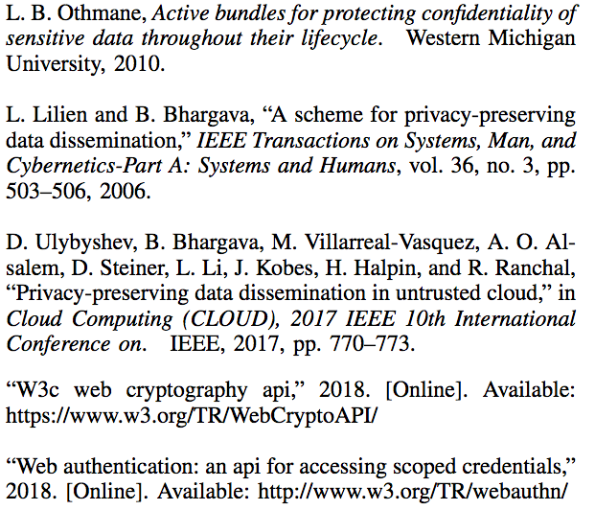
References
17

Slide 18
Thank you!!!
18

