Slide 1
Scalable Deep Learning Through Fuzzy-based Clustering in Autonomous Systems
Ganapathy Mani, Bharat Bhargava, Jason Kobes*
CS & CERIAS, Purdue University
*Northrop Grumman Corporation
AIKE 2018
1

Slide 2
  Intelligent Autonomous Systems
  Autonomous Systems should be
  Able to perform complex tasks without or with limited ongoing connection to humans.
  Cognitive enough to act without a human’s judgment lapses or execution inadequacies.
  Intelligent Autonomous Systems (IAS) are characterized as highly Cognitive, effective in Knowledge Discovery, Reflexive, and Trusted.
  The focus of this research will be on the smart cyber systems.
2

Slide 3
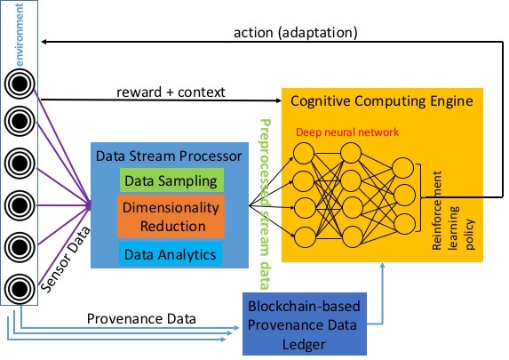
Comprehensive IAS Architecture
Adaptive action
Anomaly Detection
3

Slide 4
Motivation
  Autonomous systems receive continuous streams of diverse data from numerous sources.
  Disregarding new and unknown data or broadly classifying them into few categories would cause an inadequate learning environment.
  IAS should be trained to work with
  Meta-data, limited data, incomplete data, and unknown (new) data
  Dynamic, unpredictable, and adversarial environment
4

Slide 5
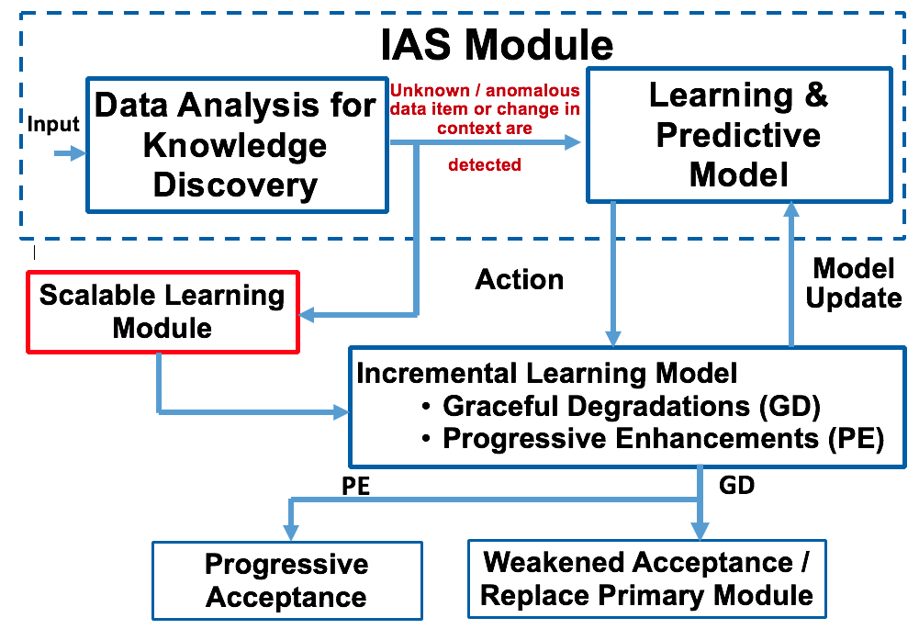
Scalable Learning
  It’s a method to achieve maximum classification without rejecting any unknown data item that was not present in the training or testing datasets as anomalies.
5

Slide 6
Bitwise Fuzzy-based Clustering (BFC)
  BFC is implemented through Perfect Error-correcting codes or Golay codes.
  Error Correcting Codes (ECC) are used for controlling errors in data (any information that could be represented in bits 0/1).
  When there is an error in data, the error correcting codes can approximately match the distorted data to the original.
      For example, take the message (m) = 000. Consider 1 bit distortions of m: 100, 010, 001.
      All three distortions are 1 hamming distance (it takes 1 bit flip to get to 000) away from 000. So they can be easily corrected.
6

Slide 7
Why Error Correcting Codes?
  BFC creates clusters based on fuzzily (approximately) matched data items similar to error correction.
      For example, take the message (m) = 000 as a data item. m’s 1 bit distortions (100, 010, and 001) will be clustered into one.
  0/1 bits are used to label binary features.
      Assume that 0 – Absent and 1 – Present. Based on number of features of a data item, we can create a binary classification.
      For example, data item D has 3 features. Presence or absence of each feature creates a code word, say, 101.
      Code word such as 101 will be a label for that data item.
      Using ECC provides scalability (2^{n} combinations of clusters) and fault tolerance (distorted labels can be clustered correctly).
7

Slide 8
Perfect Error Correction Codes - BFC
Code word = 000
Additional bits for error correction = 00 (Hash index)
Message = 0
000
111
Code word = 111
Additional bits for error correction = 11 (Hash index)
Message = 1
8

Slide 9
Perfect Error Correction Codes - BFC
000
Hamming Distance between two code words = 3
That is you need to flip 3 bits to go from
000 to 111.
111
(No. of bits in, ) code word = (3,
9

Slide 10
Perfect Error Correction Codes - BFC
010
Correction vector.
Majority 2/3 0 approximation.
000
001
100
Hamming Distance between two code words = 3
011
101
110
111
(No. bits in, message size in, ) code word = (3, 1,
10

Slide 11
Perfect Error Correction Codes - BFC
010
Correction vector.
Majority 2/3 0 approximation.
000
001
100
Hamming Distance between two code words = 3
011
101
110
111
[No. bits (M_{n}), message size (D_{k}), hamming distance (H_{d})] code word
= [3, 1, 3]
11

Slide 12
Perfect Error Correction Codes - BFC
010
Correction vector.
Majority 2/3 0 approximation.
000
001
100
Hamming Distance between two code words = 3
011
101
110
111
Perfect simplest hamming code [M_{n}, D_{k}, H_{d}] = [3, 1, 3]
Code is perfect when all the correction vectors are used.
12

Slide 13
Perfect Error Correction Codes - BFC
010
Correction vector.
Majority 2/3 0 approximation.
000
001
100
Hamming Distance between two code words = 3
011
101
110
111
When there is a 1 bit distortion, say, 010,
it can be correctly decoded by going 1 hamming distance
1 bit errors can be corrected
13

Slide 14
Perfect Error Correction Codes - BFC
010
Correction vector.
Majority 2/3 0 approximation.
000
001
100
Hamming Distance between two code words = 3
011
101
110
111
Similar to (3, 1, 3) code, (23, 12, 7) is a perfect code.
We use it for BFC with 2²³ combinations of features!
14

Slide 15
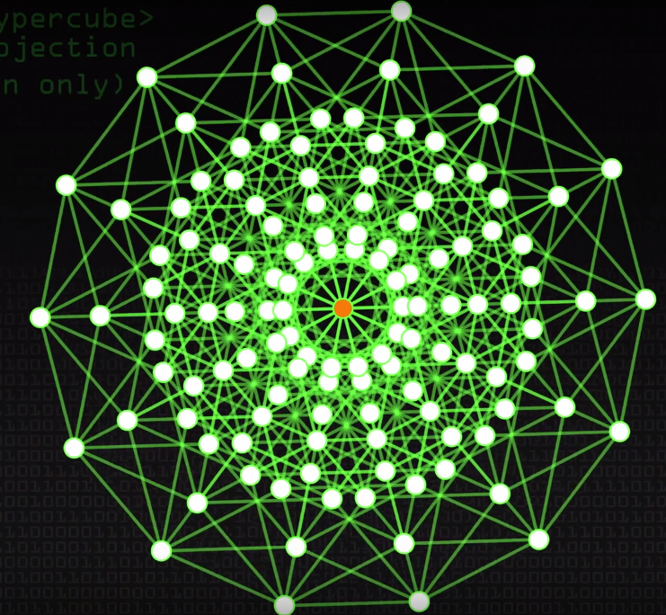
Perfect (23, 12, 7) Code - BFC
  The 3-dimensional cube of (3, 1, 3) code becomes a 23-dimentional binary hypercube for (23, 12, 7), which looks like a sphere given below.
  Each point is a corner of hypercube structure and has 7 connections to its 3-bit distortions.
15

Slide 16
Creating Indexes by Hashing - BFC
  Take an example of (7, 4, 3) coding: 4 is the size of the message and 2⁴ = 16 messages are possible.
  Hash index is created by adding 3 random bits at the end. For example, 1100 is a message. 1100101 is the code word (4 message bits + 3 hash bits = 7 bits).
  Similarly, BFC hash indexes are created by 12 bits message + 11 bits hashing tags (total of 23 bits).
  This 23-bit binary vector, notating whether a feature of a data item is present or absent, will be considered a label for clustering those data items.
16

Slide 17
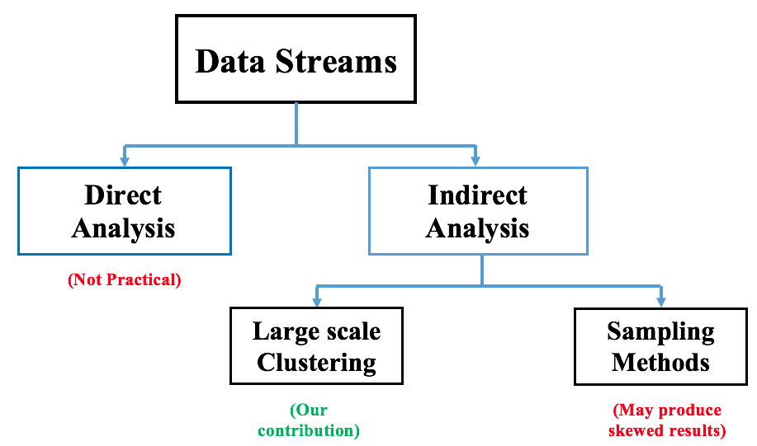
Why Clustering?
  Learning through sampling can only generalize learning. The new and small number of data items may be ignored.
  Clustering can group even a small number of data items.
17

Slide 18
Clustering by BFC – (3, 1, 3) Example
010
Correction vector.
Majority 2/3 0 approximation.
000
001
100
011
101
(3, 1, 3) Cluster
010
Sub Cluster
110
111
D = 1
100
000
3 bit 000 code word is the center
Similarly, BFC will have 12 bit centers
18
001

Slide 19
Clustering by BFC – (23, 12, 7)
  In (23, 12, 7) BFC model, a binary vector template is created. Based on the presence and absence of it, 0 or 1 is encoded.
  Consider an image data item:
  Just like (3, 1, 3) clustering, the first 12 bits in 23-bit vector will be the center of the sphere and other distortions in remaining 11-bits are fuzzily matched with the cluster.
Features | YES/NO
F1: is it red? | 0
F2: is it female? | 1
. | .
. | .
. | .
F22: is it tall? | 0
F23: is it animal? | 0
19

Slide 20
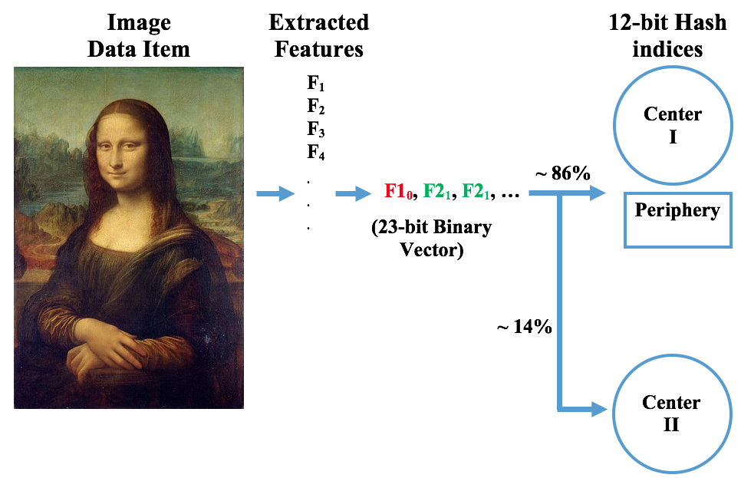
Clustering by BFC
20

Slide 21
Clustering by BFC
  We simulated BFC with 2²² = 4,194,304 for the vector representation (2²³ can provide 8,388,608 vectors).
  The hashing creation and fuzzy matching depends on comparison operation where each bit in 23-bit vector is randomly initiated and clustered.
  We take the following into account for performance evaluation:
      Recall
      Clock cycles required for computing hashes (encoding).
21

Slide 22
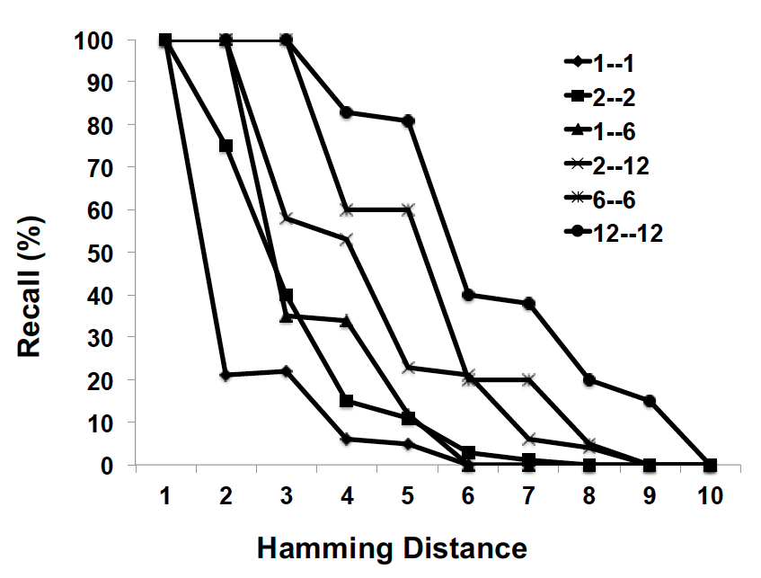
Evaluation – Recall
  Recall = (relevant items ∩ retrieved items) / relevant items
  For higher hamming distances, the recall probabilities are small. 1—1 means direct matching with 1 hamming distance cluster with the same hamming distance.
22

Slide 23
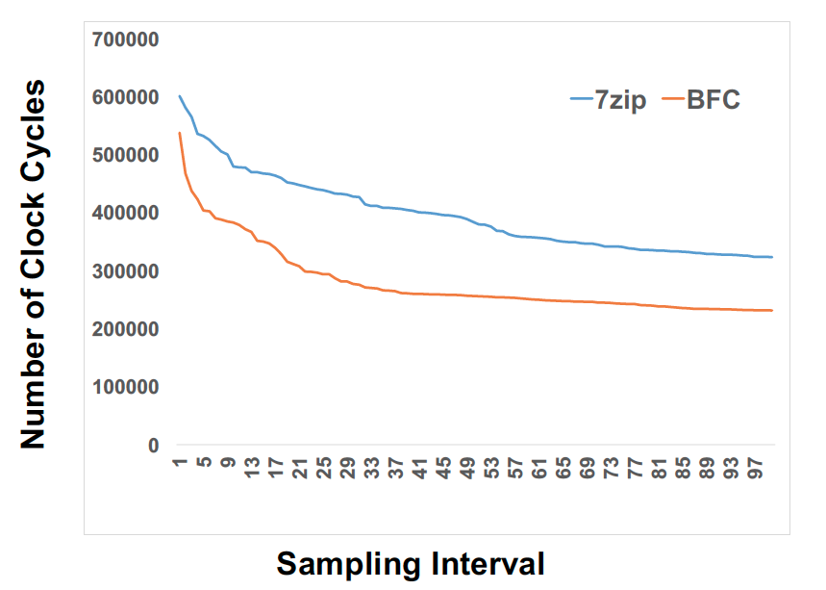
Evaluation – CPU Performance
  Number of clock cycles for encoding. We used process thread API to collect data, sampled per 1000k instructions.
23

Slide 24
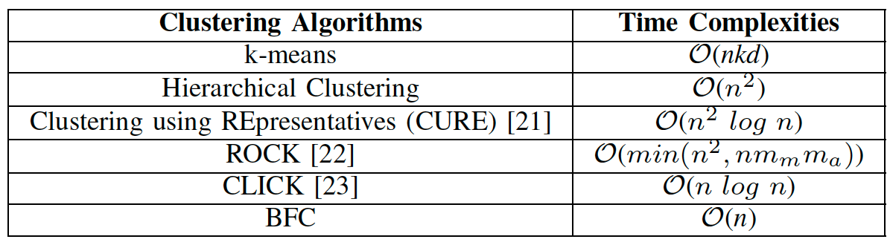
Evaluation – Time Complexity
  Number of clock cycles for encoding. We used process thread API to collect data, sampled per 1000k instructions.
24

Slide 25
Future Work
  Using Deep learning methodologies such as Convolutional Neural Networks (CNN) to further classify data stored in the clusters and enhance learning.
  Clustered data is transformed into n*23 dimensional matrices.
  Convoluted features are extracted (sampling and sliding window techniques can also be used).
  CNN will be performed to extract further insights from the classified data.
25

Slide 26
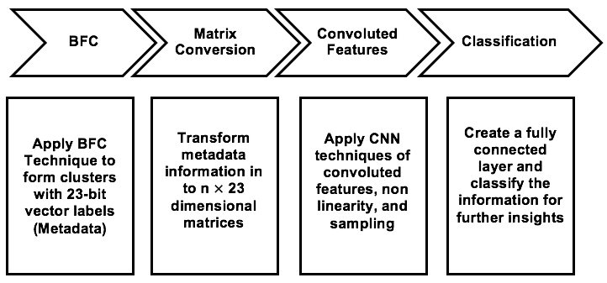
Future Work
26

Slide 27

Thank you!!!
References:
27

