Slide 1
Machine Learning Models to Enhance the Science of Cognitive Autonomy
Ganapathy Mani, Bharat Bhargava, Pelin Angin, Miguel Villarreal-Vasquez, Denis Ulybyshev, Jason Kobes*
CS & CERIAS, Purdue University
*Northrop Grumman Corporation
AIKE 2018
1

Slide 2
Intelligent Autonomous Systems
Autonomous Systems should be
Able to perform complex tasks without or with limited ongoing connection to humans.
Cognitive enough to act without a human’s judgment lapses or execution inadequacies.
Intelligent Autonomous Systems (IAS) are characterized as highly Cognitive, effective in Knowledge Discovery, Reflexive, and Trusted.
The focus of this research will be on the smart cyber systems.
2

Slide 3
Motivation – A Holistic Approach
Autonomous systems should learn at the network level as well as about their environment and context.
Autonomous systems should be trained to work with
Meta-data, limited data, incomplete data, and unknown (new) data
Dynamic, unpredictable, and adversarial environment
In this presentation, we will present theoretical framework and our implementation details.
3

Slide 4
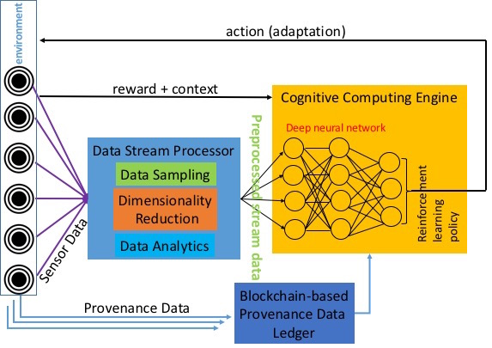
Comprehensive IAS Architecture
Adaptive action
Anomaly Detection
4

Slide 5
Implementation of Components of IAS
Cognitive Autonomy & Knowledge Discovery:
Monitors and records system’s activities (Data provenance and sequence of system calls)
Conducts privacy-preserving aggregated analytics on provenance data.
Utilizes Deep learning based anomaly detection by analyzing sequence of system calls.
Reflexivity:
Adaptive actions are performed through graceful degradations without disrupting the ongoing critical processes by incremental learning.
Trust:
Uses blockchain to store provenance data for trust.
5

Slide 6
Cognitive Autonomy
A Deep Learning Based Anomaly Detection Solution
6

Slide 7
Comprehensive Architecture of IAS
Cognitive Autonomy
Adaptive action
Anomaly Detection
7

Slide 8
Problem Statement
Programs store Return Addresses (control flow) along with data in the stack.
Control-hijacking attacks execute arbitrary code on the target IAS program by hijacking its control flow.
A Deep Learning based anomaly detection technique has been developed to protect IAS programs against these attacks.
Stack Frame
Local
Variables
EBP
Return
Address
Parameters
8

Slide 9
Problem Statement
Programs store Return Addresses (control flow) along with data in the stack.
Control-hijacking attacks execute arbitrary code on the target IAS program by hijacking its control flow.
A Deep Learning based anomaly detection technique has been developed to protect IAS programs against these attacks.
Data overrides
Return Address
Stack Frame
Local
Variables
EBP
Return
Address
Parameters
9

Slide 10
Research Approach
An event e_{i} is defined as a function call (system or library call) in the execution trace of a program.
Use Deep Learning to answer the binary classification problem of given a sequence of function calls (or system events) e₁e₂e₃…e_{k} whether or not the sequence should occur?
10

Slide 11
Research Approach
An event e_{i} is defined as a function call (system or library call) in the execution trace of a program.
Use Deep Learning to answer the binary classification problem of given a sequence of function calls (or system events) e₁e₂e₃…e_{k} whether or not the sequence should occur?
System Events
Given this sequence at time t-1
11

Slide 12
Research Approach
An event e_{i} is defined as a function call (system or library call) in the execution trace of a program.
Use Deep Learning to answer the binary classification problem of given a sequence of function calls (or system events) e₁e₂e₃…e_{k} whether or not the sequence should occur?
System Events
Given this sequence at time t-1
At time t, should this sequence occur?
12

Slide 13
Types of attacks and mitigation
Attacks:
Code injection: Malicious instruction sequences are executed using injected codes in the data portion of the stack. Examples: Buffer overflow and buffer specified injection.
Code reuse: Malicious instruction sequences are executed without injecting external code. Examples: Return-oriented programming and memory disclosure.
Mitigation:
Control Flow Integrity (CFI) is required.
Deep Learning is used to guarantee Control Flow Integrity (CFI) as the model detects non-conforming sequences of execution traces in run time.
13

Slide 14
Deep Learning Based Anomaly Detection
For a given program, a code coverage is conducted to obtain all the possible execution traces.
An event e_{i} is defined defined as a function call (system or library call) in the execution trace of a program.
Each possible system event (function calls) is uniquely identified as they will form the vocabulary of system events.
The Deep Learning model (neural network) is trained with the obtained sequences of events.
The model is based on Recurrent Neural Networks: Long-Short Term Memory (LSTM) and Gated Recurrent Units (GRU.)
14

Slide 15
Deep Learning Based Anomaly Detection
After training, given a sequence of events as input, the neural network produces as output an array of probabilities, one for each of the possible events in the system.
At any time t each possible event (system call or library call) in the system is assigned a probability estimated with respect to the sequences of events observed until time t-1.
At classification time t, the decision is made with respect to a pre-defined threshold of the top-k most likely events.
15

Slide 16
Deep Learning Based Anomaly Detection
Set of all system events
Neural Network
16

Slide 17
Deep Learning Based Anomaly Detection
Sequence of system events at time t-1
Set of all system events
Neural Network
27

Slide 18
Deep Learning Based Anomaly Detection
Sequence of system events at time t-1
Set of all system events
New event
at time t
Neural Network
18

Slide 19
Deep Learning Based Anomaly Detection
Sequence of system events at time t-1
Set of all system events
New event
at time t
Neural Network
Input
19

Slide 20
Deep Learning Based Anomaly Detection
Sequence of system events at time t-1
Set of all system events
New event
at time t
Neural Network
Input
Output
[p1, p2, p3, p4, p5, p6, p7]
Probabilities of
possible events
20

Slide 21
Deep Learning Based Anomaly Detection
Sequence of system events at time t-1
Set of all system events
New event
at time t
Neural Network
Input
Output
[p1, p2, p3, p4, p5, p6, p7]
Probabilities of
possible events
At time t, the new event is classified as normal if its probability is in the top-k
probabilities; anomalous otherwise
21

Slide 22
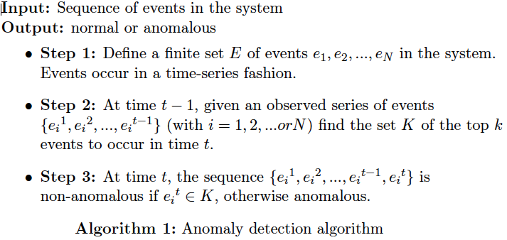
Deep Learning Based Anomaly Detection
22

Slide 23
Other Deep Learning Related Projects
User and Entity Behavior Analytics (UEBA):
Process of obtaining the baseline of user activity and behavior to detect potential intrusions and protect from insider threats.
Traffic patterns of users would represent the sequences to learn.
Network Intrusion Detection Systems (NIDS):
The application of the DL approach is straightforward.
Network packets would represent the set of events to monitor in the system.
23

Slide 24
Knowledge Discovery
Solutions Based on Pattern Recognition
24

Slide 25
Comprehensive Architecture of IAS
Adaptive action
Knowledge Discovery
Anomaly Detection
25

Slide 26
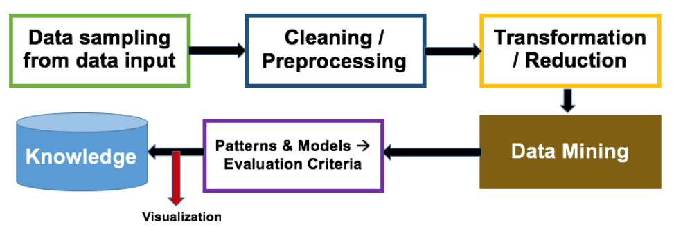
Knowledge Discovery in IAS
Knowledge discovery constitutes data transformation for processing, dimensionality reduction, and feature selection, which leads to pattern recognition and visualization.
26

Slide 27
Knowledge Discovery By Light-weight ML Algorithms
Compared to deep learning methodologies, pattern recognition through feature extraction is one of the cost effective methodologies.
Based on the best feature selection approach, light-weight machine learning algorithms such as Support Vector Machine (SVM), k-means, Random Forests, and K-Nearest Neighbors (KNN) can be very efficient.
Features can be selected through Filter methods (scoring each feature), Wrapper methods (set of features as a search problem), or embedded methods (learning features on-the-fly).
27

Slide 28
Knowledge Discovery – Inference Models
Hidden Markov Models (HMM) can be used to infer the probability of observed sequences, probability of latent variables, and statistical significance.
Models such such as these cannot handle large sequences of data but for limited data, HMMs are better preforming than deep learning methodologies.
Similarly, Bayesian inference functions as the probability update function as the new data (or context) comes to light.
In our reflexivity module, we used Bayesian inference model to update the probabilities.
28

Slide 29
Reflexivity
A Solution Based on Graceful Degradation
29

Slide 30
Comprehensive Architecture of IAS
Reflexivity
Adaptive action
Anomaly Detection
30

Slide 31
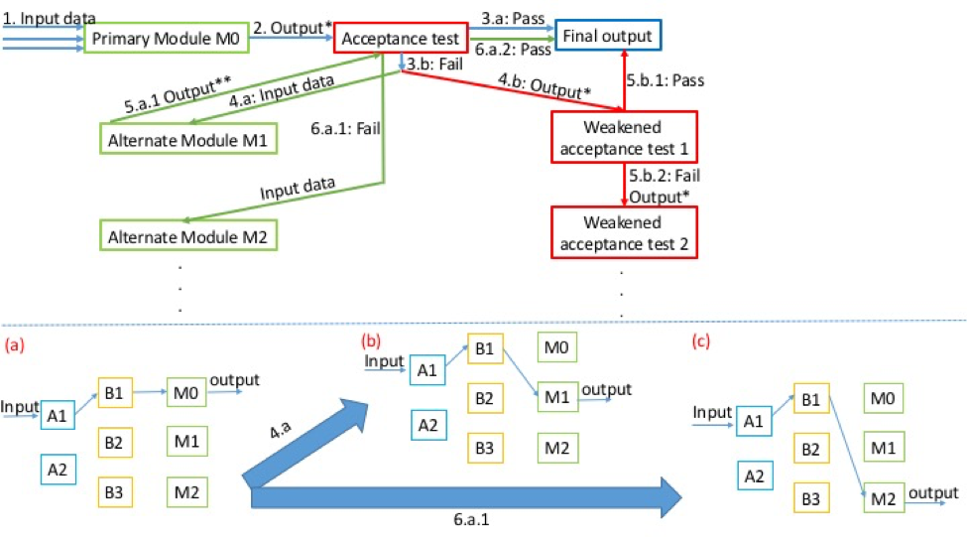
Generic Model of Dynamic Adaptation
31

Slide 32
Problem Statement
Given a smart cyber system operating in a distributed computing environment, it should be able to:
Replace anomalous/underperforming modules
Swiftly adapt to changes in context
Achieve continuous availability even under attacks and failures.
32

Slide 33
Graceful Degradations:
Combinatorial Replica Replacement Scheme
Combinatorial Structure is a subset satisfying certain conditions.
Each block contains systems and their replicas that are mathematically distributed.
The systems and their replicas in the distributed blocks are strategically connected to receive updates from primary modules.
Resources are mathematically balanced, enabling scalable designs for the systems.
33

Slide 34
(7, 7, 3, 3, 1)-configuration
7 systems {S₁, S₂, S₃, S₄, S₅, S₆, S₇}
7 Distributed Autonomous Blocks (DABs) each with 3-system subset
DAB₁ = {S₁, S₅, S₇}, DAB₂ = {S₁, S₂, S₆},
DAB₃ = {S₂, S₃, S₇}, DAB₄ = {S₁, S₃, S₄},
DAB₅ = {S₂, S₄, S₅}, DAB₆ = {S₃, S₅, S₆},
DAB₇ = {S₄, S₆, S₇}.
34

Slide 35
(7, 7, 3, 3, 1)-configuration
7 systems {S₁, S₂, S₃, S₄, S₅, S₆, S₇}
7 Distributed Autonomous Blocks (DABs) each with 3-system subset
Each system appears in 3 DABs (Say, S₆)
DAB₁ = {S₁, S₅, S₇}, DAB₂ = {S₁, S₂, S₆},
DAB₃ = {S₂, S₃, S₇}, DAB₄ = {S₁, S₃, S₄},
DAB₅ = {S₂, S₄, S₅}, DAB₆ = {S₃, S₅, S₆},
DAB₇ = {S₄, S₆, S₇}.
35

Slide 36
(7, 7, 3, 3, 1)-configuration
7 systems {S₁, S₂, S₃, S₄, S₅, S₆, S₇}
7 Distributed Autonomous Blocks (DABs) each with 3-system subset
Each system appears in 3 DABs
Each pair of systems appear in 1 DAB (Say, S₁ and S₅)
DAB₁ = {S₁, S₅, S₇}, DAB₂ = {S₁, S₂, S₆},
DAB₃ = {S₂, S₃, S₇}, DAB₄ = {S₁, S₃, S₄},
DAB₅ = {S₂, S₄, S₅}, DAB₆ = {S₃, S₅, S₆},
DAB₇ = {S₄, S₆, S₇}.
36

Slide 37
(7, 7, 3, 3, 1)-configuration
7 systems {S₁, S₂, S₃, S₄, S₅, S₆, S₇}
7 Distributed Autonomous Blocks (DABs)
each with 3-system subset
Each system appears in 3 DABs
Each pair of systems appear in 1 DAB
M
A
C
R
O
The configuration (M, A, C, R, O) = (7, 7, 3, 3, 1)
37

Slide 38
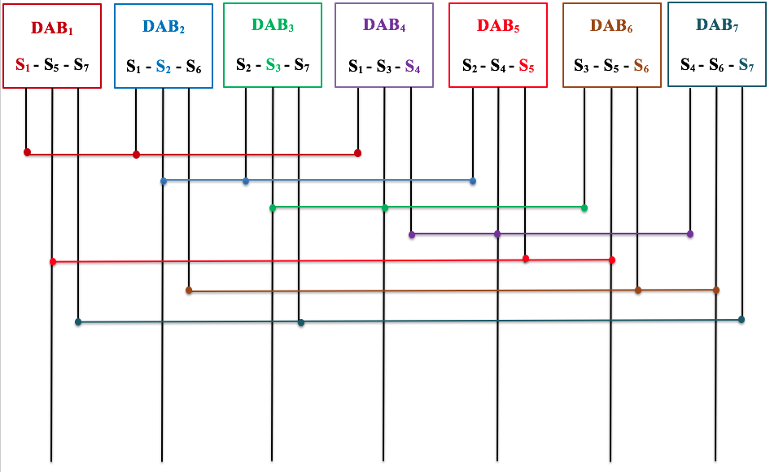
(7, 7, 3, 3, 1)-configuration
DAB: Distributed Autonomous Block
38

Slide 39
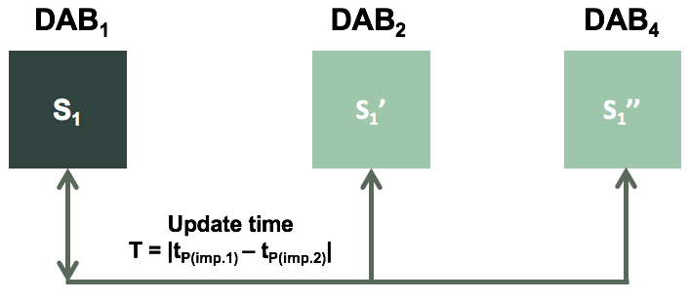
(7, 7, 3, 3, 1)-configuration
Each primary module periodically updates its replicas in corresponding distributed block connected by communication links (CC).
Update the interval dynamically through learning models with Bayesian learning by continuously updating the prior.
39

Slide 40
(7, 7, 3, 3, 1)-configuration
Update time is defined as
P_{I}(importance (I) | operational context (C)) = $\frac{P \left(C | I\right)P\left(I\right)}{P(C)}$
Update interval T = | t¹_{P(I)} – t²_{P(I)} |
Operational Context can be set dynamically and importance is a binary classifier (important /not important)
When any system in any primary module’s DAB acts in anomalous fashion, that system can be
Replaced with one of the replicas that can be selected in round robin fashion.
Anomalous module will be set for self-healing or repair by external source
40

Slide 41
(7, 7, 3, 3, 1)-configuration
The prototype is built with FAYE framework¹ with Node.js.
It is a server-client framework where servers act as primary modules and clients as replicated system.
Replica updates are done through a combinatorial design simulator².
Combinatorial simulator is loaded with finite processes to compare the updates and processing time compared to a regular or sequential processing.
41
¹https://faye.jcoglan.com/node.html ²https://goo.gl/pgVHdk

Slide 42
Measurements for Various Process Completions
Process Type | Process Name | Speed Up Due to Combinatorial Replica Scheme (Compared to regular sequential design)
P1 | FIBSEARCH | 1.3
P2 | DOUBLE MULT | 1.4
P3 | FIBB | 1.5
P4 | SEARCH | 1.8
P5 | COPY | 1.8
P6 | SCALAR | 2
P7 | SUM | 2.1
P8 | PRINT | 3
P9 | MOVEMENT | 3.1
42

Slide 43
Measurements for Various Process Completions
Number of state migrations
Process Types
43

Slide 44
Trust
A Solution Based on Blockchain
44

Slide 45
Comprehensive Architecture of IAS
Trust
Adaptive action
Anomaly Detection
45

Slide 46
Problem Statement
Provide trust (integrity, confidentiality, verifiability) to provenance data in IAS
Interactions between services are logged
Log records can not be corrupted
Provide trust for network participants in IAS
Ensure data confidentiality
Ensure data integrity
Provide privacy-preserving data exchange in IAS
46

Slide 47
Blockchain Technology Deployment
Fine-grained role-based and attribute-based access control with data leakage detection capabilities is provided by integration with ‘WAXEDPRUNE’
Performance improvements:
Depth-robust graphs to store blockchain for faster transaction verification: no need to verify all the links in the chain
47

Slide 48
Blockhub: blockchain-platform for IAS
48

Slide 49
Future Work
Develop cyber attribution techniques with machine learning to enhance the forensics and malware detection.
Optimize the reflexivity property’s replacement policy with distributed voting and Hidden Markov Model to determine update interval.
Failure recovery for blockchain framework with mobile environments.
49

Slide 50
References:
Mani, Ganapathy, Bharat Bhargava, and Basavesh Shivakumar. "Incremental Learning Through Graceful Degradations in Autonomous Systems." In 2018 IEEE International Conference on Cognitive Computing (ICCC), pp. 25-32. IEEE, 2018.
Ulybyshev, Denis, Miguel Villarreal-Vasquez, Bharat Bhargava, Ganapathy Mani, Steve Seaberg, Paul Conoval, Robert Pike, and Jason Kobes. "(WIP) Blockhub: Blockchain-Based Software Development System for Untrusted Environments." In 2018 IEEE 11th International Conference on Cloud Computing (CLOUD), pp. 582-585. IEEE, 2018.
Ranchal, Rohit, Denis Ulybyshev, Pelin Angin, and Bharat Bhargava. "PD3: policy-based distributed data dissemination." In Proceedings of the 16th Annual Information Security Symposium, p. 13. CERIAS-Purdue University, 2015.
50

Slide 51
Thank you!!!
51

